Slide 1
LESSON 06

Slide 2
Overview
of
Previous Lesson(s)

Slide 3
Over View
Interactive development environment is a software application that provides comprehensive facilities to computer programmers for software development.
Microsoft Visual Studio is an integrated development environment (IDE) from Microsoft Corporation based on .Net framework

Slide 4
Over View..
C++
  Keywords Reserved words
  Identifiers Programmers defined variables
  Variables A named storage location in the computer’s memory for holding a piece of data.
  Data Types When computer programs store data in variables, each variable must be assigned a specific data type. Some common data types include integers, floating point numbers, characters, strings, and arrays.

Slide 5
Over View...
Looping structures
  For loop
  While
  Do While
Decision structures
  If
  If / else
  Switch

Slide 6
Over View...
Operator Precedence
  Operator precedence orders the operators in a priority sequence.
In an expression with more than one operator, evaluate in this order:
  - (unary negation), in order, left to right
  * / %, in order, left to right
  + -, in order, left to right
Example expression 2 + 2 * 2 – 2
evaluate
third
evaluate
second
evaluate
first

Slide 7
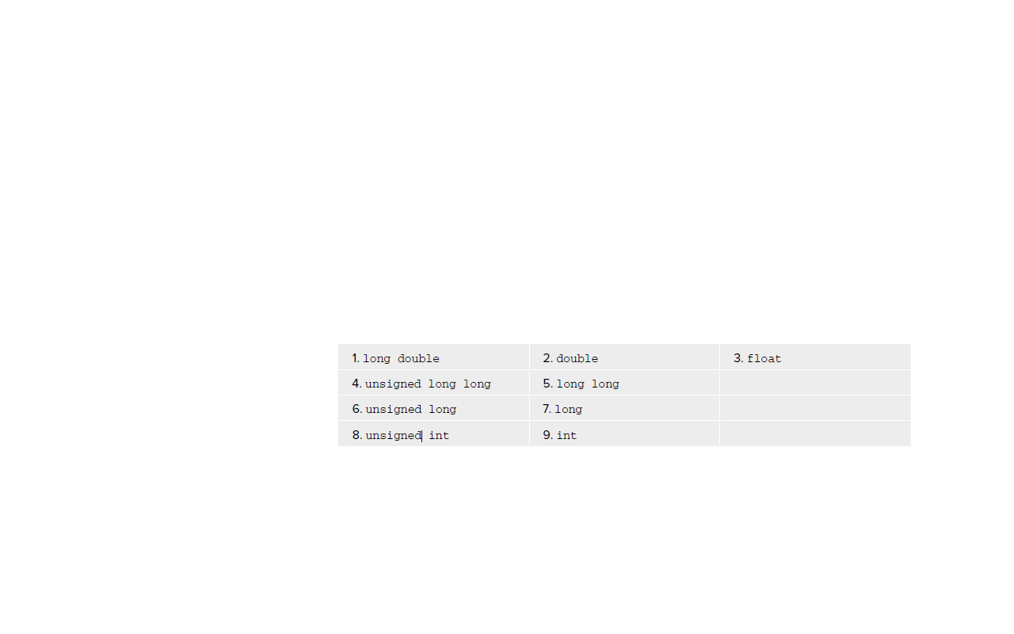
Over View…
Type Conversion and Casting
  Implicit type conversion:
    When an expression involving variables of different types then for each operation to be performed, the compiler has to arrange to convert the type of one of the operands to match that of the other.
  Any pair of operands of different types, the compiler decides which operand to convert to the other considering types to be in the following rank from high to low:

Slide 8
Over View…
Explicit Type Conversion:
  A forced conversion from one type to another is referred as explicit type conversion.
Auto keyword is used as the type of a variable in a definition statement and have its type deduced from the initial value.
auto n = 16; // Type is int
auto pi = 3.14159; // Type is double
auto x = 3.5f; // Type is float
auto found = false; // Type is bool

Slide 9

Over View…
Bitwise operators:
L Values and R Values:
  An lvalue refers to an address in memory in which something is stored on an ongoing basis.
  An rvalue is the result of an expression that is stored transiently.

Slide 10
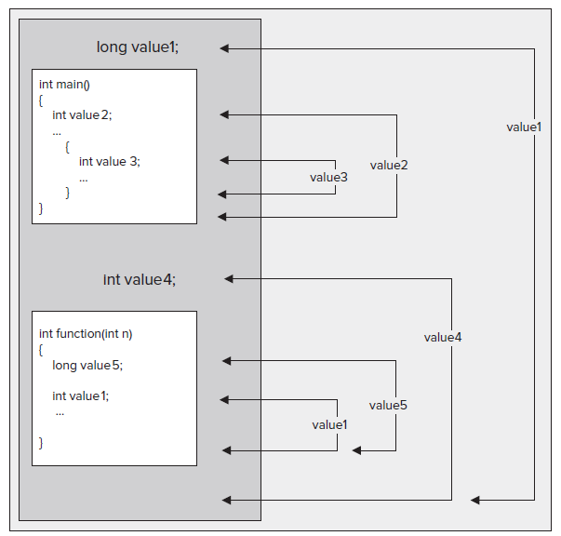
Over View…
Scope

Slide 11
Over View…
Namespaces provide a way to separate the names used in one part of a program from those used in another.
namespace keyword is used to declare a namespace
    namespace myStuff
    {
    // Code that I want to have in the namespace myStuff...
    }
This defines a namespace with the name myStuff .

Slide 12
TODAY’S LESSON

Slide 13
Contents
Structures
Enumerations
Functions

Slide 14
Structures
A structure is a collection of simple variables.
The variables in a structure can be of different types:
  Int, float, double, long.. etc
The data items in a structure are called the members of the structure.
A structure is a collection of data, while a class is a collection of both data and functions

Slide 15
A Simple Structure
The structure is a kind of blueprint specifying what information is necessary for a single part.
Following structure represents an item in a Machines company’s parts inventory.
  // parts.cpp
  // uses parts inventory to demonstrate structures
  #include <iostream>
  using namespace std;

Slide 16
Part Structure
  struct part //declare a structure
  {
  int modelnumber; //ID number of Machine model
  int partnumber; //ID number of Machine part
  float cost; //cost of part
  {;

Slide 17
Main Program
  int main()
  {
  part part1; //define a structure variable
  part1.modelnumber = 6244; //give values to structure members
  part1.partnumber = 373;
  part1.cost = 217.55F;
  //display structure members
  cout << “Model “ << part1.modelnumber;
  cout << “, part “ << part1.partnumber;
  cout << “, costs $” << part1.cost << endl;
  return 0;
  }

Slide 18
Part Structure..
The program’s output looks like this:
  Model 6244, part 373, costs $217.55
The PART program has three main aspects:
  Defining the structure.
  Defining a structure variable.
  Accessing the members of the structure.

Slide 19
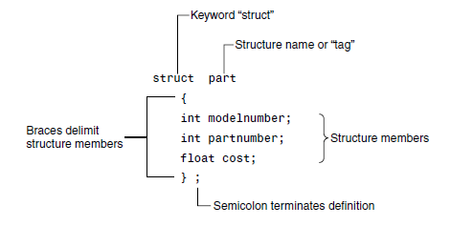
Structure Syntax

Slide 20
Use of Structure Definition
The structure definition serves only as a blueprint for the creation of variables of type part.
It does not itself create any structure variables.
So no space in memory is occupied by the structure definition.
This is unlike the definition of a simple variable, which does set aside memory.
A structure definition is merely a specification for how structure variables will look when they are defined.

Slide 21
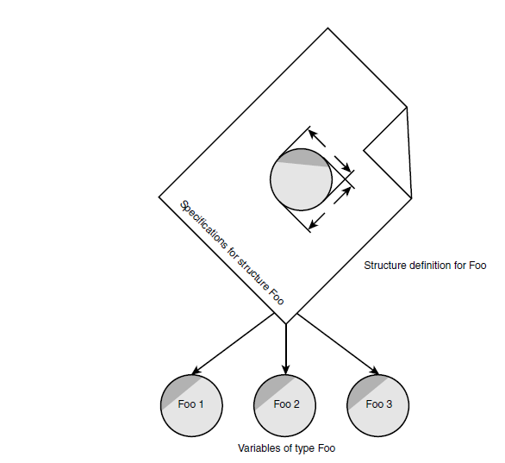
Use of Structure Definition

Slide 22
Structure Variable
part part1; //define a structure variable
This definition reserves space in memory for part1.
How much space?
Enough to hold all the members of part1.
Memory space in our example (assuming a 32-bit system)
  4 bytes for each of the two ints
  4 bytes for the float.

Slide 23
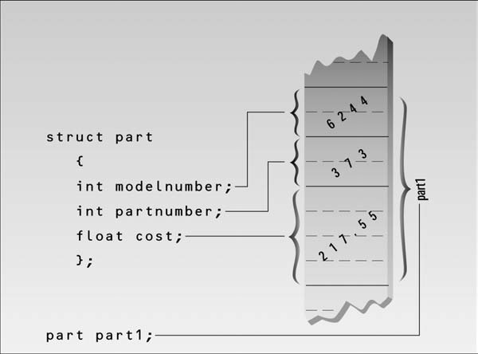
Memory Occupied

Slide 24
Accessing Structure Variable
Once a structure variable has been defined, its members can be accessed using the dot operator.
  part1.modelnumber = 6244;
Access operator

Slide 25
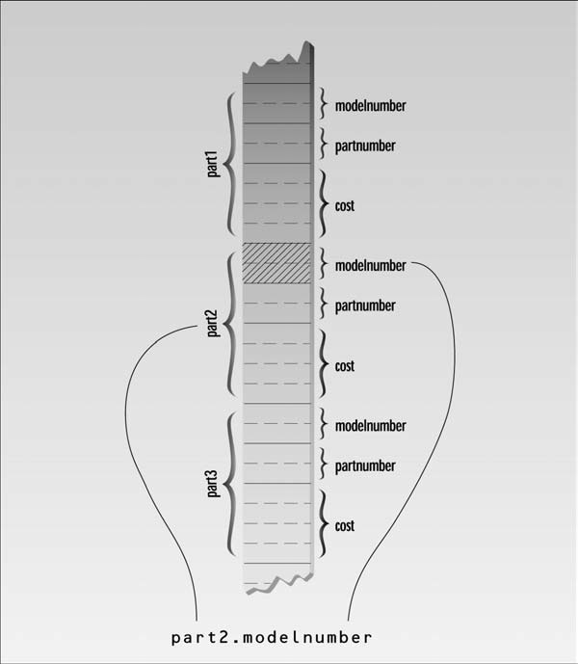
Accessing Structure Variable

Slide 26
Enumeration
A different approach to defining your own data type other than structure is enumeration.
To cope the need for variables that have a limited set of possible values.
Ex, It can be usefully referred to by labels the days of the week or months of the year.
  enum Week{Mon, Tues, Wed, Thurs, Fri, Sat, Sun} thisWeek;

Slide 27
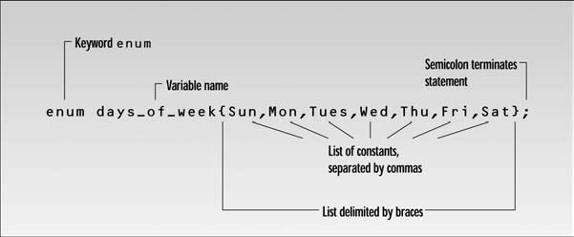
Enumeration..
An enum declaration defines the set of all names that will be permissible values of the type.
These permissible values are called enumerators.
The enum type Week has seven enumerators: Sun, Mon, Tue, and so on, up to Sat.

Slide 28
Enumeration..
// dayenum.cpp
// demonstrates enum types
#include <iostream>
using namespace std;
//specify enum type
enum days_of_week { Sun, Mon, Tue, Wed, Thu, Fri, Sat };
int main()
{
days_of_week day1, day2;
//define variables of type days_of_week

Slide 29
Enumeration..
  day1 = Mon; //give values to
  day2 = Thu; //variables
  int diff = day2 - day1; //can do integer arithmetic
  cout << “Days between = “ << diff << endl;
  if(day1 < day2) //can do comparisons
  cout << “day1 comes before day2\n”;
  return 0;
  }

Slide 30
Enumeration..
  Program Output
  Days between = 3
  day1 comes before day2

Slide 31
Functions
A function groups a number of program statements into a unit and gives it a name.
This unit can then be invoked from other parts of the program.
The function’s code is stored in only one place in memory, even though the function is executed many times in the course of the program.

Slide 32
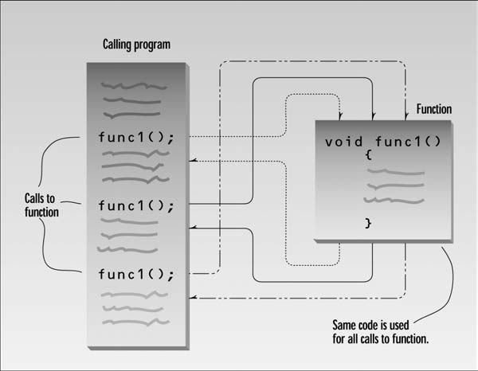
Functions..

Slide 33
A Simple Function
Our first example demonstrates a simple function whose purpose is to print a line of 45 asterisks.
  // table.cpp
  // demonstrates simple function
  #include <iostream>
  using namespace std;
  void starline(); //function declaration // (prototype)

Slide 34
A Simple Function
    int main()
    {
    starline(); //call to function
    cout << “Data type Range” << endl;
    starline(); //call to function
    cout << “char -128 to 127” << endl
    << “short -32,768 to 32,767” << endl
    << “int System dependent” << endl
    << “long -2,147,483,648 to 2,147,483,647” << endl;
    starline(); //call to function
    return 0;
    }

Slide 35
A Simple Function
      // starline()
      // function definition
      void starline() //function declarator
      {
      for(int j=0; j<45; j++) //function body
      cout << ‘*’;
      cout << endl;
      }

Slide 36
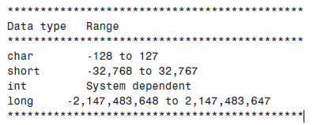
Program Output

Slide 37
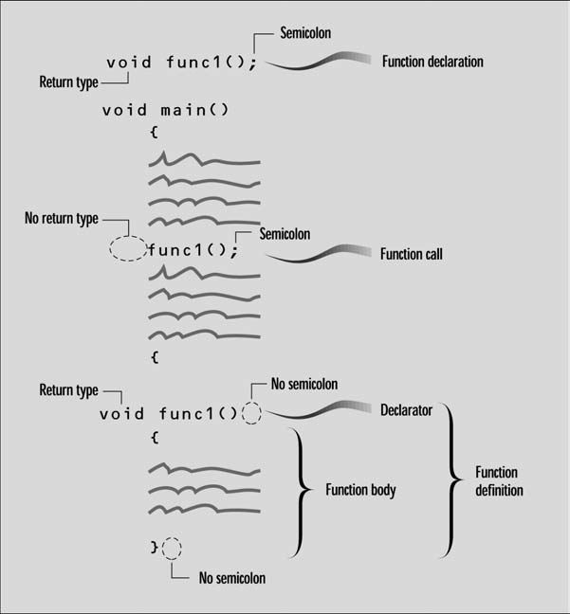
Function Syntax

Slide 38
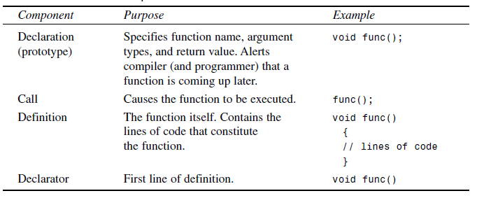
Function Components

Slide 39
Thank You

