Slide 1
LESSON 05

Slide 2
Overview
of
Previous Lesson(s)

Slide 3
Over View
Interactive development environment is a software application that provides comprehensive facilities to computer programmers for software development.
Microsoft Visual Studio is an integrated development environment (IDE) from Microsoft Corporation.
Developed on .Net framework

Slide 4
Over View..
C++
  Keywords Reserved words int, main, class, define
  Identifiers Programmers defined variables
  Variables A named storage location in the computer’s memory for holding a piece of data.
  Data Types When computer programs store data in variables, each variable must be assigned a specific data type. Some common data types include integers, floating point numbers, characters, strings, and arrays.

Slide 5
Over View...
Cout >> and Cin <<
A namespace is a part of the program in which certain names are recognized; outside of the namespace they’re unknown.
Escape Sequences /n, /t, //, /’, /” …
Library Functions
  sqrt()
  rand()

Slide 6
Over View...
Looping structures
  For loop
  While
  Do While
Decision structures
  If
  If / else
  Switch

Slide 7
TODAY’S LESSON

Slide 8
Contents
Operator Precedence
Type Conversion and Casting
Auto Keyword
Discovering Types
Bitwise Operators
L Values and R Values
Storage Duration
Variable Scopes
Static Variables
Namespaces

Slide 9
Operator Precedence
Operator precedence orders the operators in a priority sequence.
In any expression, operators with the highest precedence are always executed first, followed by operators with the next highest precedence, and so on, down to those with the lowest precedence of all.

Slide 10
Operator Precedence..
In an expression with more than one operator, evaluate in this order:
  - (unary negation), in order, left to right
  * / %, in order, left to right
  + -, in order, left to right
Example expression 2 + 2 * 2 – 2
evaluate
third
evaluate
second
evaluate
first

Slide 11
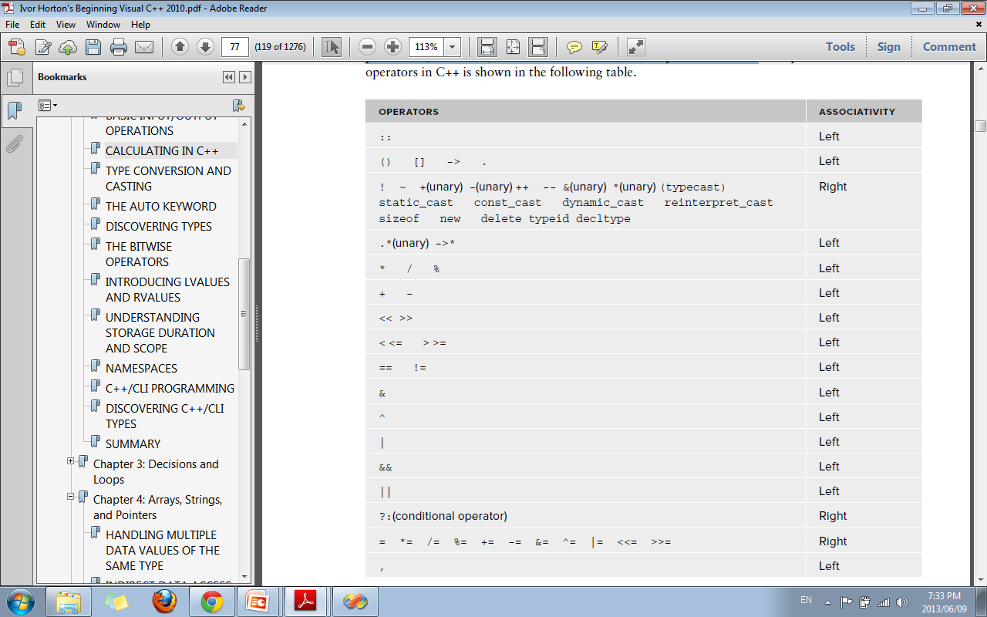
Operator Precedence...

Slide 12
Type Conversion and Casting
Operations in C++ can be carried out only between the values of the same data type.
So what if they are not of the same type ???
Implicit type conversion:
  When an expression involving variables of different types then for each operation to be performed, the compiler has to arrange to convert the type of one of the operands to match that of the other.

Slide 13
Type Conversion and Casting..
Example
  If you want to add a double value to a value of an integer type, the integer value is first converted to double , after which the addition is carried out.
  The variable that contains the value to be converted is, itself, not changed.
    double val_double;
    Int val_int;
    cout << “Type Casting” << val_double – val_int ;

Slide 14
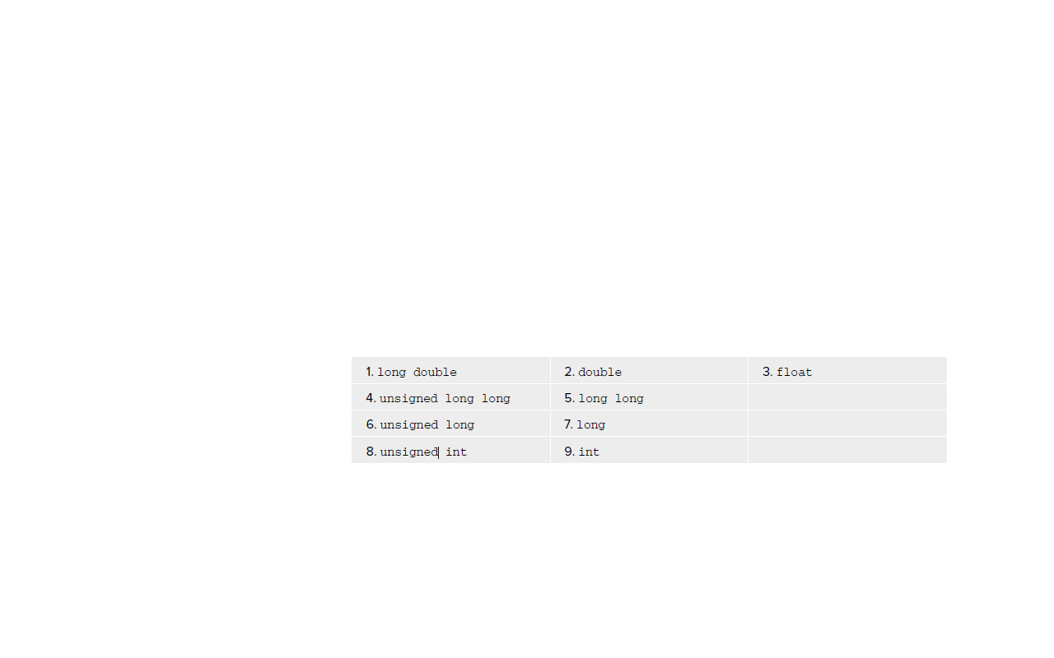
Type Conversion and Casting...
Any pair of operands of different types, the compiler decides which operand to convert to the other considering types to be in the following rank from high to low:

Slide 15
Type Conversion in Assignment
Example
    Int val_int;
    float val_float = 3.5f;
    val_int = val_float;
    Result: val_int value is 3
Single precision floating point

Slide 16
Explicit Type Conversion
With mixed expressions involving the basic types, C++ compiler automatically arranges casting where necessary, but it can also be forced for a conversion from one type to another by using an explicit type conversion.
Also referred as a cast .
To cast the value of an expression to a given type, you write the cast in the form:
static_cast < the_type_to_convert_to > ( expression )

Slide 17
Explicit Type Conversion..
The effect of the static_cast operation is to convert the value that results from evaluating expression to the type that you specify between the angled brackets.
Example
double value1 = 10.5;
double value2 = 15.5;
int whole_number = static_cast < int > (value1) + static_cast < int > (value2);

Slide 18
Auto Keyword
Auto keyword is used as the type of a variable in a definition statement and have its type deduced from the initial value.
Examples:
auto n = 16; // Type is int
auto pi = 3.14159; // Type is double
auto x = 3.5f; // Type is float
auto found = false; // Type is bool
In each case, the type assigned to the defined variable is the same as that of the literal used as the initializer.
When auto is used in this way, you must supply an initial value must be assigned for the variable.

Slide 19
Auto Keyword..
Variables defined using the auto keyword can also be specified as constants:
const auto e = 2.71828L; // Type is const long double
Functional notation:
const auto dozen(12); // Type is const int
The initial value for a defined variable using the auto keyword can also be an expression:
  auto factor(n*pi*pi); // Type is double
In this case, the definitions for the variables n and pi that are used in the initializing expression must precede this statement.

Slide 20
typeid Operator
The typeid operator enables to discover the type of an expression.
Syntax typeid(expression)
  it results in an object of type type_info that encapsulates the type of the expression.
#include < typeinfo >
cout < < "The type of x*y is " < < typeid(x*y).name() < < endl;
Output: The type of x*y is double

Slide 21
Bitwise Operators
The bitwise operators are useful in programming hardware devices, where the status of a device is often represented as a series of individual flags
The bitwise operators treat their operands as a series of individual bits rather than a numerical value.
It works only with the following data types:
  short , int , long , long long , signed char, and char.
  Unsigned variants of these can also be used.

Slide 22

Bitwise Operators..
There are six bitwise operators:

Slide 23
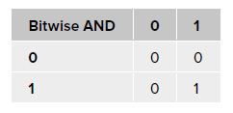
Bitwise AND &
If both corresponding bits are 1, the result is a 1 bit, and if either or both bits are 0 the result is a 0 bit.
The effect of a particular binary operator is often shown using what is called a truth table .
The truth table for & is as follows:

Slide 24
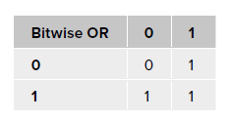
Bitwise OR |
The bitwise OR, | , sometimes called the inclusive OR , combines corresponding bits such that the result is a 1 if either operand bit is a 1, and 0 if both operand bits are 0.
The truth table for the bitwise OR is:

Slide 25
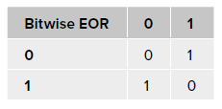
Bitwise Exclusive OR
The exclusive OR , ^ , is so called because it operates similarly to the inclusive OR but produces 0 when both operand bits are 1.
The truth table for EOR is as follows:

Slide 26
Bitwise NOT
The bitwise NOT, ~ , takes a single operand, for which it inverts the bits: 1 becomes 0, and 0 becomes 1.
For example if following statement is executed
  result = ~letter1;
if letter1 is 0100 0001, the variable result will have the value 1011 1110, which is 0xBE, or 190 as a decimal value.

Slide 27
L Values & R Values
An lvalue refers to an address in memory in which something is stored on an ongoing basis.
An rvalue is the result of an expression that is stored transiently.
Every expression in C++ results in either an lvalue or an rvalue.
An lvalue is so called because any expression that results in an l value can appear on the left of the equals sign in an assignment statement. If the result of an expression is not an lvalue, it is an rvalue.

Slide 28
L Values & R Values..
int a(0), b(1), c(2);
a = b + c;
b = ++a;
c = a++;
The result of evaluating the expression b+c is stored temporarily in a memory location and the value is copied from this location to a. Once execution of the statement is complete, the memory location holding the result of evaluating b+c is discarded. Thus, the result of evaluating the expression b+c is an rvalue.
The expression ++a is an lvalue.
The expression a++ is an rvalue because it stores the value of a temporarily as the result of the expression and then increments a.

Slide 29
Storage Duration
All variables have a finite lifetime when your program executes.
They come into existence from the point at which you declare them and then, at some point, they disappear — at the latest, when your program terminates.
How long a particular variable lasts is determined by a property called its storage duration .
There are three different kinds of storage duration that a variable can have:
  Automatic storage duration
  Static storage duration
  Dynamic storage duration
Which of these a variable will have depends on how you create it.

Slide 30
Variable Scopes
The scope of a variable is simply that part of your program over which the variable name is valid.
Within a variable ’ s scope, it can be legally referred, either to set its value or to use it in an expression.
Outside of the scope of a variable, it cannot be referred to its name — any attempt to do so will cause a compiler error.

Slide 31
Global Variables
Variables that are declared outside of all blocks and classes are called globals and have global scope.
They are accessible throughout all the functions in the file, following the point at which they are declared. If you declare them at the very top of your program, they will be accessible from anywhere in the file.
Global variables have storage class static, which means they exist for the life of the program.
Memory space is set aside for them when the program begins, and continues to exist until the program ends.

Slide 32
Static Variables
A static local variable has the visibility of an automatic local variable (that is, inside the function containing it).
Its lifetime is the same as that of a global variable, except that it doesn’t come into existence until the first call to the function containing it.
static int count;
It remains in existence for the life of the program.
Static local variables are used when it’s necessary for a function to remember a value when it is not being executed; that is, between calls to the function.

Slide 33
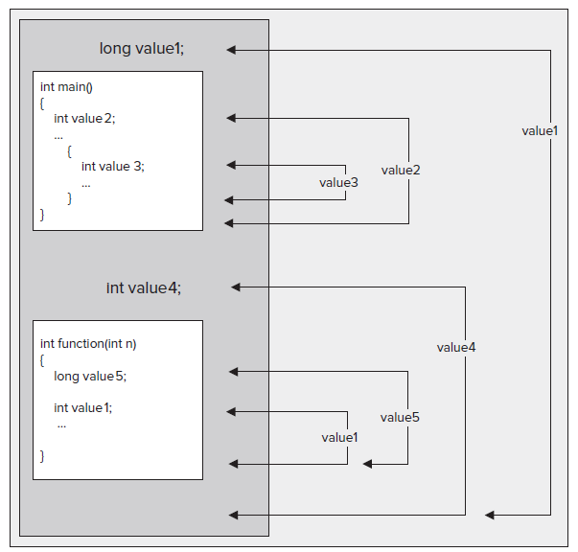
Scope

Slide 34
Name Spaces
Namespaces provide a way to separate the names used in one part of a program from those used in another.
This thing seems to invaluable with large projects involving several teams of programmers working on different parts of the program.
  Each team can have its own namespace name, and worries about two teams accidentally using the same name for different functions disappear.

Slide 35
Name Spaces
    using namespace std;
The effect of this is to import all the names from the std namespace into the source file so you can refer to anything that is defined in this namespace without qualifying the name in your program.
Programmer can use name
    cout instead of std::cout
    endl instead of std::endl .
This sounds like a big advantage, but the downside of this blanket using directive is that it effectively negates the primary reason for using a namespace, that is, preventing accidental name clashes.

Slide 36
Name Spaces
So a better solution is is to introduce just the names that you use in your code with using declarations. i.e
  using std::cout; // Allows cout usage without qualification
  using std::endl; // Allows endl usage without qualification
Each using declaration introduces a single name from the specified namespace and allows it to be used unqualified within the program code that follows.

Slide 37
Declaring a Namespace
namespace keyword is used to declare a namespace
    namespace myStuff
    {
    // Code that I want to have in the namespace myStuff...
    }
This defines a namespace with the name myStuff .
All name declarations in the code between the braces will be defined within the myStuff namespace.
To access any such name from a point Namespaces outside this namespace, the name must be qualifi ed by the namespace name, myStuff , or have a using declaration that identifies that the name is from the myStuff namespace.

Slide 38
Namespace Ex
// Declaring a namespace
#include < iostream >
namespace myStuff
{
int value = 0;
}
int main()
{
  std::cout < < "enter an integer: ";
  std::cin > > myStuff::value;
  std::cout < < "\nYou entered " < < myStuff::value < < std::endl;
  return 0;
}

Slide 39
Thank You

