Slide 1
LESSON 32

Slide 2
Overview
of
Previous Lesson(s)

Slide 3
Over View
Server controls are small building blocks of the graphical user interface, which includes
  Text boxes
  Buttons
  Labels and numerous other tools.
These controls are also used for some structural jobs like
  Validation
  Data Access
  Security

Slide 4
Over View..
HTML server controls are basically the original HTML controls but enhanced to enable server side processing.
The HTML controls like the header tags, anchor tags and input elements are not processed by the server but sent to the browser for display.
  Attribute runat="server“ & adding an id attribute.

Slide 5
Over View…
Client Side Scripts
  Run on the browser and in turn would speed up the execution of page.
Client Side Source Code
  ASP.NET pages generate.

Slide 6
Over View…
HyperLink Control
  The HyperLink control is like the HTML <a> element.
<asp:HyperLink ID="HyperLink1" runat="server"> HyperLink </asp:HyperLink>
Image Control
  The image control is used for displaying images on the web page, or some alternative text, if the image is not available.
<asp:Image ID="Image1" runat="server">

Slide 7
TODAY’S LESSON

Slide 8
Contents
ASP.NET - Directives
ASP.NET - State Management
  View State
  Session State
  Application State
ASP.NET - Validation Controls

Slide 9
Directives
ASP.Net directives are instructions to specify optional settings. Ex.
  Registering a custom control
  Specify page language.
  These settings describe how the web forms (.aspx) or user controls (.ascx) pages are processed by the .Net framework.

Slide 10
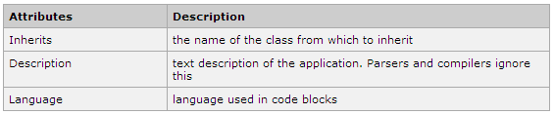
Directives..
<%@ directive_name attribute=value [attribute=value] %>
The Application Directive
  Defines application-specific attributes.
  It is provided at the top of the global.aspx file.
<%@ Application Language="C#" %>

Slide 11

Directives…
The Assembly Directive
  The Assembly directive links an assembly to the page or the application at parse time.
  This could appear either in the global.asax file for application-wide linking or in the page file or a user control file for linking to a page or user control.
  <%@ Assembly Name ="myassembly" %>

Slide 12
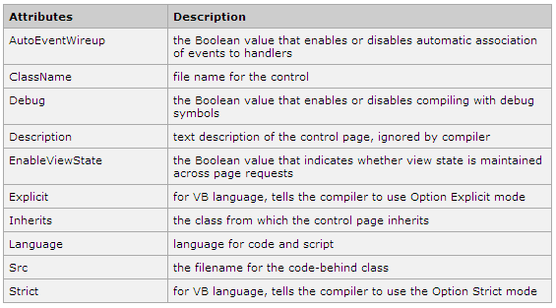
Directives…
The Control Directive
  The Control directive is used with the user controls and appears in the user control (.ascx) files.
<%@ Control Language="C#" EnableViewState="false" %>

Slide 13
Directives…
The Implements Directive
  The Implement directive indicates that the web page, master page or user control page must implement the specified .Net framework interface.
<%@ Implements Interface="interface_name" %>

Slide 14
Directives…
The Import Directive
  The Import directive imports a namespace into a web page, user control page of application.
  If the Import directive is specified in the global.asax, then it will apply to the entire application.
  If it is in a page of user control page, then it would apply to that page or control.
<%@ namespace="System.Drawing" %>

Slide 15
Directives…
The Master Directive
  The Master directive specifies a page file as being the master page.
<%@ MasterPage Language="C#" AutoEventWireup="true" CodeFile="SiteMater.master.cs" Inherits="SiteMaster" %>

Slide 16
Directives…
The MasterType Directive
  The MasterType directive assigns a class name to the Master property of a page, to make it strongly typed.
<%@ MasterType attribute="value"[attribute="value" ...] %>

Slide 17
Directives…
The OutputCache Directive
  The OutputCache directive controls the output caching policies of a web page or a user control.
  <%@ OutputCache Duration="15" VaryByParam="None" %>
The Page Directive
  The Page directive defines the attributes specific to the page file for the page parser and the compiler.
  <%@ Page Language="C#" AutoEventWireup="true" CodeFile="Default.aspx.cs" Inherits="_Default" Trace="true" %>

Slide 18
Directives…
The PreviousPageType Directive
  The PreviousPageType directive assigns a class to a page, so that the page is strongly typed.
<%@ PreviousPageType attribute="value"[attribute="value" ...] %>

Slide 19
Directives…
The Reference Directive
  The Reference directive indicates that another page or user control should be compiled and linked to the current page.
  <%@ Reference Page ="somepage.aspx" %>
The Register Directive
  The Register derivative is used for registering the custom server controls and user controls.
<%@ Register Src="~/footer.ascx" TagName="footer" TagPrefix="Tfooter" %>

Slide 20
State Management
HTTP ( Hyper Text Transfer Protocol) is a stateless protocol.
When the client disconnects from the server, the ASP.Net engine discards the page objects.
This way each web application can scale up to serve numerous requests simultaneously without running out of server memory.

Slide 21
State Management..
The current value of all the controls and variables for the current user in the current session is called the State.
ASP.Net manages four types of state:
  View State
  Control State
  Session State
  Application State

Slide 22
View State
The View State is the state of the page and all its controls.
It is automatically maintained across posts by the ASP.Net framework.
  When a page is sent back to the client, the changes in the properties of the page and its controls are determined and stored in the value of a hidden input field named _VIEWSTATE.
  When the page is again post back the _VIEWSTATE field is sent to the server with the HTTP request.

Slide 23
View State..
The view state could be enabled or disabled for
The entire application
  By setting the EnableViewState property in the <pages> section of web.config file
A page
  By setting the EnableViewState attribute of the Page directive, as
  <%@ Page Language="C#" EnableViewState="false" %>
A control
  By setting the Control.EnableViewState property.

Slide 24
View State...
It is implemented using a view state object defined by the StateBag class.
StateBag class
  Defines a collection of view state items.
  A data structure containing attribute/value pairs, stored as strings associated with objects.

Slide 25
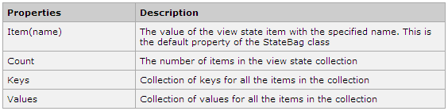
View State...
The StateBag class has the following properties

Slide 26
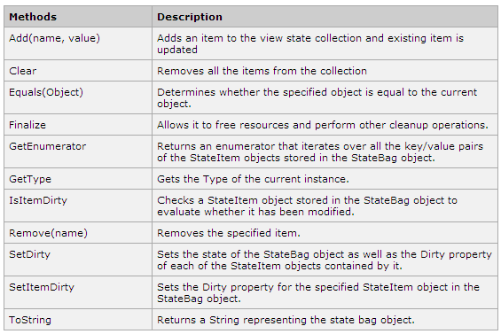
View State...

Slide 27
View State...
Example
  Let us keep a counter, which is incremented each time the page is post back by clicking a button on the page.
  A label control shows the value in the counter.
  Lets do it ..

Slide 28
Session State
When a user connects to an ASP.Net website, a new session object is created.
  When session state is turned on, a new session state object is created for each new request.
  This session state object becomes part of the context and it is available through the page.
Sessions are used to keep information about the user and his preference and keep track of pending operations.

Slide 29
Session State..
Sessions are used to keep information about
  The User
  User preferences &
  Keep track of pending operations
Sessions are identified and tracked with a 120-bit SessionID.
  Passed from client to server and back as cookie or a modified URL.

Slide 30
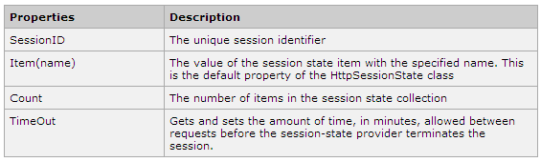
Session State…
The SessionID is globally unique and random.
The session state object is created from the HttpSessionState class.
  It defines a collection of session state items.

Slide 31
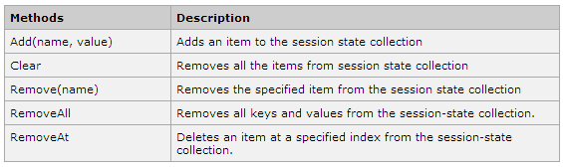
Session State…
The HttpSessionState class has the following methods
Lets see a session example.

Slide 32
Application State
An ASP.Net application is the collection of all web pages, code and other files within a single virtual directory on a web server.
Information stored in application state, it is available to all the users.
To provide for the use of application state, ASP.Net creates an application state object for each application from the HTTPApplicationState class and stores this object in server memory.

Slide 33

Application State..
Application State is mostly used to store hit counters and other statistical data, global application data like tax rate, discount rate etc and to keep track of users visiting the site.

Slide 34
Application State..
Application state data is generally maintained by writing handlers for the events
  Application_Start
  Application_End
  Application_Error
  Session_Start
  Session_End

Slide 35
Application State..
The following code shows the basic syntax for storing application state information
Void Application_Start(object sender, EventArgs e)
{
Application["startMessage"] = "The application has started.";
}
Void Application_End(object sender, EventArgs e)
{
Application["endtMessage"] = "The application has ended.";
}

Slide 36
Validations Controls
ASP.Net validation controls validate the user input data to ensure that useless, unauthenticated or contradictory data don’t get stored.
Validation controls
  RequiredFieldValidator
  RangeValidator
  CompareValidator
  RegularExpressionValidator
  CustomValidator
  ValidationSummary

Slide 37
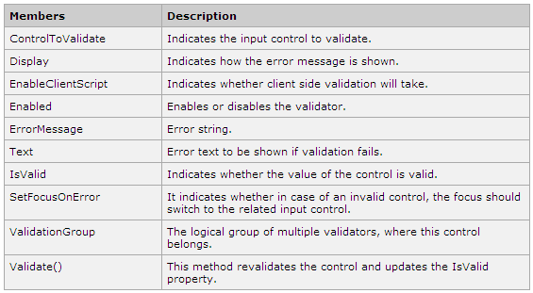
The BaseValidator Class
The validation control classes inherit from the BaseValidator class and inherit its properties and methods.

Slide 38
Validations Controls
RequiredFieldValidator
  The RequiredFieldValidator control ensures that the required field is not empty.
  It is generally tied to a text box to force input into the text box.
  <asp:RequiredFieldValidator ID="rfvcandidate" runat="server" ControlToValidate ="ddlcandidate" ErrorMessage="Please choose a candidate" InitialValue="Please choose a candidate”
  </asp:RequiredFieldValidator>

Slide 39
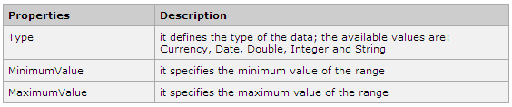
Validations Controls..
The RangeValidator
  The RangeValidator control verifies that the input value falls within a predetermined range.
  <asp:RangeValidator ID="rvclass" runat="server" ControlToValidate="txtclass" ErrorMessage="Enter your class (6 - 12)" MaximumValue="12" MinimumValue="6" Type="Integer">
  </asp:RangeValidator>

Slide 40
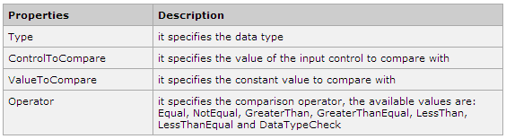
Validations Controls..
The CompareValidator
  The CompareValidator control compares a value in one control with a fixed value, or, a value in another control.
  <asp:CompareValidator ID="CompareValidator1" runat="server" ErrorMessage="CompareValidator">
  </asp:CompareValidator>

Slide 41
Validations Controls...
The CustomValidator
  The CustomValidator control allows writing application specific custom validation routines for both the client side and the server side validation.
  The client side validation is accomplished through the ClientValidationFunction property.
  The client side validation routine should be written in a scripting language, like JavaScript or VBScript, which the browser can understand.

Slide 42
Validations Controls...
The CustomValidator
  The server side validation routine must be called from the control ServerValidate event handler.
  The server side validation routine should be written in any .Net language, like C#
  <asp:CustomValidator ID="CustomValidator1" runat="server" ClientValidationFunction=.cvf_func. ErrorMessage="CustomValidator">
  </asp:CustomValidator>

Slide 43
Validations Controls...
The ValidationSummary Control
  The ValidationSummary control does not perform any validation but shows a summary of all errors in the page.
  The summary displays the values of the ErrorMessage property of all validation controls that failed validation.

Slide 44
Validations Controls...
The following two mutually inclusive properties list out the error message:
  ShowSummary shows the error messages in specified format.
  ShowMessageBox shows the error messages in a separate window.
<asp:ValidationSummary
ID="ValidationSummary1" runat="server"
DisplayMode = "BulletList" ShowSummary = "true"
HeaderText="Errors:" />

Slide 45
Validations Controls...
Validation Groups
  Complex pages have different groups of information provided in different panels.
  In such a situation a need for performing validation separately for separate group, might arise.
  This kind of situation is handled using validation groups.
To create a validation group, put the input controls and the validation controls into the same logical group by setting their ValidationGroup property.

Slide 46
Validations Controls...
Lets see the ex of Validations …

Slide 47
COURSE END

Slide 48
What we have learned ??

Slide 49
Object Oriented Programming
Visual C++
CLR Programming
Debugging Techniques
MFC based applications
SDI / MDI Applications
Windows Forms
Web Applications
MS Visual Studio 2008 / 2010

Slide 50
Thank You

