Slide 1
LESSON 31

Slide 2
Overview
of
Previous Lesson(s)

Slide 3
Over View
ASP.NET Pages
  Modular in nature and divided into the core sections
    Page directives
    Code Section
    Page Layout

Slide 4
Over View..
In ASP.Net an event is raised at the client end, and handled by the server.
  When an event message is transmitted to the server, it checks whether the Click event has an associated event handler, and if it has, the event handler is executed.
Types of Events
  App & Session Events
  Page & Control Events

Slide 5
Over View…
All ASP.Net controls are implemented as classes.
They have events which are fired when user performs certain action on them.
  Ex, when a user clicks a button the 'Click' event is generated.
  For handling these events there are in-built attributes and event handlers.
  To respond to an event, the event handler is coded.

Slide 6
Over View…
Server Object
  Instance of the System.Web.HttpServerUtility class.
    The HttpServerUtility class provides numerous properties and methods to perform various jobs.
Request Object
  Instance of the System.Web.HttpRequest class.

Slide 7
Over View…
Response Object
  The Response object represents the server's response to the client request.
  Instance of System.Web.HttpResponse class.

Slide 8
TODAY’S LESSON

Slide 9
Contents
ASP.NET - Server Controls
  Web Controls
  Properties of Server Controls
  Methods of Server Controls
ASP.NET - HTML Server Controls
ASP.NET - HTML Client Side
  Client Side Scripts
  Client Side Source Code
ASP.NET - Basic Controls

Slide 10
Server Controls
Controls are small building blocks of the graphical user interface, which includes
  Text boxes
  Buttons
  Check boxes
  List boxes
  Labels and numerous other tools.
  Using these control users can enter data, make selections and indicate their preferences.

Slide 11
Server Controls..
Controls are also used for structural jobs like
  Validation
  Data Access
  Security
  Creating master pages
  Data manipulation

Slide 12
Server Controls...
ASP.Net uses 5 types of web controls
  HTML controls
  HTML Server controls
  ASP.Net Server controls
  ASP.Net Ajax Server controls
  User controls and some custom controls
These controls are the primary controls used in ASP.Net.

Slide 13
Server Controls...
These controls could also be grouped into the following categories
  Validation controls
    Used to validate user input and work by running client-side script
  Data source controls
    Provides data binding to different data sources
  Data view controls
    These are various lists and tables, which can bind to data from data sources for display

Slide 14
Server Controls...
Personalization controls
  These are used for personalization of a page according to the user's preference, based on user information
Login and security controls
  These controls provide user authentication
Master pages
  These provides consistent layout and interface throughout the application

Slide 15
Server Controls...
Navigation controls
  These helps in navigation, for example, the menus, tree view etc.
Rich controls
  These implements special features, for example,
    AdRotator control
    FileUpload control
    Calendar control

Slide 16
Server Controls...
Basic syntax for using server controls is
<asp:controlType ID ="ControlID" runat="server" Property1=value1 [Property2=value2] />

Slide 17
Properties of the Server Control
The ASP.Net server controls are derived from the WebControl class and inherit all the properties, events and methods of this class.
  For ex. The PlaceHolder control or XML control etc. are derived from the System.Web.UI.Control class.
WebControl class itself and some other server controls are not visually rendered.

Slide 18
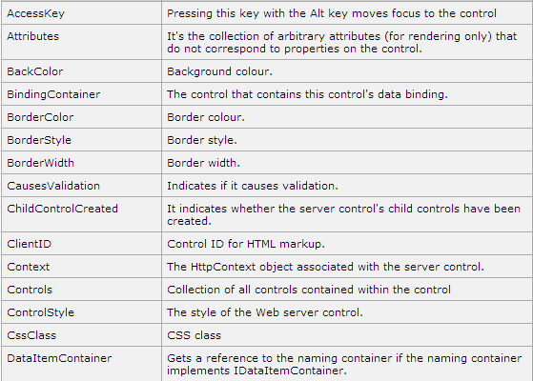
Properties of the Server Control..

Slide 19
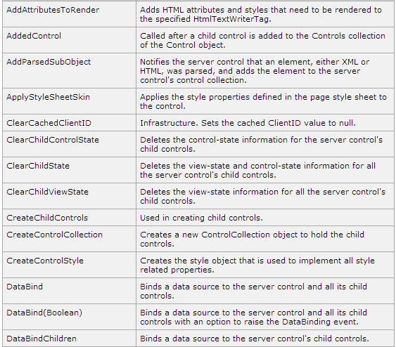
Methods of the Server Control

Slide 20
Server Control Exs
Lets check the ex …

Slide 21
HTML Server Controls
The HTML server controls are basically the original HTML controls but enhanced to enable server side processing.
The HTML controls like the header tags, anchor tags and input elements are not processed by the server but sent to the browser for display.
  Attribute runat=“server” & adding an id attribute.

Slide 22
HTML Server Controls..
HTML input control
<input type="text" size="40">
It could be converted to a server control, by adding the runat and id attribute:
<input type="text" id="testtext" size="40" runat="server">

Slide 23
HTML Server Controls...
ASP.Net server controls can perform every job accomplished by the HTML server controls.
But HTML controls are useful in the following cases
  Using static tables for layout purposes
  Converting a HTML page to run under ASP.Net

Slide 24
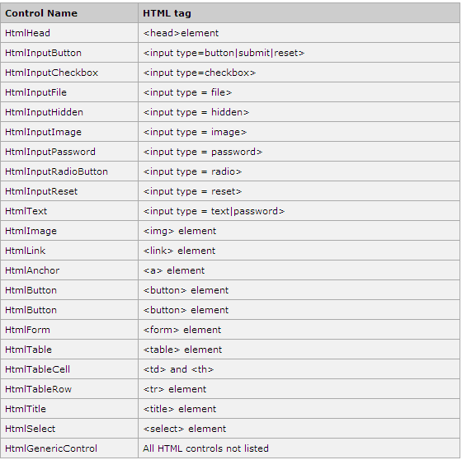
HTML Server Controls…

Slide 25
HTML Server Controls Ex
This ex uses a basic HTML table for layout.
It uses some text boxes for getting input from the users like, name, address, city, state etc.
It also has a button control, which is clicked to get the user data displayed on the last row of the table.
  Lets make it..

Slide 26
Client Side
ASP.Net client side coding has two aspects
Client Side Scripts
  Run on the browser and in turn would speed up the execution of page.
  For example, client side data validation which can catch invalid data and warn the user accordingly without making a round trip to the server.

Slide 27
Client Side..
Client Side Source Code
  ASP.NET pages generate.
  For ex, the HTML source code of an ASP.NET page contains a number of hidden fields and automatically injected blocks of JavaScript code, which keeps information like view state or does other jobs to make the page work.

Slide 28
Client Side Scripts
All ASP.Net server controls allow calling client side code written using JavaScript.
Some ASP.Net server controls use client side scripting to provide responses to the users without posting back to the server.
  Ex, the validation controls.
Apart from these scripts the Button control has a property OnClientClick
  Allows executing client-side script, when the button is clicked.

Slide 29
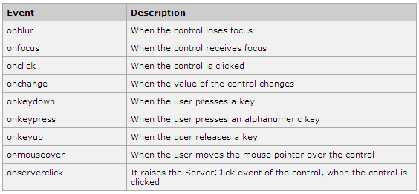
Client Side Scripts
The traditional and server HTML controls has the following events that can execute a script when they are raised.

Slide 30
Client Side Source Code
ASP.NET pages are generally written in two files
  The content file or the markup file (.aspx)
  The code-behind file (.cs)

Slide 31
Content File
  The content file contains the HTML or ASP.Net controls tags and literals to form the structure of the page and the code behind file contains the class definition.
  At run time, the content file is parsed and transformed into a page class.
  This class along with the class definition in the code file and some other system generated code make the executable code (assembly) that processes all posted data and generates the response and sends it back to the client.

Slide 32
Client Side
  Lets see an example ..

Slide 33
Basic Controls
Button Controls
  03 types of button controls
    Buttons
    Link buttons
    Image buttons
When a user clicks a button control, two events are raised Click and Command.
<asp:Button ID="Button1" runat="server" onclick="Button1_Click" Text="Click" />

Slide 34
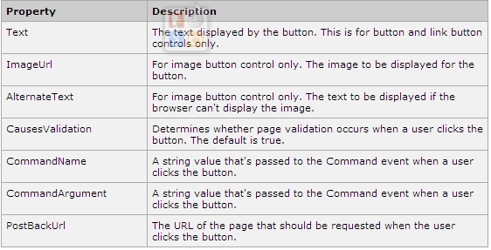
Basic Controls..
Common Properties of the Button control

Slide 35
Basic Controls…
Text Boxes and Labels
  Text box controls are typically used to accept input from the user.
  A text box control can accept one or more lines to text depending upon the setting of the TextMode attribute.
<asp:TextBox ID="txtstate" runat="server" >
  Label controls provide an easy way to display text which can be changed from one execution of a page to the next.

Slide 36
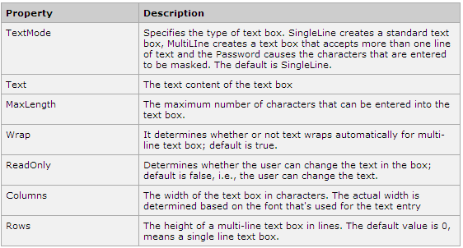
Basic Controls…
Common Properties of the Text Box and Labels

Slide 37
Basic Controls…
Check Boxes and Radio Buttons
  A check box displays a single option that the user can either check or uncheck and radio buttons present a group of options from which the user can select just one option.
  To create a group of radio buttons, specify the same name for the GroupName attribute of each radio button in the group.
    If more than one group is required in a single form specify a different group name for each group.

Slide 38
Basic Controls…
Check Boxes and Radio Buttons
  If check box or radio button is needed to be selected when it's initially displayed, set its Checked attribute to true.
  If the Checked attribute is set for more than one radio button in a group, then only the last one will be selected.
<asp:CheckBox ID= "chkoption" runat= "Server"> </asp:CheckBox>
<asp:RadioButton ID= "rdboption" runat= "Server">
</asp: RadioButton>

Slide 39
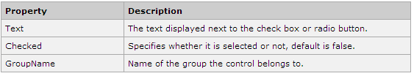
Basic Controls…
Common Properties of the Check Boxes and Radio Buttons

Slide 40
Basic Controls…
List Controls
  ASP.Net provides the controls: drop-down list, list box, radio button list, check box list and bulleted list.
  These control let a user choose from one or more items from the list.
  List boxes and drop-down list contain one or more list items.
  These lists could be loaded either by code or by the ListItem Collection Editor.

Slide 41
Basic Controls…
Basic syntax for list box control
<asp:ListBox ID="ListBox1" runat="server" AutoPostBack="True" OnSelectedIndexChanged="ListBox1_SelectedIndexChanged"> </asp:ListBox>
Basic syntax for a drop-down list control
<asp:DropDownList ID="DropDownList1" runat="server" AutoPostBack="True" OnSelectedIndexChanged="DropDownList1_SelectedIndexChanged"> </asp:DropDownList>

Slide 42
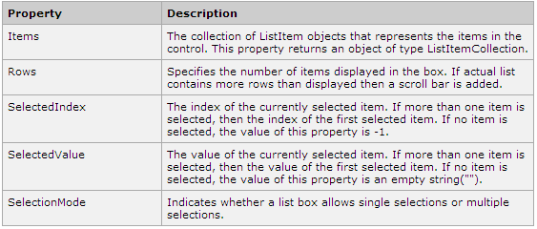
Basic Controls…
Common Properties of List box and Drop-down Lists

Slide 43
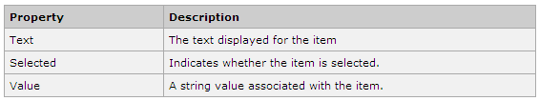
Basic Controls…
Common Properties of each List item objects.

Slide 44
Basic Controls…
The List Item Collections
  The ListItemCollection object is a collection of ListItem objects.
  Each ListItem object represents one item in the list.
  Items in a ListItemCollection are numbered from 0.
  When the items into a list box are loaded using strings like lstcolor.Items.Add("Blue"), then both the Text and Value properties of the list item are set to the string value.

Slide 45

Basic Controls…
The ListItem Collection Editor is used to add item to a drop-down list or list box.
  This is used to create a static list of items.
Common Properties of List Item Collection

Slide 46
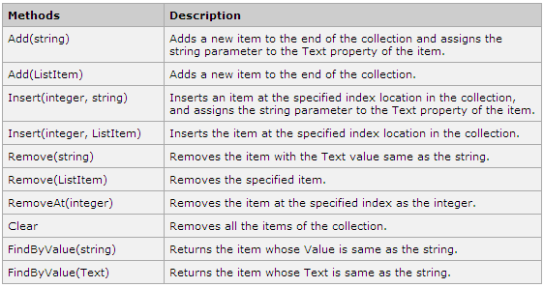
Basic Controls…
Common Methods of List Item Collection

Slide 47
Basic Controls…
Bulleted lists and Numbered lists
  The bulleted list control creates bulleted lists or numbered lists.
  These controls contain a collection of ListItem objects that could be referred to through the Items property of the control.
<asp:BulletedList ID="BulletedList1" runat="server"> </asp:BulletedList>

Slide 48
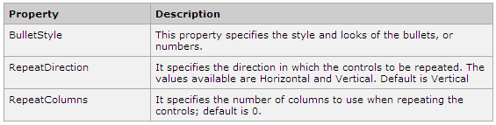
Basic Controls…
Common Properties of Bulleted List Item Collection

Slide 49
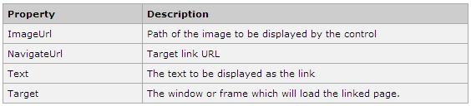
Basic Controls…
HyperLink Control
  The HyperLink control is like the HTML <a> element.
<asp:HyperLink ID="HyperLink1" runat="server"> HyperLink </asp:HyperLink>
It has the following important properties

Slide 50
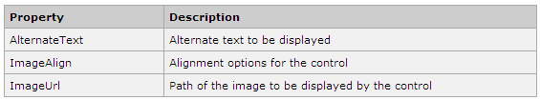
Basic Controls…
Image Control
  The image control is used for displaying images on the web page, or some alternative text, if the image is not available.
<asp:Image ID="Image1" runat="server">
It has the following important properties

Slide 51
Thank You

