Slide 1
LESSON 30

Slide 2
Overview
of
Previous Lesson(s)

Slide 3
Over View
ASP is a technology that enables scripts in web pages to be executed by an Internet server.
ASP.NET is a web development platform, which provides a programming model.
    To build a comprehensive software infrastructure and various services required to build up robust web application for PC, as well as mobile devices

Slide 4
Over View..
ASP.NET has better language support, a large set of user controls, XML-based components, and integrated user authentication.
ASP.Net applications could be written in
    C#
    Visual Basic .Net
    Jscript
    J#

Slide 5
Over View…
The ASP.Net component model provides various building blocks of ASP.Net pages.
It is an object model, which describes
  Server side counterparts of almost all HTML elements or tags, like <form> and <input>.
  Server controls, which help in developing complex user-interface for example the Calendar control or the Gridview control.

Slide 6
Over View…
ASP.Net Life Cycle
  ASP.Net processes pages to produce dynamic output
  The application and its pages are instantiated and processed
  ASP.Net compiles the pages dynamically

Slide 7
Over View…
ASP.NET Pages
  Modular in nature and divided into the following core sections
    Page directives
    Code Section
    Page Layout

Slide 8
TODAY’S LESSON

Slide 9
Contents
Event Handling
  Application Events
  Session Events
  Page & Control Events
  Default Events
Server Object
Request Object
Response Object

Slide 10
Event Handling
Event is an action or occurrence
  Mouse click,
  Key press,
  Mouse movements,
  Any system generated notification.
The processes communicate through events.

Slide 11
Event Handling..
In ASP.Net an event is raised on the client, and handled in the server.
  A user clicks a button displayed in the browser. A Click event is raised.
  The browser handles this client-side event by posting it to the server.
The server has a subroutine describing what to do when the event is raised, called the event-handler.

Slide 12
Event Handling..
When an event message is transmitted to the server, it checks whether the Click event has an associated event handler, and if it has, the event handler is executed.
  private void EventName (object sender, EventArgs e);
Event Arguments
  Two parameters and return void.
    1st parameter represents the object raising the event.
    2ns parameter is called the event argument.

Slide 13
Application Events
Some important application events are:
Application_Start
  It is raised when the application/website is started
Application_End
  It is raised when the application/website is stopped.

Slide 14
Session Events
The most used Session events are
Session_Start
  Raised when a user first requests a page from the application
Session_End
  Raised when the session ends

Slide 15
Page & Control Events
Common page and control events are..
DataBinding
  Raised when a control bind to a data source
Disposed
  When the page or the control is released
Error
  It is an page event, occurs when an unhandled exception is thrown

Slide 16
Page & Control Events..
Init
  Raised when the page or the control is initialized
Load
  Raised when the page or a control is loaded
PreRender
  Raised when the page or the control is to be rendered
Unload
  Raised when the page or control is unloaded from memory

Slide 17
Event Handling Using Controls
All ASP.Net controls are implemented as classes.
They have events which are fired when user performs certain action on them.
  Ex, when a user clicks a button the 'Click' event is generated.
  For handling these events there are in-built attributes and event handlers.
  To respond to an event, the event handler is coded.

Slide 18
Event Handling Using Controls..
By default Visual Studio creates an event handler by including a Handles clause on the Sub procedure.
This clause names the control and event that the procedure handles.
Tag for a button control
<asp:Button ID="btnCancel" runat="server" Text="Cancel" />

Slide 19
Event Handling Using Controls...
The event handler for the Click event:
Protected Sub btnCancel_Click (
ByVal sender As Object,
ByVal e As System.EventArgs)
Handles btnCancel.Click
End Sub
An event can also be coded without a Handles clause.

Slide 20
Event Handling Using Controls...
Then the handler must be named according to the appropriate event attribute of the control.
<asp:Button ID="btnCancel" runat="server" Text="Cancel" Onclick="btnCancel_Click" />
Protected Sub btnCancel_Click (
ByVal sender As Object,
ByVal e As System.EventArgs)
End Sub

Slide 21
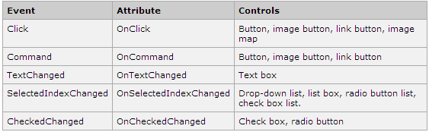
Event Handling Using Controls...
Common control events

Slide 22
Default Events
Default event for the Page object is the Load event.
  Every control has a default event.
  Ex, default event for the button control is the Click event.
Default event handler could be created in Visual Studio, just by double clicking the control in design view.

Slide 23
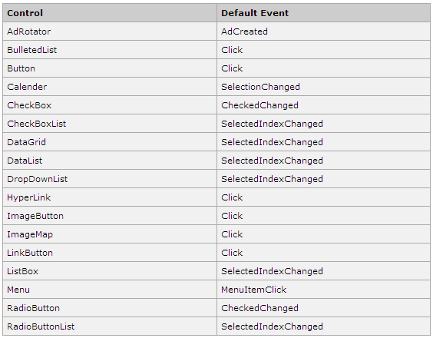
Default Events..

Slide 24
Events Example
Lets check some events practically.

Slide 25
Intrinsic Objects
We already discussed the page life cycle and how a page contains various controls.
The page itself is instantiated as a control object.
All web forms are basically instances of the ASP.Net Page class.
The page class has the extremely useful properties that correspond to intrinsic objects.

Slide 26
Intrinsic Objects..
  Session
  Application
  Cache
  Request
  Response
  Server
  User
  Trace
Lets see the Server Object.

Slide 27
Server Object
Server object is an instance of the System.Web.HttpServerUtility class.
The HttpServerUtility class provides numerous properties and methods to perform various jobs.
  The methods and properties of the HttpServerUtility class are exposed through the intrinsic Server object provided by ASP.NET.

Slide 28

Properties of the Server Object
The following table provides a list of the properties

Slide 29
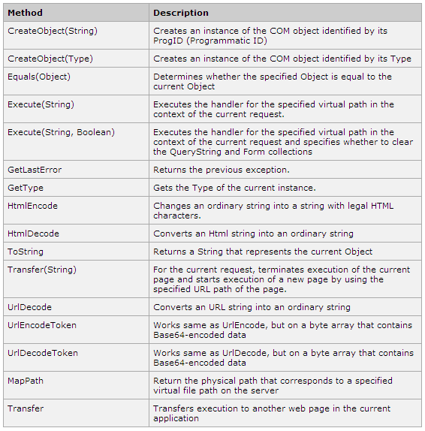
Methods of the Server Object

Slide 30
Request Object
An instance of the System.Web.HttpRequest class.
  It represents the values and properties of the HTTP request that makes the page loading into the browser.
  The information presented by this object is wrapped up by the higher level abstractions (the web control model), however, this object helps in checking some information like the client browser and cookies.

Slide 31
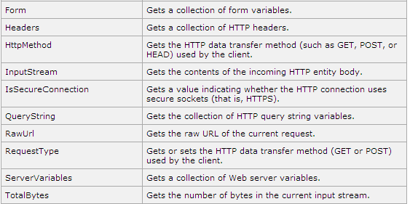
Properties of Request Object..

Slide 32
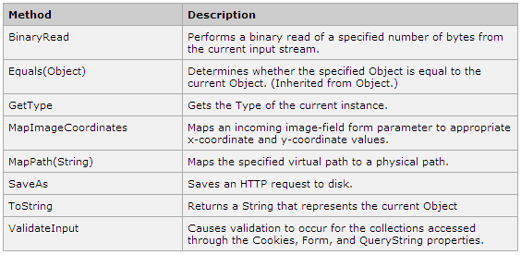
Methods of the Request Object

Slide 33
Response Object
Represents the server's response to the client request.
  It is an instance of the System.Web.HttpResponse class.
In ASP.Net, the Response object does not play a vital role in sending HTML text to the client, because the server-side controls have nested, object oriented methods for rendering themselves.

Slide 34
Response Object..
The HttpResponse object still provides some important functionalities, like the cookie feature and the Redirect() method.
The Response.Redirect() method allows transferring the user to another page, inside as well as outside the application.
  It requires a round trip.

Slide 35
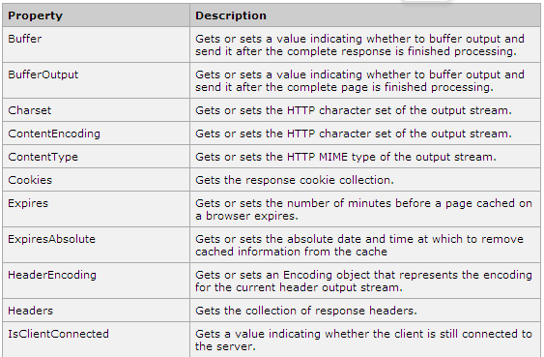
Properties of Response Object

Slide 36
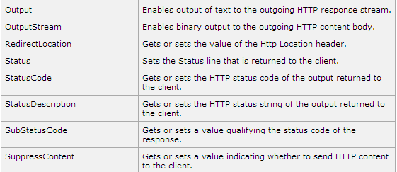
Properties of Response Object..

Slide 37
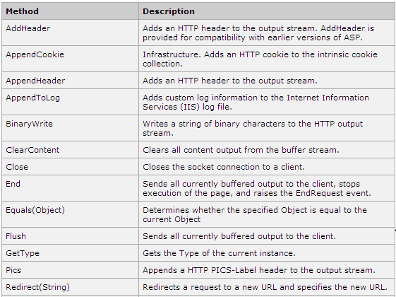
Methods of Response Object

Slide 38
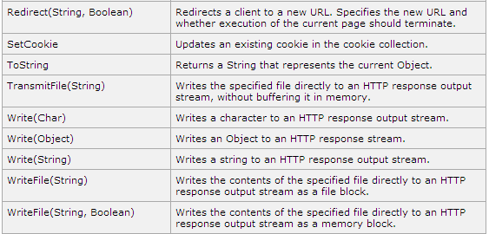
Methods of Response Object..

Slide 39
Server Side Ex
Lets see an example ..

Slide 40
Thank You

