Slide 1
Overview
of
Previous Lesson(s)

Slide 2
Over View
Programming language is an artificial language designed to communicate instructions to a machine, particularly a computer.
Types of Programming Languages
  High level languages
  Low level languages
    Assembly Language
    Machine Language
Programming Types
  Structured Programming
  Object Oriented Programming

Slide 3
Over View..
IDE
  An IDE or interactive development environment is a software application that provides comprehensive facilities to computer programmers for software development.
  An IDE normally consists of a source code editor, build automation tools and a debugger.

Slide 4
Over View…
Microsoft Visual Studio is an integrated development environment (IDE) from Microsoft Corporation.
It is used to develop console and graphical applications along with Windows Forms, Websites in both native code and with managed code.
It is supported by Microsoft Windows, Win Mobile, Win CE, .NET Framework.

Slide 5
Over View...
Our First Program
  #include <iostream.h>
  using namespace std;
  // main() is where program execution begins.
  int main()
  {
  cout << "Hello World"; // prints Hello World
  return 0;
  }

Slide 6
LESSON 03

Slide 7
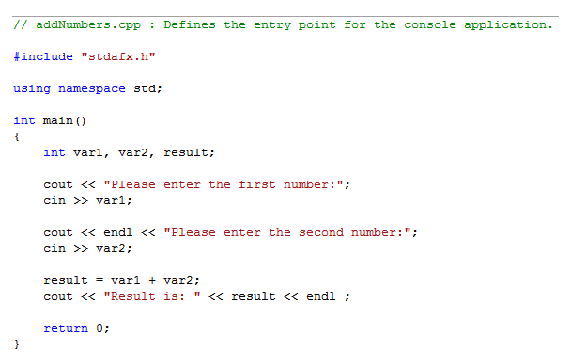
An example Program
A program which gets two values from user, add them and shows the result.

Slide 8
C++ Program
Some common elements in programming languages
  Key Words
  Programmer-Defined Identifiers
  Operators
  Punctuation
  Syntax

Slide 9
Key Words
Also known as reserved words
Have a special meaning in C++
Can not be used for any other purpose
Key words in the example program
  main
  using
  namespace
  int
  return
  cout
  cin

Slide 10
Key Words..

Slide 11
Identifiers
Programmer defined identifiers
Names made up by the programmer
Not part of the C++ language
Used to represent various things i.e variables, functions..
Identifiers used in the example program
  var1
  var2
  result

Slide 12
Rules for Identifiers
The first character of an identifier must be an alphabetic character or and underscore ( _ )
After the first character you may use alphabetic characters, numbers, or underscore characters.
Upper- and lowercase characters are distinct

Slide 13
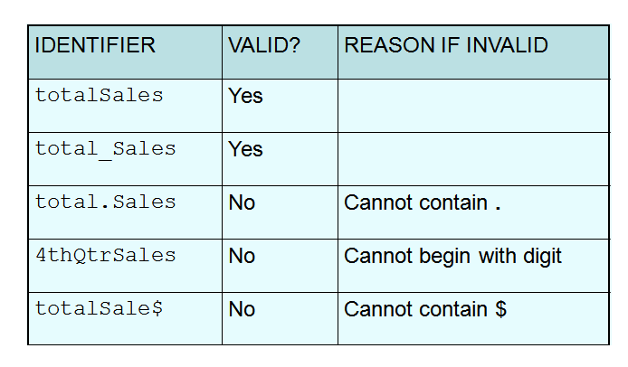
Identifiers..
Some examples of valid and Invalid Identifiers

Slide 14
Identifiers..

Slide 15
Operators
Used to perform arithmetic, logical etc operations on data.
Many types of operators
  Arithmetic + - * / %
  Logical || & !
  Assignment =
  Conditional ?
  Increment ++
  Decrement --
Operators used in the example program
  + = << >>

Slide 16
Operators..

Slide 17
Punctuation
Characters that mark the end of the program.
Characters that separate items in the list.
types of punctuation marks
  ,
  ;
Punctuation used in the example program
  ,
  ;

Slide 18
Punctuation..

Slide 19
Syntax
The rules of grammar that must be followed when writing a program.
Controls the use of key words, operators, programmer-defined symbols, and punctuation.

Slide 20
Variables
A variable is a named storage location in the computer’s memory for holding a piece of data.
To create a variable in a program you must write a variable definition (also called a variable declaration)
A variable holds a specific type of data.
The variable definition specifies the type of data a variable can hold, and the variable name.
Here is the statement from our example program that defines the variables:
int var1, var2, result;

Slide 21
Data Types
While doing programming in any programming language, you need to use various variables to store various information.
Variables are nothing but reserved memory locations to store values.
You may like to store information of various data type like character, wide character, integer, floating point, double floating point, boolean etc.
Based on the data type of a variable, the operating system allocates memory and decides what can be stored in the reserved memory.

Slide 22
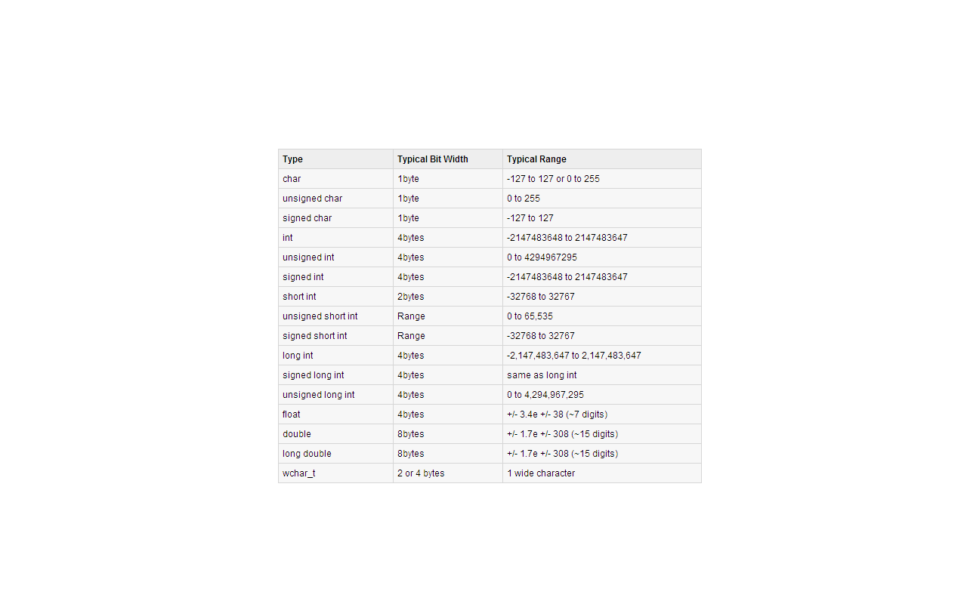
Data Types..

Slide 23
Installation of Visual Studio 2008

Slide 24
Input, Processing, and Output
Three steps that a program typically performs:
  Gather input data:
    from keyboard
    from files on disk drives
  Process the input data
  Display the results as output:
    send it to the screen
    write to a file

Slide 25
Parts of Program
// sample C++ program Comment
#include <iostream> Pre processor directive
using namespace std; Which namespace to use
int main() Main function beginning
{ beginning of block for main
cout << "Hello, there!";
return 0;
} ending of block for main

Slide 26
Include Directive
Inserts the contents of another file into the program
This is a preprocessor directive, not part of C++ language
#include lines not seen by compiler
Do not place a semicolon at end of #include line

Slide 27
Cout Object
Displays output on the computer screen
You use the stream insertion operator << to send output to cout:
  cout << "Programming is fun!";
Can be used to send more than one item to cout:
  cout << "Hello " << "there!";
  Or:
  cout << "Hello ";
  cout << "there!";

Slide 28

New Line
The endl Manipulator
  cout << "Programming is “<< endl << “fun!";
You can also use the \n escape sequence to start a new line of output.
cout << "Programming is \n fun!";
Programming is
fun!

Slide 29
Thank You

