Slide 1
LESSON 28

Slide 2
Overview
of
Previous Lesson(s)

Slide 3
Over View
Microsoft Foundation Classes (MFC)
  A set of predefined classes upon which Windows programming with Visual C++ is built.
  Represents an oo approach to Windows programming that encapsulates the Windows API.
  MFC does not adhere strictly to the object – oriented principles of encapsulation and data hiding.

Slide 4
Over View..
A document
  A document is the collection of data in our application with which the user interacts.
  A document object can have many view objects.
A view
  Each view object can provide a different presentation of the document data or a subset of the same data.

Slide 5
Over View...
SDI and MDI programs
  The Application Wizard can generate single-document interface (SDI) applications that work with a single document and a single view.
  Multiple - document interface (MDI) programs that can handle multiple documents with multiple views simultaneously.

Slide 6
Over View…
A view is an object that provides a mechanism for displaying some or all of the data stored in a document.
  It defines how the data is to be displayed in a window
  How the user can interact with it.
  Application view class be derived from the MFC class Cview.
  The window in which a view appears is called a frame window.

Slide 7
Over View…
MFC incorporates a mechanism for integrating
  A document with its views &
  Each frame window with a currently active view.
A document object automatically maintains a list of pointers to its associated views.
  A view object has a data member holding a pointer to the document that relates to it.

Slide 8
TODAY’S LESSON

Slide 9
Contents
Executable Code for MFC program
Creating MFC Applications
Creating an Executable Module
MDI Applications

Slide 10
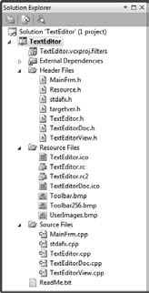
Project Files
19 files shown in the project, excluding ReadMe.txt.
Can view the contents of any of the file.
Contents of the file selected are displayed in the Editor window.

Slide 11
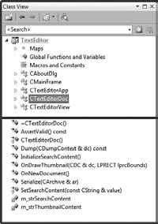
Viewing Classes
CTextEditorDoc shows the Class View pane in its docked state

Slide 12
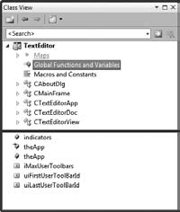
Viewing Classes..
Select Global Functions and Variables.
The application object, theApp , appears twice
  There is an extern statement for theApp in TextEditor.h and the definition for theApp is in TextEditor.cpp .
  Double - click either of the appearances of theApp in Class View, it will leads to the corresponding statement.

Slide 13
Viewing Classes..
Indicators is an array of indicators recording the status of
  caps lock
  num lock
  scroll lock
The remaining three variables relate to the management of the toolbars in the application

Slide 14
Class Definitions
CTextEditorApp //Definition of this class
// TextEditor.h : main header file for the TextEditor application
#pragma once
#ifndef __AFXWIN_H__
#error "include 'stdafx.h' before including this file for PCH"
#endif
#include "resource.h" // main symbols
class CTextEditorApp : public CWinAppEx
{
public:
CTextEditorApp();

Slide 15
Class Definitions..
// Overrides
public:
virtual BOOL InitInstance();
// Implementation
BOOL m_bHiColorIcons;
virtual void PreLoadState();
virtual void LoadCustomState();
virtual void SaveCustomState();
afx_msg void OnAppAbout();
DECLARE_MESSAGE_MAP()
};
extern CTextEditorApp theApp;

Slide 16
Description
The CTextEditorApp class derives from CWinAppEx.
  A constructor
  A virtual function InitInstance()
  A function OnAppAbout()
  3 functions concerned with dealing with the application state

Slide 17
Description..
A macro DECLARE_MESSAGE_MAP()
  It is concerned with defining which Windows messages are handled by which function members of the class.
  The macro appears in the definition of any class that process Windows messages.

Slide 18
Frame Window
The application frame window for SDI program is created by an object of the class CMainFrame
class CMainFrame : public CFrameWndEx
{
protected: // create from serialization only
CMainFrame();
DECLARE_DYNCREATE(CMainFrame)
// Attributes
public:
// Overrides
public:
virtual BOOL PreCreateWindow(CREATESTRUCT & cs);
virtual BOOL LoadFrame(UINT nIDResource, DWORD dwDefaultStyle =
WS_OVERLAPPEDWINDOW | FWS_ADDTOTITLE, CWnd* pParentWnd = NULL, CCreateContext* pContext = NULL);

Slide 19
Frame Window..
  // Implementation
  public:
  virtual ~CMainFrame();
  #ifdef _DEBUG
  virtual void AssertValid() const;
  virtual void Dump(CDumpContext & dc) const;
  #endif
  protected: // control bar embedded members
  CMFCMenuBar m_wndMenuBar;
  CMFCToolBar m_wndToolBar;
  CMFCStatusBar m_wndStatusBar;
  CMFCToolBarImages m_UserImages;
  // Generated message map functions
  protected:
  afx_msg int OnCreate(LPCREATESTRUCT lpCreateStruct);
  afx_msg void OnViewCustomize();
  afx_msg LRESULT OnToolbarCreateNew(WPARAM wp, LPARAM lp);
    DECLARE_MESSAGE_MAP()
  };

Slide 20
Description
Parent class is CFrameWndEx which provides most of the functionality required for our application frame window.
  Derived class includes 4 protected data members
m_wndMenuBar
CMFCMenuBar
m_wndToolBar
CMFCToolBar
m_wndStatusBar
CMFCStatusBar
m_UserImages
CMFCToolBarImages

Slide 21
Description..
The first three of these objects create and manage
  Menu bar
  Toolbar that provides buttons to access standard menu functions
  Status bar that appears at the bottom of the application window.
The fourth objects hold the images that are to appear on toolbar buttons.

Slide 22
Document Class
Definition of the CTextEditorDoc class
class CTextEditorDoc : public CDocument
{
protected: // create from serialization only
CTextEditorDoc();
DECLARE_DYNCREATE(CTextEditorDoc)
// Attributes
public:
// Operations
public:

Slide 23
Document Class..
// Overrides
public:
virtual BOOL OnNewDocument();
virtual void Serialize(CArchive & ar);
#ifdef SHARED_HANDLERS
virtual void InitializeSearchContent();
virtual void OnDrawThumbnail(CDC & dc, LPRECT lprcBounds);
#endif // SHARED_HANDLERS
// Implementation
public:
virtual ~CTextEditorDoc();
#ifdef _DEBUG
virtual void AssertValid() const;
virtual void Dump(CDumpContext & dc) const;
#endif

Slide 24
Document Class…
protected:
// Generated message map functions
protected:
DECLARE_MESSAGE_MAP()
#ifdef SHARED_HANDLERS
// Helper function that sets search content for a Search Handler
void SetSearchContent(const CString & value);
#endif // SHARED_HANDLERS
#ifdef SHARED_HANDLERS
private:
CString m_strSearchContent;
CString m_strThumbnailContent;
#endif // SHARED_HANDLERS
};

Slide 25
Description
DECLARE_DYNCREATE() macro enables an object of the class to be created dynamically by synthesizing it from data read from a file.
Saving an SDI document object, the frame window that contains the view is saved along with data.
Reading and writing a document object to a file is supported by a process called serialization

Slide 26
Description..
Serialization
  It is a process of taking an object and converting into a form so that it can be transported across the network or can be persisted in the storage location.
  This storage location can be physical file or a database or a Cache.
  The form contains the state of the object so that by this format, we can construct the same object a later point in time, which is called Deserialization.

Slide 27
View Class
The view class in our SDI application is defined as
class CTextEditorView : public CEditView
{
protected: // create from serialization only
CTextEditorView();
DECLARE_DYNCREATE(CTextEditorView)
// Attributes
public:
CTextEditorDoc* GetDocument() const;
// Operations
public:

Slide 28
View Class..
// Overrides
public:
virtual BOOL PreCreateWindow(CREATESTRUCT & cs);
protected:
virtual BOOL OnPreparePrinting(CPrintInfo* pInfo);
virtual void OnBeginPrinting(CDC* pDC, CPrintInfo* pInfo);
virtual void OnEndPrinting(CDC* pDC, CPrintInfo* pInfo);
// Implementation
public:
virtual ~CTextEditorView();
#ifdef _DEBUG
virtual void AssertValid() const;
virtual void Dump(CDumpContext & dc) const;
#endif

Slide 29
Class View…
protected:
// Generated message map functions
protected:
afx_msg void OnFilePrintPreview()
afx_msg void OnRButtonUp(UINT nFlags, CPoint point);
afx_msg void OnContextMenu(CWnd* pWnd, CPoint point);
DECLARE_MESSAGE_MAP()
};
#ifndef _DEBUG // debug version in TextEditorView.cpp
inline CTextEditorDoc* CTextEditorView::GetDocument() const
{ return reinterpret_cast < CTextEditorDoc* > (m_pDocument); }
#endif

Slide 30
Description
View class is derived from the class CEditView
  It already includes basic text handling facilities.
  The GetDocument() function returns a pointer to the document object corresponding to the view.
    It will be used to access data in the document object when we add our own extensions to the view class

Slide 31
Executable Module
2 implementations of the CTextEditorView class member function GetDocument()
  One in the .cpp file for the CEditView class is used for the debug version of the program.
  This is used during program development.

Slide 32
Executable Module..
For release version it is placed after the class definition in the TextEditorView.h file.
  This version is declared as inline and it does not validate the document pointer.
The GetDocument() function provides a link to the document object.
  Can call any of the functions in the interface to the document class using the pointer to the document that the function returns.

Slide 33
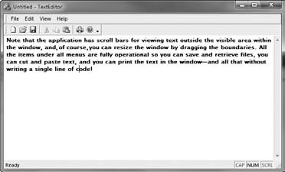
Result

Slide 34
Crux
We can sum up the operation of the application to 4 steps:
  Creating an application object, theApp .
  Executing WinMain() , which is supplied by MFC.
  WinMain() calling InitInstance() , which creates the document template, the main frame window, the document, and the view.
  WinMain() calling Run() , which executes the main message loop to acquire and dispatch Windows messages.

Slide 35
MDI Application
Now we will create MDI application using the MFC Application Wizard.
Project name Sketcher
Few differences as compared to SDI application.

Slide 36
MDI Application..
For the Application type group of options:
  Leave the default option, Multiple documents, but opt out of Tabbed documents.
  Select MFC standard as the project style and Windows Native/Default as the Visual style and colors option.
  Keep the Use Unicode libraries option.

Slide 37
MDI Application…
Under the Document Template Properties set of options in the Application Wizard dialog box
  Specify the file extension as ske.
  Change the Generated Classes set of options at their default settings so that the base class for the CSketcherView class is CView

Slide 38
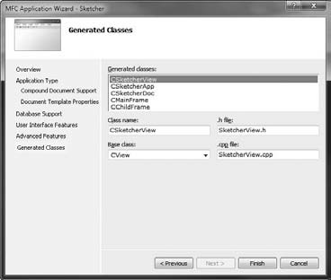
MDI Application…
An extra class for our Application compared with the TextEditor example

Slide 39
MDI Application…
The extra class is CChildFrame derived from the MFC class CMDIChildWndEx
  This class provides a frame window for a view of the document that appears inside the application window created by a CMainFrame object.
  With an SDI application, there is a single document with a single view, so the view is displayed in the client area of the main frame window.

Slide 40
MDI Application…
In an MDI application, you can have multiple documents open, and each document can have multiple views.
To accomplish this, each view of a document in the program has its own child frame window created by an object of the class CChildFrame

Slide 41
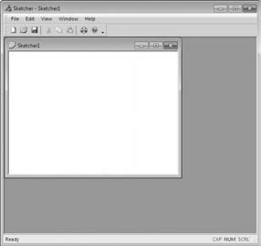
Running the Program
Build the program in exactly the same way as the previous example.

Slide 42
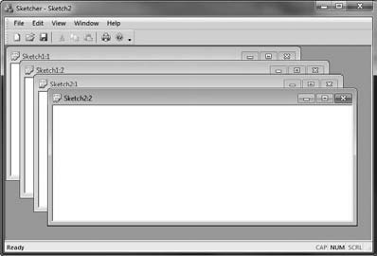
Running the Program
For Multiple Documents it will be like this

Slide 43
Thank You

