Slide 1
LESSON 27

Slide 2
Overview
of
Previous Lesson(s)

Slide 3
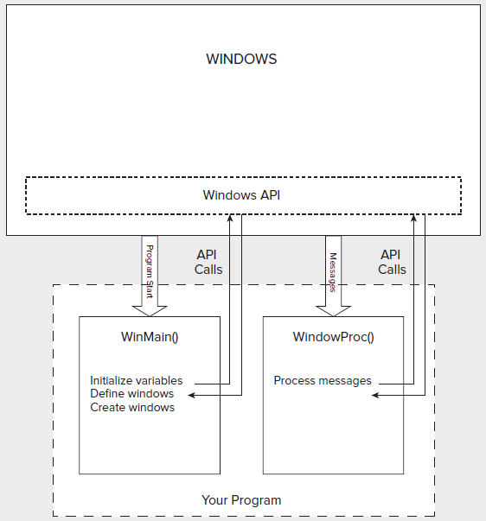
Over View
Program

Slide 4
Over View..
Microsoft Foundation Classes (MFC)
  A set of predefined classes upon which Windows programming with Visual C++ is built.
  Represents an oo approach to Windows programming that encapsulates the Windows API.
  MFC does not adhere strictly to the object – oriented principles of encapsulation and data hiding.

Slide 5
Over View…
Windows Form
  An entity that represents a window of some kind.
  A Windows form is encapsulated by a subclass of the System::Windows::Forms::Form class.
  Lets try a Message box with previous Form ..

Slide 6
TODAY’S LESSON

Slide 7
Contents
Basic Elements of MFC program
Documents
View
Document Templates
Creating MFC Applications

Slide 8
Basic Elements of MFC
The structure of an MFC program incorporates two application - oriented entities.
  A document
  A view

Slide 9
What is a document ??
A document is the collection of data in our application with which the user interacts.
It could be a data for
  A game
  A geometric model,
  A text file or anything we want.

Slide 10
What is a document..
Document class is derived from the CDocument class in the MFC library.
Application is not limited to a single document type.
  We can define multiple document classes when there are several different kinds of documents involved in application.

Slide 11
Document Interfaces
The Single Document Interface (SDI), is supported by the MFC library for programs that require only one document to be open at a time.
  A program using this interface is referred to as an SDI application.
MDI is used for programs needing several documents to be open at one time.

Slide 12
MDI
MDI manages to handle
  Multiple documents of one type.
  Documents of different types simultaneously with each document displayed in its own window.
  Each document is displayed in a child window of the application window.

Slide 13
View
A view is an object that provides a mechanism for displaying some or all of the data stored in a document.
  It defines how the data is to be displayed in a window
  How the user can interact with it.
  Application view class be derived from the MFC class Cview.
  The window in which a view appears is called a frame window.

Slide 14
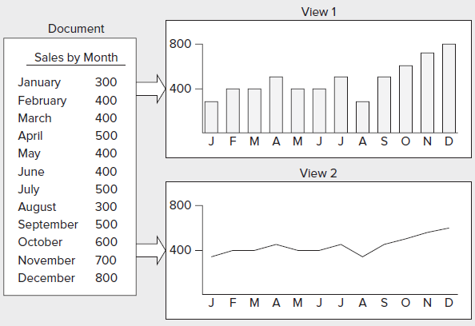
Views

Slide 15
What is a View..
A document object can have many view objects.
  Each view object can provide a different presentation of the document data or a subset of the same data.
  For a program handling graphical data,
    We could display all of the document data at different scales in separate windows, and also in different formats.

Slide 16
Linking
MFC incorporates a mechanism for integrating
  A document with its views &
  Each frame window with a currently active view.
A document object automatically maintains a list of pointers to its associated views.
  A view object has a data member holding a pointer to the document that relates to it.

Slide 17
Linking..
Each frame window stores a pointer to the currently active view object.
The coordination among a document, a view, and a frame window is established by another MFC class of objects called document templates.
Document
Frame
View

Slide 18
Document Templates
A Document template manages
  The document objects.
  The windows frames &
  The views associated with each of them.
One document template for each type of document.

Slide 19
Over View…
Document Templates
  One document template is required for two or more documents of the same type.
  A document template object creates
    Document objects.
    Frame window objects.
    Views of a document are created by a frame window object.

Slide 20
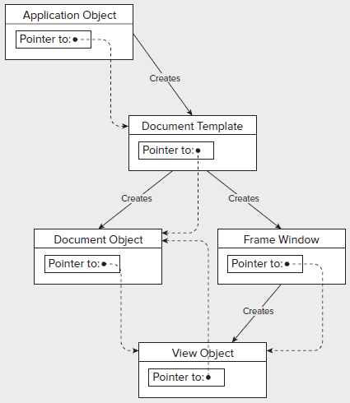
Document Templates..

Slide 21
Document Template Classes
MFC has two classes for defining document templates.
For SDI applications
  CSingleDocTemplate
  Has only one document and usually just one view.
For MDI applications
  CMultiDocTemplate
  Have multiple documents active at one time, so many views.

Slide 22
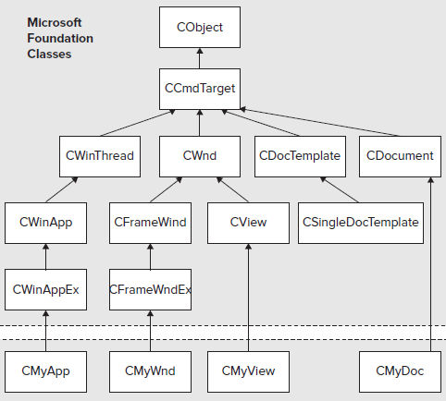
Our Application & MFC
Our Application Classes

Slide 23
Over View…
MFC provides several variations of the view class that provide a lot of functionality prepackaged.
  Standard MFC class CSingleDocTemplate usually suffices in an SDI program.
  For MDI program, our document template class is CMultiDocTemplate, which is also derived from CDocTemplate

Slide 24
MFC Application
For development we will use 4 primary tools.
  Application Wizard for creating the basic application program code.
  Project context menu in ClassView to add new classes and resources.
  Class context menu in ClassView for extending and customizing the existing classes.
  Resource Editor for creating or modifying objects as menus and toolbars.

Slide 25
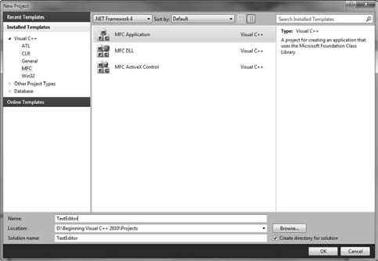
MFC Application..

Slide 26
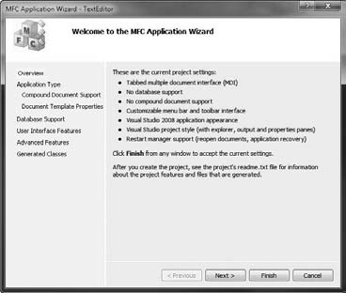
MFC Application...

Slide 27
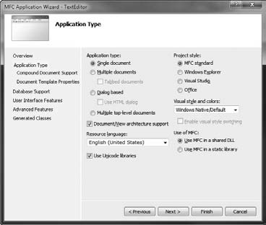
SDI Application

Slide 28
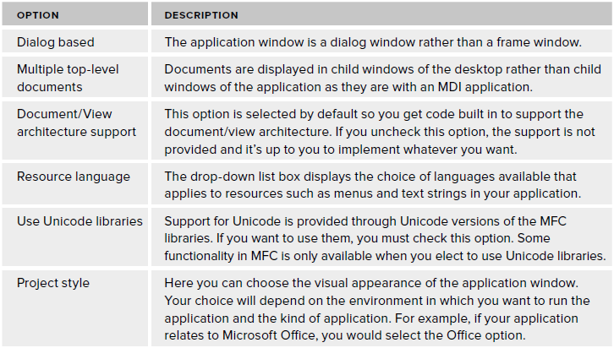
SDI Application..

Slide 29
SDI Application…
MFC library as a shared DLL .
  Reduces the size of the executable file.
  Requires the MFC DLL to be on the machine that ’ s running it.
  The two modules together (.exe module and the MFC .dll ) may be bigger than statically linked the MFC library.

Slide 30
SDI Application…
Static linking.
  MFC library routines are included in the executable module for program when it is built.
  Statically linked applications run slightly faster.
Tradeoff between memory usage and speed of execution

Slide 31
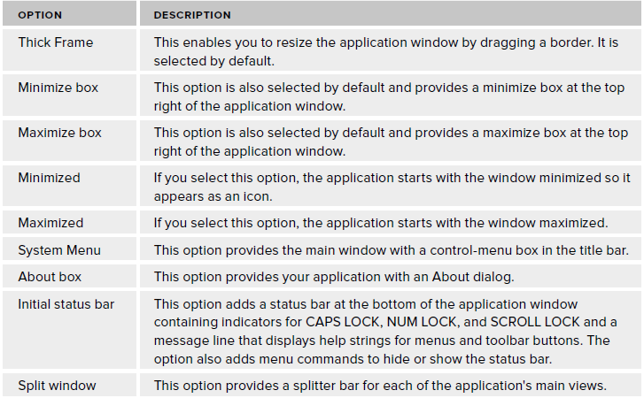
SDI Application…
User Interface Features

Slide 32
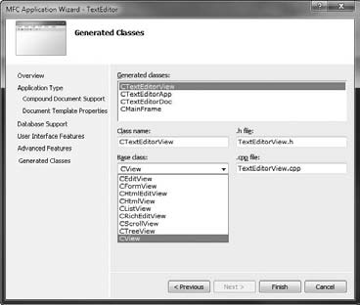
SDI Application…
Generated Classes

Slide 33
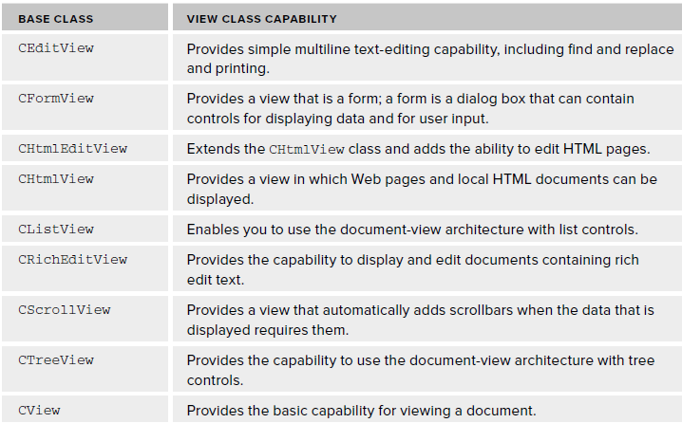
View Classes
View Classes capabilities depends on the base class

Slide 34
Wizard Output
All the program files generated by the Application Wizard are stored in the TextEditor project folder.
  Subfolder to the solution folder with the same name.
There are also resource files in the res subfolder to the project folder.
The IDE provides several ways to view the information relating to project.

Slide 35
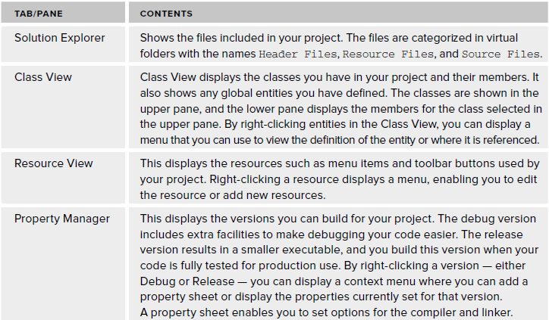
Wizard Output..

Slide 36
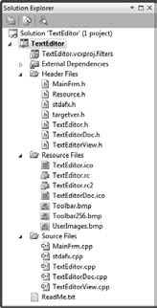
Project Files
19 files shown in the project, excluding ReadMe.txt.
Can view the contents of any of the file.
Contents of the file selected are displayed in the Editor window.

Slide 37
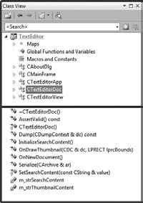
Viewing Classes
CTextEditorDoc shows the Class View pane in its docked state

Slide 38
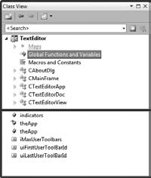
Viewing Classes..
Select Global Functions and Variables.
The application object, theApp , appears twice
  There is an extern statement for theApp in TextEditor.h and the definition for theApp is in TextEditor.cpp .
  Double - click either of the appearances of theApp in Class View, it will leads to the corresponding statement.

Slide 39
Viewing Classes..
Indicators is an array of indicators recording the status of
  caps lock
  num lock
  scroll lock
The remaining three variables relate to the management of the toolbars in the application

Slide 40
Code
These are all files for this project.
Will discuss it next time…

Slide 41
Thank You

