Slide 1
LESSON 26

Slide 2
Overview
of
Previous Lesson(s)

Slide 3
Over View
Windows Programming
  WinMain()
    Where execution of the program begins and basic program initialization is carried out.
  WndProc()
    Called by Windows to process messages for the application.
    Contains the larger portion of code deals in responding to messages caused by user input of one kind or another.

Slide 4
Over View..
1st we have to define the type of window we want to create.
  Windows defines a special struct type
  WNDCLASSEX
  It contains the data specified by a window.

Slide 5
WNDCLASSEX
struct WNDCLASSEX
{ UINT cbSize; // Size of this object in bytes
UINT style; // Window style
WNDPROC lpfnWndProc; // Pointer to message processing function
int cbClsExtra; // Extra bytes after the window class
int cbWndExtra; // Extra bytes after the window instance
HINSTANCE hInstance; // The application instance handle
HICON hIcon; // The application icon
HCURSOR hCursor; // The window cursor
HBRUSH hbrBackground; // The brush defining the background color
LPCTSTR lpszMenuName; // A pointer to the name of the menu
LPCTSTR lpszClassName; // A pointer to the class name
HICON hIconSm; // A small icon associated with the window
};

Slide 6
Over View…
2nd step is to tell Windows about our defined structure.
This is done using the Windows API function RegisterClassEx()
RegisterClassEx(&WindowClass);

Slide 7
Over View…
Each instance of the application must make sure that it registers the window classes that it needs.
CreateWindow() function is now used for creating a window whom characteristics are already known.

Slide 8
Over View…
The last task that WinMain() needs to do is dealing with the messages that Windows may have queued for our application.
  2 kinds of Win messages
Queued Messages
  Windows places in a queue and WinMain() function extract these messages from the queue for processing.
  The code in WinMain() that does this is called the message loop.

Slide 9
Over View…
Non - Queued Messages
  There are non - queued messages that result in the WndProc() function being called directly by Windows.
  A lot of the non - queued messages arise as a consequence of processing queued messages.

Slide 10
Over View…
Message Processing
WinMain() contained nothing that was application - specific beyond the general appearance of the application window.
WndProc()
  Windows calls this function each time a message for your main application window is dispatched.

Slide 11
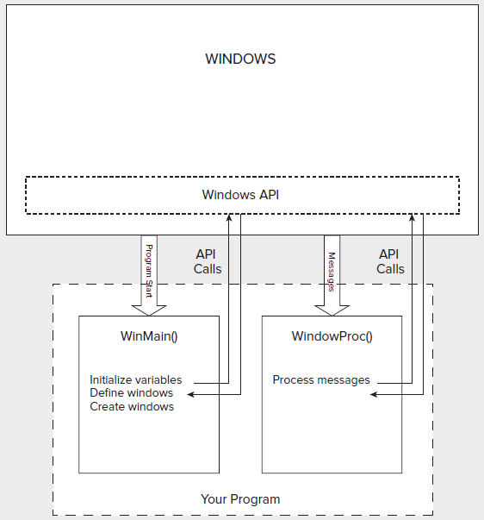
Over View…
Program

Slide 12
TODAY’S LESSON

Slide 13
Contents
MFC
Notation
Program Structure
Windows Forms

Slide 14
MS Foundation Classes
The Microsoft Foundation Classes (MFC) are a set of predefined classes upon which Windows programming with Visual C++ is built.
  Represent an oo approach to Windows programming that encapsulates the Windows API.
  MFC does not adhere strictly to the object – oriented principles of encapsulation and data hiding.

Slide 15
MS Foundation Classes..
The process of writing a Windows program involves creating and using MFC objects or objects of classes derived from MFC.
In the main part, we derive our own classes from MFC.
  Assistance from the specialized tools in Visual C++.

Slide 16
MS Foundation Classes..
The objects of these MFC class types incorporate member functions
  For communicating with Windows,
  For processing Windows messages
  For sending messages to each other.

Slide 17
MS Foundation Classes..
These derived classes, inherit all of the members of their base classes.
  So we simply need to do is
    Add data members
    Function members to customize the classes to provide the application - specific functionality.

Slide 18
MFC Notation
All the classes in MFC have names beginning with C.
  Ex. CDocument or Cview
  So we will use this notation in our customized classes as well.
Data members of an MFC class are prefixed with m_ .

Slide 19
Program Structure
#include < afxwin.h > // For the class library
  It contains the definitions for many MFC classes.
  Allows to derive our own classes from MFC.
We only need to derive two classes from MFC:
  Application class
  Window class

Slide 20
Program Structure..
Application class
  The class CWinApp is fundamental to any Windows program written using MFC.
  An object of this class includes everything necessary for starting, initializing, running, and closing the application.
  We need to produce the application to derive our own application class from CWinApp

Slide 21
Program Structure...
class COurApp: public CWinApp
{
public:
virtual BOOL InitInstance();
};
  This function is defined as a virtual function in the base class.
  Simply redefining it.
  All the other data and function members inherited from CWinApp unchanged.

Slide 22
Program Structure...
Window class
  Frame Window
    MFC application needs a window as the interface to the user.
  So we derive a window class from the MFC class CFrameWnd
    CFrameWnd class provides everything for creating and managing a window.

Slide 23
Program Structure...
class COurWnd: public CFrameWnd
{
public:
// Constructor
COurWnd()
{
Create(0, L"Our Dumb MFC Application");
}
};
  The Create() function that in the constructor is inherited from the base class.
  It creates the window and attaches it to the COurWnd object that is being created.

Slide 24
Program Structure...
  The 1st argument value for the Create() function, 0, specifies the base class default attributes.
  The 2nd argument specifies the window name that is used in the window title bar.

Slide 25
Completing Program
Having defined a window class for the application, InitInstance() function in COurApp class
BOOL COurApp::InitInstance(void)
{
// Construct a window object in the free store
m_pMainWnd = new COurWnd;
m_pMainWnd- > ShowWindow(m_nCmdShow);
// ...and display it
return TRUE;
}

Slide 26
Completing Program..
  The InitInstance() function constructs a main window object for the application by using the operator new.
  Stores the address that is returned in the variable m_pMainWnd, which is an inherited member of class COurApp
An instance of our application class COurApp must exist before Main() is executed
COurApp AnApplication; // Define an application object

Slide 27
Program
Lets check the code..

Slide 28
Window Forms
A Windows form is an entity that represents a window of some kind.
A Windows form is encapsulated by a subclass of the System::Windows::Forms::Form class.
  To see just how easy it’s going to be, we create a basic window using Windows Forms that has a standard menu.

Slide 29
Program
Lets check the code..

Slide 30
Thank You

