Slide 1
LESSON 25

Slide 2
Overview
of
Previous Lesson(s)

Slide 3
Over View
Visual C++ provides us with 3 basic ways of creating an interactive Windows application
  Using the Windows API
  Using the Microsoft Foundation Classes.
  Using Windows Forms.

Slide 4
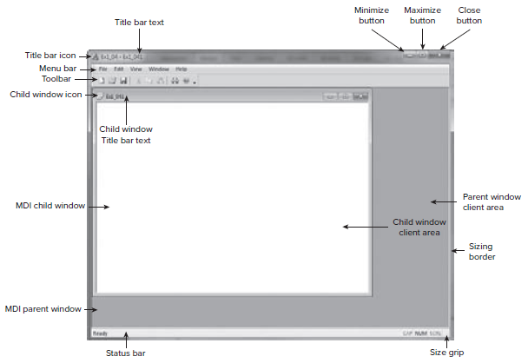
Over View..

Slide 5
Over View…
A Windows program is mostly event – driven.
Events in a Windows application are occurrences.
  Clicking the mouse.
  Pressing a key.
  Message queue for an application is just a sequence of such messages waiting to be processed by the application.

Slide 6
Over View…
  WndProc() is the function we can use to sending the messages to our applications.
    Windows accesses the function through a pointer to a function.
  DefWindowProc() is used to pass a message back to Windows.
    Provides default message processing.

Slide 7
Over View…
  WinMain()
    Where execution of the program begins and basic program initialization is carried out.
  WndProc()
    Called by Windows to process messages for the application.
    Contains the larger portion of code deals in responding to messages caused by user input of one kind or another.

Slide 8
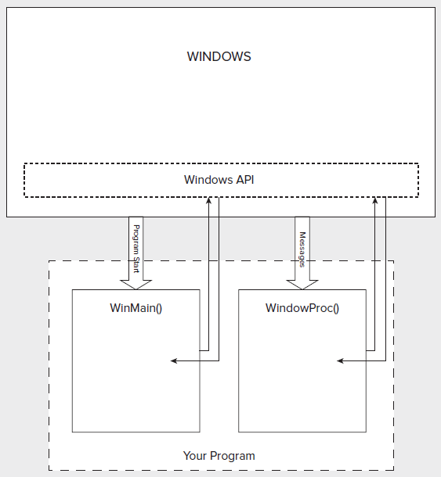
Over View...

Slide 9
TODAY’S LESSON

Slide 10
Contents
Specifying a Program Window
Creating a Program Window
Dealing with Windows Messages
WinMain()
Message Processing Functions
  The WndProc() Function
  Decoding a Windows Message
WndProc()
Program Organization

Slide 11
Specifying a Program Win
1st we have to define the type of window we want to create.
  Windows defines a special struct type
  WNDCLASSEX
  It contains the data specified by a window.

Slide 12
WNDCLASSEX
struct WNDCLASSEX
{ UINT cbSize; // Size of this object in bytes
UINT style; // Window style
WNDPROC lpfnWndProc; // Pointer to message processing function
int cbClsExtra; // Extra bytes after the window class
int cbWndExtra; // Extra bytes after the window instance
HINSTANCE hInstance; // The application instance handle
HICON hIcon; // The application icon
HCURSOR hCursor; // The window cursor
HBRUSH hbrBackground; // The brush defining the background color
LPCTSTR lpszMenuName; // A pointer to the name of the menu
LPCTSTR lpszClassName; // A pointer to the class name
HICON hIconSm; // A small icon associated with the window
};

Slide 13
WNDCLASSEX..
WNDCLASSEX WindowClass; // Create a window class object
Now we simply need to fill the values for the members of WindowClass
  Setting the value for the cbSize member of the struct is easy when you use the sizeof operator:
WindowClass.cbSize = sizeof(WNDCLASSEX);
  The style member of the struct determines various aspects of the window’s behavior.
  WindowClass.style = CS_HREDRAW | CS_VREDRAW;

Slide 14
WNDCLASSEX..
WNDPROC lpfnWndProc; // Pointer to message processing function
  It stores a pointer to the function in our program that handles messages for the created window.
cbClsExtra and cbWndExtra allows to ask that extra space be provided internally to Windows for our own use.
  Normally it is not required so they must set to zero.

Slide 15
WNDCLASSEX...
HINSTANCE hInstance; // The application instance handle
  It holds the handle for the current application instance, so we should set this to the hInstance value that was passed to WinMain() by Windows.

Slide 16
WNDCLASSEX...
HICON hIcon; // The application icon
HCURSOR hCursor; // The window cursor
HBRUSH hbrBackground;
These members are handles that defines
  Icon that represents the application when minimized.
  Cursor the window uses
  Background color of the client area of the window.
These are set using Windows API functions.
WindowClass.hIcon = LoadIcon(0, IDI_APPLICATION);
WindowClass.hCursor = LoadCursor(0, IDC_ARROW);

Slide 17
WNDCLASSEX...
The lpszMenuName member is set to the name of a resource defining the window menu, or to zero if there is no menu for the window.
The lpszClassName member of the struct stores the name that is supplied to identify this particular class of window.
  We need to keep track of this name because we will need it again when window will created.
The last member is hIconSm
  It identifies a small icon associated with the window class.

Slide 18
Creating a Program Win
2nd step is to tell Windows about our defined structure.
This is done using the Windows API function RegisterClassEx()
RegisterClassEx(&WindowClass);
  The address of the struct is passed to the function and Windows extracts all the values of the structure members.

Slide 19
Creating a Program Win
This process is called registering the window class.
  Each instance of the application must make sure that it registers the window classes that it needs.
CreateWindow() function is now used for creating a window whom characteristics are already known.

Slide 20
Creating a Program Win..
HWND hWnd; // Window handle
...
hWnd = CreateWindow(
szAppName, // the window class name
"A Basic Window the Hard Way", // The window title
WS_OVERLAPPEDWINDOW, // Window style as overlapped
CW_USEDEFAULT, // Default screen position of upper left
CW_USEDEFAULT, // corner of our window as x,y...
CW_USEDEFAULT, // Default window size, width...
CW_USEDEFAULT, // ... height
0, // No parent window
0, // No menu
hInstance, // Program Instance handle
0 // No window creation data
);

Slide 21
Creating a Program Win..
HWND hWnd; // Window handle
  The variable hWnd of type HWND is a 32 - bit integer handle to a window.
Window now exists but is not yet displayed.
So now we need to call another Win API function to get it displayed.

Slide 22
Creating a Program Win...
ShowWindow(hWnd, nCmdShow); // Display the window
  hWnd identifies the window and is the handle returned by the function CreateWindow()
  nCmdShow indicates how the window is to appear onscreen.

Slide 23
Dealing with Windows Messages
The last task that WinMain() needs to do is dealing with the messages that Windows may have queued for our application.
  2 kinds of Win messages
Queued Messages
  Windows places in a queue.
  WinMain() function extract these messages from the queue for processing.
  The code in WinMain() that does this is called the message loop.

Slide 24
Dealing with Windows Messages
Non - Queued Messages
  There are non - queued messages that result in the WndProc() function being called directly by Windows.
  A lot of the non - queued messages arise as a consequence of processing queued messages.

Slide 25
The Message Loop
Retrieving messages from the message queue is done using the message pump or message loop
MSG msg; // Windows message structure
while(GetMessage( & msg, 0, 0, 0) == TRUE) // Get any messages
{
TranslateMessage( & msg); // Translate the message
DispatchMessage( & msg); // Dispatch the message
}

Slide 26
The Message Loop..
GetMessage()
  Retrieves a message from the queue.
TranslateMessage()
  Performs any conversion necessary on the message retrieved.
DispatchMessage()
  Causes Windows to call the WndProc() function in application to deal with the message.

Slide 27
WinMain()
Lets check the code in IDE …

Slide 28
Message Processing
WinMain() contained nothing that was application - specific beyond the general appearance of the application window.
All of the code that makes the application behave in the way that we want is included in the message processing part of the program.
  WndProc()
    Windows calls this function each time a message for your main application window is dispatched.

Slide 29
WndProc()
The prototype of our WndProc() function is:
LRESULT CALLBACK WindowProc (
HWND hWnd,
UINT message,
WPARAM wParam,
LPARAM lParam);
  LRESULT is a type defined by Windows and is equivalent to type long.
  As the function is called by Windows through a pointer, so we need to qualify the function as CALLBACK

Slide 30
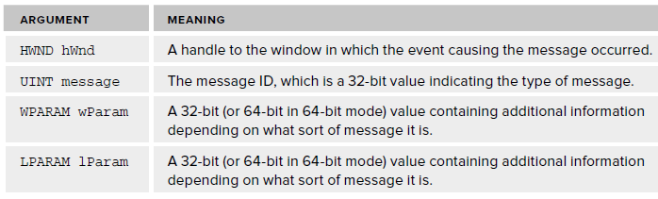
WndProc()

Slide 31
Decoding Win Message
Message that window is sending to the WndProc() needs to be decoded.
A switch statement is used for decoding in the WndProc() function.
Switch statement is something like this ..

Slide 32
Decoding Win Message
switch(message)
{
case WM_PAINT:
// Code to deal with drawing the client area
break;
case WM_LBUTTONDOWN:
// Code to deal with the left mouse button being pressed
break;
case WM_LBUTTONUP:
// Code to deal with the left mouse button being released
break;
case WM_DESTROY:
// Code to deal with a window being destroyed
break;
default:
// Code to handle any other messages
}

Slide 33
WndProc()
We will see it in IDE..

Slide 34
A Simple window Program
Already dicuss WinMain() and WndProc() to handle messages.
So we have enough to create an app Windows program just using the Windows API.
#include < windows.h >
// Insert code for WndProc()
// Insert code for WinMain()

Slide 35
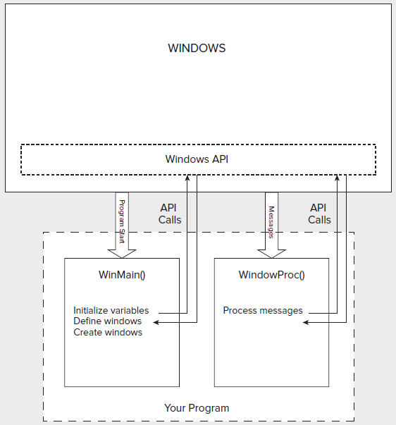
Program Organization
Program

Slide 36
Thank You

