Slide 1
LESSON 24

Slide 2
Overview
of
Previous Lesson(s)

Slide 3
Over View
Debugger
  A program that controls the execution of program code in such a way that we can step through the source code one line at a time, or run to a particular point in the program.

Slide 4
Over View
Debugger..
  Local Debugging
    Debugging process and the source code are deployed on the same machine.
  Remote Debugging
    Source program is running on a separate machine and the debugging takes place on an isolated box

Slide 5
Over View..
Debugger…
  A breakpoint is a point in our program where the debugger automatically suspends execution when in debugging mode.
  A trace-point is a special kind of breakpoint that has a custom action associated with it.

Slide 6
Over View..
assert() library function is used, that is declared in the cassert header to check logical conditions
Assertions in C++/ CLI programs
  The static Assert() function in the Debug and Trace classes provides an assertion capability in CLR programs.

Slide 7
Over View..
C++/CLI classes for debugging
  The Debug and Assert classes defined in the System::Diagnostics namespace provide functions for
    Tracing execution
    Generating debugging output in CLR programs.

Slide 8
TODAY’S LESSON

Slide 9
Contents
Windows programming basics
Elements of a window
Windows Programs and the Operating System
Event - Driven Programs
Windows Messages
The Windows API
Windows Data Types
Notation in Windows Program
Structure of a Windows Program

Slide 10
Windows Programming Concepts
In this portion we will discuss basic ideas that are involved in every Windows program in C++.
Develop a program that uses the Windows operating system API directly.
  Gives us understanding how a Windows application works behinds the scenes.
Microsoft Foundation Classes, known as the MFC.
Windows Forms

Slide 11
Windows Programming Basics
Visual C++ provides us with 3 basic ways of creating an interactive Windows application
  Using the Windows API
    This is the fundamental interface that the Windows operating system provides for communications between itself and the applications that are executing under its control.

Slide 12
Windows Programming Basics..
Using the Microsoft Foundation Classes.
  A set of C++ classes that encapsulate the Windows API.
Using Windows Forms.
  Form - based development mechanism for creating applications that execute with the CLR.
  Using Windows Forms is by far the fastest and easiest mechanism for generating an application because the amount of code that you have to write is greatly reduced compared with the other two possibilities.

Slide 13
Elements of a Window
Most probably you will inevitably be familiar with most.
Still we will see some common understanding of what the terms mean.

Slide 14
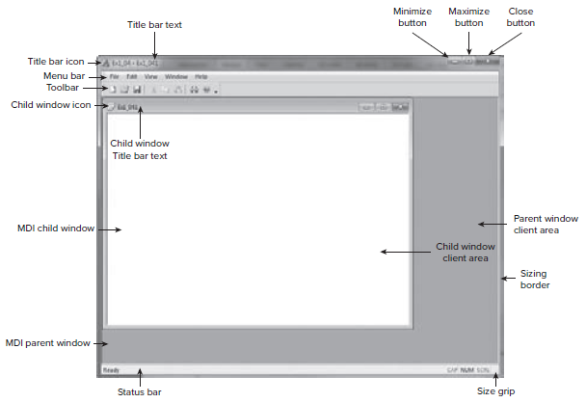
Elements of a Window..

Slide 15
Windows Program & OS
When a Programmer writes a Windows program, it is a slave to the operating system and Windows is in control.
  Program didn’t interact directly with the hardware.
  Windows – middle man role.
Why this is so.??

Slide 16
Windows Program & OS..
    Someone has to play the role of boss to manage the sharing of machine resources.
  Windows embodies a standard user interface and needs to be in charge to enforce that standard.

Slide 17
Event Driven Programs
A Windows program is mostly event - driven , so it essentially waits around for something to happen.
  A significant part of the code of a Windows application is dedicated to processing events that are caused by external actions of the user.

Slide 18
Event Driven Programs..
Events in a Windows application are occurrences.
  Clicking the mouse.
  Pressing a key.
  A timer reaching zero.
Windows operating system records each event in a message.

Slide 19
Event Driven Programs…
Windows Message
  It is simply a record of the data relating to an event.
  Message queue for an application is just a sequence of such messages waiting to be processed by the application.
By sending a message, Windows can tell our program that
  some action needs to be taken or
  an event such as a mouse click has occurred.

Slide 20
Event Driven Programs…
A Windows program must contain a function specifically for handling these messages.
  WindowProc() is the function we can use to sending the messages to our applications.
    Windows accesses the function through a pointer to a function.
  DefWindowProc() is used to pass a message back to Windows.
    Provides default message processing.

Slide 21
Windows API
All of the communications between any Windows application and Windows itself use the Windows application programming interface (API).
  100 of API’s.
  Covers all aspects of the communications between Windows and our application.

Slide 22
Windows Data Types
Windows defines a significant number of data types that are used to specify function parameter types and return types in the Windows API.
  Each of these Windows types will map to some C++ type.
  Mapping between Windows types and C++ types can change, using windows type is essential where it applies.

Slide 23
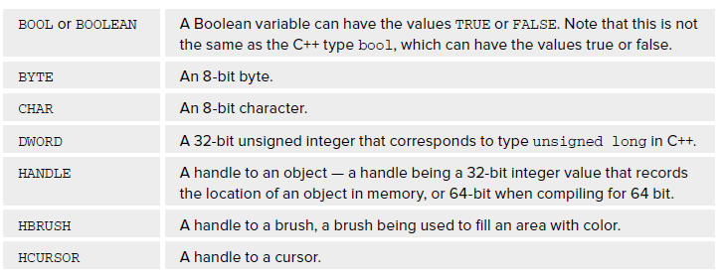
Windows Data Types..
Some of the most common win data types are

Slide 24
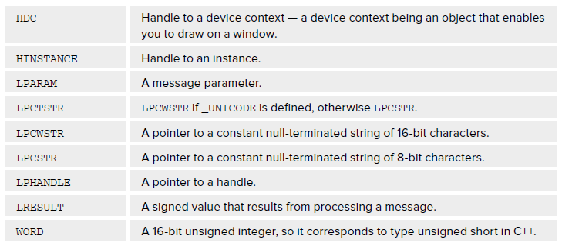
Windows Data Types…
All windows data types are contained in the header windows.h

Slide 25
Notation
In many Windows programs, variable names have a prefix.
  Indicates what is the kind of value the variable holds.
  How it will be used.
  Quite a few prefixes used in combination.
    Ex: the prefix lpfn signifies a long pointer to a function.

Slide 26
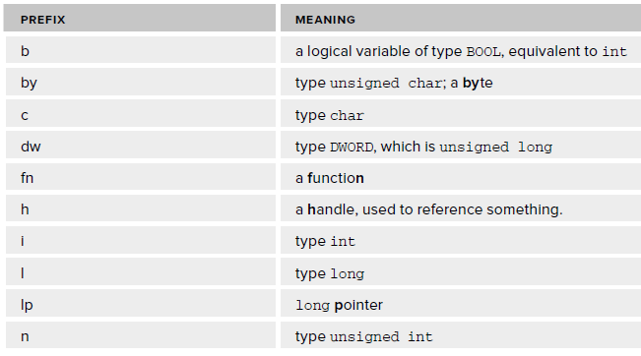
Notation..

Slide 27
Structure of a Windows Prog
A Windows program minimally contain two functions.
  WinMain()
    Where execution of the program begins and basic program initialization is carried out.
  WindowProc()
    Called by Windows to process messages for the application.
    Contains the larger portion of code deals in responding to messages caused by user input of one kind or another.

Slide 28
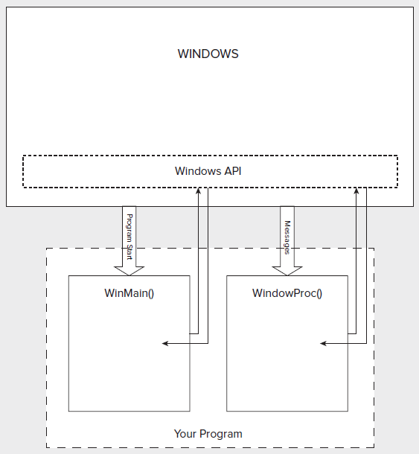
Structure of a Windows Prog..

Slide 29
Structure of a Windows Prog…
WinMain() communicates with Windows by calling some of the Windows API functions.
Same applies to WindowProc().
Integrating factor in Windows program is Windows.

Slide 30
WinMain()
The WinMain() function = main() function.
To allow Windows to pass data to it, WinMain() has four parameters and a return value of type int.
int WINAPI WinMain ( HINSTANCE hInstance,
HINSTANCE hPrevInstance,
LPSTR lpCmdLine,
int nCmdShow );

Slide 31
WinMain()..
int WINAPI
  A Windows - defined macro that causes the function name and arguments to be handled in a special way that is specific to Windows API functions.
HINSTANCE hInstance
  It is of type HINSTANCE, which is a handle to an instance.
    An instance here, a running program.
    A handle is an integer value that identifies an object.
    In this case it is instance of the application.

Slide 32
WinMain()…
HINSTANCE hPrevInstance
  It is a legacy from the 16 – bit versions of the Windows operating system, and you can safely ignore it.
  On current versions of Windows, it is always null.
LPSTR lpCmdLine
  LPSTR is another Windows type, specifying a 32 – bit pointer to a string, or 64 – bit when compiling in 64-bit mode.
  It is a pointer to a string containing the command line that started the program.

Slide 33
WinMain()…
int nCmdShow
  It determines how the window is to look when it is created.
  Ex, It could be displayed normally or it might need to be minimized.
  This argument can take one of a fixed set of values that are defined by symbolic constants such as
  SW_SHOWNORMAL
  SW_SHOWMINNOACTIVE

Slide 34
WinMain()…
To get information about all the other constants helps in specifying how a window displays can be find at MSDN.
MSDN library online
http://msdn2.microsoft.com/en-us/library/default.aspx .

Slide 35
WinMain()…
Function WinMain() in Windows program needs to do four things
  Tell Windows what kind of window the program requires
  Create the program window
  Initialize the program window
  Retrieve Windows messages intended for the program

Slide 36
Thank You

