Slide 1
LESSON 22

Slide 2
Overview
of
Previous Lesson(s)

Slide 3
Over View
Assertions
  assert() library function is declared in the cassert header to check logical conditions in native C++ program that should always be true.
_DEBUG symbol
  The preprocessor symbol DEBUG is automatically defined in the debug version of a native C++program.

Slide 4
Over View
Debugging code
  Add our own debugging code by enclosing it between an #ifdef / #endif pair of directives testing for DEBUG.
crtdbg.h header
  The crtdbg.h header supplies declarations for functions to provide debugging of free store operations.

Slide 5
Over View
_crtDbgFlag flag
  By setting the crtDbgFlag appropriately enables automatic checking of program for memory leaks.
Debug output
  To direct output messages from the free store debugging functions, we can call the CrtSetReportMode() and CrtSetReportFile() functions.

Slide 6
Over View...
Debugging Dynamic Memory
  Allocating memory dynamically is a major source of bugs.
  In this context most common bugs are memory leaks.
  Sometimes, this can result in a tragic failure of the program when all available memory has been allocated.

Slide 7
Over View...
Problem diagnosed
  Name class is allocating memory for its data members, and never releasing it.
  The problem is that in implementing the class, we forgot the fundamental rules related to classes.
Solution
  A destructor
  A copy constructor
  The assignment operator.

Slide 8
TODAY’S LESSON

Slide 9
Contents
C++ / CLI Programming
Using the Debug and Trace Classes
  Generating Output
  Setting the Output Destination
  Indenting the Output
  Controlling Output
  Assertions
  Program

Slide 10
Debugging CLI Programs
Life is simpler with C++/CLI programming.
No complications of corrupted pointers or memory leaks arise in CLR programs, so this reduces the debugging problem substantially.
  Breakpoints and tracepoints can be set exactly the same way.

Slide 11
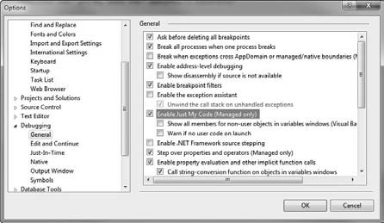
Debugging CLI Programs..
We have a specific option that applies to C++/CLI code for preventing the debugger from stepping through library code.

Slide 12
Debug & Trace Classes
The Debug and Trace classes in the System::Diagnostics namespace are used for tracing.
Same capabilities with one exception.
  Trace functions are compiled into release builds.
  Debug functions are not complied into release builds.

Slide 13
Generating Output
Debug::WriteLine() and Debug::Write() functions are used to write messages to an output destination.
Same capabilities
  Only difference is WriteLine() function writes a newline character after the output whereas the Write() function does not
They both come in four overloaded versions.

Slide 14
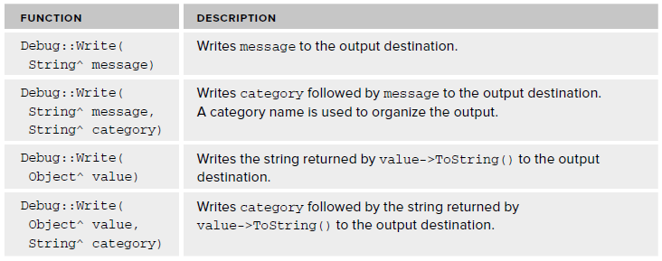
Generating Output..

Slide 15
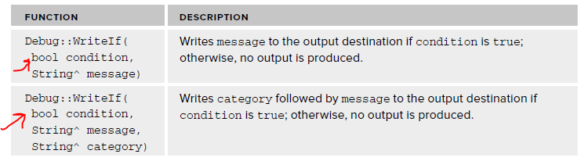
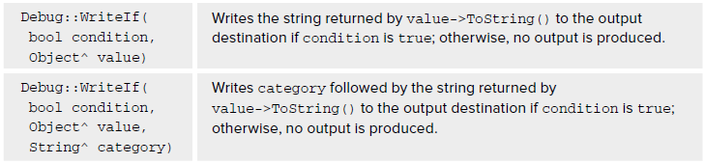
Generating Output…
Conditional versions are also available
  WriteIf() and WriteLineIf()

Slide 16
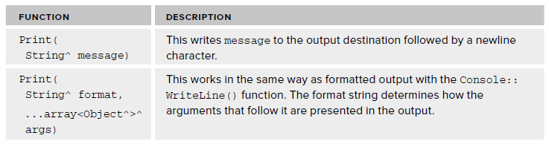
Generating Output…
Debug::Print() function can also be used for outputs.
  Comes in two overloaded versions:

Slide 17
Setting Output Destination
By default the output messages are sent to the Output window in the IDE, but it can be changed.
A listener is an object that directs debug and trace output to one or more destinations.

Slide 18
Setting Output Destination..
TextWriterTraceListener^ listener = gcnew TextWriterTraceListener( Console::Out);
It creates TextWriterTraceListener object that directs the output to the standard output stream, which is returned by the static property Out in the Console class.
Debug::Listeners- > Add(listener);
The Listeners property in the Debug class returns a collection of listeners for debug output, so the statement adds the listener object to the collection.

Slide 19
Setting Output Destination...
We could also add a ConsoleTraceListener to direct output to the console screen
ConsoleTraceListener^ myOutput = gcnew ConsoleTraceListener();
Debug::Listeners- > Add(myOutput);
Similarly other listeners can be used that additionally direct output elsewhere, i.e to a file.

Slide 20
Indenting the Output
Indenting of the debug and trace messages can be controlled.
  Effective in situations where functions are called at various depths.
  Indenting the output at the beginning of a function & removing the indent before leaving the function.

Slide 21
Indenting the Output..
To increase the current indent level for output by one.
Debug::Indent(); // Increase indent level by 1
To reduce the current indent level by one.
Debug::Unindent(); // Decrease indent level by 1
The current indent level is recorded in the static IndentLevel property in the Debug class, so we can get or set the current indent level.
Debug::IndentLevel = 2*Debug::IndentLevel;

Slide 22
Indenting the Output…
The number of spaces in one indent unit is recorded in the static IndentSize property in the Debug class.
  We can change it to a different value.
Console::WriteLine(L"Current indent unit = {0}", Debug::IndentSize);
Debug::IndentSize = 2; // Set indent unit to 2 spaces
The second statement sets it to a new value.
  Subsequent calls to Indent() increases the current indentation by the new size, which is two spaces.

Slide 23
Controlling Output
Trace switches can made the debug or trace output on and off.
  The BooleanSwitch reference class objects provides a way to switch segments of output on or off depending on the state of the switch.
  The TraceSwitch reference class objects provides with a more sophisticated control mechanism because each TraceSwitch object has four properties that correspond to four control levels for output statements.

Slide 24
Controlling Output..
public ref class MyClass
{
private:
static BooleanSwitch^ errors = gcnew BooleanSwitch(L"Error Switch", L"Controls error output");
public:
void DoIt()
{ // Code...
if(errors- > Enabled)
Debug::WriteLine(L"Error in DoIt()");
// More code...
}
// Rest of the class...
};

Slide 25
Controlling Output…
Shows the errors object as a static member of MyClass.
  The first argument to the BooleanSwitch constructor is the display name for the switch that is used to initialize the DisplayName property.
  The second argument sets the value of the Description property for the switch.
  There’s another constructor that accepts a third argument of type String^ that sets the Value property for the switch.

Slide 26
Controlling Output…
The Enabled property for a Boolean switch is of type bool.
  It is false by default.
  It can be set to ture.
errors- > Enabled = true;
The DoIt() function in MyClass outputs the debug error message only when the errors switch is enabled.

Slide 27
Controlling Output…
The TraceSwitch reference class has two constructors that have the same parameters as the BooleanSwitch class constructors.
TraceSwitch^ traceCtrl = gcnew TraceSwitch(L"Update", L"Traces update operations");
  The first argument to the constructor sets the value of the DisplayName property.
  The second argument sets the value of the Description property.

Slide 28
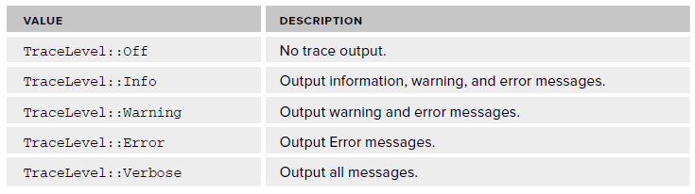
Controlling Output…
The Level property for a TraceSwitch object is an enum class type TraceLevel.
traceCtrl- > Level = TraceLevel::Verbose;

Slide 29
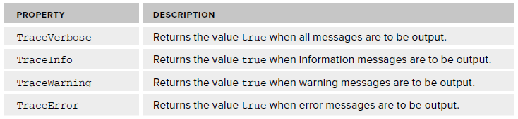
Controlling Output…
We can determine whether a particular message should be issued by trace and debug code by testing the state of one of four properties of type bool for the TraceSwitch object.

Slide 30
Assertions
The Debug and Trace classes have static Assert() functions that provide a similar capability to the native C++ assert() function.
  The Assert() function in the Debug class only works in debug builds.
  The first argument to the Debug::Assert() function is a bool value or expression that causes the program to assert when the argument is false.

Slide 31
Assertions..
There are three courses of action after an assertion.
Abort
  Clicking the Abort button ends the program immediately.
Ignore
  Clicking the Ignore button allows the program to continue.
Retry
  Clicking the Retry button gives the option of executing the program in debug mode.

Slide 32
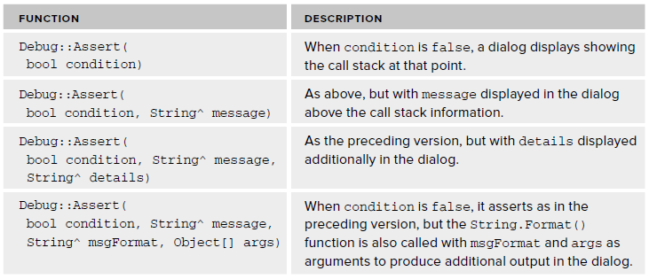
Assertions...
The following four overloaded versions of the Assert() function are available:

Slide 33
Program
Lets try all this in example…

Slide 34
Thank You

