Slide 1
LESSON 22

Slide 2
Overview
of
Previous Lesson(s)

Slide 3
Over View
Debugger
  A computer program that is used to test and debug other programs.
  Local Debugging
    Debugging process and the source code are deployed on the same machine.
  Remote Debugging
    Source program is running on a separate machine and the debugging takes place on an isolated box

Slide 4
Over View..
Dry Run
  A dry run is sometimes defines as a mental run of a computer program.
  Where the computer programmer examines the source code one step at a time and determines what it will do when run.

Slide 5
TODAY’S LESSON

Slide 6
Contents
Debugging Dynamic Memory
Checking the Free Store
Controlling Free Store
Free Store Debugging Output
Memory Leaks

Slide 7
Debugging Dynamic Memory
Allocating memory dynamically is a potent source of bugs, and perhaps the most common bugs in this context are memory leaks.
A memory leak arises when we use the new operator to allocate memory.
We never use the delete operator to free it again.

Slide 8
Debugging Dynamic Memory..
Memory leaks present no obvious symptoms much of the time, but memory leaks are detrimental to the performance of your machine because memory is being occupied to no good purpose.
Sometimes, it can result in a catastrophic failure of the program when all available memory has been allocated.

Slide 9
Debugging Dynamic Memory…
For checking program’s use of the free store, Visual C++ provides a range of diagnostic routines.
  These routines use a special debug version of the free store.
  These are declared in the header crtdbg.h.
  All calls to these routines are automatically removed from the release version of your program.

Slide 10
Checking the Free Store
A concise overview of techniques involved
  In checking free store operations.
  How memory leaks can be detected.
The functions declared in crtdbg.h check the free store using a record of its status stored in a structure of type CrtMemState .
Lets check this struct ..

Slide 11
Checking the Free Store..
typedef struct _CrtMemState
{
struct _CrtMemBlockHeader* pBlockHeader;
// Ptr to most recently allocated block
unsigned long lCounts[_MAX_BLOCKS];
// Counter for each type of block
unsigned long lSizes[_MAX_BLOCKS];
// Total bytes allocated in each block type
unsigned long lHighWaterCount;
// The most bytes allocated at a time up to now
unsigned long lTotalCount;
// The total bytes allocated at present
} _CrtMemState;

Slide 12
Checking the Free Store…
Not too many functions involved in tracking free store operations.
Capabilities :
  To record the state of the free store at any point
  To determine the difference between two states of the free store
  To output state information
  To output information about objects in the free store
  To detect memory leaks

Slide 13
Checking the Free Store…
void _CrtMemCheckpoint(_CrtMemState* state);
  This stores the current state of the free store in a CrtMemState structure.
  The argument pass to the function is a pointer to a CrtMemState structure in which the state is to be recorded.

Slide 14
Checking the Free Store…
int _CrtMemDifference(_CrtMemState* stateDiff,
const _CrtMemState* oldState,
const _CrtMemState* newState);
  This function compares the state specified by the third argument, with a previous state that is specified in the second argument.
  The difference is stored in a CrtMemState structure specified in the first argument.
  If the states are different, the function returns a non - zero value (true) otherwise, 0 (fals ) is returned.

Slide 15
Checking the Free Store…
void _CrtMemDumpStatistics(const _CrtMemState* state);
  This dumps information about the free store state specified by the argument to an output stream.
  The state structure pointed to by the argument can be a state that you recorded using CrtMemCheckpoint() or the difference between two states produced by CrtMemDifference() .

Slide 16
Checking the Free Store…
void _CrtMemDumpAllObjectsSince(const _CrtMemState* state);
  It dumps information on objects allocated in the free store.
  Since the state of the free store is specified by the argument, this has been recorded by an earlier call in program to CrtMemCheckpoint()

Slide 17
Checking the Free Store…
int _CrtDumpMemoryLeaks();
  It checks for memory leaks and dumps information on any leak that is detected.
  By enabling this mechanism we get automatic detection of any memory leaks that occurred during program execution

Slide 18
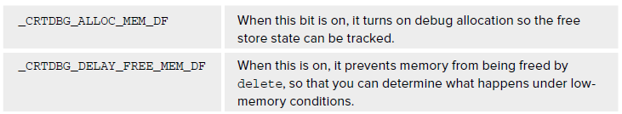
Controlling Free Store
We can control free store debug operations by setting a flag, crtDbgFlag , which is of type int.
  This flag incorporates five separate control bits, including one to enable automatic memory leak checking.
Control bits can be specified by using the following identifiers:

Slide 19
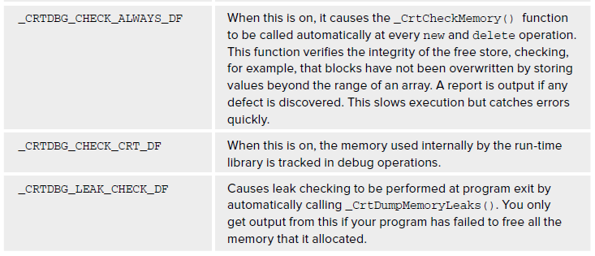
Controlling Free Store

Slide 20
Controlling Free Store
By default, the CRTDBG_ALLOC_MEM_DF bit is on, and all the others are off.
  To set the crtDbgFlag flag you pass a flag of type int to the CrtDbgFlag() function that implements the combination of indicators.
  This puts flag into effect and returns the previous status of CrtDbgFlag .

Slide 21
Controlling Free Store
  One way to set the indicators is to first obtain the current status of the crtDbgFlag flag.
int flag = _CrtSetDbgFlag(_CRTDBG_REPORT_FLAG);
// Get current flag
  We can set or unset the indicators by combining the identifiers for the individual indicators with this flag using bitwise operators.

Slide 22
Controlling Free Store
To set an indicator on, OR the indicator identifier with the flag.
  To set the automatic leak checking indicator on, in the flag:
flag |= _CRTDBG_LEAK_CHECK_DF;

Slide 23
Controlling Free Store
To turn an indicator off, AND the negation of the identifier with the flag.
  To turn off tracking of memory that is used internally by the library, you could write:
flag & = ~_CRTDBG_CHECK_CRT_DF;

Slide 24
Controlling Free Store
To put a new flag into effect, simply make a call to CrtSetDbgFlag() with flag as the argument:
_CrtSetDbgFlag(flag);
Alternatively, we can OR all the identifiers for the indicators that we want together, and pass the result as an argument.
  If you just want to leak check when the program exits
_CrtSetDbgFlag(_CRTDBG_LEAK_CHECK_DF|_CRTDBG_ALLOC_MEM_DF);

Slide 25
Free Store Debugging
The destination of the output from the free store debugging functions is not the standard output stream.
  By default it goes to the debug message window.
  To see the output on stdout , There are two functions involved.

Slide 26
Free Store Debugging
CrtSetReportMode()
  which sets the general destination for output
CrtSetReportFile()
  which specifies a stream destination.

Slide 27
Free Store Debugging
The CrtSetReportMode() function is declared as
int _CrtSetReportMode(int reportType, int reportMode)
There are three kinds of output produced by the free store debugging functions.
  Each call to the CrtSetReportMode() function sets the destination specified by the second argument for the output type specified by the first argument.

Slide 28
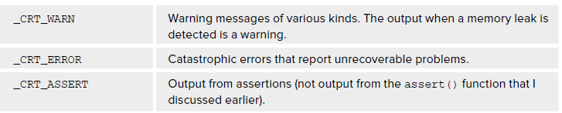
Free Store Debugging
We can specify the report type by one of the following identifiers

Slide 29
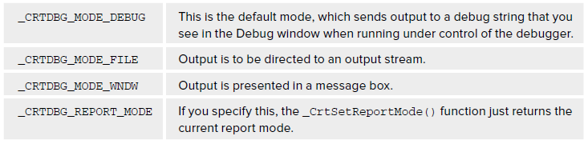
Free Store Debugging
We can specify the report mode by one or combination of the following identifiers

Slide 30
Memory Leak Detection
Lets check how can we detect the memory leaks …

Slide 31
Problems
The objects reported as being left in the free store are presented with the most recently allocated first, and the earliest last.
It is obvious from the output that the Name class is allocating memory for its data members, and never releasing it.
The problem our class has is that we forgot the fundamental rules relating to classes.

Slide 32
Solution
Always define
  A destructor
  A copy constructor
  The assignment operator.
Lets back to editor to see how our class would be…

Slide 33
Thank You

