Slide 1
Overview
of
Previous Lesson(s)

Slide 2
Over View
VP is the methodology in which development allows the user to grab and use the desired tools like menus, buttons, controls and other elements from a palette.
Programming language is an artificial language designed to communicate instructions to a machine, particularly a computer.
  Syntax
  Semantics

Slide 3
Over View..
Types of Programming Languages
  High level languages
  Low level languages
    Assembly Language
    Machine Language
Programming Types
  Structured Programming
    Top down approach
  Object Oriented Programming
    Classes and Instances

Slide 4
Over View…
In OOP Programs built from pieces called classes and functions
C++ standard library provides rich collections of existing classes and functions for all programmers to use.
Basic Syntax
  #include <iostream.h>
  using namespace std;
  // main() is where program execution begins.
  int main()
  {
  cout << "Hello World"; // prints Hello World
  return 0;
  }

Slide 5
LESSON 02

Slide 6
Integrated Development Environment
(IDE)
An IDE or interactive development environment is a software application that provides comprehensive facilities to computer programmers for software development.
An IDE normally consists of a source code editor, build automation tools and a debugger.
Several modern IDEs integrate with intelli-sense coding features.
Visual programming is a usage scenario in which an IDE is generally required.
Visual IDEs allow users to create new applications by moving programming, building blocks, or code nodes to create flowcharts or structure diagrams that are then compiled or interpreted.

Slide 7
IDE..
Visual programming is a usage scenario in which an IDE is generally required.
Visual IDEs allow users to create new applications by moving programming, building blocks, or code nodes to create flowcharts or structure diagrams that are then compiled or interpreted.

Slide 8
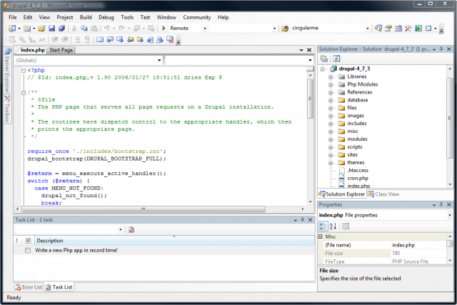
IDE..

Slide 9
Microsoft Visual Studio
Microsoft Visual Studio is an integrated development environment (IDE) from Microsoft.
It is used to develop console and graphical applications along with Windows Forms, Websites in both native code along together with managed code for all platforms supported by Microsoft Windows, Win Mobile, Win CE, .NET Framework.
Notes:
Windows CE is a distinct operating system and kernel, rather than a trimmed-down version of desktop Windows.

Slide 10
Microsoft Visual Studio..
Visual Studio includes a code editors supporting Intelli Sense as well as code refactoring.
This integrated debugger works both as a source-level debugger and a machine-level debugger.
It welcomes plug-ins that elevate the functionality at almost every stage.
VS supports different programming languages by means of language services, which allows the code editor and debugger to support nearly any programming language.

Slide 11
Microsoft Visual Studio...
We will use MS Visual Studio 2008 mostly for programming in the entire course.
MS VS Express Edition are available for free to students as downloads via Microsoft’s Dream Spark Program.
Installation of MS Visual studio 2008.

Slide 12
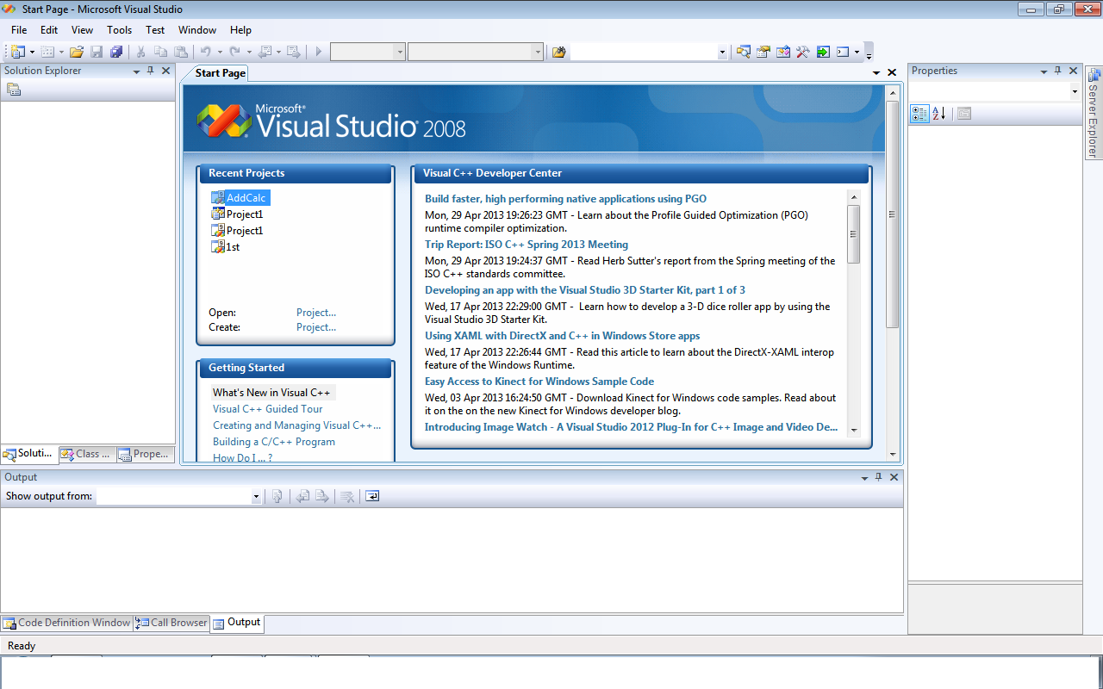
Microsoft Visual Studio 2008

Slide 13
.Net Architecture
Microsoft .NET is based on the .NET Framework, which consists of two major components
  Common Language Runtime (CLR)
  Framework Class Libraries (FCL).
The CLR defines a common programming model and a standard type system for cross-platform, multi-language development.
CLR runs the code and provides services that make the development process easier.
Notes:
The FCL is a collection of reusable classes, interfaces and value types.

Slide 14
CLR Based Executions

Slide 15
Influences
.NET is result of many influences.
OOP
JVM
GUI
.NET
Web
component-based design
n-tier design

Slide 16
Multilingual Support
.NET supports many languages
code.vb
code.cs
code.cpp
...
FCL
Development Tools
app.exe
Notes:
The Framework Class Library (FCL) is a standard library and one of two core components of Microsoft .NET Framework.
The FCL is a collection of reusable classes, interfaces and value types.

Slide 17
.NET is cross-platform
Compiled .NET applications run on any supported platform
ABC-APPLICATION.exe
Win64 bit
Win32 bit
(Win7,XP,2K,98)
WinCE
Notes:
Microsoft Windows CE (now officially known as Windows Embedded Compact and previously also known as Windows Embedded CE is an operating system developed by Microsoft for embedded systems.
Windows CE is a distinct operating system and kernel, rather than a trimmed-down version of desktop Windows.

Slide 18

How Cross-platform ???
Now question is how .net framework achieve the functionality of cross-platform ???????
Where our guess leads us to ???
What would be the technology underlying this ???

Slide 19
How Cross-platform ???...
Myth is …
  Applications are written against Framework Class Library (FCL), not underlying Operating System.
  Compilers generate generic assembly language which must be executed by the Common Language Runtime (CLR)

Slide 20
Framework Class Library
The Framework Class Library (FCL) is a standard library and one of two core components of Microsoft .NET Framework.
The FCL is a collection of 1000’s of predefined reusable classes and interfaces.
Common subset across all platforms & languages.
Networking, database access, XML processing, GUI, Web, etc.

Slide 21
CLR APPLICATION EXECUTION
APP.exe
OS Process
CLR
JIT Compiler
other FCL components
Core FCL
obj code
Underlying OS and HW
Notes:
JIT = Just-in-time, which gets its name because you generate the actual x86 code at the last possible moment, i.e. run-time.
Java uses same approach with its JVM

Slide 22
Implications of .NET
Clients need CLR & FCL to run .NET applications
  Available via Redistributable .NET Framework
  20MB+ download
  Runs on 98 and above, NT (SP6) and above.

Slide 23
Implications of .NET
Design trade-off
  Positives are
    Managed execution (memory protection, verifiable code, etc.)
    Portability
  Negatives are
    Slower execution

Slide 24
Application Designs

Slide 25
Monolithic Application
All source code compiled into one exe file.
APP.exe
Source Code

Slide 26
Component Based Application
Combination of exe file and dynamic link library file(s)
  .Exe + DLL(s)
  Standard practice in windows applications
GUI.exe
abc.dll
data.dll

Slide 27
Component based ????
Why is it so …????
  Team programming
  Multi-language development (I like VB, you like C#)
  Code reuse (e.g. across different .EXEs)
  Independent updating (update just component X)
FCL ships as a set of Components.

Slide 28
Assemblies
.NET packages comes into assemblies
01 assembly comprises of a single or more compiled classes.
  .EXE represents an assembly with classes + Main program
  .DLL represents an assembly with classes
code.cpp
code.vb
code.cs
Development Tools
.EXE / .DLL
assembly

Slide 29
CLR execution with Assemblies
CLR must be able to locate all assemblies.
.DLL
.EXE
.DLL
.DLL
CLR
OS Process
JIT Compiler
other FCL assemblies
Core FCL
assembly
obj code
obj code
obj code
Underlying OS and HW

Slide 30
Assembly Resolution
How does CLR find assemblies?
For now, simple answer is sufficient:
  DLLs must reside in same directory as our EXE
  FCL assemblies reside in GAC
  CLR looks in GAC first, then EXE's directory…

Slide 31
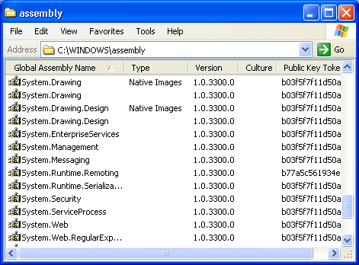
Global Assembly Cache
GAC = Global Assembly Cache
  C:\Windows or C:\WinNT directory

Slide 32
Thank You

