Slide 1
LESSON 19

Slide 2
Overview
of
Previous Lesson(s)

Slide 3
Over View
Debugging
  It is a methodical process of finding and reducing the number of bugs, or defects, in a computer program.
  Used in almost any new software or hardware development process, whether a commercial product or an enterprise or personal application program.

Slide 4
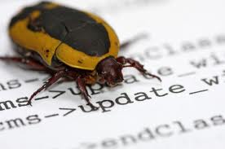
Over View..
  A bug is not necessarily visible in the program.
  If it is apparent, programmer may not know where it and how to eliminate it.
  Many bugs are eliminated during the compile and link phases, but there are still quite a few left even after an executable module is produced.

Slide 5
Over View…
4 strategies that can help to make debugging as painless as possible:
  Don’t re-invent the wheel.
    Library functions.
  Develop and test your code incrementally.
  Code defensively

Slide 6
Over View…
Syntactic errors
  These are errors that result from statements that are not of the correct form.
Semantic errors
  These are errors where the code is syntactically correct, but it does not do what you intended.

Slide 7
Over View…
Debugger
  A program that controls the execution of program code in such a way that we can step through the source code one line at a time, or run to a particular point in the program.
A breakpoint is a point in our program where the debugger automatically suspends execution when in debugging mode.
A trace-point is a special kind of breakpoint that has a custom action associated with it.

Slide 8
TODAY’S LESSON

Slide 9
Contents
Start Debugging
Inspecting Variable Values
Changing Variable Values
Adding Debugging Code
  Using Assertions
CLR Programming
  Struct Types
  Class Types
Defining Value Class Types
ToString() Function in a Class

Slide 10
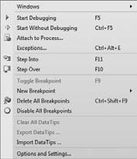
Start Debugging
Following are the ways of starting application in debug mode.

Slide 11
Start Debugging..
Start Debugging – f5:
  It simply executes a program up to the first breakpoint (if any) where execution will halt.
  When programmer examined all he/she needs to at a breakpoint, selecting the same menu item or toolbar button again will continue execution up to the next breakpoint and so on.
  If there are no breakpoints, the entire program is executed without stopping.

Slide 12
Start Debugging…
Attach to Process:
  This option on the Debug menu enables to debug a program that is already running.
  This option displays a list of the processes that are running on machine and you can select the process you want to debug.
  For advanced users only.

Slide 13
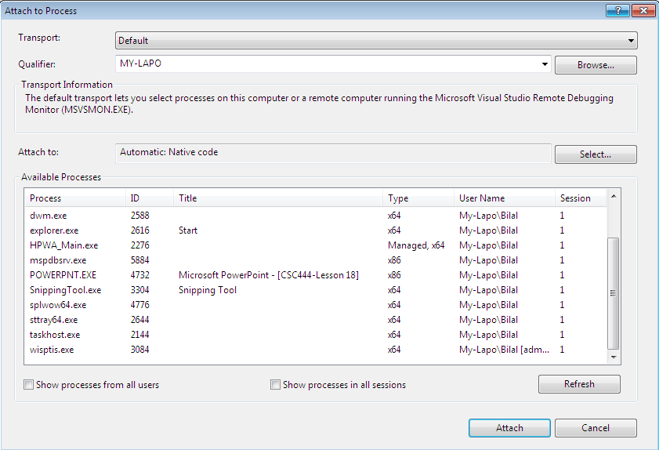
Start Debugging…
Attach to Process:

Slide 14
Start Debugging...
Step Into – f11 :
  It executes program one statement at a time, stepping into every code block, which includes every function that is called.
  This would be something of a nuisance.
  For example If we used it throughout the debugging process, it would also execute all the code in the library functions for stream output.

Slide 15
Start Debugging...
Step Over – f12 :
  This option simply executes the statements in program one at a time and runs all the code used by functions that might be called within a statement.
  Such as stream operations, without stopping.

Slide 16
Start Debugging...
Run to Cursor:
  This does precisely what it says.
  It runs the program up to the line where the cursor is and then breaks execution to allow you to inspect or change variables in the program.

Slide 17
Inspecting Variable Values
Defining a variable that you want to inspect is referred to as setting a watch for the variable.
5 tabs in the bottom left window by selecting from the
  Debug ➪ Windows menu
Local tab
  The Locals tab shows the values of the variables local to the current function.
  In general, new variables come into scope as you trace through a program and then go out of scope as you exit the block in which they are defined.

Slide 18
Inspecting Variable Values..
Auto Tab
  Shows the automatic variables in use in the current statement and its immediate predecessor.
Threads Tab
  Allows to inspect and control threads in advanced applications.

Slide 19
Inspecting Variable Values..
Modules Tab
  Lists details of the code modules currently executing.
  If application crashes, we can determine in which module the crash happened.
Watch1 Tab
  Variables can be added to the Watch1 tab that we want to watch.
  We can also watch the value of a expression.

Slide 20
Viewing Variables in the Edit Window
To look at the value of a single variable, and if that variable is visible in the Text Editor window.
  Position the cursor over the variable for a second.
  A tool tip pops up showing the current value of the variable.
  We can also look at more complicated expressions by highlighting them and resting the cursor over the highlighted area.

Slide 21
Changing Variable Values
We can change the values of the variables that we are watching in the
  Watch windows
  Autos window
  Locals windows.
  If code involves a loop with a large number of iterations, ex 3000, we could set the loop counter to 2995 to step through the last few to verify that the loop terminates correctly.

Slide 22
Changing Variable Values
How to change the value of a variable in a Watch window
  Double - click the variable value that is displayed and type new value.
  For an array element, 1st expand the array & then change the element value.
  For a variable displayed in hexadecimal notation,
    Either enter a hexadecimal number i.e A9
    Enter a decimal value prefixed by 0n, i.e 0n169.

Slide 23
Adding Debugging Code
For large programs, we added code that is aimed at highlighting bugs wherever possible and providing tracking output to help you pin down the bugs.
  This debugging code is only required while testing phase.
  Don’t put it in finished product.

Slide 24
Using Assertions
#include <cassert>
void assert(int expression);
The argument to the function specifies the condition to be checked.
The effect of the assert() function is suppressed if a special preprocessor symbol, NDEBUG , is defined.
NDEBUG switch off assertions in the debug version of a program
#define NDEBUG // Switch off assertions in the code
#include < cassert > // Declares assert()

Slide 25
Using Assertions..
If the expression passed as an argument to assert() is non - zero (i.e. true ), the function does nothing.
If the expression is 0 & NDEBUG are not defined:
  A diagnostic message is output showing the expression that failed, the source file name, and the line number in the source file where the failure occurred.
  After displaying the diagnostic message, the assert() function calls abort() to end the program.

Slide 26
Using Assertions…
An example of an assertion used in a function:
char* append(char* pStr, const char* pAddStr)
{
// Verify non-null pointers
assert(pStr != nullptr);
assert(pAddStr != nullptr);
// Code to append pAddStr to pStr...
}
Calling the append() function with a null pointer argument produced the following diagnostic message
Assertion failed: pStr != nullptr, file c:\examples\visual studio project files\tryassertion\tryassertion\tryassertion.cpp, line 10

Slide 27
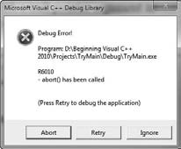
Using Assertions...
The assertion also displays a message box offering three options:
Clicking the Abort button ends the program immediately.

Slide 28
Using Assertions...
The Retry button starts the Visual debugger so you can step through the program to find out more about why the assertion failed.
In principle, the Ignore button allows the program to continue in spite of the error, but this is usually an unwise choice as the results are likely to be unpredictable.

Slide 29
C++ / CLI Programming

Slide 30
struct and class types
The C++/CLI language has its own struct and class types.
C++/CLI allows the definition of two different struct and class types that have different characteristics
  value struct types
  value class type
  ref struct types
  ref class types.

Slide 31
struct and class types
As in native C++, the only difference between a struct and a class in C++/CLI is that members of a struct are public by default.
One essential difference between value classes and reference classes is that
  variables of value class types contain their own data,
  variables to access reference class types must be handles, and therefore contain an address.

Slide 32
struct and class types
3 restrictions that apply to both value classes and reference classes:
  A value class or ref class cannot contain fields that are native C++ arrays or native C++ class types.
  Friend functions are not allowed.
  A value class or ref class cannot have members that are bit - fields.

Slide 33
struct and class types
Declare a data item of a value class type, memory for it will be allocated on the stack
We can create value class objects on the heap using the gcnew operator.
double pi(3.142); // pi is stored on the stack
int^ lucky(gcnew int(7));
// lucky is a handle and 7 is stored on the heap
double^ two(2.0); // two is a handle, and 2.0 is stored on the heap

Slide 34
Defining value class type
A value class provides the possibility to define new primitive types that can be used in a similar way to the fundamental types.
A variable of a value class type is created on the stack and stores the value directly
But we can also use a tracking handle to reference a value class type stored on the CLR heap.

Slide 35
Defining value class type..
// Class representing a height
value class Height
{
private:
// Records the height in feet and inches
int feet, int inches;
public:
// Create a height from inches value
Height(int ins)
{
feet = ins/12;
inches = ins%12;
}
// Create a height from feet and inches
Height(int ft, int ins) : feet(ft), inches(ins){ }
};

Slide 36
Defining value class type..
Height tall = Height(7, 8); // Height is 7 feet 8 inches
  Creates the variable, tall, containing a Height object representing 7 feet, 8 inches; this object is created by calling the constructor with two parameters.
Height baseHeight;
  Creates a variable, baseHeight , that will be automatically initialized to a height of zero.

Slide 37
Main Function
int main(array<System::String ^> ^args)
{
Height myHeight(Height(6,3));
Height^ yourHeight(Height(70));
Height hisHeight(*yourHeight);
Console::WriteLine(L”My height is {0}”, myHeight);
Console::WriteLine(L”Your height is {0}”, yourHeight);
Console::WriteLine(L”His height is {0}”, hisHeight);
return 0;
}
Lets try it …

Slide 38
ToString()
Every C++/CLI class that you defi ne has a ToString() function
The compiler arranges for the ToString() function for an object to be called whenever it recognizes that a string representation of an object is required, and can also call explicitly.
double pi(3.142);
Console::WriteLine(pi.ToString());
// output = 3.142

Slide 39
ToString()
Every C++/CLI class that you defi ne has a ToString() function
The compiler arranges for the ToString() function for an object to be called whenever it recognizes that a string representation of an object is required, and can also call explicitly.
double pi(3.142);
Console::WriteLine(pi.ToString());
// output = 3.142

Slide 40
ToString()
// Create a string representation of the object
virtual String^ ToString() override
{
  return feet + L” feet “+ inches + L” inches”;
}
My height is 6 feet 3 inches
Your height is 5 feet 10 inches
His height is 5 feet 10 inches

Slide 41
Thank You

