Slide 1
LESSON 17

Slide 2
Overview
of
Previous Lesson(s)

Slide 3
Over View
OOP
  A class is a data type that you define to suit customized application requirements.
  A class can be designed to represent something abstract, such as a complex number, which is a mathematical concept, or a truck, which is physical.
  Cbox class

Slide 4
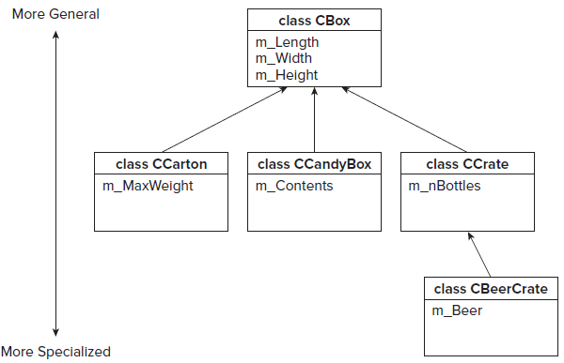
Over View..

Slide 5
Over View…
Inheritance
  Inheritance is an essential part of OOP
  It is the process of creating new classes, called derived classes, from existing or base classes.
  The derived class inherits all the capabilities of the base class & can also add its own functionality.

Slide 6
Over View…
Advantages of Inheritance
  Reusability
  Extensibility
  Data hiding
  Overriding

Slide 7
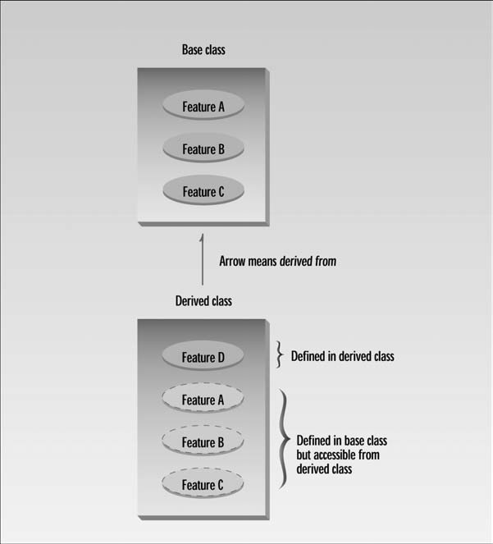
Over View...

Slide 8
Over View…
Strings
  The string class type that is defined in the system namespace represents a string in C++/CLI.
String creation
  System::String^ saying(L"Many hands make light work.");

Slide 9
Over View…
Tracking Handles:
  A tracking handle is a form of pointer used to reference variables defined on the CLR heap.
  A tracking handle is automatically updated if what it refers to is relocated in the heap by the garbage collector.
  Variables that reference objects and arrays on the heap are always tracking handles.

Slide 10
Over View…
Tracking references
  A tracking reference is similar to a native reference, except that the address it contains is automatically updated if the object referenced is moved by the garbage collector.
Interior pointers
  An interior pointer is a C++/CLI pointer type to which you can apply the same operation as a native pointer.

Slide 11
TODAY’S LESSON

Slide 12
Contents
Inheritance
  Protected Members
  Access Levels
  Friends Classes
  Virtual Functions
  Polymorphism
  Pointer with Objects
  References to Virtual Functions
CLR Programming
  Functions
  Variable number of Arguments
  Arguments to main()

Slide 13
Protected Members
In addition to the public and private access specifiers for members of a class we can also declare members of a class as protected .
Within the class, the protected keyword has the same effect as the private keyword
  Members of a class that are protected can only be accessed by member functions of the class, and by friend functions of the class.

Slide 14
Protected Members..
class CBox
{
public:
CBox(double lv = 1.0, double wv = 1.0, double hv = 1.0):
m_Length(lv), m_Width(wv), m_Height(hv)
{ cout < < endl < < "CBox constructor called"; }
~CBox()
{ cout << “CBox destructor called” << endl; }
protected:
double m_Length;
double m_Width;
double m_Height;
};

Slide 15
Protected Members..
Now, the data members are still effectively private and can’t be accessed by ordinary global functions.
They will still be accessible to member functions of a derived class.

Slide 16
Access Level
Members of a base class that are declared as private are never accessible in a derived class.
Defining a base class as public doesn’t change the access level of its members in the derived class.
Defining a base class as protected changes its public members to protected in the derived class.

Slide 17
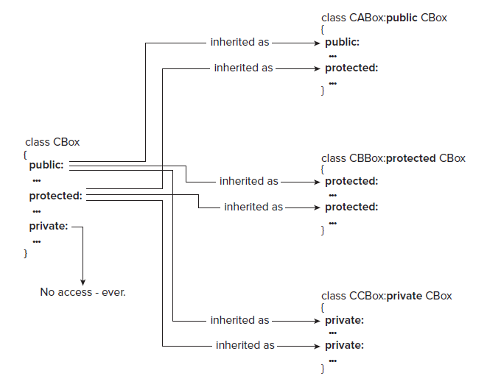
Access Level..

Slide 18
Class Members as Friends
Declaring function as a friend of a class, gives the friend function the privilege of free access to any of the class members.
We can also allow all the function members of one class to have access to all the data members of another by declaring it as a friend class.
Limitations:
  Class friendship is not reciprocated.

Slide 19
Class Members as Friends
Limitations..
  Making the “A” class a friend of the class “B” does not mean that the “B” class is a friend of the “A” class.
  If you want this to be so, you must add a friend declaration for the “B” class to the “A” class.
  Class friendship is also not inherited.

Slide 20
Virtual Functions
Virtual means existing in appearance but not in reality.
When virtual functions are used, a program that appears to be calling a function of one class may in reality be calling a function of a different class.
Why virtual functions ?
  Suppose you have a number of objects of different classes but you want to put them all in an array and perform a particular operation on them using the same function call.

Slide 21
Virtual Functions
For ex a graphics program includes several different shapes:
  triangle
  ball
  square and so on.
Each of these classes has a member function draw() that causes the object to be drawn on the screen.
  Now we have to make a picture by grouping a number of these elements together.
  One approach is to create an array that holds pointers to all the different objects in the picture.

Slide 22
Virtual Functions
The array might be defined like this:
shape* ptrarr[100]; // array of 100 pointers to shapes
To insert pointers to all the shapes into this array, an entire picture is drawn using a simple loop
for(int j=0; j<N; j++)
ptrarr[j]->draw();
Completely different functions are executed by the same function call.
  If the pointer in ptrarr points to a ball, the function that draws a ball is called.
  if it points to a triangle, the triangle-drawing function is called.

Slide 23
Polymorphism
This phenomena is called polymorphism, which means different forms.
The functions have the same appearance, the draw() expression, but different actual functions are called, depending on the contents of ptrarr.
Polymorphism is one of the key features of oop after classes and inheritance.

Slide 24
Polymorphism..
For the polymorphic approach to work, several conditions must be met.
  First, all the different classes of shapes, such as balls and triangles, must be descended from a single base class.
  Second, the draw() function must be declared to be virtual in the base class.

Slide 25
Virtual Functions
Lets implement the Virtual phenomena to our same Cbox class …

Slide 26
Using Pointers with Objects
A pointer can be used to a base class type to store the address of a derived class object and also of a base class object.
We can use a pointer of the type “ pointer to base ” to obtain different behavior with virtual functions, depending on what kind of object the pointer is pointing to.
Lets see an ex..

Slide 27
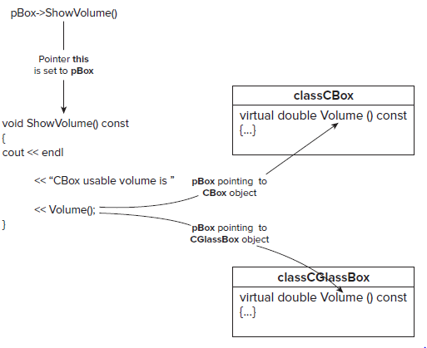
Using Pointers with Objects..

Slide 28
References with Virtual ()s
A function can be defined with a reference to a base class as a parameter or we can pass an object of a derived class to it as an argument.
When the function executes, the appropriate virtual function for the object passed is selected automatically.
Lets see an ex..

Slide 29
C++ / CLI Programming

Slide 30
Functions
For the most part, functions in a C++/CLI program work in exactly the same way as in a native program.
As we deal in handles and tracking references when programming for the CLR, not native pointers & references, so that introduces some differences.
  Function parameters and return values in a CLR program can be value class types, tracking handles, tracking references, and interior pointers.

Slide 31
Functions..
  When a parameter is an array, there is no need to have a separate parameter for the size of the array because C++/CLI arrays have the size built into the Length property.
  We cannot do address arithmetic with array parameters in a C++/CLI program as in native C++ program, so we use array indexing for this.
  Returning a handle to memory we have allocated on the CLR heap is not a problem because the garbage collector takes care of releasing the memory when it is no longer in use.

Slide 32
Functions...
  The mechanism for accepting a variable number of arguments in C++/CLI is different from the native C++ mechanism.
  Accessing command line arguments in main() in a C++/CLI program is also different from the native C++ mechanism.
Lets go deeper for these two points …

Slide 33
Variable Number of Arguments
The C++/CLI language provides for a variable number of arguments by allowing specification the parameter list as an array with the array specification.
int sum(... array < int > ^ args)
{
// Code for sum
}
Accepts number of arguments

Slide 34
Variable Number of Arguments
Lets do it ..

Slide 35
Arguments to main()
One parameter to the main() function in a C++/CLI program.
It is an array of elements of type String^ .
  Accessing and processing command - line arguments in a CLR program, for the time being boils down to just accessing the elements in the array parameter.
Lets do it …

Slide 36
Thank You

