Slide 1
LESSON 16

Slide 2
Overview
of
Previous Lesson(s)

Slide 3
Over View
In computing, a visual programming language (VPL) is any programming language that lets users create programs by manipulating program elements graphically.
Visual programming environments provide graphical or iconic elements which can be manipulated by users in an interactive way according to some specific spatial grammar for program construction.

Slide 4
Over View..
Strings
  The string class in the standard library for native C++ provides a powerful and superior way to process strings in your programs.
  Strings are objects that represent sequences of characters.
  The standard string class provides support to objects with an interface similar to that of standard containers, but adding features specifically designed to operate with strings of characters.

Slide 5
Over View..
The string standard header defines the string and wstring classes that represent character strings.
The string class is defined as basic_string < char >
The wstring class is defined as basic_string < wchar_t >.

Slide 6
Over View...
string astring; // Create an empty string
string sentence("This sentence is false.");
string bees(7, 'b'); // String is “bbbbbb”
string letters(bees);
string animals[] = { "dog", "cat", "horse", "donkey", "lion"};

Slide 7
TODAY’S LESSON

Slide 8
Contents
Object - Oriented Programming Basics
Inheritance in Class
  Base Classes
  Deriving Classes
  Access Controls
  Protected Members
CLR
  Strings
  Tracking References

Slide 9
OOP
A class is a data type that you define to suit customized application requirements.
Classes in OOP also define the objects to which the program relates.
A class can be designed to represent something abstract, such as a complex number, which is a mathematical concept, or a truck, which is decidedly physical.
So, as well as being a data type, a class can also be a definition of a set of real - world objects of a particular kind.

Slide 10
OOP..
We could think of a class as defining the characteristics of a particular group of things that are specified by a common set of parameters and share a common set of operations that may be performed on them.
The operations that you can apply to objects of a given class type are defined by the class interface, which corresponds to the functions contained in the public part of the class.
The CBox class that is a good example, it defined a box in terms of its dimensions plus a set of public functions that we could apply to CBox objects to solve a problem.

Slide 11
OOP…
There are many different kinds of boxes in the real world
  cartons, coffins, candy boxes, and cereal boxes.
It’s also possible that some objects may be the result of combining a particular kind of box with some other type of object.
A box of candy or a crate of beer, for example.
To accommodate this, we could define one kind of box as a generic box with basic “ boxiness ” characteristics and then specify another sort of box as a further specialization of that.

Slide 12
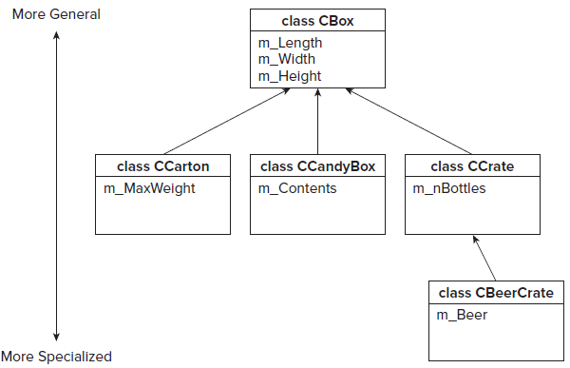
OOP…

Slide 13
Inheritance
Inheritance is the process of creating new classes, called derived classes, from existing or base classes.
  The derived class inherits all the capabilities of the base class but can add embellishments and refinements of its own.
  The base class is unchanged by this process.
The only members of a base class that are not inherited by a derived class are the destructor, the constructors, and any member functions overloading the assignment operator.

Slide 14
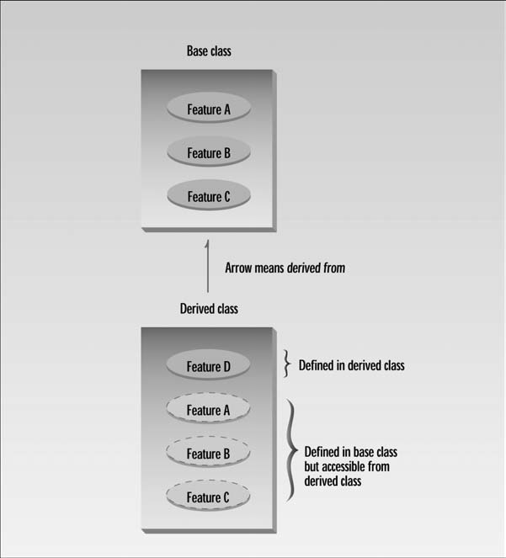
Inheritance..

Slide 15
+’s of Inheritance
Reusability -- facility to use public methods of base class without rewriting the same
Extensibility -- extending the base class logic as per business logic of the derived class
Data hiding -- base class can decide to keep some data private so that it cannot be altered by the derived class
Overriding-- With inheritance, we will be able to override the methods of the base class so that meaningful implementation of the base class method can be designed in the derived class.

Slide 16
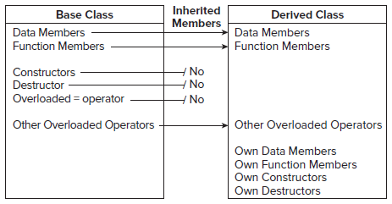
Base Class
A base class is any class that you use as a basis for defining another class.
If we define a class, B , directly in terms of a class, A , A is said to be a direct base class of B.

Slide 17
Base Class..
#pragma once
class CBox
{
public:
double m_Length;
double m_Width;
double m_Height;
CBox(double lv = 1.0, double wv = 1.0, double hv = 1.0):
m_Length(lv), m_Width(wv), m_Height(hv){ }
};
// The #pragma once directive ensures the definition
of CBox appears only once in a build.
// Save the file in Box.h file

Slide 18
Derived Class
Now we define CCandyBox as a derived class with the CBox class as the base class
#pragma once
#include "Box.h"
class CCandyBox: CBox
{
public:
char* m_Contents;
CCandyBox(char* str = "Candy") // Constructor
{
m_Contents = new char[ strlen(str) + 1 ];
strcpy_s(m_Contents, strlen(str) + 1, str);
}
~CCandyBox() // Destructor
{ delete[] m_Contents; };
};

Slide 19
Main Function..
#include "stdafx.h"
#include "CandyBox.h" // For CBox and CCandyBox
using std::cout;
using std::endl;
int main()
{
CBox myBox(4.0, 3.0, 2.0); // Create CBox object
CCandyBox myCandyBox;
CCandyBox myMintBox("Wafer Thin Mints");
// Create CCandyBox object

Slide 20
Main Function...
cout << endl << "myBox occupies " << sizeof myBox
// Show how much memory
<<" bytes" << endl // the objects require
<< "myCandyBox occupies "<< sizeof myCandyBox <<" bytes"<< endl
<< "myMintBox occupies " << sizeof myMintBox << " bytes";
cout << endl <<"myBox length is "<< myBox.m_Length;
myBox.m_Length = 10.0;
// myCandyBox.m_Length = 10.0; // uncomment this for an error
cout << endl;
getchar();
return 0;
}

Slide 21
Main Function...
Out Put
myBox occupies 24 bytes
myCandyBox occupies 32 bytes
myMintBox occupies 32 bytes
myBox length is 4
The length of the string doesn’t affect the size of an object, as the memory to hold the string is allocated in the free store.
The 32 bytes are made up of 24 bytes for the three double members, plus 4 bytes for the pointer member m_Contents, which makes 28 bytes.
So, where did the other 4 bytes come from?
  This is due to the compiler aligning members at addresses that are multiples of 8 bytes.

Slide 22
Public Base Class
class CCandyBox: public CBox
{
public:
char* m_Contents;
CCandyBox(char* str = "Candy") // Constructor
{
m_Contents = new char[ strlen(str) + 1 ];
strcpy_s(m_Contents, strlen(str) + 1, str);
}
~CCandyBox() // Destructor
{ delete[] m_Contents; };
};

Slide 23
Access Control
class CBox
{
public:
CBox(double lv = 1.0, double wv = 1.0, double hv = 1.0):
m_Length(lv), m_Width(wv), m_Height(hv){}
private:
double m_Length;
double m_Width;
double m_Height;
};

Slide 24
Access Control..
class CCandyBox: public CBox
{
public:
char* m_Contents;
// Function to calculate the volume of a CCandyBox object
double Volume() const // Error - members not accessible
{ return m_Length*m_Width*m_Height; }
CCandyBox(char* str = "Candy") // Constructor
{ m_Contents = new char[ strlen(str) + 1 ];
strcpy_s(m_Contents, strlen(str) + 1, str); }
~CCandyBox() // Destructor
{ delete[ ] m_Contents; }
};

Slide 25
Constructor in a Derived Class
Though base class constructors are not inherited in a derived class, they still exist in the base class and are used for creating the base part of a derived class object.
This is because creating the base class part of a derived class object is really the business of a base class constructor, not the derived class constructor.
Private members of a base class are inaccessible in a derived class object, even though they are inherited, so responsibility for these has to lie with the base class constructors.

Slide 26
C++ / CLI Programming

Slide 27
Strings
The string class type that is defined in the system namespace represents a string in C++/CLI.
in fact, a string consists of Unicode characters. To be more precise, it
represents a string consisting of a sequence of characters of type System::Char
String creation
  System::String^ saying(L"Many hands make light work.");
Notes:
Wide character string size is compiler specific .. Min is 8 bit per character ..

Slide 28
Strings..
Access an individual characters in a string
  The first character has an index value of 0.
Console::WriteLine(L"The third character in the string is {0}", saying[2]);
Length property of Strings.
Console::WriteLine(L"The string has {0} characters.", saying -> Length);
saying is a tracking handle, a kind of pointer so the - > operator to access the Length property (or any other member of the object).

Slide 29
Joining Strings
Join strings to form a new string object + operator
String^ name1(L"Beth");
String^ name2(L"Betty");
String^ name3(name1 + L" and " + name2);
Same operator is used to join String objects with string literals
String^ str(L"Value: ");
String^ str1(str + 2.5); // Result is new string L"Value: 2.5"
String^ str2(str + 25); // Result is new string L"Value: 25"
String^ str3(str + true); // Result is new string L"Value: True"

Slide 30
Joining Strings..
string and character can also be joined, but the result depends on the type of character:
String^ str(L"Value: ");
char ch('Z');
wchar_t wch(L'Z');
String^ str4(str + ch); // Result is new string L"Value: 90"
String^ str5(str + wch); // Result is new string L"Value: Z“
String objects are immutable, once created, they cannot be changed.

Slide 31
Joining Strings…
The String class also defines a Join() function.
  It is used to join a series of strings stored in an array into a single string with separators between the original strings:
array < String^ > ^ names = { L"Jill", L"Ted", L"Mary", L"Eve", L"Bill"};
String^ separator(L", ");
String^ joined = String::Join(separator, names);
Output:
Jill, Ted, Mary, Eve, Bill

Slide 32
Modifying Strings
Trim() function:
  trim spaces from both the beginning and the end of the string.
String^ str = {L" Handsome is as handsome does... "};
String^ newStr(str- > Trim());
Trim() function also allows to specify the characters that are to be removed from the start and end of the string.
String^ toBeTrimmed(L"wool wool sheep sheep wool wool wool");
array < wchar_t > ^ notWanted = {L'w',L'o',L'l',L' '};
Console::WriteLine(toBeTrimmed- > Trim(notWanted));
OUTPUT sheep sheep

Slide 33
Comparing Strings
Two string objects can be compared using the Compare() function in the String class.
  It returns an integer < 0, = 0, or > 0, accordingly.
String^ him(L"Jacko");
String^ her(L"Jillo");
int result(String::Compare(him, her));
if(result < 0)
Console::WriteLine(L"{0} is less than {1}.", him, her);
else if(result > 0)
Console::WriteLine(L"{0} is greater than {1}.", him, her);
else
Console::WriteLine(L"{0} is equal to {1}.", him, her);

Slide 34
Comparing Strings..
Result …

Slide 35
Searching Strings
StartsWith() and EndsWith()
  Check whether a string starts or ends with a given substring.
String^ sentence(L"Hide, the cow's outside.");
if(sentence- > StartsWith(L"Hide"))
Console::WriteLine(L"The sentence starts with 'Hide'.");
The sentence starts with 'Hide'.
Console::WriteLine(L"The sentence does{0} end with 'outside'.",
sentence- > EndsWith(L"outside") ? L"" : L" not");

Slide 36
Tracking References
A tracking reference provides a similar capability to a native C++ reference in that it represents an alias for something on the CLR heap.
Tracking references to value types can be created on the stack and to handles in the garbage - collected heap.
Tracking references themselves are always created on the stack.
A tracking reference is automatically updated if the object referenced is moved by the garbage collector.

Slide 37
Tracking References
Example
tracking reference to a value type:
int value(10);
int% trackValue(value);
trackValue *= 5;
Console::WriteLine(value);
trackValue is an alias for value, Output = 50

Slide 38
Interior Pointers
Though we cannot perform arithmetic on the address in a tracking handle, it is still possible with an interior pointer.
  keyword interior_ptr
  Address stored in an interior pointer can be updated automatically by the CLR garbage collector.
  An interior pointer is always an automatic variable that is local to a function.

Slide 39
Interior Pointers
array < double > ^ data = {1.5, 3.5, 6.7, 4.2, 2.1};
interior_ptr < double > pstart( & data[0]);
  If no initial value is provided, by default it is initialized ny nullptr.
Constraints:
  It cannot contain the address of a whole object on the CLR heap.
  It cannot store the String object itself.
interior_ptr < String^ > pstr1; // OK - pointer to a handle
interior_ptr < String > pstr2;
// Will not compile - pointer to a String object

Slide 40
Thank You

