Slide 1
LESSON 15

Slide 2
Overview
of
Previous Lesson(s)

Slide 3
Over View
In computing, a visual programming language (VPL) is any programming language that lets users create programs by manipulating program elements graphically.
VPLs may be further classified, according to the type and extent of visual expression used, into icon-based languages, form-based languages, and diagram languages.

Slide 4
Over View..
Problem Definition:
  The principal function of a box is to contain objects of one kind or another, so, in one word, the problem is packaging.
Basic operations on CBox class include:
  Calculate the volume of a Cbox.
  Compare the volumes of two CBox objects.
  Compare the volume of a CBox object with a specified value, and vice versa.

Slide 5
Over View...
  Add two CBox objects to produce a new CBox object that will contain both the original objects.
  Multiply a CBox object by an integer (and vice versa).
  Determine how many CBox objects of a given size can be packed in another CBox object of a given size.
  Determine the volume of space remaining in a CBox object after packing it with the maximum number of CBox objects of a given size.

Slide 6
Over View…
In first preference we start writing the code to use the CBox class and its overloaded operators, first we assemble the definition for the class into a coherent whole.
In this project we used the visual facilities that Visual C++ 2008 / 2010 provides for creating and maintaining code for our classes.

Slide 7
Over View…
In our project we distributed the code among several files for the first time during this course.
It is not a common practice with C++ applications generally, but with Windows programming, it is essential.
The sheer volume of code involved in even the simplest program necessitates dividing it into workable chunks.
There are basically two kinds of source code files in a
  Header Files
  Source Files

Slide 8
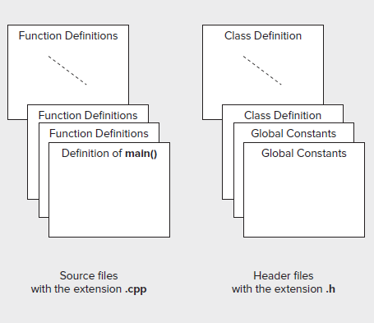
Over View…

Slide 9
Over View…
Arrays in C++ / CLI
  In C++ / CLI programming arrays are different from the native C++ arrays.
  Memory for a CLR array is allocated on the garbage - collected heap.
Garbage Collector
  In C & C++, many objects require the programmer to allocate their resources once declared, before the objects can be safely used.

Slide 10
Over View…
Garbage Collector..
  Releasing these resources back to the free memory pool once the object has been used is the responsibility of the programmer.
  If resources are not released, the code is said to leak memory, as more and more resources are consumed needlessly.
  On the other hand, if resources are released prematurely, loss of data, the corruption of other memory areas, and null pointer exceptions can occur.

Slide 11
Over View…
The general form for specifying the type of variable to reference a one - dimensional array is
array < element_type > ^
  CLR array is created on the heap so an array variable is always have a tracking handle.
array < int > ^ data;
  The array variable, data can store a reference to any one - dimensional array of elements of type int .
CLR array can be created using the gcnew operator at the same time that you declare the array variable:
array < int > ^ data = gcnew array < int > (100);

Slide 12
TODAY’S LESSON

Slide 13
Contents
Library Class for Strings
  Creating String Objects
  Concatenating Strings
  Example creating & joining strings
  Comparing Strings
  Example Program
  Searching Strings
CLI Programming
Searching One Dimensional Arrays
  Example Program
Multidimensional Arrays
  Using a multidimensional array
Array of Arrays
  Using an array of arrays

Slide 14
Strings
Strings are objects that represent sequences of characters.
The standard string class provides support for such objects with an interface similar to that of standard containers, but adding features specifically designed to operate with strings of characters.
The string standard header defines the string and wstring classes that represent character strings.
  Both are defined in the string header as template classes that are instances of the basic_string < T > class template.

Slide 15
Strings..
The string class is defined as basic_string < char > , and wstring is defined as basic_string < wchar_t >.
  string class represents strings of characters of type char.
  wstring represents strings of characters of type wchar_t .
These string types are much easier to use than null - terminated strings.
wstring type will work just the same as string, except that the strings contain Unicode character codes and we use the L prefix for string literals in code.

Slide 16
Creating String Objects
Create and initialize a string object
  string sentence = "This sentence is false.";
    The sentence object will be initialized with the string literal that appears to the right of the assignment operator.
    A string object has no terminating null character, so the string length is the number of characters in the string.
    23 in this instance.
length of the string can be encapsulated by a string object at any time by calling its length() member function
  cout << "The string is of length " < < sentence.length() << endl;

Slide 17
Creating String Objects..
Output a string
  cout < < sentence < < endl;
Input a string
  cin > > sentence;
  ignore leading whitespaces
  Terminates input when you enter a space following one or more non - whitespace characters.
  getline(cin, sentence, '*');
  1st argument is the stream that is the source of input.
  2nd argument is the object that is to receive the input.
  3rd argument is the character that terminates reading.

Slide 18
Creating String Objects..
string astring; // Create an empty string
string sentence("This sentence is false.");
string bees(7, 'b'); // String is “bbbbbb”
string letters(bees);
string animals[] = { "dog", "cat", "horse", "donkey", "lion"};

Slide 19
Concatenating Strings
The most common operation with strings is joining two strings to form a single string.
+ operator is used to concatenate two string objects or a string object and a string literal.
string sentence1("This sentence is false.");
string sentence2("Therefore the sentence above must be true!");
string combined; // Create an empty string
sentence1 = sentence1 + "\n";
combined = sentence1 + sentence2; // Join two strings
cout << combined << endl; // Output the result
Executing these statements will result in the following output:
This sentence is false.
Therefore the sentence above must be true!

Slide 20
Accessing Strings
We can access any character in a string object to read it or overwrite it by using the subscript operator, []
string sentence("Too many cooks spoil the broth.");
for(size_t i = 0; i < sentence.length(); i++)
{
  if(' ' == sentence[i])
  sentence[i] = '*';
}
This just inspects each character in the sentence string in turn to see if it is a space, if it is, replaces the character with an asterisk.

Slide 21
Accessing Strings..
at() member function achieve the same result as the [] operator:
string sentence("Too many cooks spoil the broth.");
for(size_t i = 0; i < sentence.length(); i++)
{
if(' ' == sentence.at(i))
sentence.at(i) = '*';
}
Downside is the validity of the index is not checked. If the index is out of range, the result of using the subscript operator is undefined.
The at() function, on the other hand, is a bit slower, but it does check the index, and if it is not valid, the function will throw an out_of_range exception.

Slide 22
Accessing Strings…
A part of string can be extracted from an existing string object as a new string object.
string sentence("Too many cooks spoil the broth.");
// Extracts "many cooks"
string substring = sentence.substr(4, 10);
  The first argument to the substr() function is the fi rst character of the substring to be extracted.
  2nd argument is the count of the number of characters in the substring.

Slide 23
Accessing Strings…
Append Function
string phrase("The higher");
string word("fewer");
phrase.append(1, ' '); // Append one space
phrase.append("the "); // Append a string literal
phrase.append(word); // Append a string object
phrase.append(2, '!'); // Append two exclamation marks
The higher the fewer!!

Slide 24
Accessing Strings…
To append a single character to a string object, alternative is push_back() function to append() .
query.push_back('*');
  This appends an asterisk character to the end of the query string.
Insert() can insert one or more characters at some position in the interior of a string

Slide 25
Accessing Strings…
string saying("A horse");
string word("blind");
string sentence("He is as good as gold.");
string phrase("a wink too far");
saying.insert(1, " "); // Insert a space character
saying.insert(2, word); // Insert a string object
saying.insert(2, "nodding", 3); // Insert 3 characters of a string literal
saying.insert(5, sentence, 2, 15); // Insert part of a string at position 5
saying.insert(20, phrase, 0, 9); // Insert part of a string at position 20
saying.insert(29, " ").insert(30, "a poor do", 0, 2);
“A nod is as good as a wink to a blind horse”

Slide 26
Comparing Strings
We have a full complement of operators for comparing two string objects or comparing a string object with a string literal.
Operator overloading has been implemented in the string class for the following operators:
    == != < < = > > =
string dog1("St Bernard");
string dog2("Tibetan Mastiff");
if(dog1 < dog2)
cout < < "dog2 comes first!" < < endl;
else if(dog1 > dog2)
cout < < "dog1 comes first!" < < endl;

Slide 27
Comparing Strings..
Comparing two strings, corresponding characters are compared until a pair of characters is found that differ, or the end of one or both strings is reached.
When two corresponding characters are found to be different, the values of the character codes determine which string is less than the other.
If no character pairs are found to be different, the string with fewer characters is less than the other string.
Two strings will be equal if they contain the same number of characters and corresponding characters are identical.

Slide 28
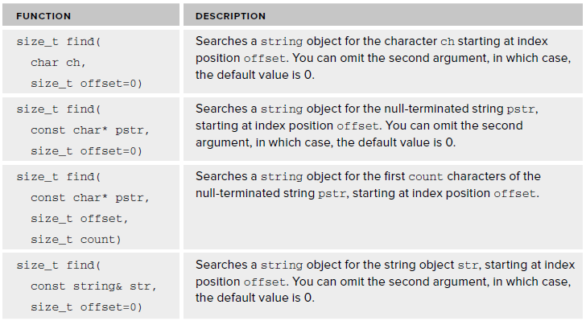
Searching Strings
There are four versions of the find() function that search a string object for a given character or substring.
All the find() functions are defined as being const .

Slide 29
Searching Strings..
Examples
string phrase("So near and yet so far");
string str("So near");
cout < < phrase.find(str) < < endl; // Outputs 0
cout < < phrase.find("so far") < < endl; // Outputs 16
cout < < phrase.find("so near") < < endl;
// Outputs string::npos = 4294967295

Slide 30
C++ / CLI Programming

Slide 31
Searching One Dimensional Array
The Array class provides functions that search the elements of a one - dimensional array.
  BinarySearch() function use a binary search algorithm to find the index position of a given element in the entire array, or in a given range of elements.
  The binary search algorithm requires that the elements are ordered.
array < int > ^ values = { 23, 45, 68, 94, 123, 127, 150, 203, 299};
int toBeFound(127);
int position = Array::BinarySearch(values, toBeFound);
if(position < 0)
Console::WriteLine(L"{0} was not found.", toBeFound);
else
Console::WriteLine(L"{0} was found at index position {1}.", toBeFound, position);

Slide 32
Searching One Dimensional Array..
To search a given range of elements in an array you use a version of the BinarySearch() function that accepts four arguments.
array < int > ^ values = { 23, 45, 68, 94, 123, 127, 150, 203, 299};
int toBeFound(127);
int position = Array::BinarySearch(values, 3, 6, toBeFound);
First argument is the handle of the array to be searched.
2nd argument is the index position of the element where the search should start.
Third argument is the number of elements to be searched
4th argument is what you are looking for.

Slide 33
Searching One Dimensional Array..
Lets try an searching example..

Slide 34
Multidimensional Arrays
We can create arrays that have two or more dimensions
Max number of dimensions an array can have is 32.
Specify the number of dimensions that your array has between the angled brackets immediately following the element type, and separated from it by a comma.
The dimension of an array is 1 by default.
array < int, 2 >^ values = gcnew array < int, 2 > (4, 5);
This statement creates a two - dimensional array with four rows and five columns for a total of 20 elements.

Slide 35
Multidimensional Arrays
Array Shape:

Slide 36
Multidimensional Arrays
This is the method by which values are set for two dimensional array.
int nrows(4);
int ncols(5);
array < int, 2 > ^ values(gcnew array < int, 2 > (nrows, ncols));
for(int i = 0 ; i < nrows ; i++)
for(int j = 0 ; j < ncols ; j++)
values[i,j] = (i+1)*(j+1);
Nested loop iterates over all the elements of the array.
Outer loop iterates over the rows
Inner loop iterates over every element in the current row

Slide 37
Multidimensional Arrays
Lets have an example …

Slide 38
Array of Arrays
Array elements can be of any type, so you can create arrays where the elements are tracking handles that reference arrays.
This gives you the possibility of creating so - called jagged arrays , because each handle referencing an array can have a different number of elements.
Suppose you want to store the names of children in a class grouped by the grade they scored, where there are five classifications corresponding to grades A, B, C, D, and E.
You could first create an array of five elements where each element stores an array of names.

Slide 39
Array of Arrays
array < array < String^ > ^ > ^ grades(gcnew array < array < String^ > ^ > 5));
The array variable, grades , is a handle of type array < type > ^ .
Each element in the array is also a handle to an array, so the type of the array elements is of the same form, array < type > ^ , this has to go between the angled brackets in the original array type specification, which results in array < array < type > ^ > ^ .
The elements stored in the array are also handles to String objects, so you must replace type in the last expression with String^ .

Slide 40

Array of Arrays
How it will look like

Slide 41
Thank You

