Slide 1
LESSON 14

Slide 2
Overview
of
Previous Lesson(s)

Slide 3
Over View
VP is the methodology in which development allows the user to grab and use the desired tools like menus, buttons, controls and other elements from a palette.

Slide 4
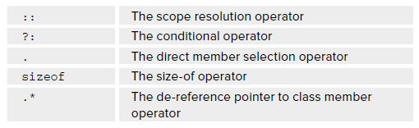
Over View
Operator Overloading:
  Operator overloading is a very important capability, it enables to make standard C++ operators, such as + , - , * , and so on, work with objects of user defined data types.
  Following operators can’t be overloaded:

Slide 5
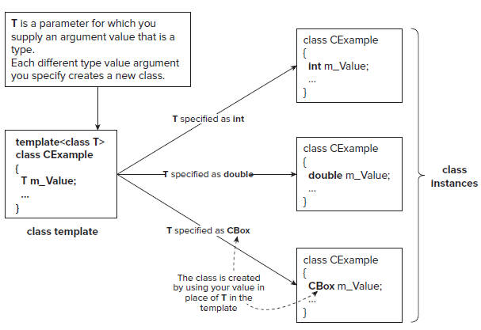
Over View..
Class Template
A class template is not a class, but a sort of recipe for a class that will be used by the compiler to generate the code for a class.

Slide 6
Over View…
Problem Definition:
  The principal function of a box is to contain objects of one kind or another, so, in one word, the problem is packaging.
Basic operations on CBox class include:
  Calculate the volume of a Cbox.
  Compare the volumes of two CBox objects.
  Compare the volume of a CBox object with a specified value, and vice versa.

Slide 7
Over View...
  Add two CBox objects to produce a new CBox object that will contain both the original objects.
  Multiply a CBox object by an integer (and vice versa).
  Determine how many CBox objects of a given size can be packed in another CBox object of a given size.
  Determine the volume of space remaining in a CBox object after packing it with the maximum number of CBox objects of a given size.

Slide 8
TODAY’S LESSON

Slide 9
Contents
A Multi-file Project
Organizing Program Code
Naming Program Files
CLR Programming
  Arrays
  Sorting Arrays

Slide 10
A Multi-file Project
Before we actually start writing the code to use the CBox class and its overloaded operators, first we assemble the definition for the class into a coherent whole.
We are going to take a rather different approach from what we have done previously.
We are also going to start using the facilities that Visual C++ 2008 / 2010 provides for creating and maintaining code for our classes.
This mean that practically we do rather less of the work, but it will also mean that the code will be slightly different in places.

Slide 11
A Multi-file Project..
Lets Code some files..

Slide 12
Organizing Program Code
In our project we distributed the code among several files for the first time.
It is not a common practice with C++ applications generally, but with Windows programming, it is essential.
The sheer volume of code involved in even the simplest program necessitates dividing it into workable chunks.
There are basically two kinds of source code files in a
  Header Files
  Source Files

Slide 13
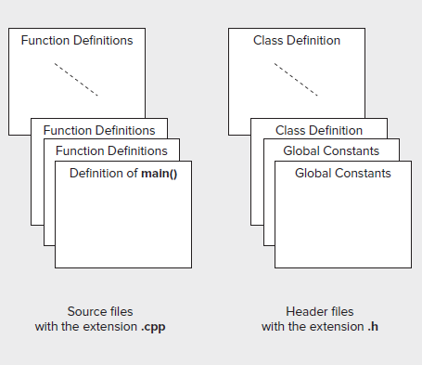
Organizing Program Code..

Slide 14
Naming Program Files
For classes of any complexity, it’s usual to store the class definition in a .h file with a file name based on the class name.
Store the implementation of the function members of the class that are defined outside the class definition in a .cpp file with the same name.

Slide 15
Naming Program Files..
On this basis, the definition of our CBox class appeared in a file with the name Box.h
Similarly, the class implementation was stored in the file Box.cpp .
With programs of any size it would be a good idea to get into the habit of creating .h and .cpp files to hold your program code from now on.

Slide 16
Naming Program Files..
Segmenting a C++ program into .h and .cpp files is a very convenient approach, as it makes it easy to find the definition or implementation of any class.
As long as you know the class name, you can go directly to the file you want.
However you can choose to structure your files, the Class View still displays all the individual classes, as well as all the members of each class

Slide 17
C++ / CLI Programming

Slide 18
Arrays
CLR arrays are different from the native C++ arrays.
Memory for a CLR array is allocated on the garbage - collected heap.
The general form for specifying the type of variable to reference a one - dimensional array is
array < element_type > ^
  CLR array is created on the heap so an array variable is always have a tracking handle.
array < int > ^ data;
  The array variable, data can store a reference to any one - dimensional array of elements of type int .

Slide 19
Arrays..
CLR array can be created using the gcnew operator at the same time that you declare the array variable:
array < int > ^ data = gcnew array < int > (100);
Functional notation can also be used to initialize the variable data :
array < int > ^ data(gcnew array < int > (100));
  Elements in a CLR array are objects; here storing objects are of type Int32 in the array.
An array variable can store the address of any array of the same rank (the rank being the number of dimensions, which in the case of the data array is 1) and element type.

Slide 20
Arrays
data = gcnew array < int > (45);
  This statement creates a new one - dimensional array of 45 elements of type int and stores its address in data .
  The original array referenced by the handle, data, is discarded.
static Clear() function of the Array class can be used to set any sequence of numeric elements in an array to zero.
You call a static function using the class name.
Array::Clear(samples, 0, samples- > Length);

Slide 21
Arrays
The first argument to Clear() is the array that is to be cleared.
The second argument is the index for the first element to be cleared.
The third argument is the number of elements to be cleared.
Thus, this example sets all the elements of the samples array to 0.0.
If Clear() function is applied to an array of tracking handles such as String^ , the elements are set to nullptr.
Apply it to an array of bool elements they are set to false .

Slide 22
Using a CLR Array
Lets do the practical work …

Slide 23
Sorting Arrays
The Array class in the System namespace defines a Sort() function that sorts the elements of a one - dimensional array so that they are in ascending order.
To sort an array, just pass the array handle to the Sort() function.
Here ’ s an example:
array < int > ^ samples = { 27, 3, 54, 11, 18, 2, 16};
Array::Sort(samples); // Sort the array elements
for each(int value in samples) // Output the array elements
Console::Write(L"{0, 8}", value);
Console::WriteLine();

Slide 24
Sorting Arrays..
The call to the Sort() function rearranges the values of the elements in the samples array into ascending sequence.
The result of executing this code fragment is:
2 3 11 16 18 27 54
We can also sort a range of elements in an array by supplying two more arguments to the Sort() function, specifying the index for the first element of those to be sorted, and the number of elements to be sorted.
array < int > ^ samples = { 27, 3, 54, 11, 18, 2, 16};
Array::Sort(samples, 2, 3); // Sort elements 2 to 4

Slide 25
Thank You

