Slide 1
LESSON 13

Slide 2
Overview
of
Previous Lesson(s)

Slide 3
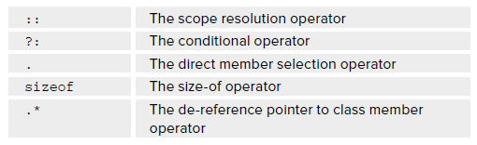
Over View
Operator Overloading:
  Operator overloading is a very important capability, it enables to make standard C++ operators, such as + , - , * , and so on, work with objects of user defined data types.
  Following operators can’t be overloaded:

Slide 4
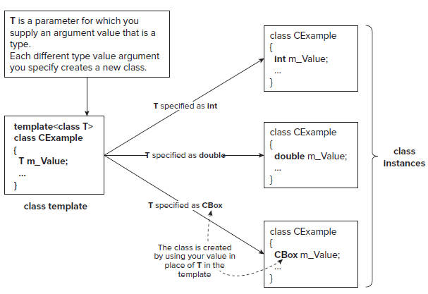
Over View..
Class Template
A class template is not a class, but a sort of recipe for a class that will be used by the compiler to generate the code for a class.

Slide 5
Over View…
A pointer is a variable that stores the address of another variable of a particular type.
long *pnum; //convention in C++
For getting the address & operator is used.
  This is a unary operator that obtains the address of a variable.
  It ’ s also called the reference operator.
long number = 200;
long* pnumber;
pnumber = &number;

Slide 6
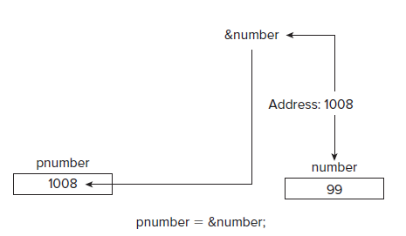
Over View…
Operator & can be used to obtain the address of any variable, but you need a pointer of the appropriate type to store it.

Slide 7
Over View…
Enumerations:
  enum class Suit{Clubs, Diamonds, Hearts, Spades};
This defines an enumeration type, Suit , and variables of type Suit can be assigned only one of the values defined by the enumeration, Hearts , Clubs , Diamonds , or Spades.
Suit suit = Suit::Clubs;
  This statement assigns the value Clubs from the Suit enumeration to the variable with the name suit .

Slide 8
Over View…
Reading Key Presses.
  AS we see earlier that Console::ReadKey(true); is used to store the result in the variable keypress, which is of type ConsoleKeyInfo.
  Lets have a look into an example which uses Readkey() and do while loop in CLR programming.
Task:
  Continue to Press a key until Escape key is pressed.

Slide 9
TODAY’S LESSON

Slide 10
Contents
Using Classes
Defining a Problem
Implementing the CBox class
  Comparing CBox Objects
  Combining CBox Objects
  Analyzing CBox Objects
CLR Programming
  Nested If Statements
  Reading Key Presses
  For each Loop
  Tracking Handles

Slide 11
Using Classes
Until now we have touched on most of the basic aspects of defining a native C++ class.
So now we should look at how a class might be used to solve a problem.
The problem has to be simple so that we can try to focus on the complete solution so we ’ ll consider problems in which we can use an extended version of the CBox class.

Slide 12
Defining a Problem
The principal function of a box is to contain objects of one kind or another, so, in one word, the problem is packaging.
Basic operations that we might want to provide in the CBox class include:
  Calculate the volume of a Cbox. (Already done)
  Compare the volumes of two CBox objects to determine which is the larger. (Already done)

Slide 13
Defining a Problem..
  Compare the volume of a CBox object with a specified value, and vice versa.
  Add two CBox objects to produce a new CBox object that will contain both the original objects. Thus, the result will be at least the sum of the volumes, but may be larger.
  Multiply a CBox object by an integer (and vice versa) to provide a new CBox object that will contain a specified number of the original objects.
    This is effectively designing of a carton.

Slide 14
Defining a Problem...
  Determine how many CBox objects of a given size can be packed in another CBox object of a given size.
    This is effectively division, so you could implement this by overloading the / operator.
  Determine the volume of space remaining in a CBox object after packing it with the maximum number of CBox objects of a given size.

Slide 15
Cbox Class
We need a bit change in our existing Cbox class to address all the problems:
class CBox // Class definition at global scope
{
public:
// Constructor definition
explicit CBox(double lv = 1.0, double wv = 1.0, double hv = 1.0)
{
lv = lv < = 0 ? 1.0 : lv; // Ensure positive
wv = wv < = 0 ? 1.0 : wv; // dimensions for
hv = hv < = 0 ? 1.0 : hv; // the object
m_Length = lv > wv ? lv : wv; // Ensure that
m_Width = wv < lv ? wv : lv; // length > = width
m_Height = hv;
}

Slide 16
Cbox Class..
// Function to calculate the volume of a box
double Volume() const
{ return m_Length*m_Width*m_Height; }
// Function providing the length of a box
double GetLength() const { return m_Length; }
// Function providing the width of a box
double GetWidth() const { return m_Width; }
// Function providing the height of a box
double GetHeight() const { return m_Height; }

Slide 17
Cbox Class..
private:
double m_Length; // Length of a box in inches
double m_Width; // Width of a box in inches
double m_Height; // Height of a box in inches
};
The constructor is now secure because any dimension that the user of the class tries to set to a negative number or zero will be set to 1 in the constructor.

Slide 18
Comparing Cbox Objects
We have to include support for the operators > , > = , == , < , and < = so that they work with both operands as CBox objects, as well as between a CBox object and a value of type double .
We can implement these as ordinary global functions because they don’t need to be member functions.
They can be written as functions that compare the volumes of two CBox objects in terms of the functions that compare the volume of a CBox object with a double value,

Slide 19
Comparing Cbox Objects..
// Function for testing if a constant is > a CBox object
bool operator > (const double & value, const CBox & aBox)
{ return value > aBox.Volume(); }
// Function for testing if a constant is < a CBox object
bool operator < (const double & value, const CBox & aBox)
{ return value < aBox.Volume(); }

Slide 20
Comparing Cbox Objects…
We can code the implementations of the same operators with the arguments reversed in terms of the two functions you have just defined:
// Function for testing if CBox object is > a constant
bool operator > (const CBox & aBox, const double & value)
{ return value < aBox; }
// Function for testing if CBox object is < a constant
bool operator < (const CBox & aBox, const double & value)
{ return value > aBox; }

Slide 21
Comparing Cbox Objects…
The operator==() functions are also very similar:
// Function for testing if constant is == the volume of a CBox object
bool operator==(const double & value, const CBox & aBox)
{
return value == aBox.Volume();
}
// Function for testing if CBox object is == a constant
bool operator==(const CBox & aBox, const double & value)
{
return value == aBox;
}

Slide 22
Combining Cbox Objects
Now, the time comes for the question of overloading the operators + , * , / , and % .
// Function adding two CBox objects
CBox operator+(const CBox & aBox) const;
{
// New object has larger length & width, and sum of heights
return CBox(
m_Length > aBox.m_Length ? m_Length :aBox.m_Length,
m_Width > aBox.m_Width ? m_Width : aBox.m_Width,
m_Height + aBox.m_Height );
}

Slide 23
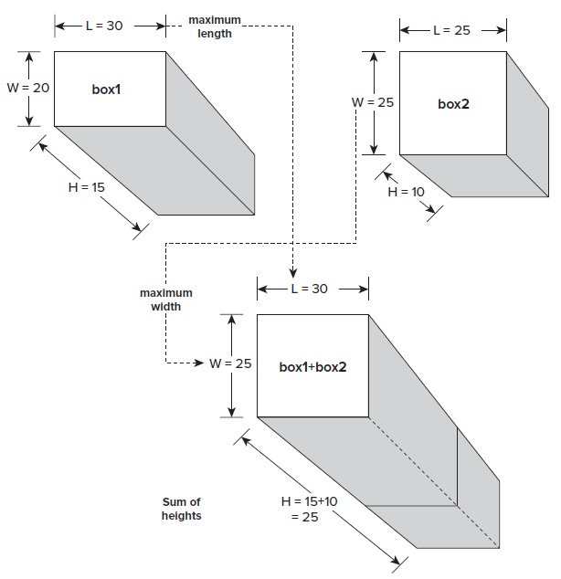
Addition Operation

Slide 24
Multiply Operation
It represents the process of creating a box to contain n boxes, where n is the multiplier.
The simplest solution would be to take the m_Length and m_Width of the object to be packed and multiply the height by n to get the new CBox object.
You can make it a little cleverer by checking whether or not the multiplier is even and, if it is, stack the boxes side by side by doubling the m_Width value and only multiplying the m_Height value by half of n .

Slide 25
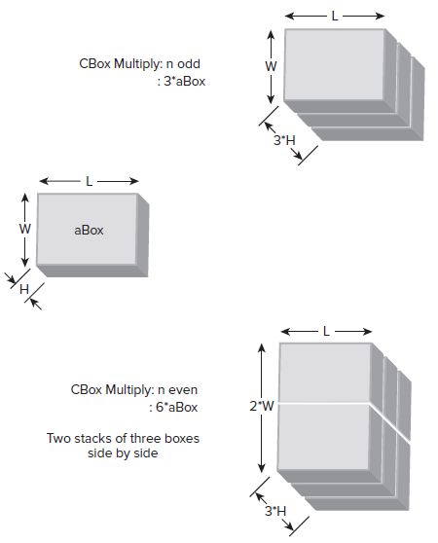
Multiply Operation..

Slide 26
Multiply Operation…
As a member function with the left operand as a CBox object:
// CBox multiply operator this*n
CBox operator*(int n) const
{
if(n % 2)
return CBox(m_Length, m_Width, n*m_Height); // n odd
else
return CBox(m_Length, 2.0*m_Width, (n/2)*m_Height); // n even
}
Here, you use the % operator to determine whether n is even or odd.
If n is odd, the value of n % 2 is 1 and the if statement is true .
If it is even, n % 2 is 0 and the statement is false .

Slide 27
Multiply Operation…
As a simple non-member function with the left operand as an int.
// CBox multiply operator n*aBox
CBox operator*(int n, const CBox & aBox)
{
return aBox*n;
}
This version of the multiply operation simply reverses the order of the operands so as to use the previous version of the function directly.

Slide 28
Analyzing Cbox Objects
Division operation will determine how many CBox objects identical to that specified by the right operand can be contained in the CBox object specified by the left operand.
To keep it relatively simple, assume that all the CBox objects are packed the right way up, that is, with the height dimensions vertical.

Slide 29
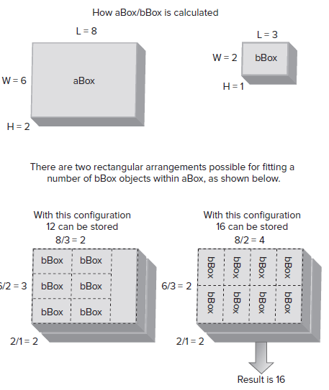
Divide Operation..

Slide 30
Divide Operation…
int operator/(const CBox & aBox) const
{
int tc1 = 0; // Temporary for number in horizontal plane this way
int tc2 = 0; // Temporary for number in a plane that way
tc1 = static_cast < int > ((m_Length / aBox.m_Length))*
static_cast < int > ((m_Width / aBox.m_Width));
// and that way Return best fit
tc2 = static_cast < int > ((m_Length / aBox.m_Width))*
static_cast < int > ((m_Width / aBox.m_Length));
return static_cast < int > ((m_Height/aBox.m_Height)*(tc1 > tc2 ? tc1 : tc2));
}

Slide 31
% Operation
The other analytical operator function, operator%(), for obtaining the free volume in a packed aBox is easier, because it uses the operator /, which is already defined.
It can be written as an an ordinary global function because the private members of the class are don’t need to be accessed.
// Operator to return the free volume in a packed box
double operator%(const CBox & aBox, const CBox & bBox)
{ return aBox.Volume() - ((aBox/bBox)*bBox.Volume()); }
The result is the volume of the big box, aBox , minus the volume of the bBox boxes that can be stored in it.

Slide 32
C++ / CLI Programming

Slide 33
For each loop
All the loop statements apply equally well to C++/CLI programs, and the C++/CLI language provides with the luxury of an additional kind of loop called the for each loop.
This loop also works with native C++ code in Visual C++ 2010, although formally the for each loop is not part of the ISO/IEC standard C++ language.
The for each loop is specifically for iterating through all the objects in a particular kind of set of objects.

Slide 34
For each loop..
#include "stdafx.h"
using namespace System;
int main(array < System::String ^ > ^args)
{
int vowels(0), consonants(0);
String^ proverb(L“When in Rome, do as the Romans.");
for each(wchar_t ch in proverb)
{
if(Char::IsLetter(ch))
{
ch = Char::ToLower(ch); // Convert to lowercase
switch(ch)
{
case 'a':
case 'e':
case 'i':

Slide 35
For each loop…
case 'o':
case 'u':
++vowels;
break;
default:
++consonants;
break;
}
}
}
Console::WriteLine(proverb);
Console::WriteLine(L"The proverb contains {0} vowels and {1} consonants.",
vowels, consonants);
return 0;
}

Slide 36
For each loop…
This loop counts the vowels and constants.
Lets check this …

Slide 37
Tracking Handles
A tracking handle has similarities to a native C++ pointer, but there are also some significant differences.
A tracking handle does store an address, which is automatically updated by the garbage collector if the object it references is moved during compaction of the heap.
Garbage Collector:
  In C and C++, many objects require the programmer to allocate their resources once declared, before the objects can be safely used.
  Releasing these resources back to the free memory pool once the object has been used is the responsibility of the programmer.

Slide 38
Garbage Collector
  If resources are not released, the code is said to leak memory, as more and more resources are consumed needlessly.
  On the other hand, if resources are released prematurely, loss of data, the corruption of other memory areas, and null pointer exceptions can occur.
The CLR garbage collector periodically checks the memory heap for any unreferenced objects, and releases the resources held by these objects.

Slide 39
Tracking Handles..
However, you cannot perform address arithmetic with a tracking handle as you can with a native pointer, and casting a tracking handle is not permitted.
  For instance, the String class type is a reference class type, so variables that reference String objects must be tracking handles.

Slide 40
Creating Tracking Handles
A handle is specified for a type by placing the ^ symbol following the type name.
String^ proverb;
  This defines the variable proverb to be a tracking handle of type String^ .
  When a handle is declared it is automatically initialized with null, so it will not refer to anything.
To explicitly set a handle to null you use the keyword nullptr like this:
proverb = nullptr; // Set handle to null

Slide 41
Creating Tracking Handles..
Of course, you can initialize a handle explicitly when you declare it.
Here ’ s another statement that defines a handle to a String object:
String^ saying(L"I used to think I was indecisive but now I'm not so sure");
This statement creates a String object on the heap that contains the string between the parentheses.
Address of the new object is stored in saying .
Here ’ s how you could create a handle for a value type:
int^ value(99);
This statement creates the handle value of type int^ ; the value it points to on the heap is initialized to 99.

Slide 42
Thank You

