Slide 1
LESSON 11

Slide 2
Overview
of
Previous Lesson(s)

Slide 3
Over View
CLR Programming
  Common Language Runtime (CLR) is a programming that manages the execution of programs written in any of several supported languages, allowing them to share common object oriented classes written in any of the languages.
  Microsoft refers to its Common Language Runtime as a "managed execution environment”.

Slide 4
Over View..
ISO/IEC C++ fundamental data type names can be used in C++/CLI programs, and with arithmetic operations.
The fundamental type names in a C++/CLI program have a different meaning and introduce additional capabilities in certain situations.
A fundamental type in a C++/CLI program is a value class type and can behave either as an ordinary value or as an object if the circumstances require it.

Slide 5
Over View...
ISO/IEC C++ fundamental type names are aliases for the value class type names in a C++/CLI program, so it can be used in managed code.
Ex ISO/IEC C++
int count = 10;
double value = 2.5;
But in C++ / CLI, it is like this:
System::Int32 count = 10;
System::Double value = 2.5;

Slide 6

Over View...
CLI Ouput
  Console::Write() and Console::WriteLine() methods are used to write a string or other items of data to the command line.
  The arguments that follow the first argument to the Console::WriteLine() function are numbered in sequence starting with zero.
Notes:
Console::ReadLine();

Slide 7
Over View…
Class Constructor
  A class constructor is a special function in a class that is responsible for creating new objects when required.
  A constructor provides the opportunity to initialize objects as they are created and to ensure that data members only contain valid values.
  A class may have several constructors, enabling you to create objects in various ways.

Slide 8
Over View…
Class Destructor
  A destructor is a function that destroys an object when it is no longer required or when it goes out of scope.
  The class destructor is called automatically when an object goes out of scope.
  Destroying an object involves freeing the memory occupied by the data members of the object except for static members, which continue to exist even when there are no class objects in existence.
  ~Cbox () { }

Slide 9
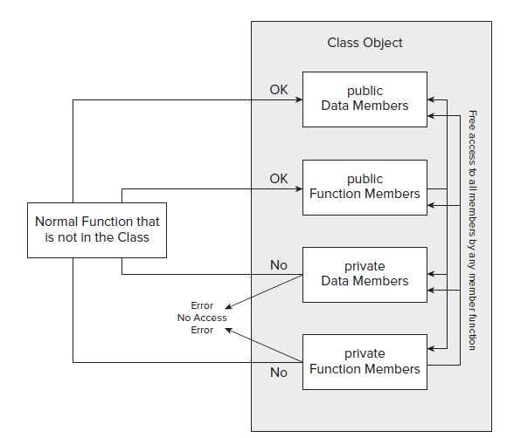
Over View...
Private Members:-

Slide 10
Over View…
Friends Function
  Functions outside the class that are able to access all the members of a class i.e private or public.
  They are defined using the keyword friend
  Either include the prototype of a friend function in the class definition, or you can include the whole function definition.
friend double BoxSurface(Cbox aBox);

Slide 11
TODAY’S LESSON

Slide 12
Contents
Objects, Data, Functions & Memory
Constant Objects
Arrays of Objects
Static Data / Function Members
Pointers to Objects
References to Objects
Sharing Memory Between Variables
Unions
CLI - Formatting the output
CLI – Input
Using safe_cast
Discovering C++/Cli Types

Slide 13
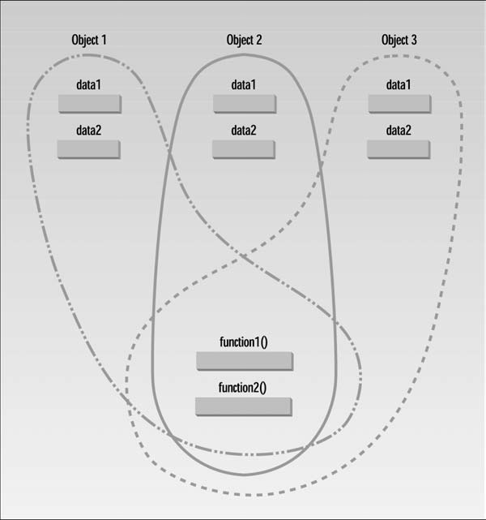
Objects, Data, Functions

Slide 14
Constant Objects
When an object is declared as const, it can’t be modified.
It follows that only const member functions with it, because they’re the only ones that guarantee not to modify it.
You will undoubtedly want to create class objects that are fixed from time to time, just like values such as pi or inchesPerFoot that you might declare as const double.
Suppose we wanted to define a CBox object as const.
  const CBox standard(3.0, 5.0, 8.0);

Slide 15
Constant Member Functions
A const member function guarantees that it will never modify any of its class’s member data.
An object is declared as const will always have a this pointer that is const , so the compiler will not allow any member function to be called that does not assume the this pointer that is passed to it is const .
To make the this pointer in a member function const , declare the function as const within the class definition.
double Volume() const
bool Compare(const CBox & xBox) const

Slide 16
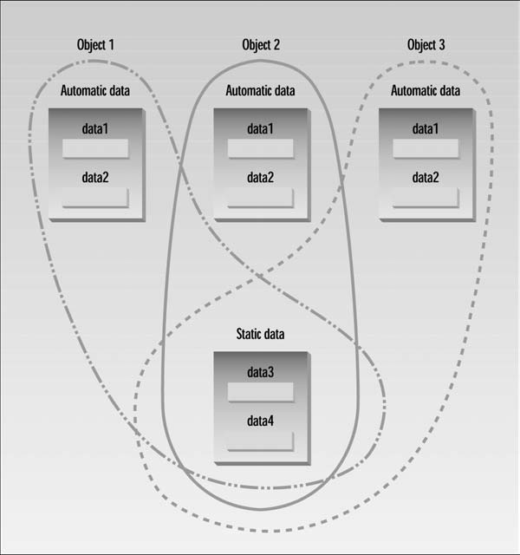
Static Classes
Both data members and function members of a class can be declared as static.

Slide 17
Static Data Members
class counter {
private:
static int scount; //static data member declaration
public:
counter ()
{ scount++; }
int getcount() // returns scount
{ return scount; }
};
Int counter::scount = 0; //static data member definition

Slide 18
Static Data Members..
int main()
{
counter o1, o2, o3; //create three objects
cout << “count is “ << o1.getcount() << endl; //each object
cout << “count is “ << o2.getcount() << endl; //sees the
cout << “count is “ << o3.getcount() << endl; //same value
return 0;
}

Slide 19
Static Function Members
A static function member is independent of any particular object of the class.
The static member function can be called even if no objects of the class exist. In this case, only static data members can be used because they are the only ones that exist.
So a static member function could be used to determine whether some objects of the class have been created or, indeed, how many have been created.
static void Afunction(int n);

Slide 20
Static Function Members..
A static function can be called in relation to a particular object by a statement such as the following
aBox.Afunction(10);
  where aBox is an object of the class.
  The same function could also be called without reference to an object. In this case, the statement would take form mentioned below
CBox::Afunction(10);
  where CBox is the class name. Using the class name and the scope resolution operator serves to tell the compiler to which class the function Afunction() belongs.

Slide 21
Pointers to Objects
Class objects can involve considerable amounts of data, so using the pass - by - value mechanism by specifying parameters to a function to be objects can be very time - consuming and inefficient because each argument object will be copied.
A pointer to a class object is declared in the same way that as declare other pointers.
For example, a pointer to objects of type CBox is declared in this statement:
CBox* pBox(nullptr); // Declare a pointer to CBox

Slide 22
Pointers to Objects..
Let ’ s try exercising the indirect member access operator a little more.

Slide 23
References to Objects
References really come into their own when they are used with classes. As with pointers, there is virtually no difference between the way you declare and use references to class objects and the way in which references to variables of basic types are declared and used.
A reference to the object cigar can be declared as
CBox &rcigar(cigar); // Define reference to object cigar
To use a reference to calculate the volume of the object cigar , you would just use the reference name where the object name would otherwise appear:
cout << rcigar.Volume(); // Output volume of cigar thru a reference

Slide 24
Unions
A facility of sharing the same memory by more than one variable is called a union and there are four basic ways in which you can use one:
  You can use it so that a variable A occupies a block of memory at one point in a program, which is later occupied by another variable B of a different type, because A is no longer required.
  A situation in a program where a large array of data is required, but you don’t know in advance of execution what the data type will be.

Slide 25
Unions..
  A third possible use for a union is when you want to interpret the same data in two or more different ways. This could happen when you have a variable that is of type long , and you want to treat it as two values of type short.
  You can use a union as a means of passing an object or a data value around where you don’t know in advance what its type is going to be. The union can provide for storing any one of the possible range of types that you might have.

Slide 26
Unions…
A union is defined using the keyword union
union shareLD // Sharing memory between long and double
{
double dval;
long lval;
};
This defines a union type shareLD that provides for the variables of type long and double to occupy the same memory.
The union type name is usually referred to as a tag name.

Slide 27
Unions…
Once the union type has been defined, it can define instances of a union in a declaration.
shareLD myUnion;
To refer to a member of the union, direct member selection operator (the period) is used with the union instance name.
myUnion.lval = 100; // Using a member of a union

Slide 28
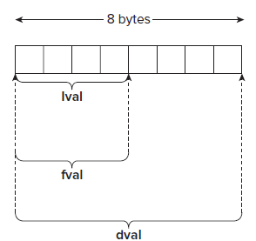
Unions…
A union is not limited to sharing between two variables. Same memory can be shares between several variables.
The memory occupied by the union will be that which is required by its largest member.
union shareDLF
{
double dval;
long lval;
float fval;
} uinst = {1.5};

Slide 29
C++ / CLI Programming

Slide 30
Formatting the Output
We already had an example of output format.
It could also be written as the statement with the last two arguments in reverse sequence:
Console::WriteLine(L"There are {1} packages weighing {0} pounds.",
packageWeight, packageCount);
  The packageWeight variable is now referenced by 0 and packageCount by 1 in the format string.

Slide 31
Formatting the Output..
Console::WriteLine(L"There are {0} packages weighing {1:F2} pounds.", packageCount, packageWeight);
  In the substring {1:F2} , the colon separates the index value, 1 , that identifies the argument to be selected from the format specification that follows, F2 .
  The F in the format specification indicates that the output should be in the form “ ± ddd.dd . . . ” (where d represents a digit) and the 2 indicates that you want to have two decimal places after the point.
  The output produced by the statement will be:
There are 25 packages weighing 7.50 pounds.

Slide 32
Formatting the Output…
You can write the format specification in the form {n,w : Axx}
  where the n is an index value selecting the argument following the format string.
  w is an optional field width specification.
  A is a single letter specifying how the value should be formatted.
  xx is an optional one or two digits specifying the precision for the value.
Console::WriteLine(L"Packages:{0,3} Weight: {1,5:F2} pounds.",
packageCount, packageWeight);
The package count is output with a field width of 3 and the weight with a field width of 5.
Packages: 25 Weight: 7.50 pounds.

Slide 33
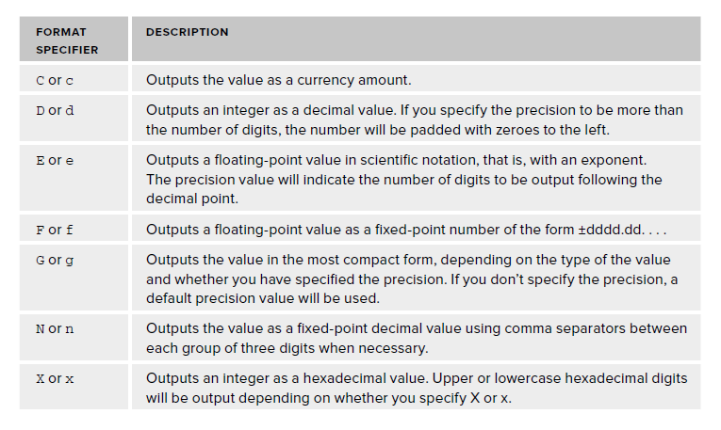
Some Format Specifications

Slide 34
Input
The keyboard input capabilities with a .NET Framework console program are limited.
Console::ReadLine()
  Reads complete line of input as a string using the function.
  String^ line = Console::ReadLine();
  The variable line is of type String^ and stores a reference to the string that results from executing the Console::ReadLine() function; the little hat character, ^ , following the type name, String , indicates that this is a handle that references an object of type String .

Slide 35
Input..
Console::Read()
  This function can read a single character.
char ch = Console::Read();
  With the Read() function, you could read input data character by character, and then, analyze the characters read and convert the input to a corresponding numeric value.
Console::ReadKey()
  This function returns the key that was pressed as an object of type ConsoleKeyInfo , which is a value class type defined in the System namespace.
    ConsoleKeyInfo keyPress = Console::ReadKey(true);

Slide 36
Input..
The argument true to the ReadKey() function results in the key press not being displayed on the command line.
An argument value of false (or omitting the argument) will cause the character corresponding to the key pressed being displayed.
The result of executing the function will be stored in keyPress .
  To identify the character corresponding to the key (or keys) pressed, use the expression keyPress.KeyChar .
Console::WriteLine(L"The key press corresponds to the character: {0}", keyPress.KeyChar);

Slide 37
safe_cast
The safe_cast operation is for explicit casts in the CLR environment.
In most instances, static_cast is used to cast from one type to another in a C++/CLI program without problems, but because there are exceptions that will result in an error message, it is better to use safe_cast .
double value1 = 10.5;
double value2 = 15.5;
int whole_number = safe_cast < int > (value1) + safe_cast < int > (value2);
The last statement casts each of the values of type double to type int before adding them together and storing the result in whole_number

Slide 38
Thank You

