Slide 1
LESSON 10

Slide 2
Overview
of
Previous Lesson(s)

Slide 3
Over View
.NET Framework is a software framework developed by Microsoft that runs primarily on Microsoft Windows.
It includes a large library and provides language interoperability across several programming languages

Slide 4
Over View..
Programs written for the .NET Framework execute in a software environment, known as the CLR, an application virtual machine that provides services such as security, memory management, and exception handling.
The class library and the CLR together constitute the .NET Framework.

Slide 5
Over View…
A pointer is a variable that stores the address of another variable of a particular type.
long *pnum; //convention in C++
For getting the address & operator is used.
  This is a unary operator that obtains the address of a variable.
  It ’ s also called the reference operator.
long number = 200;
long* pnumber;
pnumber = &number;

Slide 6
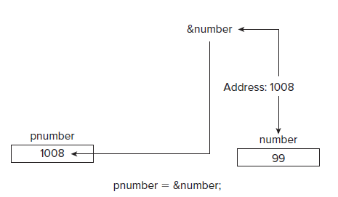
Over View…
Operator & can be used to obtain the address of any variable, but you need a pointer of the appropriate type to store it.

Slide 7
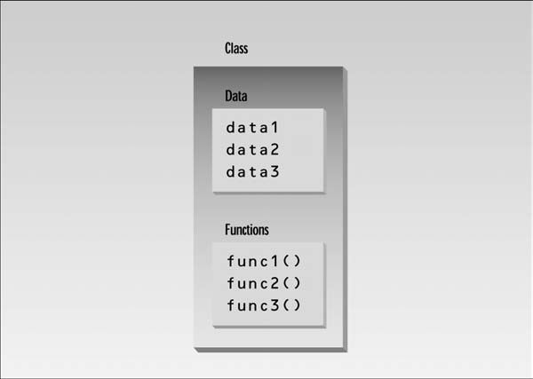
Class
A class is a specification of a data type that you define.
A class combines both the definition of the elementary data that makes up an object and the means of manipulating the data that belongs to individual objects of the class (functions).

Slide 8
Over View…
CBox data type using the keyword class is defined as follows:
class CBox
{
public:
double m_Length; // Length of a box in inches
double m_Width; // Width of a box in inches
double m_Height; // Height of a box in inches
double Volume()
{ return m_Length*m_Width*m_Height; }
};

Slide 9
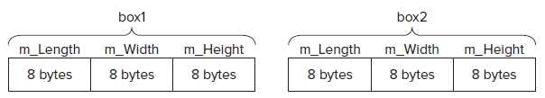
Over View…
CBox box1; // Declare box1 of type CBox
CBox box2; // Declare box2 of type Cbox

Slide 10
TODAY’S LESSON

Slide 11
Contents
Class Constructor
Default Constructor / Default Copy Constructor
Initializer List
Private Members of a Class
Friend’s Functions
The pointer this
Destructor
C++/CLI Programs
C++/CLI Specific: Fundamental Data Types
C++/CLI Output

Slide 12
Class Constructor
A class constructor is a special function in a class that is responsible for creating new objects when required.
A constructor provides the opportunity to initialize objects as they are created and to ensure that data members only contain valid values.
A class may have several constructors, enabling you to create objects in various ways.

Slide 13
ExAMPLE
// Using a constructor
#include <iostream>
Using namespace std;
class CBox // Class definition at global scope
{
public:
double m_Length;
double m_Width;
double m_Height;

Slide 14
Constructor Definition
// Constructor definition
CBox(double lv, double bv, double hv)
{
cout << endl << “Constructor called.”;
m_Length = lv; // Set values of data members
m_Width = bv;
m_Height = hv;
}
// Function to calculate the volume of a box
double Volume()
{ return m_Length* m_Width* m_Height; }
};

Slide 15
Main Function
int main()
{
CBox box1(78.0,24.0,18.0); // Declare and initialize box1
CBox cigarBox(8.0,5.0,1.0); // Declare and initialize cigarBox
double boxVolume(0.0); // Stores the volume of a box
boxVolume = box1.Volume(); // Calculate volume of box1
cout << endl << “Volume of box1 = “ << boxVolume;
cout << endl << “Volume of cigarBox = “<< cigarBox.Volume();
cout << endl;
return 0;
}

Slide 16
Default Constructor
CBox box2; // Declare box2 of type Cbox
Here, you ’ ve left box2 without initializing values.
When you rebuild this version of the program,
you get the error message:
  error C2512: 'CBox': no appropriate default constructor available
A default constructor is one that does not require any arguments to be supplied, or one whose arguments are all optional.
CBox() // Default constructor
{ } // Totally devoid of statements

Slide 17
Ex Default Constructor
class CBox // Class definition at global scope
{
public:
double m_Length; double m_Width; double m_Height;
// Constructor definition
CBox(double lv, double bv, double hv)
{
cout << endl << “Constructor called.”;
m_Length = lv; m_Width = bv; m_Height = hv;
}
// Default constructor definition
CBox()
{ cout << endl << “Default constructor called.”; }
// Function to calculate the volume of a box
double Volume()
{ return m_Length*m_Width*m_Height; }
};

Slide 18
Ex Default Constructor
int main()
{ CBox box1(78.0,24.0,18.0); // Declare and initialize box1
CBox box2; // Declare box2 - no initial values
CBox cigarBox(8.0, 5.0, 1.0); // Declare and initialize cigarBox
double boxVolume(0.0); // Stores the volume of a box
boxVolume = box1.Volume(); // Calculate volume of box1
cout << endl<< “Volume of box1 = “ << boxVolume;
box2.m_Height = box1.m_Height - 10; // Define box2
box2.m_Length = box1.m_Length / 2.0; // members in
box2.m_Width = 0.25*box1.m_Length; // terms of box1
return 0;
}

Slide 19
Output
Constructor called.
Default constructor called.
Constructor called.
Volume of box1 = 33696

Slide 20
Default Copy Constructor
A no-argument constructor can initialize data members to constant values & a multi-argument constructor can initialize data members to values passed as arguments.
It can be initialized with an other object of the same type.
It’s called the default copy constructor.
It’s a one argument constructor whose argument is an object of the same class as the constructor.
CBox box2(box1); CBox box2 = box1;

Slide 21
Intializer List
Previously the members of an object in the class constructor, were intialized using explicit assignment.
// Constructor definition using an initialization list
CBox(double lv = 1.0, double bv = 1.0, double hv = 1.0):
m_Length(lv), m_Width(bv), m_Height(hv)
{ cout << endl << "Constructor called."; }
The way this constructor definition is written assumes that it appears within the body of the class definition.

Slide 22
Intializer List..
The values of the data members are not set in assignment statements in the body of the constructor.
As in a declaration, they are specified as initializing values using functional notation and appear in the initializing list as part of the function header.
Syntax:
  Note that the initializing list for the constructor is separated from the parameter list by a colon, and each of the initializers is separated by a comma.
The MFC also relies heavily on the initialization list technique.

Slide 23
Private Members
A constructor that sets the values of the data members of a class object, but still admits the possibility of any part of a program being able to mess with what are essentially the guts of an object, is almost a contradiction in terms.
Protection is needed for class data members.
Private Keyword:
  Class members that are private can, in general, be accessed only by member functions of a class.
A normal function has no direct means of accessing the private members of a class.

Slide 24
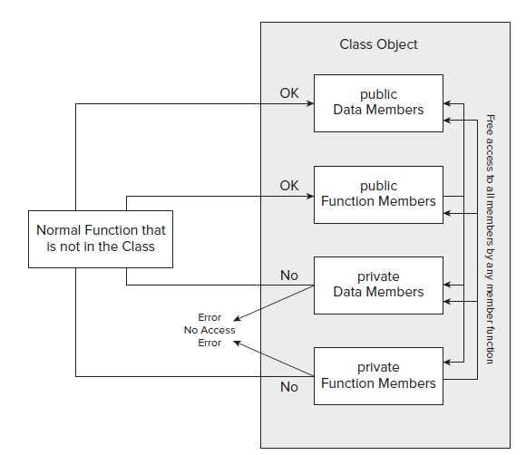
Private Members..

Slide 25
Private Members..
class CBox // Class definition at global scope
{
public:
// Constructor definition using an initialization list
CBox(double lv = 1.0, double bv = 1.0, double hv = 1.0):
m_Length(lv), m_Width(bv), m_Height(hv)
{ cout < < endl < < "Constructor called."; }
// Function to calculate the volume of a box
double Volume()
{ return m_Length*m_Width*m_Height; }
private:
double m_Length; // Length of a box in inches
double m_Width; // Width of a box in inches
double m_Height; // Height of a box in inches
};

Slide 26
Private Members..
int main()
{
CBox match(2.2, 1.1, 0.5); // Declare match box
CBox box2; // Declare box2 - no initial values
cout << endl << "Volume of match = “< < match.Volume();
// Uncomment the following line to get an error
// box2.m_Length = 4.0;
cout << endl << "Volume of box2 = “< < box2.Volume();
return 0;
}

Slide 27
Friends Function
Functions outside the class be able to access all the members of a class, a sort of elite group with special privileges.
Such functions are called friend functions of a class and are defined using the keyword friend
Either include the prototype of a friend function in the class definition, or you can include the whole function definition.
friend double BoxSurface(Cbox aBox);

Slide 28
The Pointer this
In the CBox class, Volume() function is defined in terms of the class member names in the definition of the class.
Of course, every object of type CBox that you create contains these members, so there has to be a mechanism for the function to refer to the members of the particular object for which the function is called.
When any member function executes, it automatically contains a hidden pointer with the name this, which points to the object used with the function call.

Slide 29
The Pointer this
When the member m_Length is accessed in the Volume() function during execution, its actually referring to this - > m_Length
The compiler takes care of adding the necessary pointer name this to the member names in the function.
If you need to, you can use the pointer this explicitly within a member function.

Slide 30
Destructor
As constructor is called automatically when a object is created, similarly there is another function, which is called automatically when an object is destroyed.
Such a function is called a destructor.
A destructor has the same name as the constructor (which is the same as the class name) but is preceded by a tilde:
  ~Cbox () { }

Slide 31
C++ / CLI Programs
C++/CLI provides a number of extensions and additional capabilities:
  All the ISO/IEC fundamental data types can be used in a C++/CLI program, but with few add-ons.
  C++/CLI provides its own mechanism for keyboard input and output to the command line in a console program.
  C++/CLI introduces the safe_cast operator that ensures that a cast operation results in verifiable code being generated.
  C++/CLI provides an alternative enumeration capability that is class - based and offers more flexibility than the ISO/IEC C++ enum declaration you have seen.

Slide 32
C++ / CLI Fundamental Data Types
ISO/IEC C++ fundamental data type names can be used in C++/CLI programs, and with arithmetic operations.
The fundamental type names in a C++/CLI program have a different meaning and introduce additional capabilities in certain situations.
A fundamental type in a C++/CLI program is a value class type and can behave either as an ordinary value or as an object if the circumstances require it.

Slide 33
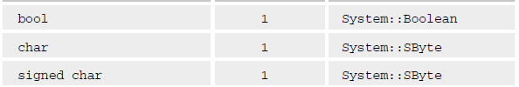
C++ / CLI Fundamental Data Types..
Within the C++/CLI language, each ISO/IEC fundamental type name maps to a value class type that is defined in the System namespace.
The fundamental types, the memory they occupy, and the corresponding value class types are shown next:

Slide 34
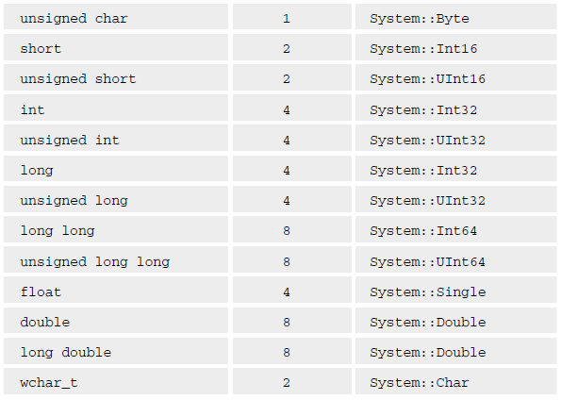
C++ / CLI Fundamental Data Types..

Slide 35
C++ / CLI Fundamental Data Types...
Because the ISO/IEC C++ fundamental type names are aliases for the value class type names in a C++/CLI program, in principle, you can use either in your C++/CLI code.
Ex ISO/IEC C++
int count = 10;
double value = 2.5;
But in C++ / CLI, it is like this:
System::Int32 count = 10;
System::Double value = 2.5;

Slide 36
C++ / CLI Output
#include "stdafx.h"
using namespace System;
int main(array < System::String ^ > ^args)
{
int apples, oranges; // Declare two integer variables
int fruit; // ...then another one
apples = 5; oranges = 6; // Set initial values
fruit = apples + oranges; // Get the total fruit
Console::WriteLine(L"\nOranges are not the only fruit...");
Console::Write(L"- and we have ");
Console::Write(fruit);
Console::Write(L" fruits in all.\n");
return 0;
}
Notes:
Console::ReadLine();

Slide 37
C++ / CLI Output Format..
The Write() and WriteLine() function is a C++/CLI function is defined in the Console class in the System namespace.
Both the Console::Write() and Console::WriteLine() functions have a facility for you to control the format of the output, and the mechanism works in exactly the same way with both.
int packageCount = 25;
Console::WriteLine(L"There are {0} packages.", packageCount);
Notes:
Console::ReadLine();

Slide 38

C++ / CLI Output Format...
The arguments that follow the first argument to the Console::WriteLine() function are numbered in sequence starting with zero, like this:
Thus, the zero between the braces in the previous code fragment indicates that the value of the packageCount argument should replace the {0} in the string that is to be written to the command line.
Notes:
Console::ReadLine();

Slide 39
Thank You

