Slide 1
LESSON 05

Slide 2
Overview
of
Previous Lesson(s)

Slide 3
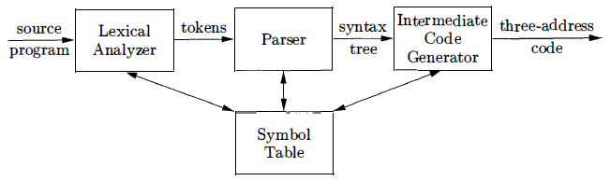
Over View
Model of a Compiler Front End

Slide 4
Over View..
Analysis is organized around the "syntax" of the language to be compiled.
  The syntax of a programming language describes the proper form of its programs.
  The semantics of the language defines the programs actual meaning.

Slide 5
Over View...
Context Free Grammar is used to specify the syntax of the language.
A grammar describes the hierarchical structure of most programming language constructs.
It has components
  A set of tokens (terminal symbols)
  A set of nonterminals
  A set of productions
  A designated start symbol

Slide 6
Over View...
Given a CF grammar determining the set of all strings generated by the grammar is known as derivation.
  Begin with the start symbol
  In each step, replace one nonterminal in the current sentential form with one of the right-hand sides of a production for that nonterminal

Slide 7
Over View...
Derivation for 9 – 5 + 2
list Start Symbol
⇒ list + digit P-1
⇒ list - digit + digit P-2
⇒ digit - digit + digit P-3
⇒ 9 - digit + digit P-4
⇒ 9 - 5 + digit P-4
⇒ 9 - 5 + 2 P-4
This is an leftmost derivation, because we replaced
the leftmost nonterminal.

Slide 8
Over View...
Parsing is the problem of taking a string of terminals and figuring out how to derive it from the start symbol of the grammar.
Given a CFG, a parse tree according to the grammar is a tree with the following properties:
  The root is labeled by the start symbol.
  Each leaf is labeled by a terminal or by ɛ.
  Each interior node is labeled by a nonterminal.
  If A → X1 X2 … Xn is a production, then node A has immediate children X1, X2, …, Xn where Xi is a (non)terminal or ε.

Slide 9
Over View...
Parse tree of the string 9-5+2 using grammar G
list
list
digit
list
digit
digit
The sequence of
leafs is called the
yield of the parse tree
9
-
5
+
2

Slide 10
Over View…
Ambiguity: Two Parse Trees for 9 – 5 + 2
string
string
string
string
string
string
string
string
string
string
9
-
5
+
2
9
-
5
+
2

Slide 11
TODAY’S LESSON

Slide 12
Contents
Attributes
Translation Schemes
Postfix Notation
Synthesized Attributes
Tree Traversals
Translation Schemes
Preorder and Postorder Traversals

Slide 13
Syntax-Directed Translation
Syntax-directed translation is done by attaching rules or program fragments to productions in a grammar.
Ex. consider an expression expr generated by the production
Expr -> expr₁ + term
Translating expr by exploiting its structure, got the following pseudo-code:
        translate expr₁;
        translate term;
        handle +;

Slide 14
Syntax-Directed Translation..
Syntax directed translation introduces two new concepts Attributes and Translation schemes.
An attribute is any quantity associated with a programming construct .
Examples of attributes are
  Data types of expressions,
  Number of instructions in the generated code,
  The location of the first instruction in the generated code.

Slide 15
Syntax-Directed Translation...
A translation scheme is a notation for attaching program fragments to the productions of a grammar.
  The program fragments are executed when the production is used during syntax analysis.
  Combined result of all these fragment executions, produces the translation of the program.

Slide 16
Postfix Notation
The postfix notation for an expression E can be defined inductively as follows:
  If E is a variable or constant , then the postfix notation for E is E itself.
  If E is an expression of the form El op E2 , where op is any binary operator, then the postfix notation for E is E₁’ E₂’ op, where E₁’ and E₂’ are the postfix notations for El and E2 , respectively.
  If E is a parenthesized expression of the form (E1), then the postfix notation for E is the same as the postfix notation for E1.

Slide 17
Postfix Notation..
Ex (9 - 5) + 2
  Translations of 9, 5 and 2 are constant themselves by Rule 1
  9 – 5 is 95- by Rule 2
  (9-5) is the same by Rule 3
  Now we have to apply Rule 2
  So E₁ represents (9-5) , E₂ represents 2 , op is +
  We got 95-2+ by Rule 2

Slide 18
Postfix Notation...
Another Ex 9 – (5 + 2)

Slide 19
Synthesized Attributes
A syntax-directed definition associates
  With each grammar symbol, a set of attributes, and
  With each production, a set of semantic rules for computing the values of the attributes associated with the symbols appearing in the production.
A parse tree showing the attribute values at each node is called an annotated parse tree.

Slide 20
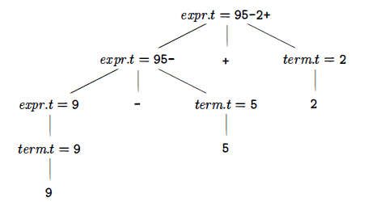
Synthesized Attributes..
Suppose a node N in a parse tree is labeled by the grammar symbol X then X.a is used to denote the value of attribute a of X at that node.

Slide 21
Synthesized Attributes...
An attribute is said to be synthesized if its value at a parse-tree node N is determined from attribute values at the children of N and at N itself.
  Synthesized attributes can be evaluated during a single bottom-up traversal of a parse tree.
An annotated parse tree is based on the syntax directed definition.

Slide 22
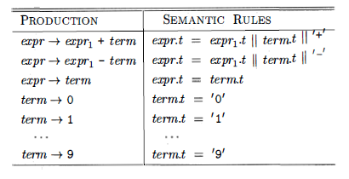
Synthesized Attributes...
Each non terminal has a string-valued attribute t that represents the postfix notation for the expression generated by that non terminal in a parse tree.
  String concatenation operator ||
Syntax-directed definition for infix to postfix translation

Slide 23
Tree Traversals
Tree traversals are used for describing attribute evaluation and for specifying the execution of code fragments in a translation scheme.
  A traversal of a tree starts at the root and visits each node of the tree in some order.
A depth-first traversal starts at the root and recursively visits the children of each node in any order, not necessarily from left to right .

Slide 24
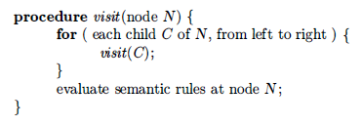
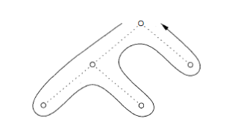
Tree Traversals
A depth-first traversal of a tree

Slide 25
Translation Schemes
A syntax-directed translation scheme is a notation for specifying a translation by attaching program fragments to productions in a grammar.
  Program fragments embedded within production bodies are called semantic actions.
    rest -> + term { print('+') } rest₁
Action to be executed

Slide 26
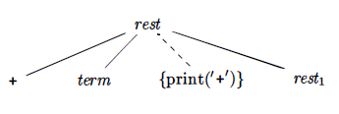
Translation Schemes..
An extra leaf is constructed for the semantic action.

Slide 27
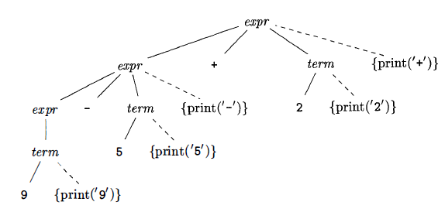
Translation Schemes...
Actions translating 9-5+2 into 95-2+

Slide 28
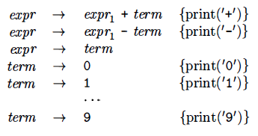
Translation Schemes...
Actions for translating into postfix notation

Slide 29
Translation Schemes...
The implementation of a translation scheme must ensure
  Semantic actions are performed in the order they would appear during a postorder traversal of a parse tree.

Slide 30
Preorder and Postorder Traversals
In preorder traversal action is done when we first visit a node.
If the action is done just before we leave a node for the last time, then we say it is a postorder traversal of the tree.
  Preorder and postorder traversals define corresponding orderings on nodes, based on when the action at a node would be performed.

Slide 31
Thank You

