Slide 1
LESSON 04

Slide 2
Overview
of
Previous Lesson(s)

Slide 3
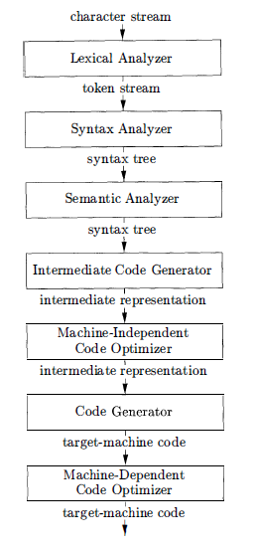
Over View…
Decomposition
of a compiler.
Symbol Table
Notes:
The symbol table, which stores information about the entire source program, is used by all phases of the compiler.

Slide 4
Over View..
Language can also be classified using generations as well.
1st generation programming language (1GL)
  Architecture specific binary delivered on Switches, Patch Panels and/or Tape.
2nd generation programming language (2GL)
  Most commonly use in RISC, CISC and x86 as that is what our embedded systems and desktop computers use.

Slide 5
Over View...
3rd generation programming language (3GL)
  C, C++, C#, Java, Basic, COBOL, Lisp and ML.
4th generation programming language (4GL)
  SQL, SAS, R, MATLAB's GUIDE, ColdFusion, CSS.
5th generation programming language (5GL)
  Prolog, Mercury.

Slide 6
Over View...
Modeling in Compiler Design
  Compiler design is one of the places where theory has had the most impact on practice.
  Models that have been found useful include automata, grammars, regular expressions, trees, and many others.

Slide 7
Over View…
Optimization is to produce code that is more efficient than the obvious code.
Compiler optimizations must meet the following design objectives:
  The optimization must be correct, that is, preserve the meaning of the compiled program.
  The optimization must improve the performance of many programs.
  The compilation time must be kept reasonable.

Slide 8
TODAY’S LESSON

Slide 9
Contents
Syntax Director Translator
Introduction
Syntax Definition
  Context Free Grammars
  Derivations
  Parse Trees
  Ambiguity
  Associativity of Operators
  Operator Precedence

Slide 10
Syntax Directed Translator
This section illustrates the compiling techniques by developing a program that translates representative programming language statements into three-address code, an intermediate representation.
We will focus on
  Front end of a compiler
  Lexical analysis
  Parsing
  Intermediate code generation.

Slide 11
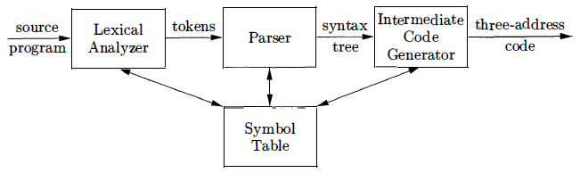
Syntax Directed Translator..
Model of a Compiler Front End

Slide 12
Introduction
Analysis is organized around the "syntax" of the language to be compiled.
  The syntax of a programming language describes the proper form of its programs.
  The semantics of the language defines what its programs mean.
For specifying syntax, Context-Free Grammars is used.
  Also known as BNF (Backus-Naur Form)
We start with a syntax-directed translation of an infix expression to postfix form.
  Infix form: 9 – 5 + 2 to Postfix form: 9 5 – 2 +

Slide 13
Syntax Definition
Context Free Grammar is used to specify the syntax of the language.
  Shortly we can say it “Grammar”.
A grammar describes the hierarchical structure of most programming language constructs.
Ex.
if ( expression ) statement else statement

Slide 14
Syntax Definition..
This rule can be expressed as production by using the variable expr to denote an expression and the variable stmt to denote a statement.
stmt -> if ( expr ) stmt else stmt
In a production
  lexical elements like the keyword if, else and the parentheses are called terminals.
  Variables like expr and stmt represent sequences of terminals and are called nonterminals.

Slide 15
Grammars
A context-free grammar has four components
  A set of tokens (terminal symbols)
  A set of nonterminals
  A set of productions
  A designated start symbol
Lets check an example that elaborates these components.

Slide 16
Grammars..
Expressions …
9 – 5 + 2 , 5 – 4 , 8 …
Since a plus or minus sign must appear between two digits, we refer to such expressions as lists of digits separated by plus or minus signs.
The productions are
  List -> list + digit P-1
    List -> list – digit P-2
    List -> digit P-3
    Digit -> 0 1 1 1 2 1 3 1 4 1 5 1 6 1 7 1 8 1 9 P-4

Slide 17
Grammars..
Terminals
0,1,2,3,4,5,6,7,8,9
Non-Terminals
list , digit
Designated Start Symbol
list

Slide 18
Derivations
Given a CF grammar we can determine the set of all strings (sequences of tokens) generated by the grammar using derivation.
  We begin with the start symbol
  In each step, we replace one nonterminal in the current sentential form with one of the right-hand sides of a production for that nonterminal

Slide 19
Derivations..
Derivation for our example expression.
list Start Symbol
⇒ list + digit P-1
⇒ list - digit + digit P-2
⇒ digit - digit + digit P-3
⇒ 9 - digit + digit P-4
⇒ 9 - 5 + digit P-4
⇒ 9 - 5 + 2 P-4
This is an example of leftmost derivation, because we replaced
the leftmost nonterminal (underlined) in each step.

Slide 20
Parse Trees
Parsing is the problem of taking a string of terminals and figuring out how to derive it from the start symbol of the grammar.
  If it cannot be derived from the start symbol of the grammar, then reporting syntax errors within the string.
Given a context-free grammar, a parse tree according to the grammar is a tree with the following properties:
  The root is labeled by the start symbol.
  Each leaf is labeled by a terminal or by ɛ.
  Each interior node is labeled by a nonterminal.
  If A → X1 X2 … Xn is a production, then node A has immediate children X1, X2, …, Xn where Xi is a (non)terminal or ε.

Slide 21
Parse Trees..
Parse tree of the string 9-5+2 using grammar G
list
list
digit
list
digit
digit
The sequence of
leafs is called the
yield of the parse tree
9
-
5
+
2

Slide 22
Tree Terminology
A tree consists of one or more nodes.
Exactly one is the root.
If node N is the parent of node M, then M is a child of N.
  The children of one node are called siblings.
  They have an order, from the left.
A node with no children is called a leaf.
A descendant of a node N is either N itself, a child of N, a child of a child of N, and so on.

Slide 23
Ambiguity
A grammar can have more than one parse tree generating a given string of terminals.
Such a grammar is said to be ambiguous.
To show that a grammar is ambiguous, all we need to do is find a terminal string that is the yield of more than one parse tree.

Slide 24
Ambiguity..
Consider the Grammar
G = [ {string}, {+,-,0,1,2,3,4,5,6,7,8,9}, P, string ]
Its productions are
string → string + string | string - string | 0 | 1 | … | 9
This grammar is ambiguous, because more than one parse tree
represents the string 9-5+2

Slide 25
Ambiguity…
string
string
string
string
string
string
string
string
string
string
9
-
5
+
2
9
-
5
+
2
Two Parse Trees for 9 – 5 + 2

Slide 26
Associativity of Operators
Left-associative operators have left-recursive productions
For instance
list → list – digit | digit
String 9-5-2 has the same meaning as (9-5)-2
Right-associative operators have right-recursive productions
For Instance see the grammar below
right → letter = right | letter
String a=b=c has the same meaning as a=(b=c)

Slide 27
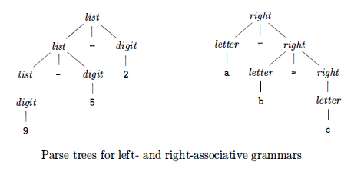
Associativity of Operators..

Slide 28
Operator Precedence
Consider the expression 9+5*2.
There are two possible interpretations of this expression:
(9+5 ) *2 or 9+ ( 5*2)
The associativity rules for + and * apply to occurrences of the same operator, so they do not resolve this ambiguity.
A grammar for arithmetic expressions can be constructed from a table showing the associativity and precedence of operators.

Slide 29
Operator Precedence..
Lets see an example of four common arithmetic operators and a precedence table, showing the operators in order of increasing precedence.
        left-associative: + -
        left-associative: * /
Now we create two nonterminals expr and term for the two levels of precedence, and an extra nonterminal factor for generating basic units in expressions.
The basic units in expressions are presently digits and parenthesized expressions.
        factor -> digit I ( expr )

Slide 30
Operator Precedence..
Now consider the binary operators, * and /, that have the highest precedence and left associativity.
    term - > term * factor | term / factor | factor
Similarly, expr generates lists of terms separated by the additive operators.
    expr -> expr + term I expr – term I term
Final grammar is
  expr -> expr + term I expr – term I term
  term - > term * factor | term / factor | factor
  factor -> digit I ( expr )

Slide 31
Operator Precedence..
Ex. String 2+3*5 has the same meaning as 2+(3*5)
expr
expr
term
term
term
factor
factor
factor
number
number
number
2
+
3
*
5

Slide 32
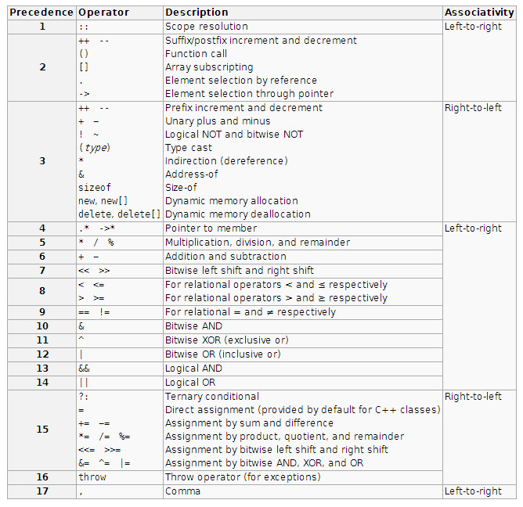
Associativity & Precedence Table

Slide 33
Thank You

