Slide 1
LESSON 03

Slide 2
Overview
of
Previous Lesson(s)

Slide 3
Over View
Compilers are the s/w systems that translated a source language program to a form in which it can be executed by a computer.
Program in Source Language
Program in Target Language
Compiler
Errors

Slide 4
Over View..
An Interpreter appears to directly execute the program and provide output.
Source Program
Interpreter
Output
Input
Error Messages

Slide 5
Over View…
Language
Processing
System
Source Program
Interpreter
Modified Source Program
Compiler
Target Assembly Program
Assembler
Relocatable Machine Code
Library File
Relocatable Object Files
Target Machine Code
Linker / Loader

Slide 6
Over View…
Structurally, Compiler can be divided into two parts
Analysis determines the operations implied by the source program which are recorded in a tree structure.
Synthesis takes the tree structure and translates the operations therein into the target program.

Slide 7
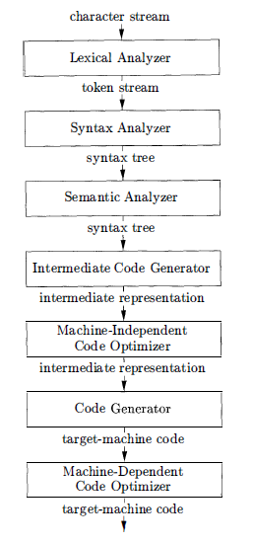
Over View…
A typical decomposition
of a compiler
can be done
into several phases.
Symbol Table
Notes:
The symbol table, which stores information about the entire source program, is used by all phases of the compiler.

Slide 8
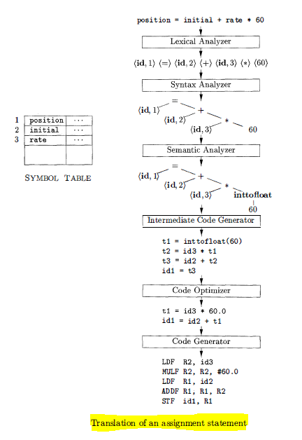
Over View…
Translation of (Ex)
Assignment Statement

Slide 9
TODAY’S LESSON

Slide 10
Contents
Programming Language Generations
  1st - 5th Generation Languages
  Impacts on Compilers
Science of Building a Compiler
  Modeling in Compiler Design
  Code Optimization
Applications of Compilers
Programming Language Basics
  Static / Dynamic Distinction
  Environment and States
  Variables & Scope
  Structures & Functions

Slide 11
Programming Languages Generations
Language can also be classified using generations as well.
First-generation programming language (1GL)
  Introduced in the 1940s
  Instructions/Data entered directly in binary
  Memory must be manually moved around
  Very difficult to edit/debug
  Simple programs only
  Examples:
  Architecture specific binary delivered on Switches, Patch Panels and/or Tape.

Slide 12
Programming Languages Generations..
2nd generation programming language (2GL)
  Assembly languages were introduced in 1950s to mitigate the error prone and excessively difficult nature of binary programming.
  Used today for embedded systems and optimization.
  Specific to platform architecture
  Defined by three language elements:
  Opcodes (CPU Instructions)
  Data Sections (Variable Definitions)
  Directive (Macros)
  Examples:
  Most commonly use in RISC, CISC and x86 as that is what our embedded systems and desktop computers use.

Slide 13
Programming Languages Generations...
3rd generation programming language (3GL)
  Third generation languages introduced in later 1950s , are the primary languages used in general purpose programming today.
  Designed for the easy use of programmer.
  Based on natural language.
  Use Structural approach.
  Examples:
  C, C++, C#, Java, Basic, COBOL, Lisp and ML.

Slide 14
Programming Languages Generations...
4th generation programming language (4GL)
  A fourth generation language introduced in 1970s is designed with making problems in a specific domain simple to implement.
  Driven by the need to enhance developer productivity.
  Further from the machine.
  Examples:
  SQL, SAS, R, MATLAB's GUIDE, ColdFusion, CSS.

Slide 15
Programming Languages Generations...
5th generation programming language (5GL)
  5th generation language introduced in 1990s is designed as constraint systems.
  Constraint-based instead of algorithmic.
  Used for AI Research, Proof solving, Logical Inference.
  Not in common use.
  Examples:
  Prolog, Mercury.
Some applications of Prolog are:
  Intelligent data base retrieval
  Natural language understanding
  Expert systems
Notes:
Mercury is a functional logic programming language geared towards real-world applications. Mercury is a purely declarative logic language.

Slide 16
Programming Languages Generations...
Object Oriented Approach
  It is a programming style in which a program consists of a collection of objects that interact with one another.
  Commonly used now a days.
  Examples:
  Simula 67, Smalltalk, C++, C#, Java and Ruby.

Slide 17
Programming Languages Generations...
Scripting Languages
  Scripting languages are interpreted languages with high-level operators designed for "gluing together" computations.
  Programs written in scripting languages are often much shorter than equivalent programs written in languages like C.
  Examples:
  Awk, JavaS cript, Perl, PHP, Python, Ruby, and TCl.

Slide 18
Impact on Compilers
Design of programming languages and compilers are intimately related.
  Advances in programming languages placed new demands on compiler writers.
Compilers can help promote the use of high-level languages by minimizing the execution overhead.
Compilers are also critical in making high-performance computer architectures.
  Used as a tool in evaluating architectural concepts before a computer is built.

Slide 19
Science of Compiler Building
A compiler must accept all source programs that conform to the specification of the language.
  The set of source programs is infinite and any program can be very large, consisting of possibly millions of lines of code.
Any transformation performed by the compiler must preserve the meaning of the program being compiled.

Slide 20
Modeling in Compiler Design
Most fundamental models in compiler design are:
  Finite State Machines
  Regular Expressions
  Context-Free Grammars
Mainly these are used for
  Describing the lexical units of programs i.e keywords, identifiers.
  Describing the algorithms used by the compiler to recognize those units.
  Describing the syntactic structure of programming languages such as the nesting of parentheses or control constructs.

Slide 21
Code Optimization
Optimization: To produce code that is more efficient than the obvious code.
Compiler optimizations must meet the following design objectives:
  The optimization must be correct, that is, preserve the meaning of the compiled program.
  The optimization must improve the performance of many programs.
  The compilation time must be kept reasonable.

Slide 22
Compiler Applications
Compiler technology can be used in following ways:
  Implementation of High-level languages
  Optimizations for computer architectures
  Designing in new computer architectures
  Program Translations
  S/w productivity tools

Slide 23
Programming Language Basics
Now we discuss the important terminology and distinctions appears in the study of programming language.
Lets start it.

Slide 24
Static / Dynamic Policy
If a language uses a policy that allows the compiler to decide an issue, then we say that the language uses a static policy.
A policy that only allows a decision to be made when we execute the program is said to be a dynamic policy.

Slide 25
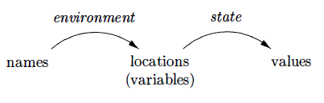
Environment & States
The environment is a mapping from names to locations in the store.
The state is a mapping from locations in store to their values.
Environments change according to the scope rules of a language.

Slide 26
Identifiers & Variables
An identifier is a string of characters, typically letters or digits, that refers to an entity, such as a data object, a procedure, a class, or a type.
Ex. Int result, class Box and soon …
A variable refers to a particular location of the store.
It is common for the same identifier to be declared more than once, each such declaration introduces a new variable.

Slide 27
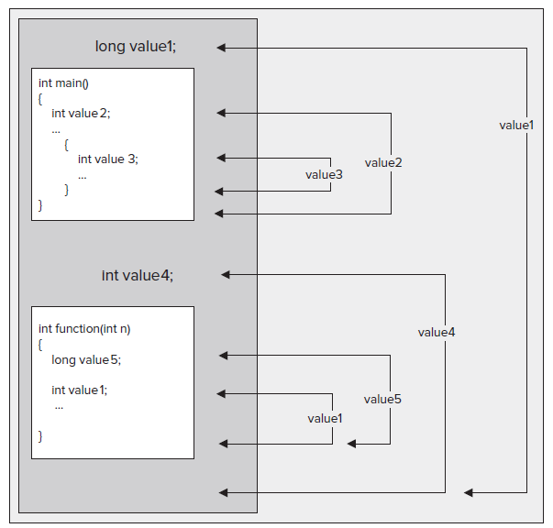
Scopes in PL

Slide 28
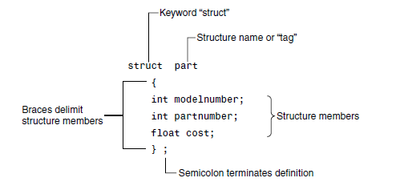
Structures
A structure is a collection of simple variables.
The data items in a structure are called the members of the structure.

Slide 29
Functions
A function groups a number of program statements into a unit and gives it a name.
This unit can then be invoked from other parts of the program.
The function’s code is stored in only one place in memory, even though the function is executed many times in the course of the program.

Slide 30
Passing Arguments to Function
An argument is a piece of data passed from a program to the function.
Arguments allow a function to operate with different values, or even to do different things, depending on the requirements of the program calling it.
Parameters are passed from a calling procedure to the callee either by value or by reference.

Slide 31
Input, Processing, and Output
Three steps that a program typically performs:
  Gather input data:
    from keyboard
    from files on disk drives
  Process the input data
  Display the results as output:
    send it to the screen
    write to a file

Slide 32
Thank You

