Slide 1
LESSON 02

Slide 2
Overview
of
Previous Lesson(s)

Slide 3
Over View
A program must be translated into a form in which it can be executed by a computer.
  The software systems that do this translation are called compilers.

Slide 4
Over View..
Program in Source Language
Program in Target Language
Compiler
Errors

Slide 5
Over View…
Interpreters are the common kind of language processor.
An Interpreter appears to directly execute the program and provide output.
Source Program
Interpreter
Output
Input
Error Messages

Slide 6
Over View…
Compiler Vs Interpreter
Pros
  Less space
  Fast execution
Cons
  Slow processing
    Partly Solved
    (Separate compilation)
  Debugging
    Improved thru IDEs
Pros
  Easy debugging
  Fast Development
Cons
  Not for large projects
  Requires more space
  Slower execution
    Interpreter in memory all the time

Slide 7
Over View…
Language
Processing
System
Source Program
Interpreter
Modified Source Program
Compiler
Target Assembly Program
Assembler
Relocatable Machine Code
Library File
Relocatable Object Files
Target Machine Code
Linker / Loader

Slide 8
TODAY’S LESSON

Slide 9
Contents
The Structure of a Compiler
  Lexical Analysis
  Syntax Analysis
  Semantic Analysis
  Intermediate Code Generation
  Code Optimization
  Code Generation
  Symbol-Table Management
  Compiler Construction Tools
Evolution of Programming Languages

Slide 10
Structure of a Compiler
If we open the Compiler Box a little, There are two parts to this mapping.
Analysis determines the operations implied by the source program which are recorded in a tree structure.
Synthesis takes the tree structure and translates the operations therein into the target program.

Slide 11
Analysis
Operations performed
  Breaks up the source program into pieces
  Imposes a grammatical structure on these pieces
  Then an intermediate representation is created using this structure
  Display error messages (If any)
  It also collects information about the source program & stores in a data structure called Symbol Table
  Front End of a Compiler

Slide 12
Synthesis
Operations performed
It takes the intermediate representation and information from the symbol table as input.
Constructs the desired target program.
  Back End of a Compiler.

Slide 13
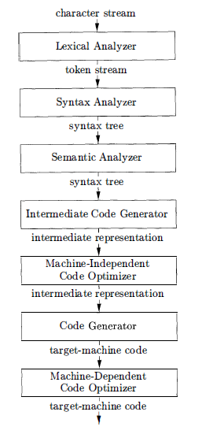
Compilation Phases
A typical decomposition
of a compiler
can be done
into several phases.
Symbol Table
Notes:
The symbol table, which stores information about the entire source program, is used by all phases of the compiler.

Slide 14

Each phase one by one !!!

Slide 15
Lexical Analysis
1st phase of Compiler, also known as Scanner.
  It verifies that input character sequence is lexically valid.
  Group characters into meaningful sequence of lexemes.
  For each lexeme, the lexical analyzer produces as output a token of the form
    (token-name, attribute-value)
  Discards white space and comments.

Slide 16
Lexical Analysis..
    Tokens (token-name, attribute-value)
  These tokens are passes on to the subsequent phase i.e syntax analysis.
  Token comprises of following components
    Token- name is an abstract symbol that is used during syntax analysis.
    Attribute-value points to an entry in the symbol table for this token. Information from the symbol-table entry is needed for semantic analysis and code generation.

Slide 17
Lexical Analysis...
    Example
  position = initial + rate * 60
After lexical analysis (id,1) (=) (id,2) (+) (id,3) (*) (60)
Lexemes mapped into
Position
=
initial
+
rate
*
60
Tokens
(id,1)
(=)
(id,2)
(+)
(id,3)
(*)
(60)

Slide 18
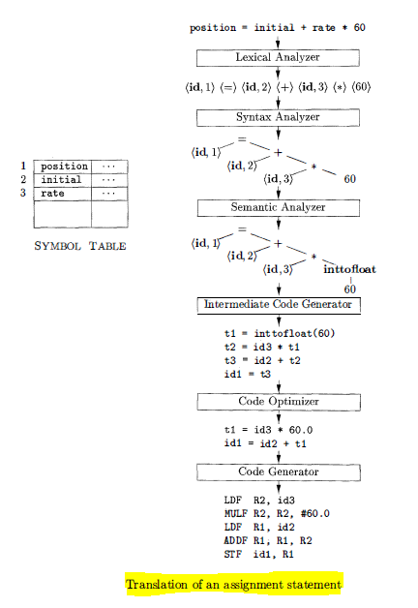
Translation of (Ex) Assignment Statement

Slide 19

Syntax Analysis
2nd phase of Compiler, also known as Parsing.
  The parser uses the first components of the tokens to create a syntax tree that depicts the grammatical structure of the token stream.
  In Syntax Tree each interior node represents an operation and the children of the node represent the arguments of the operation.

Slide 20
Semantic Analysis
The semantic analyzer uses the syntax tree and the information in the symbol table to check the source program for semantic consistency with the language definition.
  It gathers type information and saves it in either the syntax tree or the symbol table.
  An important part of semantic analysis is type checking.
  For example, compiler report an error if a floating-point number is used to index an array.

Slide 21
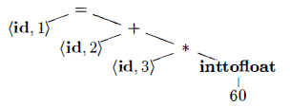
Semantic Analysis..
The language specification may permit some type conversions called coercions.
  For example, a binary arithmetic operator may be applied to either a pair of integers or to a pair of floating-point numbers.
  If the operator is applied to a floating-point number and an integer, the compiler may convert or coerce the integer into a floating-point number.

Slide 22
Intermediate Code Generation
In the process of translating a source program into target code, a compiler may construct one or more intermediate representations.
  Ex . Syntax Trees
An explicit low-level or machine-like intermediate representation is generated in this phase.
For ex a three-address intermediate code which consists of a sequence of assembly-like instructions.
  It contains three operands per instruction.

Slide 23
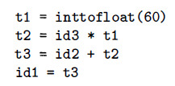
Intermediate Code Generation..
The output of the intermediate code generator in our example consists of the three-address code sequence.
  Each three-address assignment instruction has at most one operator on the right side.
  The compiler must generate a temporary name to hold the value computed.
  Can have fewer than three operands.

Slide 24

Code Optimization
The code-optimization phase helps to improve the intermediate code so that better target code will be achieved.
Result of code optimization phase in our Ex ..
  Optimizer can deduce that conversion of 60 from integer to floating point 60.0 can be done once and for all at compile time.
  Moreover, t3 is used only once to transmit its value to id1 so the optimizer can transform into the shorter sequence.

Slide 25
Code Generation
The code generator takes as input an intermediate representation of the source program and maps it into the target language.
  For example, using registers R1 and R2, the intermediate code is translated into the machine code
    LDF R2, id3
    MULF R2, R2, #60.0
    LDF R1, id2
    ADDF R1, R1, R2
    STF id1, R1
  The first operand of each instruction specifies a destination.
  The F in each instruction depicts floating-point numbers.

Slide 26
Symbol Table Management
The symbol table is a data structure containing a record for each variable name, with fields for the attributes of the name.
  This data structure should be designed with following privileges
    To allow the compiler to find the record for each name quickly.
    To store or retrieve data from that record quickly.

Slide 27
Compiler Construction Tools
The compiler programmer can use modern software development environments containing tools such as language editors, debuggers, version managers , and so on including some specialized tools.
The most successful tools are those that hide the details of the generation algorithm and produce components that can be easily integrated into the remainder of the compiler.

Slide 28
Compiler Construction Tools..
Some common tools are:
  Parser generators automatically produce syntax analyzers from a grammatical description of a programming language.
  Scanner generators produce lexical analyzers from a regular-expression description of the tokens of a language.
  Syntax-directed translation engines produce collections of routines for walking a parse tree and generating intermediate code.

Slide 29
Compiler Construction Tools...
  Code-generators produce a code from a collection of rules for translating each operation of the intermediate language into the machine language for a target machine.
  Data-flow analysis engines facilitate the gathering of information about how values are transmitted from one part of a program to each other part.
  Compiler- construction toolkits provide an integrated set of routines for constructing various phases of a compiler.

Slide 30
Evolution of Programming Languages
Lets have look on the evolution of the programming languages.
  The first electronic computers appeared in the 1940's .
  Sequences of O's and 1 's were used that explicitly told the computer what operations to execute and in what order.
  The operations themselves were very low level:
  i.e move data from one location to another
  add the contents of two registers
  compare two values

Slide 31
Evolution of Programming Languages..
The first step towards more people-friendly programming languages was the development of mnemonic assembly languages in the early 1950's.
A major step towards higher-level languages was made in the latter half of the 1950's with the development of
  Fortran for scientific computation.
  Cobol for business data processing.
  Lisp for symbolic computation.

Slide 32
Thank You

