Slide 1
Compiler Construction
by
Muhammad Bilal Zafar (AP)

Slide 2
INTRODUCTION

Slide 3
Compilers
Programming languages are notations for describing computation to people and to machines.
All the software running on the computers was written in some programming language.
Types of Languages:
  High level languages
  Low level languages
  Machine level languages

Slide 4
  Compilers..
A program must be translated into a form in which it can be executed by a computer.
  The software systems that do this translation are called COMPILERS
Program in Source Language
Program in Target Language
Compiler
Errors

Slide 5
Course Description
The purpose of the course is to become familiar with the functionality of the different phases in the construction of a compiler front end and to gain insight of how these phases are related to each other.

Slide 6
Course Description..
Covers the fundamentals & details of following
  Process of construction of a Compiler
  Lexical Analysis
  Syntax Analysis
  Semantic Analysis
  Syntax Directed Translation
  Intermediate Code Representation

Slide 7
Flow of Course
We start with an Introduction followed by some motivational material and will also discuss some background issues in computer architecture and programming-language principles.
Then we move on to a section which develops a miniature compiler and introduces many of the important concepts.
So then we study lexical analysis, regular expressions, finite-state machines, and scanner-generator tools. This material is fundamental to text-processing of all sorts.

Slide 8
Flow of Course..
In the later section we will see the major parsing methods, top-down(recursive-descent , LL) and bottom-up (LR and its variants).
Start of last quarter introduces the principal ideas in syntax-directed definitions and syntax-directed translations.
Last part of the course takes the theory of previous section and shows how to use it to generate intermediate code for a typical programming language.

Slide 9
Course Objectives
The course is intended to teach the students the basic techniques that underlie the practice of Compiler Construction.
The course will introduce the theory that can be standarly employed in order to perform syntax-directed translation of a high-level programming language into an executable code.

Slide 10
Course Objectives..
Additionally These techniques can be employed in wider areas of application whenever we need a syntax-directed analysis of symbolic expressions and languages and their translation into a lower-level description.
They have multiple applications for man-machine interaction, including verification and program analysis

Slide 11
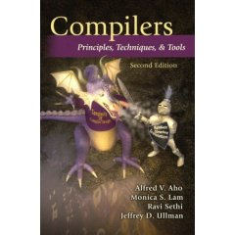
Recommended Book
COMPILERS
Principles, Techniques & Tools
Second Ed by
Alfred V. Aho,
Monica S. Lam,
Ravi Sethi,
Jeffrey D. Ullman

Slide 12
Reference Books / Readings
CRAFTING COMPILER WITH C,
By Charles N Fischer

Slide 13
Course Prerequisites
It is expected that students are somehow familiar with the
  Data structures
  Programming languages (High level & Low level)
  Automata Theory &
  Operating systems concepts

Slide 14
Assessment & Grading
Exam No | Exam Type | Due after Lecture No. | Total Marks
1 | Quiz 1 | 5 | 5%
2 | Quiz 2 | 22 | 5%
3 | Assignment 1 | 10 | 10%
4 | Assignment 2 | 26 | 10%
5 | Midterm Exam | 18 | 20%
6 | Final Exam | 32 | 50%
Marks scheme:
Quizzes + assignments = 30%
Mid Term Exam = 20%
Final = 50%

Slide 15
LESSON 01

Slide 16
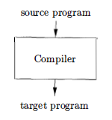
Languages Processors
Simply stated, a compiler is a program that can read a program in one language - the source language - and translate it into an equivalent program in another language - the target language;
Important Role
  Report errors, if any, found in source program.

Slide 17
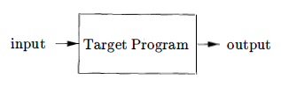
Languages Processors..
If the target program is an executable machine-language program, it can then be called by the user to process inputs and produce outputs.

Slide 18
Interpreter
Interpreters are the common kind of language processor.
An Interpreter appears to directly execute the program and provide output.
Source Program
Interpreter
Output
Input
Error Messages

Slide 19
Compiler Vs Interpreter
Compiler Interpreter
Pros
  Less space
  Fast execution
Cons
  Slow processing
    Partly Solved
    (Separate compilation)
  Debugging
    Improved thru IDEs
Pros
  Easy debugging
  Fast Development
Cons
  Not for large projects
  Requires more space
  Slower execution
    Interpreter in memory all the time

Slide 20
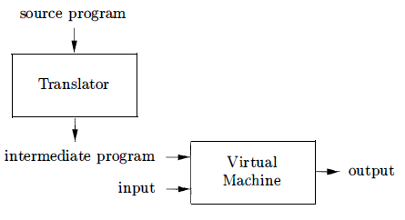
Languages Processors..
Ex.
Java language processors combine compilation and interpretation shown as follows:
A Hybrid Compiler

Slide 21
Languages Processors...
A Java source program may first be compiled into an intermediate form called bytecodes
The bytecodes are then interpreted by a virtual machine
A benefit of this arrangement is that bytecodes compiled on one machine can be interpreted on another machine, perhaps across a network.

Slide 22
Languages Processors...
In order to achieve faster processing of inputs to outputs, some Java compilers use just-in-time compilers
  It translates the bytecodes into machine language immediately before they run the intermediate program to process the input.
In addition to a compiler, several other programs may be required to create an executable target program.

Slide 23
Languages Processors...
A source program may be divided into modules stored in separate files.
The task of collecting the source program is sometimes entrusted to a separate program, called a preprocessor
The preprocessor may also expand shorthands called macros into source language statements.

Slide 24
Languages Processors...
The modified source program is then fed to a compiler.
The compiler may produce an assembly-language program as its output, because assembly language is easier to produce as output and is easier to debug.
The assembly language is then processed by a program called an assembler that produces relocatable machine code as its output.

Slide 25
Languages Processors...
Large programs are often compiled in pieces, so the relocatable machine code may have to be linked together with other relocatable object files and library files into the code that actually runs on the machine.
The linker resolves external memory addresses, where the code in one file may refer to a location in another file.
The loader then puts together all of the executable object files into memory for execution.

Slide 26
Language Processing System
Source Program
Interpreter
Modified Source Program
Compiler
Target Assembly Program
Assembler
Relocatable Machine Code
Library File
Relocatable Object Files
Target Machine Code
Linker / Loader

Slide 27
Next Lesson
Structure of a Compiler

Slide 28
Thank You

