Slide 1
Lecture 4
Inputting Data In Other Ways

Slide 2
Summary of Previous Lecture
In the previous lecture we have seen,
  Input devices and their functions,
    E.g. Keyboard, mouse
  History of Keyboard and a Mouse
  Ergonomic Keyboard
  Stress Management techniques
  Practical concerning windows commands and a Notepad

Slide 3
Lecture 4 Overview
Today’s topics are,
  Reasons why some computer users prefer alternative methods of input over a standard keyboard or mouse.
  Input data by touch
  Game controllers
  Input data by light
  Other input types, e.g. audio, video etc.
  When to use which input device?
  Practical

Slide 4
Introduction
There are a huge range of input devices on the market
These fall into two main groups
  Manual Input and
  Automatic data capture

Slide 5
Introduction
Manual Input include devices such as the keyboard and mouse, where the user has to put the data in by hand.
Automatic Data Capture devices collect the data automatically and feed it straight into a computer.
  Some of them are operated by people, like bar-code scanners, but some devices just collect data, such as web cams and data loggers.

Slide 6
Benefits of entering data in other ways
Automatic data capture tends to cut down on errors compared to manual data entry.
It is usually quicker too – imagine how long the supermarket queue would be if every number on the bar-code had to be typed by hand.
However, they tend to be more expensive, and so are usually used when there is a lot of data to capture.

Slide 7
When to chose which device?
Sometime the decision to choose input device is optional, sometimes it becomes mandatory.
  For example in a dusty factory, decision to choose decision to choose a standard keyboard and a mouse can be damaged if it becomes clogged with dirt.

Slide 8
Input data by Touch
Various devices exists in this category.
  Light Pen
  Touch screens
  Trackballs
  Keyboards
  Graphics tablets
  Game controllers
  Concept keyboards

Slide 9
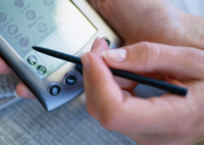
Light Pen
Users may use Tablet PC Input Panel to enter text and use the tablet pen to point.
A tablet light pen is a computer input device in the form of a light-sensitive wand used in conjunction with the computer's CRT monitor.
It allows the user to point to displayed objects, or draw on the screen, with greater positional accuracy.
A light pen can work with any CRT-based monitor, but not with LCD screens, projectors or other display devices.

Slide 10
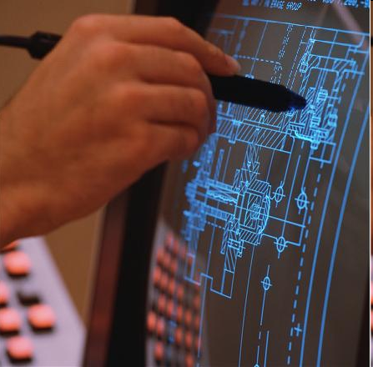
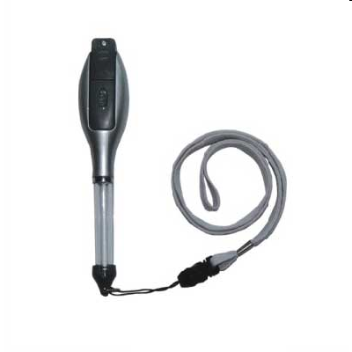

Slide 11
Light Pen
The first light pen was created around 1952 as part of the Whirlwind project at MIT.
The light pen became moderately popular during the early 1980s.
However, due to the fact that the user was required to hold his or her arm in front of the screen for long periods of time, the light pen fell out of use as a general purpose input device
Notes:
The Whirlwind computer was developed at the Massachusetts Institute of Technology. It is the first computer that operated in real time, used video displays for output, and the first that was not simply an electronic replacement of older mechanical systems.

Slide 12
Pointing the Objects
Pointing with a tablet pen and pointing with a mouse are different.
Pointing with a tablet pen is normally more difficult.
Clicking a mouse is a purely vertical movement that is made with one finger.
With the tablet pen, the user points and taps by using the same arm, wrist, hand, and finger muscles.
  Tapping and hovering require precise muscle movements, which may be hard for new users of Tablet PC.

Slide 13
Pointing with Light Pen
When users hold a tablet pen, their hand may obscure menus, objects, or cursors.
When considering tablet pen interaction, it is important to understand where users might rest their hand.
  Because of their ergonomic posture, users generally rest their hand in the lower half of the screen. Thus, any object or user interface (UI) that appears below the users hand may be partially obscured and hard to view.

Slide 14
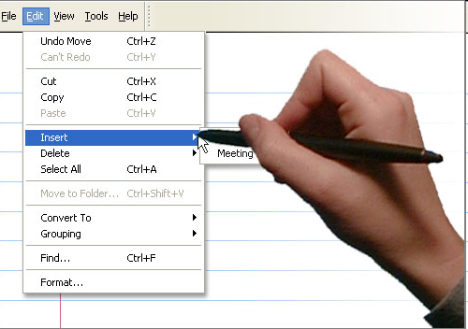

Slide 15
Touch Sensing
It is the input modality for sensing contact of the bare hand or fingers, used in Touch pads, touch screens, touch tablets etc.
It has main attributes.
  First, it enables one to interact directly with what is displayed, rather than indirectly with a pointer controlled by a mouse or touchpad.
  Secondly, it lets one do so without requiring any intermediate device that would need to be held in the hand.

Slide 16
Tablet PC’s/Touch Tablets
A tablet computer, or a tablet, is a mobile computer, larger than a mobile phone or personal digital assistant.
It is integrated into a flat touch screen and primarily operated by touching the screen rather than using a physical keyboard.

Slide 17
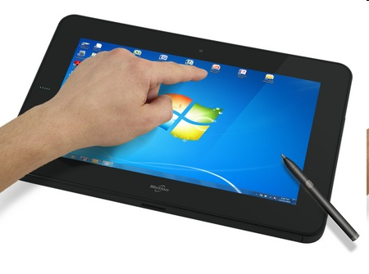
Tablets
It often uses an onscreen virtual keyboard, a passive stylus pen, or a digital pen.

Slide 18
Advantages of Touch Sensing
Easy to use - intuitive, don't need much training
No extra peripherals such as a mouse are needed
Software can alter the screen while it is being used, making it more flexible than a concept keyboard which has a permanent overlay.

Slide 19
Disadvantages of Touch Sensing
Not suitable for inputting large amounts of data
Not very accurate - selecting detailed objects can be difficult with fingers
Tiring to use for long periods
More expensive than alternatives such as a mouse
Not robust - can soon become faulty if misused.

Slide 20
Game Controller
A game controller is a device used with games or entertainment systems to provide input to a video game, typically to control an object or character in the game.
A controller is usually connected to a game console or computer by means of a wire or cord, although wireless controllers are also widespread.
Input devices that have been classified as game controllers include keyboards, mice, game pads, joysticks, etc.

Slide 21
Types of Game Controllers
List of Few available game controllers are
Gamepad
Paddle
Joystick
Arcade Style Joystick
Trackball
Throttle quadrant

Slide 22
Type of Game Controllers
Steering Wheel
Yoke
Pedals3
Keyboard and Mouse
Gaming keypads and programmable PC controllers
Touch screen
Motion sensing
Light gun

Slide 23
Gamepad
A gamepad, also known as a joypad, are the primary means of input on nearly all modern video game consoles.
They are held in both hands with thumbs and fingers used to provide input.
Gamepads can have a number of action buttons combined with one or more omni directional control sticks or buttons.

Slide 24
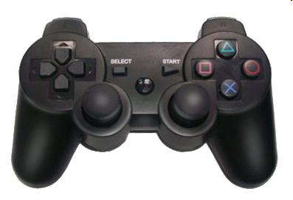
Gamepad

Slide 25
Paddle
A paddle is a controller that features a round wheel and one or more fire buttons.
The wheel is typically used to control movement of the player or of an object along one axis of the video screen.
Paddle controllers were the first analog controllers and they lost popularity when "paddle and ball" type games fell out of favor

Slide 26
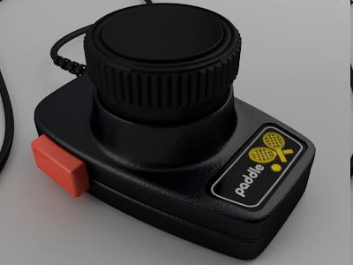
Atari Game Paddle Controller

Slide 27
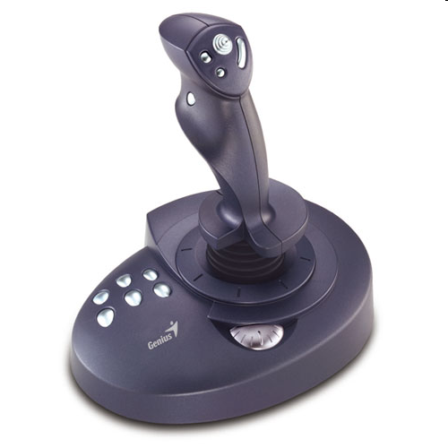
Joystick
This joystick is a peripheral that consists of a handheld stick that can be tilted around either of two axes and (sometimes) twisted around a third.

Slide 28
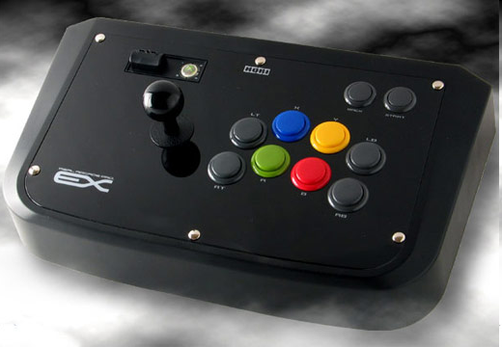
Arcade Style Joystick
An arcade stick is a large-format controller for use with home consoles or computers.
They follow multi-button arrangements.

Slide 29
Trackball
A trackball is an upside down mouse that is manipulated with the palm of one's hand.
It has the advantage of not requiring a lot of desktop space, and that it is as fast as one can roll the ball on it.
This is faster than one can move a mouse due to space not being an issue.

Slide 30
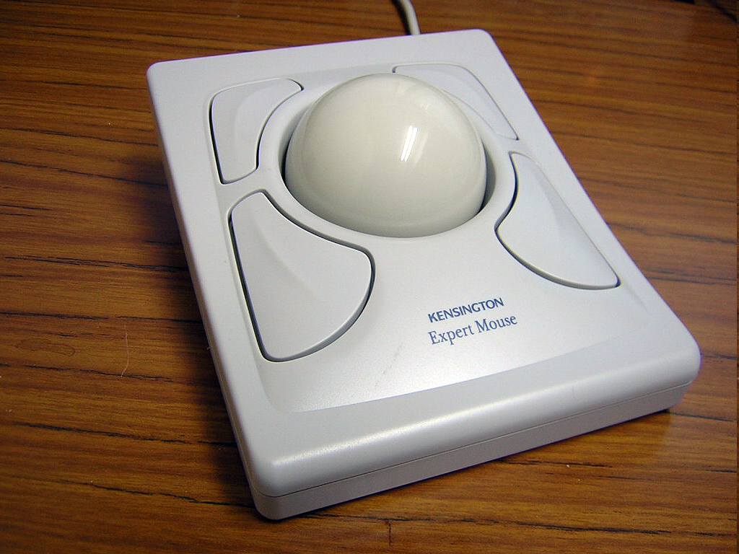
Trackball

Slide 31
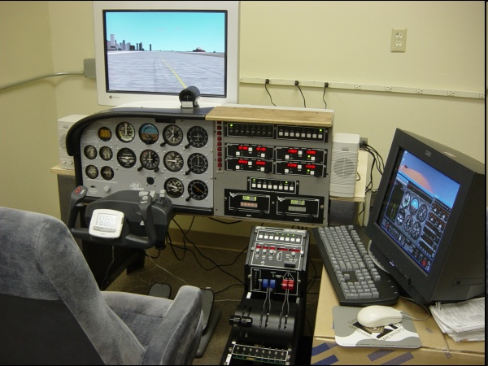
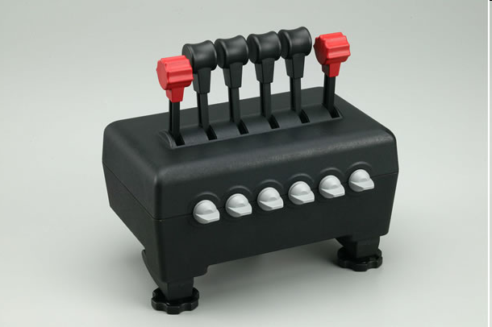
Throttle quadrant
It is a set of one or more levers.
It is used to simulate throttles or other similar controls in a real vehicle, particularly an aircraft.

Slide 32
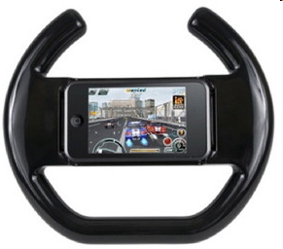
Steering Wheel
Most video games today also provide steering wheel for input.
  For example the iPhone steering wheel for controlling race car games.
  You simply mount the iPhone in a slot inside a steering wheel and then use the iPhone.

Slide 33
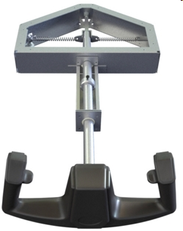
Yoke
A yoke is very similar to a steering wheel except that it resembles the control yoke found on many aircraft and has two axes of movement:
  Rotational Movement
  Forward and backward axis

Slide 34
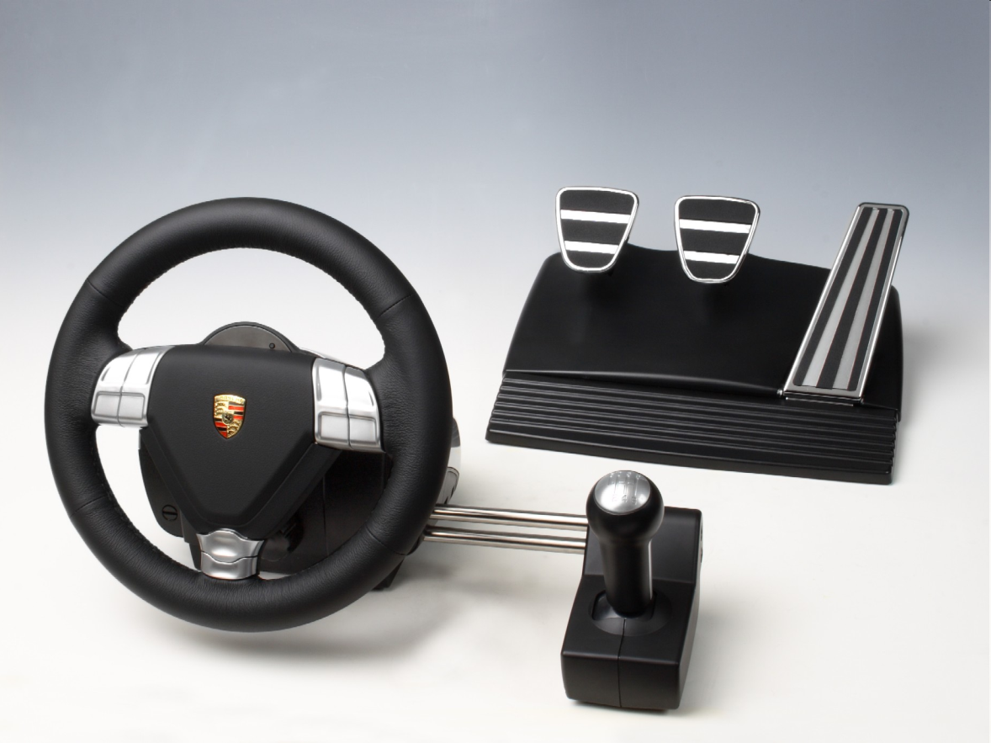
Pedals
Pedals may be used for driving simulations or flight simulations.
Most steering wheel controllers come with a set of pedals.

Slide 35
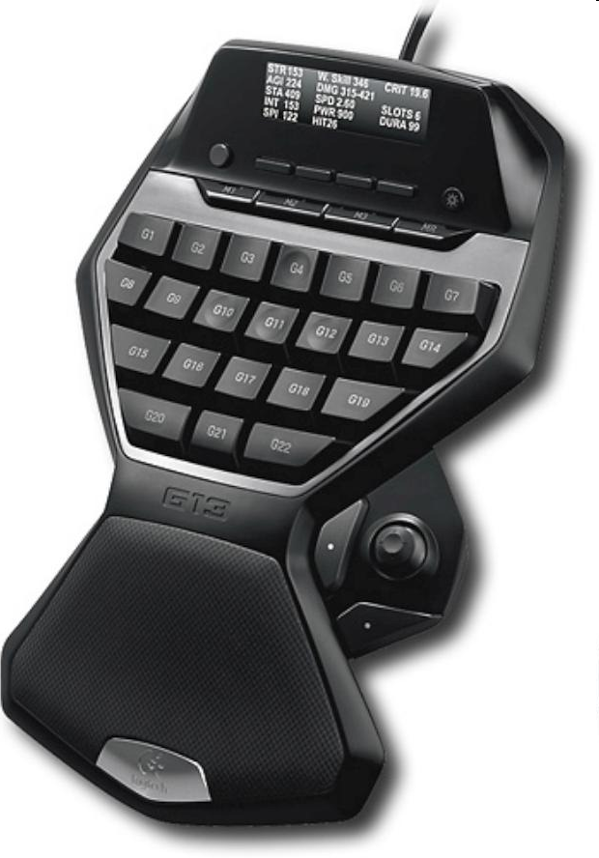
Gaming keypads and programmable PC controllers
These are specialized form of controllers.
These controllers can be programmed to allow the emulation of keys, and macros in some cases.

Slide 36
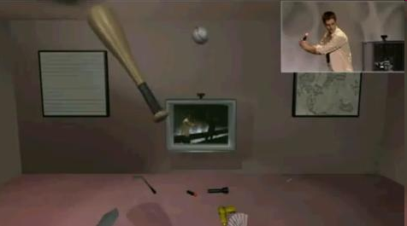
Motion sensing controllers
These controllers are now compatible with thousands of existing games.

Slide 37
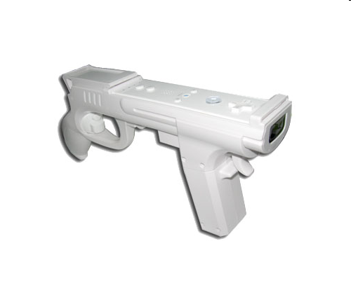
Light gun
A light gun is a peripheral used to "shoot" targets on a screen.
They resembles with firearms or ray guns.

Slide 38
Concept Keyboards
A concept keyboard is a flat board that contains a grid of buttons.
Each button can be programmed to do whatever you want.
Concept keyboards are particularly useful for people who would find using an ordinary keyboard difficult.
  e.g.; Primary schools often use them with young children.

Slide 39
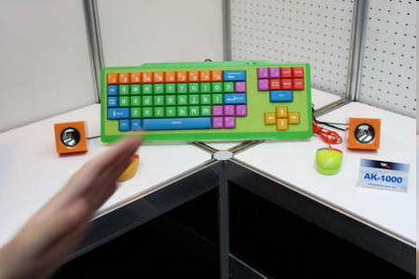
Concept Keyboard

Slide 40
Input by light
Digital Camera
Scanner
Digital video camera
OMR
OCR
Light pen
Bar-code reader

Slide 41
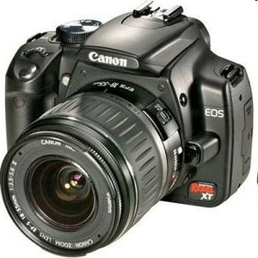
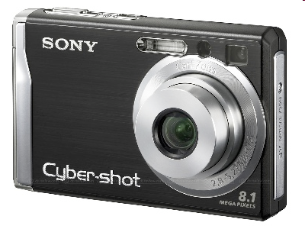
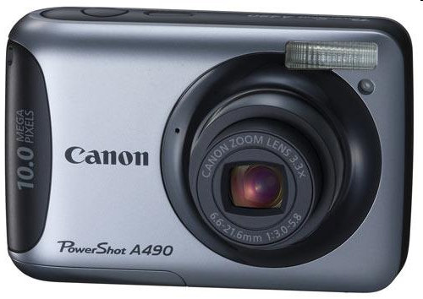
Digital Camera
Light received through lens is converted to digital signals by sensors, rather then stored by chemical change on a film as in normal camera.
The resulting photographs can then be stored on a computer and used just like any clip art files.

Slide 42
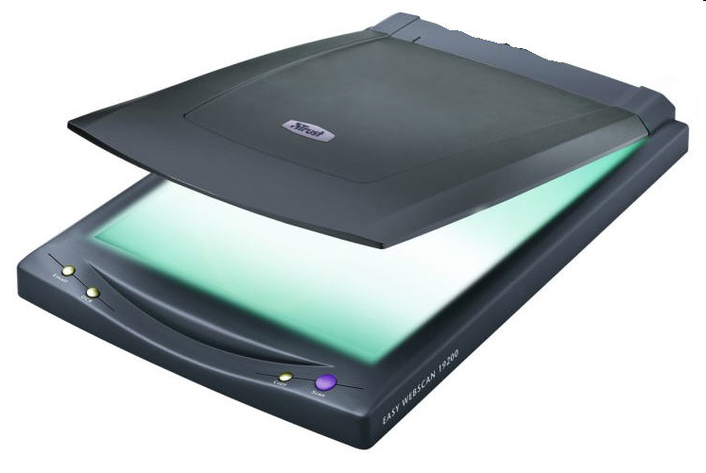
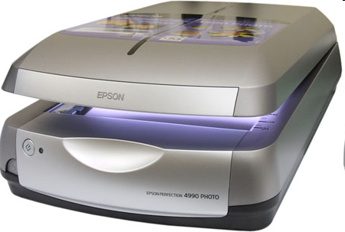
Scanner
It is a device used to scan images.
It can scan printed text or an object and converts it into a digital image.
Modern scanners may be considered the successors of early telephotography and fax input devices.

Slide 43
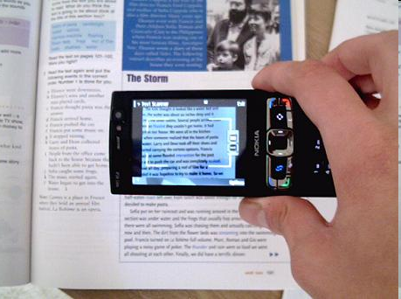
OCR
OCR stands for Optical Character Recognition.
  Converts scanned text into editable text
  Each letter is scanned
  Letters are compared to known letters
  Best match is entered into document
  Rarely 100% accurate

Slide 44
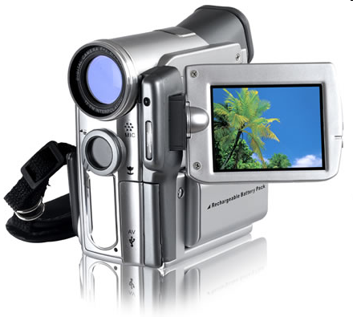
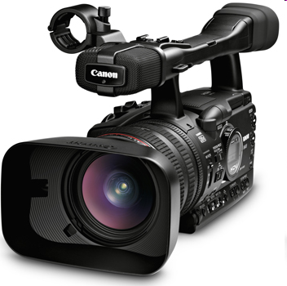
Digital Video Camera
It captures moving images by digitally recording photographs and play them back rapidly in sequence to create movement.

Slide 45
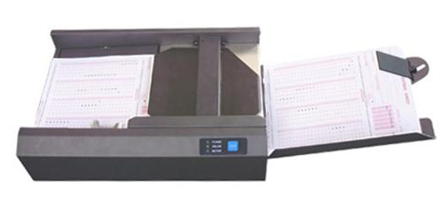
OMR (Optical Mark Reader)
Similar to bar-code reader.
Uses infra-red light to scan pencil marks on prepared forms such as multiple choice examination answer sheets or lottery tickets.

Slide 46
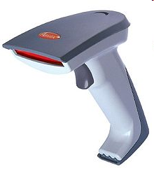
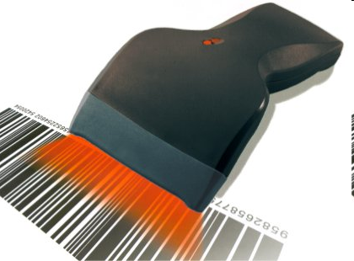
Bar-Code Reader
An item is wiped over a laser scanner or a wind is wiped over a bar-code to read in the data.
It is the same as scanner.
Due to its simple nature, scanning is very rapid.
Used at supermarket checkouts and some libraries.

Slide 47
Other Input Types
Remote Control
Sensors
MIRC
Micro-Phone
MIDI
Smart card
Magnetic strip

Slide 48
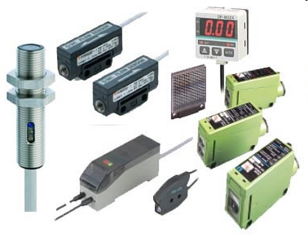
Sensors
Sensors can be used to measure heat, light, sound, pressure, strain, acidity (pH), oxygen concentration, humidity, pulse, water flow speed.
It transmits input signal to a computer.

Slide 49
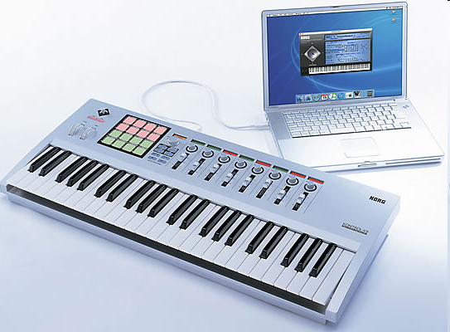
MIDI (Musical Instrument digital Interface)
It is an electronic musical instrument.
It has a port to input into an interface in the computer.
The music can then be stored as a file, displayed on the screen and edited ready for playback.

Slide 50
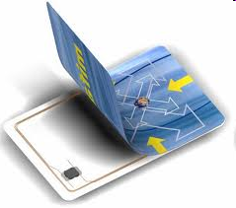
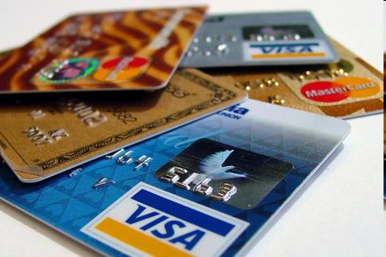
Smart Card
It is a card with a microchip inside.
It contains volatile memory.
Smart cards also provide strong security and authentication within large organizations.

Slide 51
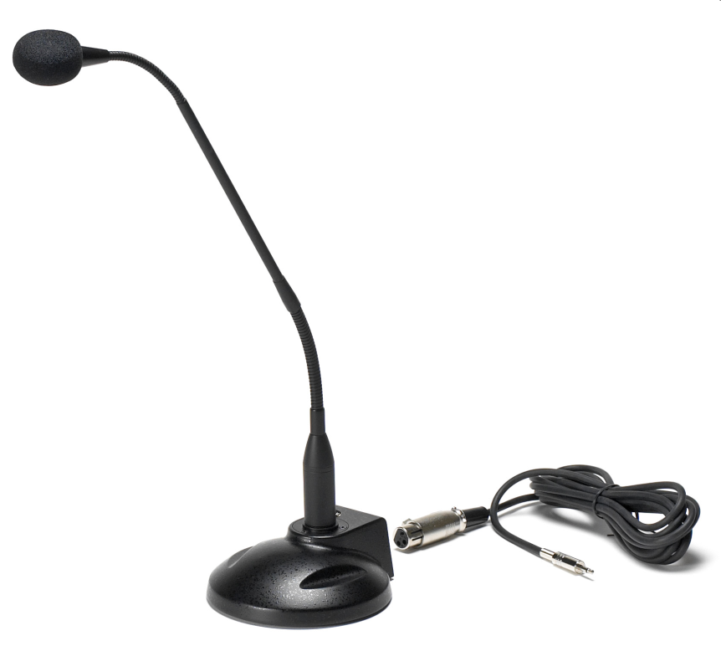
Microphone
Microphone converts sound into an electrical signal.
For input voice, software is used to convert voice into text or to activate menu options.
This requires fast processing and a lot of memory and will become more common as technology improves.

Slide 52
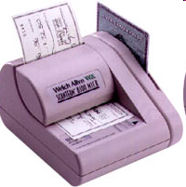
MIRC (Magnetic Ink Character Recognition)
MICR, is a character recognition technology.
It uses ink containing magnetic particles.
It is used primarily by the banking industry to facilitate the processing of cheques and makes up the routing number and account number at the bottom of a check.
It is then scanned into a computer.

Slide 53
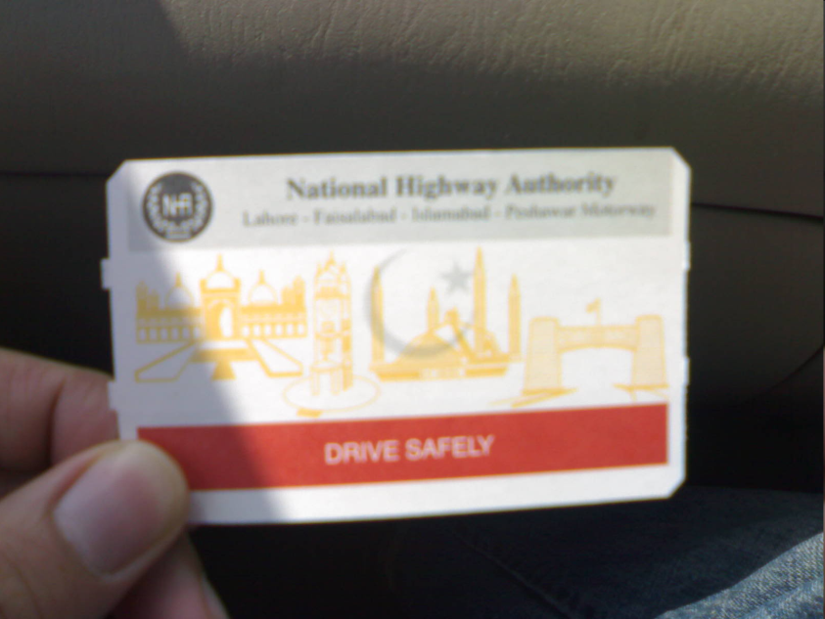
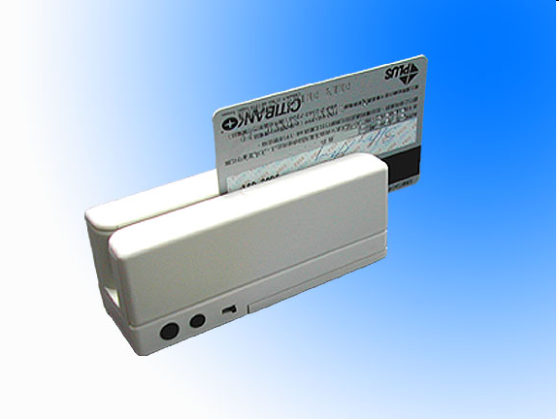
Magnetic Strip
It is a narrow band of magnetic tape that can hold data.
These are usually read only.
  E.g.; magnetic strip cards.
It was invented by IBM in 1960 for security purpose.

Slide 54
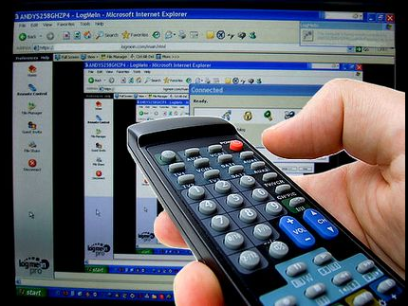
Remote Control
IT emits beam of infra-red light which carries data signals.
Mostly used for television.
Works on the line of sight principle.
Now being used by computers as wireless method of communication.

Slide 55
Input Devices are All Around Us

Slide 56
Input Devices are All Around Us
Input Device | Place Used | Purpose
OMR | Newsagent | Lottery ticket
Touch screen | Bus stop | Plan your journey
Keyboard | ATM outside bank | Withdraw money
OCR | Post Office | Sorting letters
Concept keyboard | Child Nursery | Alphabet teaching
MICR | Bank | Processing cheques
Bar-code reader | Supermarket | Finding cost of items
CCTV | Street | Security in street
Switch | Pedestrian crossing | Change traffic lights

Slide 57
Which input device to use & when
Volume of data | Speed | Nature of System | Ease of use | Technological development | Cost
Large automatic equipment is best | Barcode scanner useful if high speeds necessary | MICR – needed for specialist input methods such as banking cheques | Conditions may influence choice | Methods constantly updated as new methods introduced | Major factor – could relate to staffing or hardware
tcowling 2009 from Mott, Leaming & Williams

Slide 58
Practical

Slide 59
Practical 1
Record your voice in the computer. Then play it back.
  Use Microphone, Microsoft software for recording.

Slide 60
Practical 2
Record a video in your computer.
  Use Web Camera for recording a video.
  Edit this video with different options in Windows movie maker.

Slide 61
Practical 3
Take a print out of this slide and scan it in a computer.
  Use scanner
  Learn different features of scanning software.
  Save the picture in Jpeg format.
Use windows OCR software to convert image into text.
  Software is available with windows OS.

Slide 62
Summary
There are different ways to input data.
  Automatic input methods remove need to key in data
  Large quantities of data to be read/input quickly
  Data can be input by touch, sound, light, control, and electronic means.
Input devices are being used all around us in daily life.

Slide 63
Summary
Number of factors considered when choosing an input method
  Volume of data
  Cost
  Speed
  Ease of Use

Slide 64
THE END

