Slide 1
Project Risk Management
SEII-Lecture 9
Dr. Muzafar Khan
Assistant Professor
Department of Computer Science
CIIT, Islamabad.

Slide 2
Recap
Project quality management
  Planning quality
  Performing quality assurance
  Performing quality control
Project communication management
  Identifying stakeholders
  Planning communications
  Distributing information
  Managing stakeholder expectations
  Reporting performance

Slide 3
Importance [1/2]
Risk management is the art and science
A frequently overlooked and underestimated aspect
Significant improvement can be achieved to meet project objectives
Often goes unnoticed
Study conducted with 38 organizations
  Engineering and construction, telecommunications, information systems/software development, high-tech manufacturing
  Maturity level in different knowledge areas
  Lowest maturity level in risk management

Slide 4
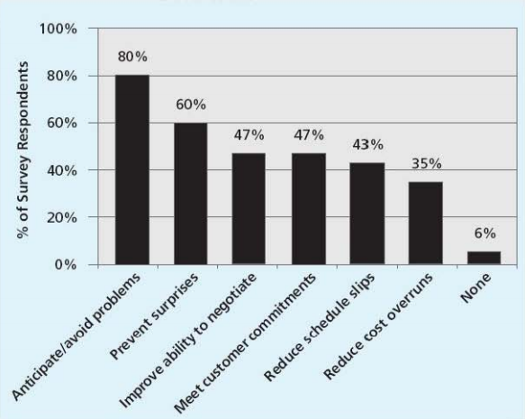
Importance[2/2]
KLCI Study with 260 software organizations in 2001
Figure source: IT Project Management, K. Schwalbe, 6th ed., p. 424

Slide 5
Basic Concepts [1/2]
Risk
  “the possibility of loss or injury”
  Negativity is associated and uncertainty is involved
  Negative VS positive risks
Negative risk management
  To lessen the impact of potentially adverse events
Positive risk management
  Investing in opportunities
Risk management is an investment

Slide 6
Basic Concepts [2/2]
Risk utility / tolerance
  The amount of satisfaction / pleasure received from a potential payoff
Risk averse
  Lower tolerance for the risk
Risk seeking
  Higher tolerance for the risk
Risk neutral
  A balanced approach
Known and unknown risks
Residual and secondary risks

Slide 7
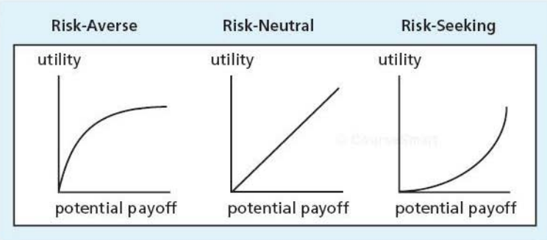
Risk Tolerance
Figure source: IT Project Management, K. Schwalbe, 6th ed., p. 427

Slide 8
Main Processes
Planning risk management
Identifying risks
Performing qualitative risk analysis
Performing quantitative risk analysis
Planning risk responses
Monitoring and controlling risk

Slide 9
Planning Risk Management
How to approach and plan for risk management activities
Main output: risk management plan
Planning meetings at early stage of project
Risk management policies, risk categories, lesson-learned reports from past projects
Review risk tolerance of stakeholders
Clarify roles and responsibilities, prepare budget and schedule estimates for risk-related activities
Level of information details can vary

Slide 10
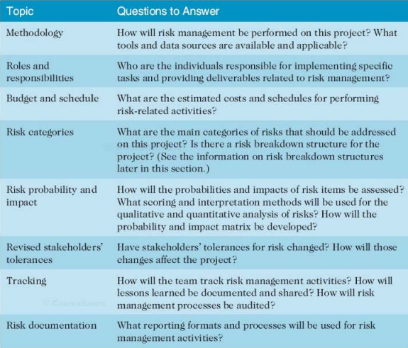
Topics Addressed in Risk Management Plan
Figure source: IT Project Management, K. Schwalbe, 6th ed., p. 427

Slide 11
Additional Plans
Contingency plans
  Predefined action if risk occurs
  Example: unavailability of new software
Fallback plans
  To address high impact risk
Contingency reserves/allowances
  Provisions by organization / project sponsor to reduce the risk

Slide 12
Common Sources of Risks on IT Projects
Standish group study with 60 IT professionals
Success Criterion | Relative Importance
User involvement | 19
Executive management support | 16
Clear statement of requirements | 15
Proper planning | 11
Realistic expectations | 10
Smaller project milestones | 9
Competent staff | 8
Ownership | 6
Clear visions and objectives | 3
Hardworking, focused staff | 3
Total | 100

Slide 13
Risk Categories
Market risk
  New product or service
Financial risk
  Affordance to undertake the project
Technology risk
  Technical feasibility
People risk
  Availability of skilled people
Structure/process risk
  Change in business processes

Slide 14
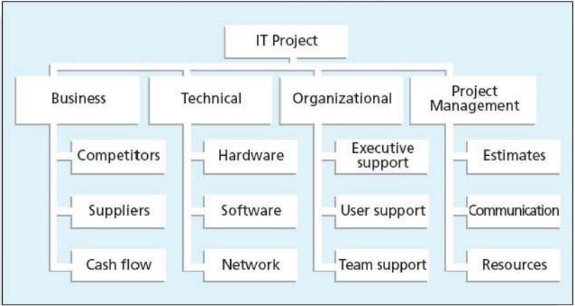
Example – Risk Breakdown Structure
Figure source: IT Project Management, K. Schwalbe, 6th ed., p. 433

Slide 15
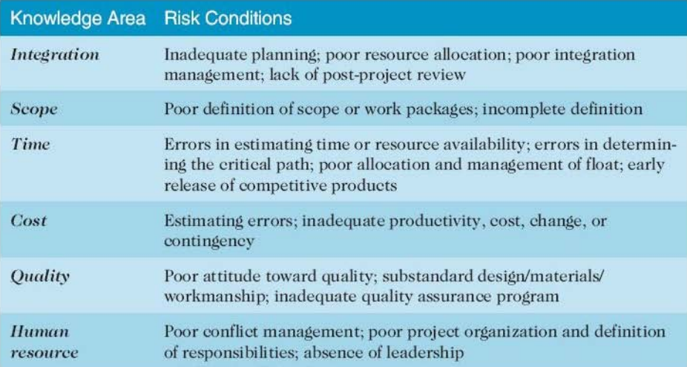
Potential Negative Risk Conditions Associated With Each Knowledge Area
Figure source: IT Project Management, K. Schwalbe, 6th ed., p. 433

Slide 16
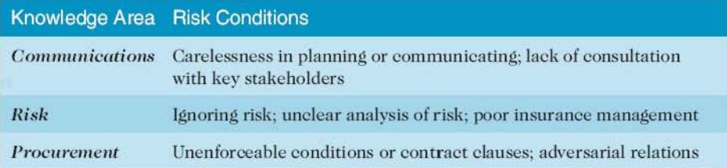
Potential Negative Risk Conditions Associated With Each Knowledge Area
Figure source: IT Project Management, K. Schwalbe, 6th ed., p. 434

Slide 17
Identifying Risks
Different tools and techniques
  Brainstorming
  Delphi technique
  Interviewing
  SWOT analysis
  Checklists
  Analysis of assumptions
  Diagramming techniques
Risk registers

Slide 18
Contents of Risk Register
Identification number
Risk ranking
Risk title
Risk description
Risk category
Root cause
Triggers
Potential responses
Risk owner
Probability, impact, and status

Slide 19
Performing Qualitative Risk Analysis
Expert judgment to assess likelihood and impact of identified risks
Using probability/impact matrix
Top ten risk item tracking
Risk management review
Updated risk registers
Watch list

Slide 20
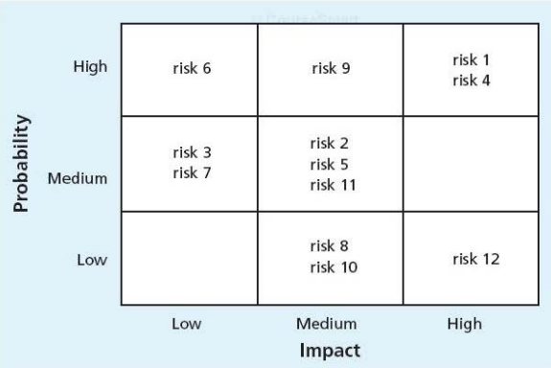
Example – Probability/Impact Matrix
Figure source: IT Project Management, K. Schwalbe, 6th ed., p. 439

Slide 21
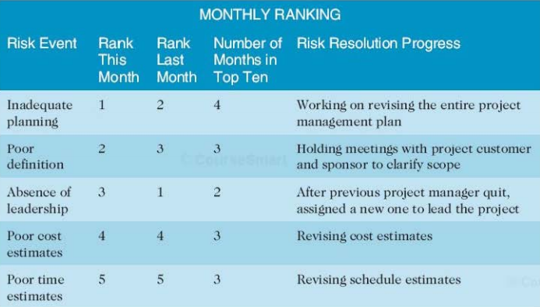
Example – Top Ten Risk Item Tracking
Figure source: IT Project Management, K. Schwalbe, 6th ed., p. 441

Slide 22
Performing Quantitative Risk Analysis
Follows qualitative risk analysis
Main techniques
  Data gathering
  Decision trees – expected monetary value
  Simulation – Monte Carlo analysis
  Sensitivity analysis
Updated risk register

Slide 23
Planning Risk Responses [1/2]
Developing options and defining strategies
Risk avoidance
  Eliminate the cause
Risk acceptance
  Accepting the consequences
Risk transference
  Shifting the consequences to other party
Risk mitigation
  Reducing the impact

Slide 24
Planning Risk Responses [2/2]
Strategies for positive risks
Risk exploitation
  Make sure the positive risk happens
Risk sharing
  Sharing the ownership with other party
Risk enhancement
  Maximizing the opportunity
Risk acceptance
  No extra effort

Slide 25
Monitoring and Controlling Risks
Execution of risk processes
Risk awareness
Redistribution of resources
Workarounds – unplanned responses
Risk reassessment, risk audits, variance and trend analysis, technical performance measurements, reserve analysis, status meetings
Updated risk register

Slide 26
Summary
Basic concepts
  Risk, positive/negative risk management, Risk utility / tolerance (risk averse, risk seeking, risk neutral)
Planning risk management
  Risk management plan, contingency and fallback plans
Identifying risks
  Brainstorming, Delphi technique, interviewing, SWOT analysis, checklists, risk registers
Performing qualitative and quantitative risk analysis
Planning risk responses
  Risk avoidance, risk acceptance, risk transference, risk mitigation, Risk exploitation, Risk sharing
Monitoring and controlling risks

