Slide 1
Project Quality Management
Project Communication Management
SEII-Lecture 8
Dr. Muzafar Khan
Assistant Professor
Department of Computer Science
CIIT, Islamabad.

Slide 2
Recap
Basic Concepts
  Cost, profit, profit margin, direct and indirect costs, sunk cost, learning curve theory
Estimating costs
  Rough Order of Magnitude, budgetary, and definitive cost estimates
Cost estimation tools and techniques
  Top-down and bottom-up estimates, and parametric modeling
  Problems related to IT project costs estimates
Determining and controlling budget
  Earned Value Management

Slide 3
Joke ☺ [1/2]
At a recent computer exposition (COMDEX), Bill Gates, the founder and CEO of Microsoft Corporation, stated: “If General Motors had kept up with technology like the computer industry has, we would all be driving $25 cars that got 1,000 miles to the gallon.” In response of Gates’ comments, General Motors issued a press release stating: “if GM had developed technology like Microsoft, we would all be driving cars with the following characteristics:
For no reason whatsoever your car would crash twice a day.
Every time they repainted the lines on the road, you would have to buy a new car.
Occasionally, your car would die on the freeway for no reason, and you would just accept this, restart, and drive on.
Occasionally, executing a maneuver such as a left turn would cause your car to shut down and refuse to restart, in which case you would have to reinstall the engine.

Slide 4
Joke ☺ [2/2]
Only one person at a time could use the car, unless you bought “Car95” or “CarNT”. But then you would have to buy more seats.
Macintosh would make a car that was powered by the sun, reliable, five times as fast, and twice as easy to drive, but would run on only five percent of the roads.
The oil, water temperature, and alternator warning lights would be replaced by a single “general car default” warning light.
The airbag system would say “are you sure?” before going off.
Occasionally, for no reason whatsoever, your car would lock you out and refuse to let you in until you simultaneously lifted the door handle, turned the key, and grabbed hold of the radio antenna.
Every time GM introduced a new model car, buyers would have to learn how to drive all over again because none of the controls would operate in the same manner as the old car.
You would press the start button to shut off the engine.

Slide 5
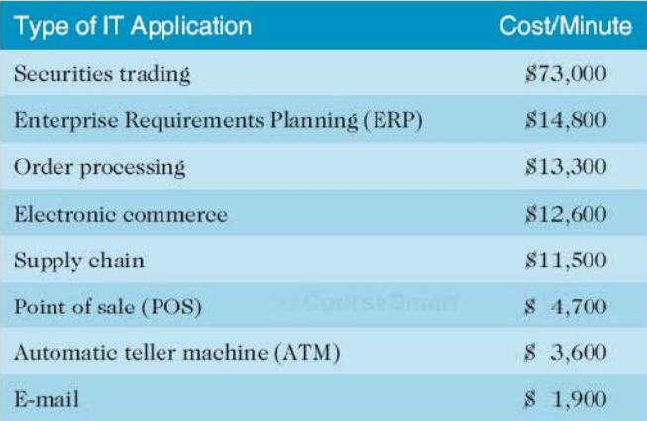
Cost of downtime
Standish group study in 2008
Figure source: IT Project Management, K. Schwalbe, 6th ed., p. 258

Slide 6
Quality
ISO definition
  “The totality of characteristics of an entity that bear on its ability to satisfy stated or implied needs”.
  “the degree to which a set of inherent characteristics fulfill requirements”.
Conformance to requirements and fitness for use
Customer decides about the quality
Scope, time, cost, plus quality

Slide 7
Main Processes
Planning quality
  Incorporating relevant quality standards
  Main outputs: quality management plan, quality metrics, quality checklists
Performing quality assurance
  Periodically evaluating project performance
  Main outputs: updated quality management plan and change requests
Performing quality control
  Monitoring project results
  Main outputs: quality control measurements, validated changes, and validated deliverables

Slide 8
Improving IT Project Quality
Leadership
Cost of quality
  Cost of conformance and nonconformance
  Prevention cost
  Appraisal cost
  Internal failure cost
  External failure cost
  Measurement and test equipment cost
Expectations and cultural differences in quality
Maturity models
  CMMI

Slide 9
Improving IT Project Quality
Organizational influences, workplace factors, and quality
  Several year study done by T. DeMarco and T. Lister
  600+ software developers from 92 organizations
  Games were developed to examine programming quality and productivity over a wide range of organizations, technical environments, and programming languages
  Productivity varied from by a factor of about one to ten across the participants
  Productivity varied by an average of 21% between pairs of programmers from the same organization
  No correlation between productivity and programming language, year of experience, or salary
  Dedicated workspace and quiet work environments are key factors

Slide 10
Project Communication Management
Communication failure is the greatest threat for IT projects success
In general, IT professionals are not good in communication skills
Main objective
  Ensure timely and appropriate generation, collection, dissemination, storage, and disposition of project information

Slide 11
Main Processes
Identifying stakeholders
Planning communications
Distributing information
Managing stakeholder expectations
Reporting performance

Slide 12
Identifying Stakeholders
Need of formal and informal communication networks to identify stakeholders
Create stakeholder register
Stakeholders management strategy
Stakeholders analysis

Slide 13
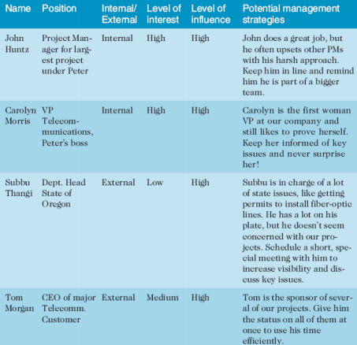
Example – Stakeholder Management Strategy
Figure source: IT Project Management, K. Schwalbe, 6th ed., p. 386

Slide 14
Planning Communications
Communication management plan
  Guide for communication
  Stakeholder communication requirements
  Information to be communicated
  information receiver and producer
  Suggest methods for conveying information
  Frequency of communication
  Escalation procedures for resolving issues
  Revision procedures to update communication plan
  A glossary of common terminology

Slide 15
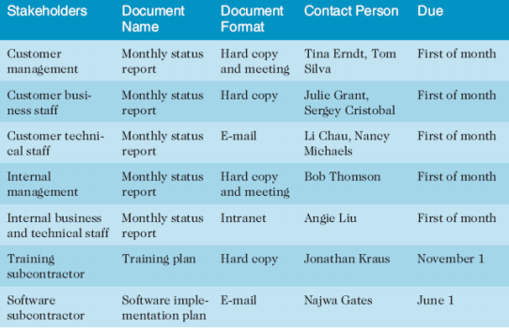
Example – Stakeholder Communication Analysis
Figure source: IT Project Management, K. Schwalbe, 6th ed., p. 387

Slide 16
Distributing Information [1/2]
Information to the right people at the right time
Use of technology
Formal and informal methods
Good skills required for project manager and team
Effective and timely manner distribution of important information
Face-to-face interaction
  58% body language, 35% words, and 7% contents
Good to have short and frequent meetings

Slide 17
Distributing Information [2/2]
Selecting the appropriate communications medium
Understanding group and individual communication needs
  People are not interchangeable parts. (The mythical man-month by F. Brooks)
  Open dialogue
  Geographic location and cultural background
Setting the stage for communicating bad news
Determining the number of communication channels

Slide 18
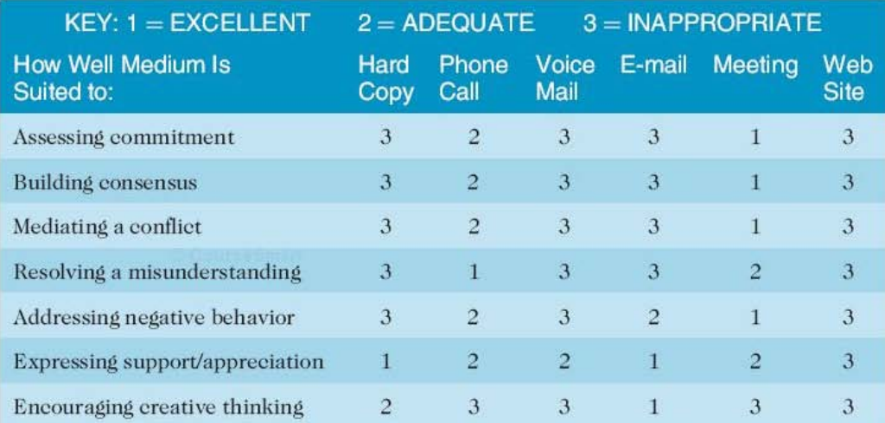
Example – Choice of Medium
Figure source: IT Project Management, K. Schwalbe, 6th ed., p. 392

Slide 19
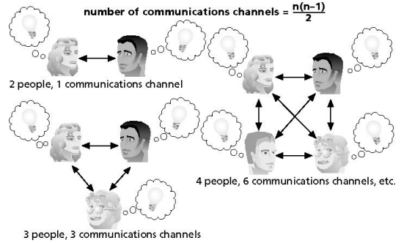
Example – Number of Communication Channels
Figure source: IT Project Management, K. Schwalbe, 6th ed., p. 396

Slide 20
Managing Stakeholders
Project manager has the key role
Triple constraint – often modifications
Project sponsors usually rank these constraints and provide guidelines to balance it
Expectations management matrix
  List of success measures, priorities, expectations, and guidelines
It helps to manage issues

Slide 21
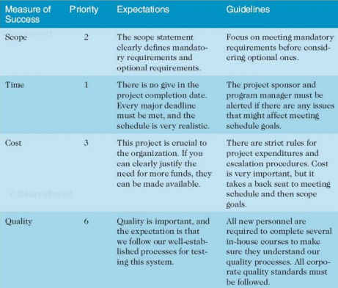
Example – Expectations Management Matrix
Figure source: IT Project Management, K. Schwalbe, 6th ed., p. 397

Slide 22
Reporting Performance
Helps to update stakeholders
Performance Reports
  Status reports: where the project stands
  Progress reports: What project team has done
  Status review meetings
Forecasts
  Predicts future project status and progress
  Earned value managment

Slide 23
How to Improve Project Communications
Use communication skills to manage conflict
Develop better communication skills
Running effective meetings
Use collaborative tools effectively
Use templates

Slide 24
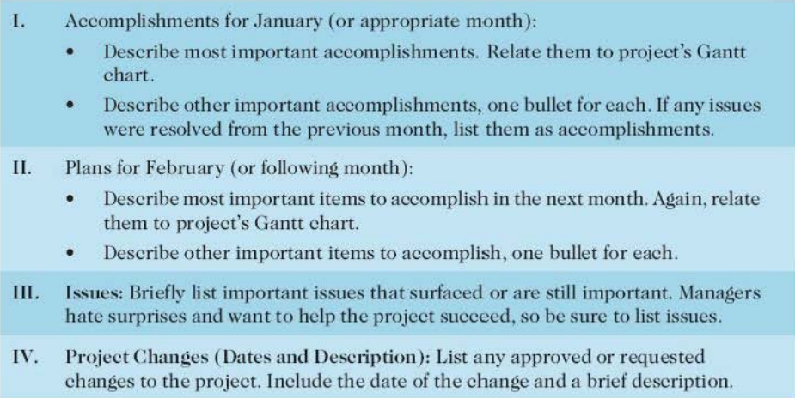
Example – Monthly Progress Report
Figure source: IT Project Management, K. Schwalbe, 6th ed., p. 408

Slide 25
Summary
Project quality management
  Planning quality
  Performing quality assurance
  Performing quality control
Project communication management
  Identifying stakeholders
  Planning communications
  Distributing information
  Managing stakeholder expectations
  Reporting performance

