Slide 1
Project Cost Management
SEII-Lecture 7
Dr. Muzafar Khan
Assistant Professor
Department of Computer Science
CIIT, Islamabad.

Slide 2
Recap
Developing the schedule
  Tracking Gantt charts
Critical path method
  Longest path, earliest time
Schedule trade-offs using CPM
  Free slack, total slack
Shortening the schedule
  Crashing, fast tracking
Critical chain scheduling
  Availability of critical resources, project and feeding buffer
PERT technique
Controlling the schedule

Slide 3
Importance
CHAOS studies
  180% in 1994
  56% in 2004
Other studies
  33-34% (in all projects)
US Internal Revenue Service
  $50 billion loss in 1990
UK National Health Service
  $26 billion loss in 2002

Slide 4
Basic Concepts [1/4]
Cost
  A resource sacrificed to achieve a specific objective
  Something given up in exchange
  Often measured in monetary amounts
Profit
  Revenues minus expenditures
Profit margin
  Ratio of revenues to profits

Slide 5
Basic Concepts [2/4]
Life cycle costing
  Cost of a project throughout its life cycle
Cash flow analysis
  Determining the estimated annual costs and benefits and resulting annual cash flow
Tangible cost and benefit
  Easily measurable in monetary terms
Intangible cost and benefit
  Difficult to measure in monetary terms
  Harder to justify

Slide 6
Basic Concepts [3/4]
Direct costs
  Directly related to producing the products and services
  Can be controlled
Indirect costs
  Not directly related
  Very little control
Sunk cost
  Money spent in the past
  Not included while deciding further investment
Learning curve theory
  Continuous production reduces unit cost

Slide 7
Basic Concepts [4/4]
Reserves
  The money reserved to mitigate cost risk
  Contingency reserves / known unknowns
  Management reserves / unknown unknowns

Slide 8
Main Processes
Estimating costs
  Main outputs: activity cost estimates and basis of estimates
Determining the budget
  Main outputs: cost performance baseline, project funding requirements
Controlling costs
  Main outputs: work performance measurements, budget forecasts, and change requests

Slide 9
Estimating Costs [1/2]
Rough Order of Magnitude (ROM) estimate
  A ballpark estimate
  Very early in the project
  Helps in project selection decisions
  3+ years prior to project completion
  Accuracy: -50% to +100%
Budgetary estimate
  Allocating money into an organization’s budget
  1-2 years prior to project completion
  Accuracy: -10% to +25%

Slide 10
Estimating Costs [2/2]
Definitive estimate
  The most accurate estimate
  Purchasing decisions and final project costs
  1 year or less prior to project completion
  Accuracy: -5% to +10%
Estimates vary in different domains
Labor cost: number of people and hours required
Differentiation between external and internal resources

Slide 11
Cost Estimation Tools and Techniques [1/2]
Top-down estimates
  Analogous estimate
  Based on the previous projects’ cost
  Expert judgment required
Bottom-up estimates
  Activity based costing
  Estimating individual work items and summing them
  Organizations often have resource cost rates

Slide 12
Cost Estimation Tools and Techniques [2/2]
Parametric modeling
  Based on project characteristics/parameters
  Most reliable if previous estimates were accurate
  Example: line of code cost, language used, level of programmer expertise, size and complexity of data involved
  COCOMO II

Slide 13
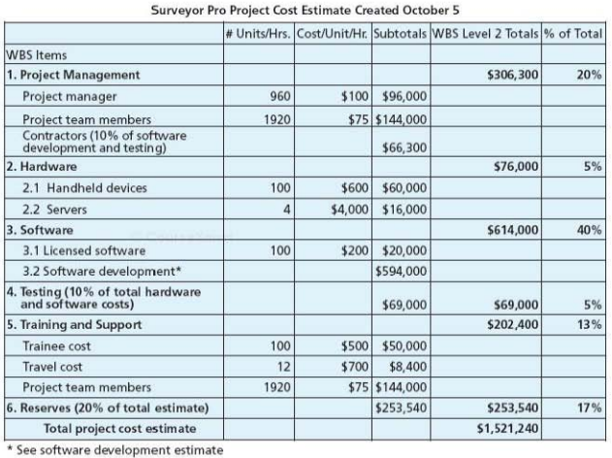
Example – Project Cost Estimate
Figure source: IT Project Management, K. Schwalbe, 6th ed., p. 269

Slide 14
Cost Estimate Problems in IT Projects
Estimates are done too quickly
  Complex task, needs serious efforts
  Need to understand system requirements
Lack of estimating experience
  Unavailability of reliable project data
  Training required
Biasness towards underestimation
  Do not forget juniors and allow extra cost
Management desires accuracy
  Negotiation skills required

Slide 15
Determining the Budget
Allocating the project cost estimate to individual work items over time
Main inputs: activity cost estimates, project schedule, and resource calendars
Main goal: cost baseline
Well established process
Budget categories such as travel and depreciation etc.
Information used for legal and tax purposes
Provides project funding information

Slide 16
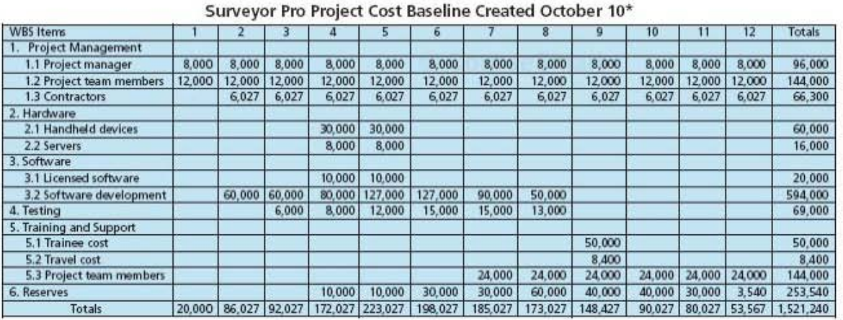
Example – Project Budget
Figure source: IT Project Management, K. Schwalbe, 6th ed., p. 271

Slide 17
Controlling Cost
Monitoring cost performance
Revised cost baseline
Main inputs: project management plan, project funding requirements, and work performance data
Change control system
Performance review meetings
Performance measurement techniques

Slide 18
Earned Value Management [1/5]
Project performance measurement technique
Integrates scope, time, and cost data
Comparison of actual information and baseline
Calculating three values for each/summary activity
Planned Value (PV)
  Also called budget
  Approved cost estimate for an activity

Slide 19
Earned Value Management [2/5]
Actual Cost (AC)
  Total direct and indirect costs
Earned Value (PV)
  Estimated value of the work completed
  Based on the original planned cost and the rate of work completed to date
  Rate of Performance (RP): ratio of actual work completed to the percentage of work planned

Slide 20
Earned Value Management [3/5]
Cost Variance (CV)
  Earned value minus the actual cost
  If negative, spent more than planned
  If positive, spent less than planned
Schedule Variance (SV)
  Earned value minus the planned value
  If negative, it took longer than planned
  If positive, it took less than planned

Slide 21
Earned Value Management [4/5]
Cost Performance Index (CPI)
  Ratio of earned value to actual cost
  Estimate the projected cost of project completion
  If 100%, planned and actual costs are same
  If less than 100%, over budget
  If greater than 100%, under budget
Schedule Performance Index (SPI)
  Ratio of earned value to planned value
  Estimate the projected time of project completion
  If 100%, project is on schedule
  If less than 100%, behind schedule
  If greater than 100%, ahead of schedule

Slide 22
Earned Value Management [5/5]
Estimate at Completion (EAC)
  CPI for estimating cost to complete the project based on the performance to date
  SPI for estimating time to complete the project based on the performance to date
Budget at Completion (BAC)
  The original total project budget

Slide 23
Example 1 – EVM
Activity: purchasing and installing a new web server
Time required: one week
Total cost: $10,000
When executed
  Actual time: two week
  Actual cost: $20,000 (15,000 in week 1 and 5,000 in week 2)

Slide 24
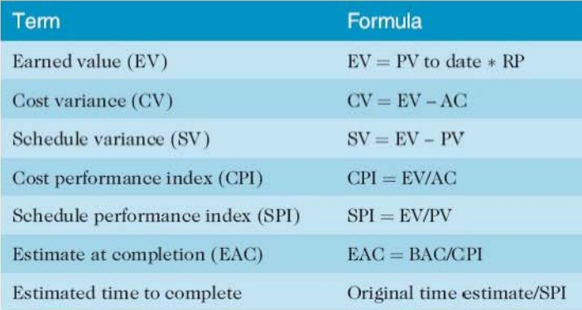
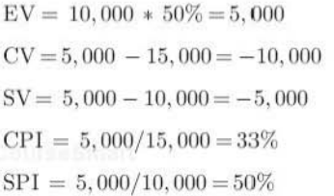
Example 1 – EVM
Figure source: IT Project Management, K. Schwalbe, 6th ed., p. 274

Slide 25
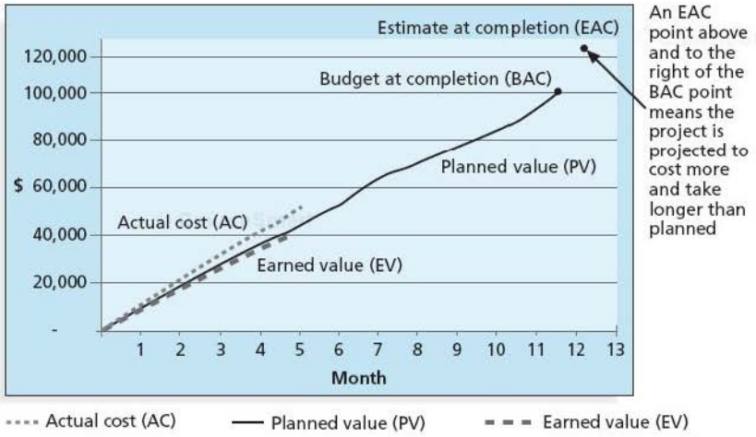
Example 2 – EVM
Figure source: IT Project Management, K. Schwalbe, 6th ed., p. 276

Slide 26
Summary
Basic Concepts
  Cost, profit, profit margin, direct and indirect costs, sunk cost, learning curve theory
Estimating costs
  Rough Order of Magnitude, budgetary, and definitive cost estimates
Cost estimation tools and techniques
  Top-down and bottom-up estimates, and parametric modeling
  Problems related to IT project costs estimates
Determining and controlling budget
  Earned Value Management

