Slide 1
Project Time Management
SEII-Lecture 6
Dr. Muzafar Khan
Assistant Professor
Department of Computer Science
CIIT, Islamabad.

Slide 2
Recap
Defining activities
  Activity list containing activity name, identifier, attributes, and brief description
Sequencing activities
  determining the dependencies
  Mandatory, discretionary, external
  evaluating the reasons for dependencies
Estimating activity resources
  list of activity resource requirements, resource breakdown structure, project document updates
Estimating activity durations
  Duration VS effort, activity duration estimates
  Three point estimates
Developing the schedule
  Project schedule, Gantt charts

Slide 3
Tracking Gantt Charts
Comparison of planned and actual dates
To evaluate the project progress
Planned schedule dates: baseline dates
Entire approved planned schedule: baseline schedule
Easy to create and understand

Slide 4
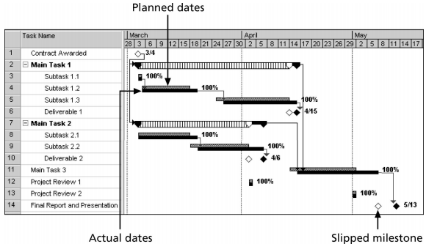
Example – Tracking Gantt Chart
Figure source: IT Project Management, K. Schwalbe, 6th ed., p. 227

Slide 5
Critical Path Method [1/2]
Also called critical path analysis
Network diagramming technique
Predict total project duration
Critical path is the earliest time to complete the project
It is the longest path through the network diagram
It has least amount of slack or float
  The amount of time an activity may be delayed without delaying a succeeding activity or the project finish date

Slide 6
Critical Path Method [2/2]
Several tasks done in parallel
Multiple paths through a network diagram
Longest path or path containing critical tasks derive the completion date
How to calculate critical path
  Develop a good network diagram
  Estimate activities durations
  Add durations of all activities on each path
  The longest path is the critical path

Slide 7
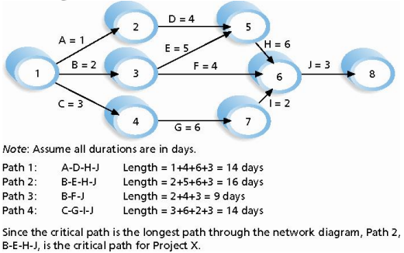
Example – CPM
Figure source: IT Project Management, K. Schwalbe, 6th ed., p. 229

Slide 8
Issues related to CPM
Creativity to manage critical path
  Stuffed gorilla and Apple computer project
Confusions about critical path
  Critical does not mean critical activities
  It is concerned with time dimension
  Critical path is not the shortest path
  Example: growing grass
  More than one critical paths
  Critical path can change

Slide 9
Schedule Trade-Offs using CPM [1/2]
If the task on critical path is behind schedule
Proactive role of project manager and team
Technique to do trade-offs
Free slack / float
  The amount of time activity can be delayed without delaying the early start date of any immediately following activities
  Early start date is the earliest possible time to start an activity

Slide 10
Schedule Trade-Offs using CPM [2/2]
Total slack / float
  The amount of time activity can be delayed from its early start without delaying the planned project finish date
Project managers calculate free and total slack by doing forward and backward pass
  Forward pass: early start and finish dates for each activity
  Backward pass: late start and finish dates for each activity

Slide 11
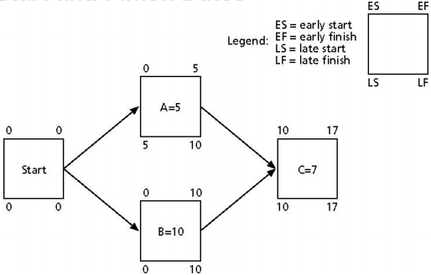
Example
Figure source: IT Project Management, K. Schwalbe, 6th ed., p. 231

Slide 12
How to Shorten Project Schedule Using CPM [1/2]
Stakeholders always want to shorten project schedule
Different duration compression techniques
One is to reduce the duration of activities on the critical path
  By adding more resources or changing the scope
Crashing
  To do cost and schedule trade-offs
  Greatest schedule compression for least incremental cost

Slide 13
How to Shorten Project Schedule Using CPM [2/2]
Fast tracking
  To do activities in parallel (rather than sequential)
  Risk of lengthening the project schedule
Importance of updating critical path data
  Update the schedule with actual data
  Document revised estimates
  Informed decisions based on updated plans

Slide 14
Critical Chain Scheduling [1/2]
Based on Theory of Constraints (TOC)
  A chain with its weakest link
  Any complex system at any point in time often has only one constraint that limits the ability to achieve more of its goal
  That constraint must be identified for improvement
CCS considers limited resources to create schedule and includes buffers to protect the completion date

Slide 15
Critical Chain Scheduling [2/2]
Availability of limited/critical resources
CCS avoids multitasking
  A resource works on more than one tasks
Murphy’s law: if something can go wrong, it will
Parkinson’s law: work expands to fill the time allowed
CCS prefers project buffer and feeding buffers rather than individual tasks buffer

Slide 16
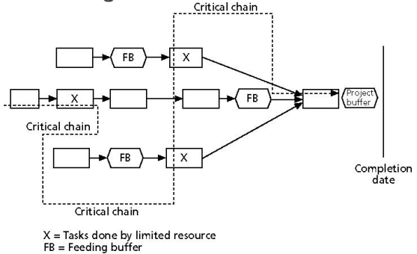
Example – CCS
Figure source: IT Project Management, K. Schwalbe, 6th ed., p. 235

Slide 17
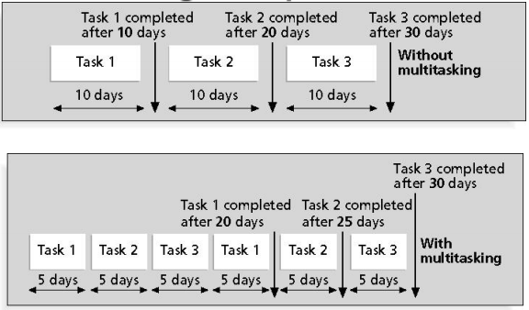
Example – Multitasking
Figure source: IT Project Management, K. Schwalbe, 6th ed., p. 234

Slide 18
Program Evaluation and Review Technique (PERT)
Another network analysis technique
Used when high degree of uncertainty about activity estimates
Uses critical path method to a weighted average duration estimate
Uses probabilistic time estimates
  Optimistic, most likely, and pessimistic time estimates
PERT weighted average = optimistic time + 4 * most likely time + pessimistic time
6

Slide 19
Controlling the Schedule [1/2]
Part of integrated change control under project integration management
Main objectives: schedule status information, influencing the factors that cause schedule changes, managing schedule changes
Main inputs: project management plan, project schedule, work performance data
Main outputs: work performance measurements, change requests, lesson learned reports

Slide 20
Controlling the Schedule [2/2]
Tools
  Progress reports
  Schedule change control system
  Schedule comparison bar charts e.g. tracking Gantt chart
  Variance analysis
  What-if scenario analysis
  Adjusting leads and lags
  Schedule compression e.g. crashing and fast tracking
  Project management software

Slide 21
Reality Checks on Scheduling
Should have realistic schedule goals
Review the draft schedule
Preparation of detailed schedule
Seeking stakeholders’ approval
Involvement and commitment from all team members, top management, the customer, and other key stakeholders
Progress meetings with stakeholders

Slide 22
Summary
Developing the schedule
  Tracking Gantt charts
Critical path method
  Longest path, earliest time
Schedule trade-offs using CPM
  Free slack, total slack
Shortening the schedule
  Crashing, fast tracking
Critical chain scheduling
  Availability of critical resources, project and feeding buffer
Controlling the schedule

