Slide 1
Project Time Management
SEII-Lecture 5
Dr. Muzafar Khan
Assistant Professor
Department of Computer Science
CIIT, Islamabad.

Slide 2
Recap
Collecting requirements
  Different methods
Defining scope
  Estimates for all resources
Creating the WBS
  Different approaches
Verifying scope
  Formal acceptance
Controlling scope
  Change control

Slide 3
Importance of Time Management
On-time project delivery is a challenging task
Schedule problems are common
Time can be measured easily
Comparison of estimated and actual time
Time is least flexible; time always goes on
Individual work styles, cultural differences, work ethics
Project time management

Slide 4
Main Processes
Defining activities
Sequencing activities
Estimating activity resources
Estimating activity durations
Developing the schedule
Controlling the schedule

Slide 5
Defining Activities [1/2]
Start and end dates in project charter
Main inputs: scope statement and WBS
Main output: activity list
Activity list
  Activity name, identifier, and brief description
Activity attribute
  Predecessors, successors, logical relationships, leads and lags, resource requirements, constraints, imposed dates, and the related assumptions

Slide 6
Defining Activities [2/2]
Milestone
  A significant event with no duration
  Helps to identify main activities
  Assists to set schedule goals and monitor progress
  Not necessarily deliverable

Slide 7
Sequencing Activities
Determining the dependencies
Evaluating the reasons for dependencies
Dependencies
  Mandatory / hard logic
  Discretionary / soft logic
  External
Main inputs: activity list, scope statement, milestone list

Slide 8
Schedule Tools
Network diagrams
  Also called project schedule network diagrams or PERT charts
  Schematic display of logical relationships and sequencing of activities
  Arrow Diagramming Method (ADM) / Activity On Arrow (AOA) approach
  Precedence Diagramming Method (PDM)

Slide 9
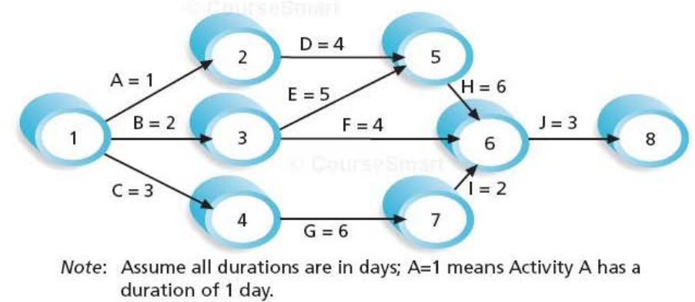
Example – AOA
Figure source: IT Project Management, K. Schwalbe, 6th ed., p. 218

Slide 10
How to Create AOA diagram
Find all activities which start at Node 1
Draw finish nodes
Draw arrow between the nodes and label it with activity name and duration
Look for bursts and merge
Continue it from left to right until all activities are included
No arrows should cross on the diagram

Slide 11
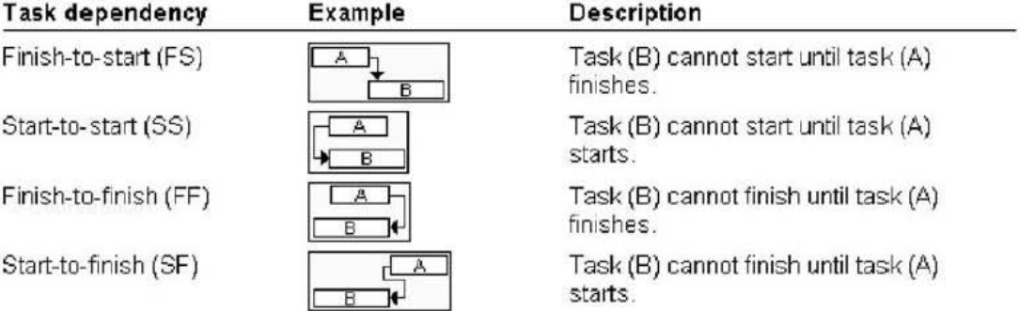
Task Dependencies
Figure source: IT Project Management, K. Schwalbe, 6th ed., p. 219

Slide 12
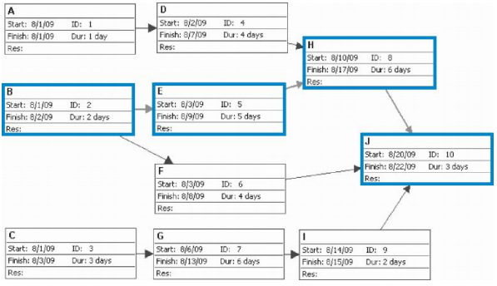
Example – PDM
Figure source: IT Project Management, K. Schwalbe, 6th ed., p. 221

Slide 13
Comparison of AOA and PDM
PDM is used more frequently
No dummy activities in PDM
  Dummy activities are often used in AOA
  No duration and resources required
  Often needed to show logical relationship
  Represented with dashed arrow lines and zero duration
PDM shows different dependencies among tasks whereas AOA uses finish-to-start dependency only

Slide 14
Estimating Activity Resources [1/3]
Before estimating the duration, good estimate for other resources
Nature of project and organization affect resource estimation
Tools: expert judgment, analysis of alternatives, estimating data, project management software
Good to have team members having experience of similar projects

Slide 15
Estimating Activity Resources [2/3]
Important questions to answer
  How difficult will it be to do specific activities?
  Is there anything unique in project scope that will affect resources?
  What is the organization’s history in doing similar activities?
  Does the organization have appropriate resources?
  Would it make some sense to outsource some of the work?

Slide 16
Estimating Activities Resources [3/3]
Main outputs: list of activity resource requirements, resource breakdown structure, project document updates
Activity resources estimate also helps in other knowledge areas of project management
Resource breakdown structure
  Hierarchical structure of resources
  Identify resources categories and types
  Resources category: programmers
  Resources types: Java and .NET programmers

Slide 17
Estimating Activity Durations [1/2]
Estimation of durations
Duration: actual time worked on an activity plus elapsed time
Resources assigned to a task also affect the task duration estimate
Duration VS effort
If scope changes, duration estimates should be revised
Always good to review similar projects and seek experts’ advice

Slide 18
Estimating Activity Durations [2/2]
Main inputs: activity list, activity resource requirements, resource calendars
Team should review the accuracy of duration estimates so far on the project
Availability of human resource is critical
Main output: activity duration estimates
Duration estimates are in the form of discrete number

Slide 19
Three Point Estimate
Optimistic
  Best case scenario
Most likely
  Most likely / expected scenario
Pessimistic
  Worst case scenario
Required for PERT estimates
Expert judgment is good tool

Slide 20
Developing the Schedule
Results from earlier time management processes required for schedule development
Several iterations of processes are required to finalize the schedule
Main objective: realistic project schedule
It provides basis to monitor project progress for the time dimension
Main output: project schedule
Tools: Gantt chart, critical path analysis, critical chain scheduling, PERT analysis

Slide 21
Gantt Chart
Standard format to show project schedule
Also called bar charts
Project activities, start and end dates, milestones, summary task, task dependencies
Activities are same as mentioned in WBS
Different symbols are used

Slide 22
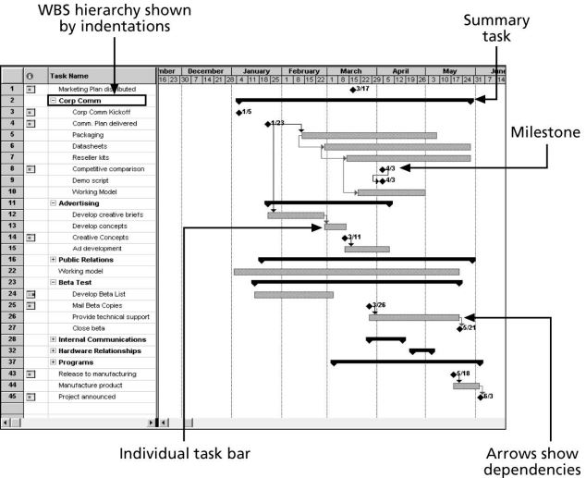
Example – Gantt Chart
Figure source: IT Project Management, K. Schwalbe, 6th ed., p. 225

Slide 23
Guidelines for Milestones
SMART criteria
Specific
Measurable
Assignable
Realistic
Time-framed

Slide 24
Schedule Risk and Milestones
Define milestone early in the project and include them in Gantt chart
Keep milestones small and frequent
The set of milestones must be all-encompassing
Each milestone must be binary, either complete or incomplete
Carefully monitor the critical path

Slide 25
Recommendations for Software Development Projects
Monitor the project progress and revise the plan
Build on a solid line i.e. with least defects (less than .1 percent defect rate)
Assign the right people to right tasks. Put the best developer on the critical tasks
Start with high-risk tasks
“Don’t boil the ocean”
Integrate early and often, and follow practices like the daily build process

Slide 26
Summary
Defining activities
  Activity list containing activity name, identifier, attributes, and brief description
Sequencing activities
  determining the dependencies
  Mandatory, discretionary, external
  evaluating the reasons for dependencies
Estimating activity resources
  list of activity resource requirements, resource breakdown structure, project document updates
Estimating activity durations
  Duration VS effort, activity duration estimates
  Three point estimates
Developing the schedule
  Project schedule, Gantt charts

