Slide 1
Project Scope Management
SEII-Lecture 4
Dr. Muzafar Khan
Assistant Professor
Department of Computer Science
CIIT, Islamabad.

Slide 2
Recap
Recent trends in IT projects
  Globalization, outsourcing, and virtual teams
Project management process groups
  Initiating, planning, executing, monitoring and control, and closing processes
Project integration management
  Key processes and the relevant discussion

Slide 3
Project Scope Management
Scope
  Work to be done
  Products
  Process
Deliverable
  Product-related
  Process-related
Stakeholders’ agreement

Slide 4
Main Processes
Processes to define, control, and decide work
Collecting requirements
Defining scope
Creating the WBS
Verifying scope
Controlling scope

Slide 5
Collecting Requirements [1/4]
Most difficult
If not properly defined; major rework
IEEE Standard [1990] definition
  “A condition or capability needed by a user to solve a problem or achieve an Objective.
  A condition or capability that must be met or possessed by a system or system component to satisfy a contract, standard, specification, or other formally imposed document.
  A documented representation of a condition or capability as in 1 or 2.”

Slide 6
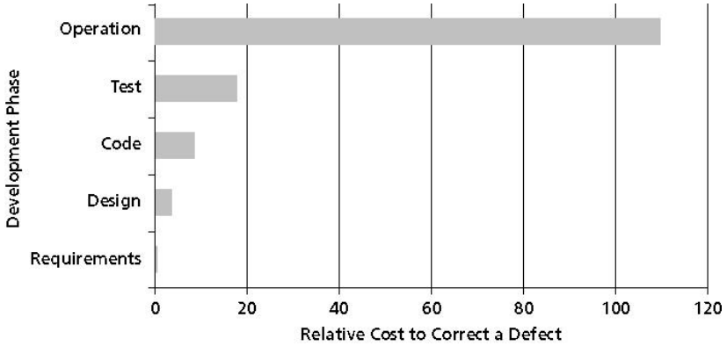
Collecting Requirements [2/4]
Figure source: IT Project Management, K. Schwalbe, 6th ed., p. 180

Slide 7
Collecting Requirements [3/4]
Many Techniques
  Interviews
  Focus groups
  Workshops
  Surveys
  Observation
  Prototyping
Effort VS project size

Slide 8
Collecting Requirements [4/4]
High level requirements from project charter
A piece of paper to multi volume document
Text, images, diagrams, and videos etc.
Functional and non-functional requirements
Requirements management plan
  Analysis, documentation, management
Requirements traceability matrix
  Requirements, their attributes and status

Slide 9
Defining Scope
Defining the work required in detail
Good scope definition – accurate estimate for time, cost, and other resources
Baseline for performance measurement and project control
Techniques: expert judgment, product analysis, alternative identification, and facilitated workshops
Main output: project scope statement

Slide 10
Creating the WBS [1/2]
Deliverable-oriented grouping of the work
WBS – a foundation document
Main inputs: project scope statement, stakeholder requirements documentation, and organizational process assets
Main technique: decomposition
Main outputs: WBS, WBS dictionary, scope baseline, and project document updates

Slide 11
Creating the WBS [2/2]
Task-oriented family tree of activities
Organized around project products, project phases, or process groups
Work package – task at the lowest level
Duration estimates for work packages
Good WBS needs good understanding

Slide 12
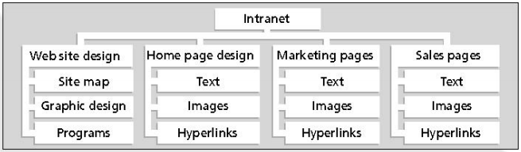
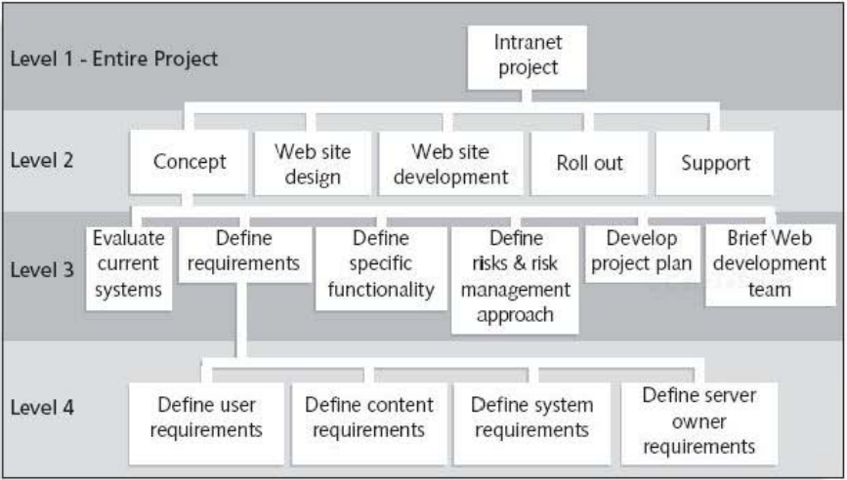
Sample WBS [1/3]
Figures source: IT Project Management, K. Schwalbe, 6th ed., p. 187-8

Slide 13
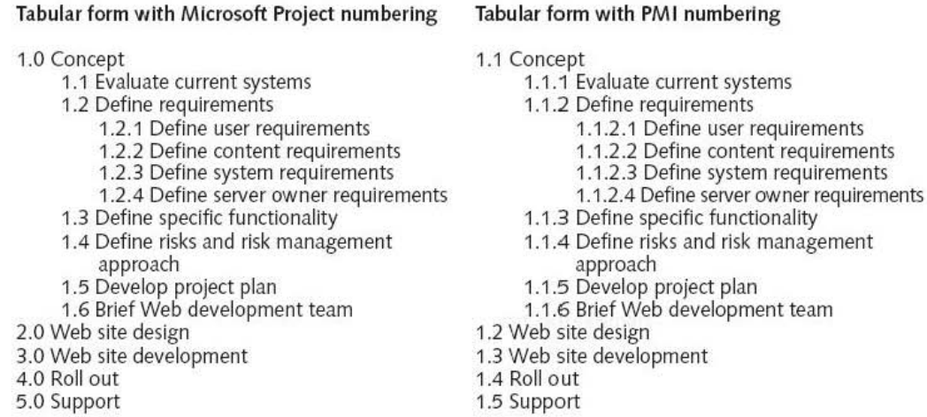
Sample WBS [2/3]
Figure source: IT Project Management, K. Schwalbe, 6th ed., p. 188

Slide 14
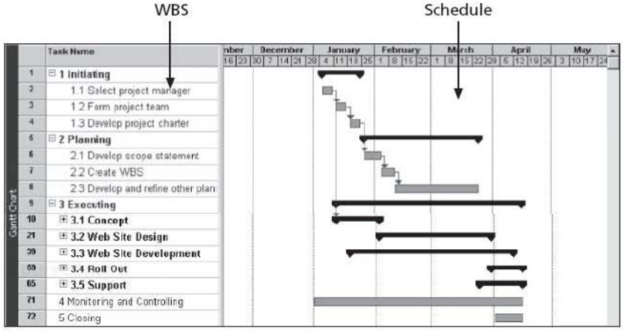
Sample WBS [3/3]
Figures source: IT Project Management, K. Schwalbe, 6th ed., p. 190

Slide 15
Approaches for Developing WBS [1/4]
Using guidelines
The analogy approach
The top-down approach
The bottom-up approach
The mind-mapping approach

Slide 16
Approaches for Developing WBS [2/4]
Using guidelines
  If guidelines exist then follow
  For example, US DOD
  Templates and past examples
Analogy approach
  Similar projects
  Repository of WBS
  Better understanding

Slide 17
Approaches for Developing WBS [3/4]
Top-down approach
  Conventional approach
  Start with the largest item
  Must have vast technical insight and broad perspective
Bottom-up approach
  Identify specific tasks
  Aggregate these tasks
  Very time consuming
  New systems/approaches

Slide 18
Approaches for Developing WBS [4/4]
Mind-mapping approach
  Like brain storming
  Core idea then branches
  More visual, less structured
  Increased creativity and participation
  Use of top-down and bottom-up approaches
  Later on any type of WBS i.e. chart or tabular form

Slide 19
Suggestions for Creating WBS [1/2]
A unit of work at only one place
The work content of a WBS item is the sum of the WBS items below it
WBS item is the responsibility of only one individual
WBS must be consistent with the work planned to be performed
WBS should mainly serve the project team

Slide 20
Suggestions for Creating WBS [2/2]
Project team members should be involved in developing the WBS
Each WBS item must be documented in a WBS dictionary
WBS must be a flexible tool to accommodate inevitable changes

Slide 21
Verifying Scope
Difficult to verify scope in IT projects and minimize scope changes
Scope creep – tendency for project scope to keep getting bigger
Formal acceptance
Main inputs: project management plan, requirements documentation, validated deliverables
Main tool: inspection
Main outputs: accepted deliverables and change requests

Slide 22
Controlling Scope
Controlling changes to the project scope
Main objective – to influence the factors that cause scope changes
Main inputs: project management plan, work performance data, requirements documentation
Main tool: variance analysis
Main outputs: work performance measurements and change requests

Slide 23
Suggestions to Improve User Input
Develop a good project selection process and insist that sponsors are from the user organization
Important roles in project teams
Regular meetings with defined agendas
Regular deliverables to users and sponsors
Don’t promise too much
Users and developers togather

Slide 24
Summary
Collecting requirements
  Different methods
Defining scope
  Estimates for all resources
Creating the WBS
  Different approaches
Verifying scope
  Formal acceptance
Controlling scope
  Change control

