Slide 1
Component-Based Software Engineering
SEII-Lecture 31
Dr. Muzafar Khan
Assistant Professor
Department of Computer Science
CIIT, Islamabad.

Slide 2
Recap
Component-based software engineering
Essentials of CBSE
  Independent components, component standards, middleware, development process
Characteristics of components
  Standardized, independent, composable, deployable, documented
Elements of component model
  Interfaces, usage, deployment
CBSE processes
  Development for reuse, development with reuse
  Component acquisition, management, and certification

Slide 3
CBSE for Reuse [1/2]
Process of developing reusable components and making them available for reuse
The vision of early supporters
  Thriving component marketplace
  Specialist component providers and vendors
  Software developers would buy components or pay for services
This vision is not realized
Most likely CBSE for reuse take place within an organization
Internally developed components also need modification to reuse

Slide 4
CBSE for Reuse [2/2]
Efforts are required to change application-specific components to more generic one
Need to decide whether a component is likely to be reused and cost comparison for it
To make the component reusable
  Either the component implements stable domain abstraction (business objects)
  Estimate the cost of changes to make it reusable

Slide 5
Possible Changes [1/2]
Removing application-specific methods
Changing names to make them more general
Adding methods to provide more complete functional coverage
Making exception handling consistent for all methods
Adding a ‘configuration’ interface to allow the component to be adapted to different situations of use
Integrating required components to increase independence

Slide 6
Possible Changes [2/2]
Problem of exception handling is difficult
  Applications have their exception handling requirements
  Component should define what exceptions can arise and publish these as a part of the interface
  Example: component for stack data management should detect and publish stack overflow and underflow exceptions
  Publishing all exceptions lead to difficulty of understanding interfaces
  Operation of component may depend on local exception handling and changing it may have serious implications

Slide 7
Other Factors [1/2]
Ways to estimate cost of making component reusable and the return on investment
  Benefits are not simply productivity gains
  Quality gains
  Time-to-market gains
Component reuse depends on its application domain and functionality
Trade-off between reusability and usability of a component
Potential source of components is existing legacy systems
  Obsolete software technologies
  No clearly defined ‘requires’ and ‘provides’ interfaces
  Need to develop wrapper

Slide 8
Other Factors [2/2]
Once developed and tested a reusable component, manage it for future reuse
  Classify it to be easily discovered
  Availability of the component in a repository
  Maintaining information about its use
  Track of different versions
Carry out some form of component certification
  Apart from the testing
  Expensive process

Slide 9
Software Process [1/4]
Successful reuse requires a tailored development process
Differences between CBSE with reuse and traditional development process
User requirements are outlined rather than in detail
  Stakeholders are encouraged to be flexible
  Rigid requirements limit the use of components
  Need a complete set of requirements (unlike incremental development)

Slide 10
Software Process [2/4]
Requirements are refined and modified early in the process
  Components availability
  Users may change their minds for cheaper and quicker system delivery
Component search and design refinement activity
  After system architecture design
    Component model and implementation platform
  Components interfacing conflicts
Development is a composition process
  Integration of components

Slide 11
Software Process [3/4]
Identifying candidate components or services is a unique activity
  Component search
  Component selection
  Component validation

Slide 12
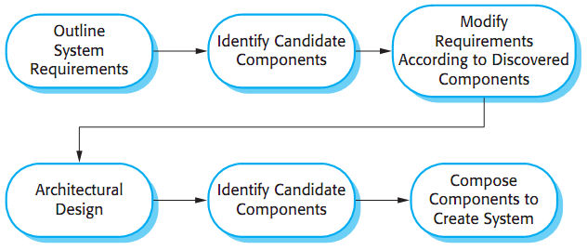
Software Process [4/4]
Figure source: Software Engineering, I. Sommerville, 9th ed., p. 465

Slide 13
Component Composition [1/4]
The process of integrating components
Specially written ‘glue code’
Different ways to integrate
Sequential composition
  Creation of new components by calling two existing components in sequence
  Composition of the ‘provides’ interfaces
  Component do not call each other
  ‘Glue code’ is required to call components services in right order
  ‘provides’ interface of the composition depends on the combined functionality of both components

Slide 14
Component Composition [2/4]
Hierarchical composition
  One component calls directly the other component
  The ‘provides’ interface of called component must be compatible with the ‘requires’ interface of the calling component
  No need of additional code if interfaces match
  It is not used for web services
Additive composition
  Two or more components are put together to create a new component
  Interfaces of new component is a combination of the corresponding interfaces in already used components
  Components are called separately through the external interface of the new component
  Both used components are not dependent and do not call each other

Slide 15
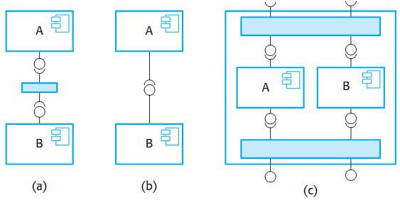
Component Composition [3/4]
Figure source: Software Engineering, I. Sommerville, 9th ed., p. 469

Slide 16
Component Composition [4/4]
Any/all composition forms may be used to create a system
‘Glue code’ may be required to link the components
When new components are created for composition, interfaces should be compatible with other components in the system
When components are developed independently for reuse, interface incompatibility issue may arise

Slide 17
Components Incompatibility [1/2]
Three types of incompatibility
Parameter incompatibility
  Number and types of parameters
Operational incompatibility
  Operation names are different in ‘requires’ and ‘provides’ interfaces
Operational incompleteness
  The ‘provides’ interface of a component is a subset of the ‘requires’ interface of another component or vice versa
It can be tackled by writing an adaptor

Slide 18
Components Incompatibility [2/2]
Component documentation helps to decide whether or not interfaces are compatible
Interface definition includes operation name and parameter types
Documentation helps to decide about the semantically compatibility

Slide 19
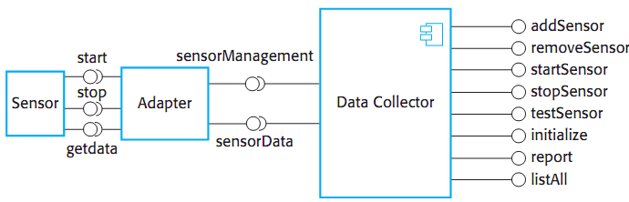
Example – Components Incompatibility
Figure source: Software Engineering, I. Sommerville, 9th ed., p. 471

Slide 20
Trade-offs
Potential conflicts between functional and nonfunctional requirements
Decisions to make
  What composition of components is most effective for delivering the functional requirements for the system?
  What composition of the components will make it easier to adapt the composite component when its requirements change?
  What will be the emergent properties of the composed system? These are properties such as performance and dependability. You can only assess these once the complete system is implemented.

Slide 21
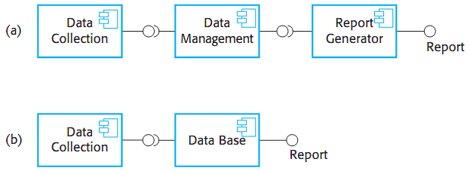
Example – Trade-offs
Figure source: Software Engineering, I. Sommerville, 9th ed., p. 475

Slide 22
Summary
CBSE for reuse
Possible Changes and other factors
Software Process
Component composition
  Sequential, hierarchical, and additive composition
Components incompatibility
  Parameter and operational incompatibility, operational incompleteness
Trade-offs

