Slide 1
Component-Based Software Engineering
SEII-Lecture 30
Dr. Muzafar Khan
Assistant Professor
Department of Computer Science
CIIT, Islamabad.

Slide 2
Recap
COTS product reuse
Benefits of COTS product reuse
Problems with COTS product reuse
COTS-solution systems
ERP systems
  Architecture of ERP systems
  Limitations of reuse
Configuration of COTS-solution systems
COTS-integrated systems
  Problems with COTS-integrated systems

Slide 3
Importance
If an organization cannot use COTS system
CBSE is an effective and reuse-oriented way
It emerged in the late 1990s
Designers’ frustration about the limited reuse of object-oriented approach
Object classes are too detailed and specific
  Detailed knowledge
  Access to source code
Selling and distributing objects as individual reusable components is practically impossible

Slide 4
Components
Components are higher-level abstractions than objects
These are defined by their interfaces and their implementation details are hidden
CBSE is the process of
  Defining, implementing, and integrating / composing loosely coupled, independent components into systems
Software systems are large and complex
Customers demand more dependable software that is delivered and deployed more quickly

Slide 5
Essentials of CBSE
Independent components
  Specified by their interfaces
  Clear separation between interface and implementation
  Implementation can be replaced
Component standards
  Facilitates the integration
  Components written in different languages
Middleware
  Support for the component integration
  Handle low-level issues efficiently
Development process

Slide 6
Characteristics of Component [1/2]
Standardized
  Standard component model
  Component interfaces, component metadata, documentation, composition, and deployment
Independent
  Compose and deploy it without the use of other specific components
  If it needs externally provided services, it should be clearly described in interface specification
Composable
  All external interactions through publicly defined interfaces
  External access to its information (methods and attributes)

Slide 7
Characteristics of Component [2/2]
Deployable
  Self-contained component
  Stand-alone entity on a component platform
  Provide an implementation of the model
  No need to compile it before the deployment
  If it is service, it should be deployed by service provider
Documented
  Fully documented
  Syntax and semantics of component interfaces
  Helps to decide about the use

Slide 8
Component as a Service Provider
When a system needs a service, it calls on a component to provide that service
Examples – search service and data conversion service
Emphasize on two critical characteristics
  Component as an independent executable entity that is defined by its interfaces
    No need of knowledge about its source code to use it
    It can be referenced as an external service or directly included in a program
  Services are made available through an interface
    All interactions are through that interface
    Interface is expressed in terms of parameterized operations
    Internal state is never exposed

Slide 9
Component Interfaces [1/2]
‘Provides’ interface
  Define the services provided
  Component API
  Methods that can be called by a user
  Indicated as circle in UML component diagram
‘Requires’ interface
  Services must be provided by other components
  It does not compromise the independence or deployability of a component
  Indicated as semicircle in UML component diagram

Slide 10
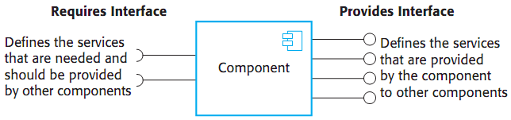
Component Interfaces [2/2]
Figure source: Software Engineering, I. Sommerville, 9th ed., p. 457

Slide 11
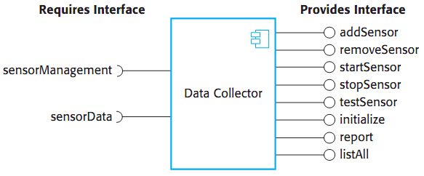
Example – Component Interfaces
Figure source: Software Engineering, I. Sommerville, 9th ed., p. 458

Slide 12
Component Models
A definition of standards for component implementation, documentation, and deployment
It helps to make sure that components can interoperate
Providers of component execution infrastructures
Examples: WebServices model, Sun’s Enterprise Java Beans (EJB) model, Microsoft .NET model

Slide 13
Elements of Component Model [1/3]
Interfaces
  How the interfaces should be defined?
  Which elements such as operation names and parameters should be included in the definition
  Model should specify the language to define interfaces
  Example: EJB is Java specific so it is used as interface definition language
  Some models require specific interface that must be defined by a component

Slide 14
Elements of Component Model [2/3]
Usage
  Unique name or handle to distribute and access remotely
  Example: services have unique uniform resource identifier (URI)
  Component meta-data
  specifies how the binary components can be customized

Slide 15
Elements of Component Model [3/3]
Deployment
  Specification of how components should be packaged for deployment as independent, executable entities
  Information about the contents of a package and its binary organization
  Governing rules an how component replacement is allowed
Component model should define the documentation to be produced
Component model implementation provides comparable shared services for components

Slide 16
Services Provided by Component Model [1/2]
Platform services
  Fundamental services
  Enable components to communicate and interoperate in a distributed environment
Support services
  Common services that are likely to be required by many different components
  Example: authentication
  A standard set of middleware services for use by all components

Slide 17
Services Provided by Component Model [2/2]
Component is deployed in a “container”
  An implementation of support services plus a definition of the interfaces
  Component can access the support services and the container can access the component interfaces
  Component interfaces are not directly accessed by other components
  Containers are large and complex, access to all middleware services
  Component may not need to access all the services
  Standards for common web services such as transaction management and security
  Standards are implemented as program libraries

Slide 18
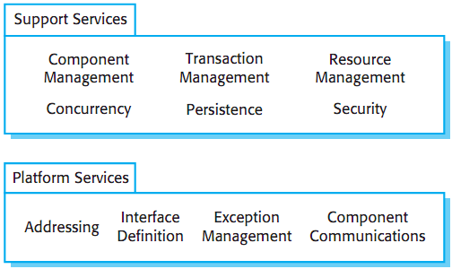
Example – Middleware Services Defined in a Component Model
Figure source: Software Engineering, I. Sommerville, 9th ed., p. 460

Slide 19
CBSE Processes [1/3]
Software processes that support component-based software engineering
Considering the possibilities of reuse and different process activities involved
Two types of processes at highest level
  Development for reuse
    Good knowledge about the components
    Access to source code and work for generalization
  Development with reuse
    Discover the components
    May not have access to source code

Slide 20
CBSE Processes [2/3]
Component acquisition
  The process of acquiring components
  Local or external components
Component management
  Managing organization’s reusable components
  Properly cataloged, stored, and made available
Component certification
  Process of checking and certifying components

Slide 21
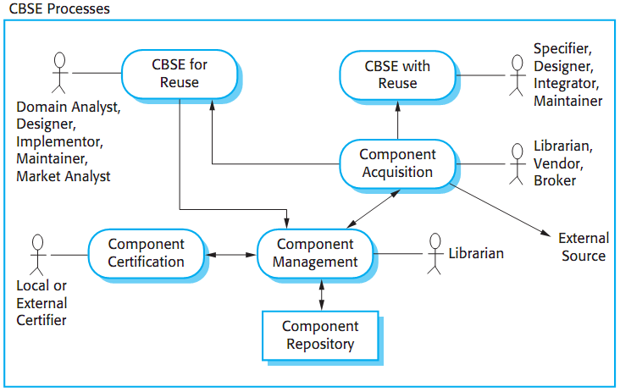
CBSE Processes [3/3]
Figure source: Software Engineering, I. Sommerville, 9th ed., p. 462

Slide 22
Summary
Component-based software engineering
Essentials of CBSE
  Independent components, component standards, middleware, development process
Characteristics of components
  Standardized, independent, composable, deployable, documented
Elements of component model
  Interfaces, usage, deployment
CBSE processes
  Development for reuse, development with reuse
  Component acquisition, management, and certification

