Slide 1
Project Integration Management
SEII-Lecture 3
Dr. Muzafar Khan
Assistant Professor
Department of Computer Science
CIIT, Islamabad.

Slide 2
Outline
Recap
Recent trends in IT projects
Project management process groups
Project Integration management

Slide 3
Recap
Systems Philosophy
  Business, organization, technology
Organization frames
  Structure, HR, political, symbolic
Project life cycle
  Concept, development, implementation, close-out
IT projects are complex
Notes:
Here is the outline for today’s lecture.

Slide 4
Globalization [1/2]
Global village
Lower trade / political barriers
IT is the key enabler
Project managers need to address
  Communications
  Trust
  Common work practices
  Tools

Slide 5
Globalization [2/2]
KPMG International suggestions after studying 600 global organizations
  Greater project discipline
  Think global, act local
  Collaboration over standardization
  Keep project momentum
  Use of newer and innovative tools

Slide 6
Outsourcing
Acquiring goods/services from an outside source
Offshoring – another country
Reduced costs
Issues
  Integration and standardization of IT infrastructure and business processes
  Negotiating contracts, working plans, and managing virtual teams

Slide 7
Virtual Teams
Remote locations
Same country / across the globe
Possible advantages
  Competitiveness, responsiveness, 24/7 availability
  Reduced costs, even no office space
  Work/life balance for team members
Possible disadvantages
  Isolating team members
  Communication problems
  Informal learning/networking
  Technology dependent

Slide 8
Success Factors for Virtual Teams
Team processes
Leadership style
Trust and relationships
Team member selection and role preferences
Task-technology fit
Cultural differences
Computer-mediated communication
Team life cycles
Conflict management

Slide 9
Project Management Process Groups [1/2]
Process
  A series of actions directed towards a specified goal
Project management – series of interlinked processes
Do not confuse it with project phases
Initiating processes
  Defining and authorizing project/phase
  At the beginning of each phase
Planning processes
  Devising and maintaining workable scheme
  Project management plan

Slide 10
Project Management Process Groups [2/2]
Executing processes
  Coordinating people and other resources
  Development activities
Monitoring and closing processes
  Measuring and monitoring progress
  Corrective actions
Closing processes
  Formal acceptance
  Administrative activities

Slide 11
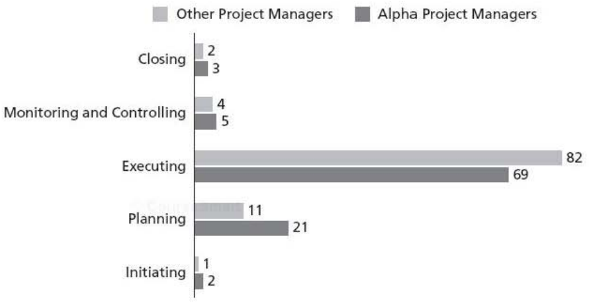
Time Spent on Each Process Group
Figure source: IT Project Management, K. Schwalbe, 6th ed., p. 80

Slide 12
Project Integration Management
Coordinating all knowledge areas throughout a project’s life cycle
Main processes
  Developing project charter
  Developing project management plan
  Directing and managing project execution
  Monitoring and controlling project work
  Performing integrated change control
  Closing project or phase

Slide 13
Project Charter
A formal document to recognize the project
  Project title and date of authorization, contact info
  Project objectives, business need, justification
  Summary of project schedule, budget, communication plan
  Project success criteria
  Roles and responsibilities matrix
  Sign-off and comments sections

Slide 14
Project Management Plan
To coordinate all project planning documents
Project planning assumptions and decisions
Assist in project’s execution and control
Baseline for progress measurement and project control
Dynamic, flexible, and subject to change
Information required from all knowledge areas
Main inputs: project charter, outputs from planning processes, enterprise environment factors
Main technique: Expert judgment

Slide 15
Project Management Plan Contents [1/4]
Projects are unique so are management plans
Common sections
Introduction section
  Project title
  Brief project description
  Sponsor’s name
  Names of project manager and key team members
  Project deliverables
  List of reference material, definitions, and acronyms

Slide 16
Project Management Plan Contents [2/4]
Organization section
  Organization charts
  Project responsibilities
  Other organizational / process-related information
Management and technical approaches
  Management objectives
  Project controls
  Risk management
  Project staffing
  Technical processes

Slide 17
Project Management Plan Contents [3/4]
Scope management
  Major work packages
  Key deliverables
  Other work-related information
Schedule management
  Summary schedule
  Detailed schedule
  Other schedule-related information

Slide 18
Project Management Plan Contents [4/4]
Budget section
  Summary budget
  Detailed budget
  Other budget-related information

Slide 19
Directing and Managing Project Execution [1/2]
Main inputs: managing and performing the work as described in project management plan, and change requests
Most of the time spent on execution
Leading the team and managing stakeholders relationships
Project manager must be flexible and creative

Slide 20
Directing and Managing Project Execution [2/2]
Coordinating planning and execution
  Those who will do the work should plan the work
Providing strong leadership
Providing a supportive culture
Capitalizing on product, business, and application area knowledge
Project execution tools and techniques
  Expert judgment and project management information systems

Slide 21
Monitoring and Controlling Project Work
Changes are inevitable
90% of job: communicating and managing changes
Collecting, measuring, and disseminating performance information
Main inputs: project management plan and performance reports
Project management plan is the baseline for identifying and controlling changes
Main output: change request

Slide 22
Performing Integrated Change Control [1/3]
Identifying, evaluating, and managing changes
Influencing the factors that create changes
Determine that a change has occurred
Managing actual changes as they occur
Main inputs: work performance information and change requests
Main outputs: updated change request status and project documents
Oral, written, formal, and informal change requests

Slide 23
Performing Integrated Change Control [2/3]
Change control system
Change control board
Key stakeholders on the board
Configuration management
Proper communication
Possible drawbacks
  Time demanding
  48 hour policy

Slide 24
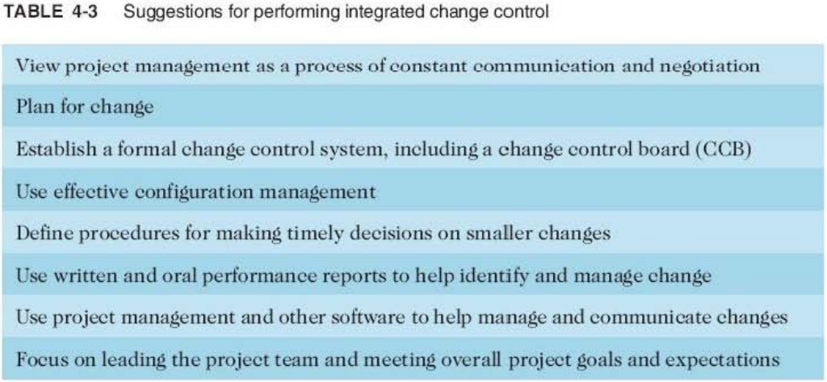
Performing Integrated Change Control [3/3]
Table source: IT Project Management, K. Schwalbe, 6th ed., p. 164

Slide 25
Closing Projects or Phases
Finalizing all the activities and transferring the completed / cancelled work
Main input: accepted deliverables
Main technique: expert judgment
Main output: final product, service, or result transmission, and process asset updates

Slide 26
Summary
Recent trends in IT projects
  Globalization, outsourcing, and virtual teams
Project management process groups
  Initiating, planning, executing, monitoring and control, and closing processes
Project integration management
  Key processes and the relevant discussion

