Slide 1
Software Reuse
SEII-Lecture 29
Dr. Muzafar Khan
Assistant Professor
Department of Computer Science
CIIT, Islamabad.

Slide 2
Recap
Problems with reuse
  Increased maintenance costs; lack of tool support; not-invented-here syndrome; creating, maintaining, and using a component library
The reuse landscape
  Application frameworks, legacy system wrapping, service-oriented systems, software product lines, COTS product reuse
Key factors for reuse
  Development schedule, expected software lifetime, background, skills, and experience of development team, criticality of software and its non-functional requirements, application domain, system platform
Application frameworks
Software Product lines

Slide 3
COTS Product Reuse
Commercial-Off-The-Shelf product
to fulfill the needs of different customers without changing the source code
Desktop applications and server products
general use, many features and functions
Open source products
Built-in configuration mechanisms to tailor functionality

Slide 4
Benefits of COTS Product Reuse
Rapid deployment of a reliable system
Easier to decide for reuse as functionality is already known
Organizations may have previous experience
Some development risks are avoided
Business can focus on the core activity
Vendor is the responsible for updates

Slide 5
Problems with COTS Product Reuse
Requirements have to be adapted to reflect the functionality of COTS product
COTS product may have some assumptions that are practically impossible to change
Choosing the right COTS product is difficult task
Lack of local expertise to support systems development
Vendor may go out of business

Slide 6
COTS Products
Despite of problems, its use is increased
COTS is preferred over object-oriented approach
Studies show that COTS-based reuse reduces effort and the time to deploy the system
Two types of COTS product reuse
  COTS-solution systems
  COTS-integrated systems

Slide 7
COTS-Solution Systems
Generic application systems
Example 1: management system for dentist
  Handles appointments, dental records, patient recall
Example 2: ERP system
  Manufacturing, ordering, and customer relationship management activities
Domain-specific COTS-solution systems
  Assumptions about how users work
  Example: student registration at university

Slide 8
ERP Systems
ERP systems are used in large organizations, widely used form of software reuse
ERP system by SAP
Ordering and invoicing, inventory management, and manufacturing scheduling
Gathering detailed information about customer’s business and business processes
ERP system is configured based on that information
Configuration is done by consultants

Slide 9
Architecture of ERP System
Number of modules
  May be composed in different ways
  Configuration process
Business processes
  A defined set of processes associated with each module
  Roles and activities are defined
Common database
  Maintains information about all related business functions
  No replication
Business rules
  Consistent rules for all data in the database

Slide 10
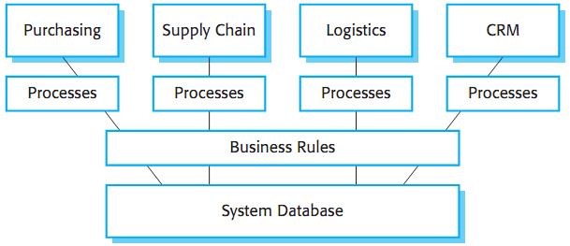
Example – Architecture of ERP System
Figure source: Software Engineering, I. Sommerville, 9th ed., p. 443

Slide 11
Limitations of ERP System Reuse
functionality is restricted to the generic core
Organization’s processes have to be expressed in the system configuration language
Mismatch between business concepts and concepts supported by the configuration language
Example: ERP for university, need for the definition of customer in this context
It cause problems in configuring the system

Slide 12
Configuration of COTS-Solution Systems [1/2]
Selection of required functionality from the system
Establish a data model for the organization
Define business rules to apply on the data
Define the expected interactions with external systems
Define the input forms and output reports
Design new business processes to conform the system
Setting parameters to deploy the system on its underlying platform

Slide 13
Configuration of COTS-Solution Systems [2/2]
After the configuration settings, testing is started
Testing is a major problem
Systems are built using reliable platforms
Problems are often related to the interaction between the operational processes and the system configuration
Often detectable by end-users only
No automated testing

Slide 14
COTS-Integrated Systems
Two or more COTS products
When no single system fulfills all the needs
Sometimes integration with the existing system
Interaction through APIs
Otherwise, output of one system as an input to other system or updating the database
Design choices
  Which COTS products offer the most appropriate functionality?
  How will data be exchanged?
  What features of a product will actually be used?

Slide 15
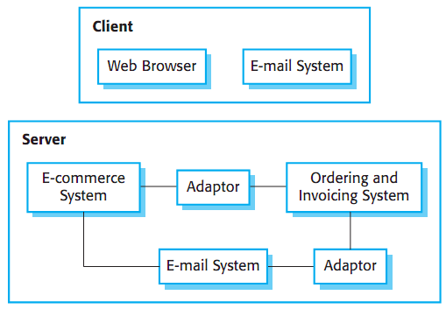
Example – COTS-Integrated Procurement System
Figure source: Software Engineering, I. Sommerville, 9th ed., p. 446

Slide 16
Problems with COTS-Integrated Systems [1/3]
Lack of control over functionality and performance
  Hidden operations may interfere in some situations
  Fixing problems is the concern of product integrator rather than vendor
Problems with COTS system interoperability
  Every product has its own assumptions
  A study conducted to integrate four products
  Each product assumed the exclusive access to the event queue
  Consequently, project effort was five times more that originally predicted
  Project took two years whereas the predicted time was six months
  After ten years, the researchers found that the discovered integration problems could not fixed in the whole duration

Slide 17
Problems with COTS-Integrated Systems [2/3]
No control over system evolution
  Vendors have their own decisions in response to market pressures
  New versions are frequently produced and may not be compatible with all previous versions
  New versions may have new unwanted functionality
  No support for previous versions
Support from COTS vendors
  Level of support varies widely
  Developers have no access to the source code and detailed documentation
  Changing market and economic circumstances may affect it

Slide 18
Problems with COTS-Integrated Systems [3/3]
The cost of system maintenance and evolution may be greater for such products
Life-cycle problems
If people involved in the system maintenance left the organization
Real difficulties with COTS-integrated systems

Slide 19
Summary
COTS product reuse
Benefits of COTS product reuse
Problems with COTS product reuse
COTS-solution systems
ERP systems
  Architecture of ERP systems
  Limitations of reuse
Configuration of COTS-solution systems
COTS-integrated systems
  Problems with COTS-integrated systems

