Slide 1
Software Reuse
SEII-Lecture 28
Dr. Muzafar Khan
Assistant Professor
Department of Computer Science
CIIT, Islamabad.

Slide 2
Recap
Restructuring
  Code restructuring, data restructuring
Forward engineering
  Client-server architectures, object-oriented architectures
Economics of reengineering
  Cost benefit analysis
Software reuse
  Benefits of reuse

Slide 3
Problems with Reuse
Increased maintenance costs
  If source code is not available of reused component
  Incapability with system changes
Lack of tool support
  No support for development with reuse component
  Difficult/impossible to integrate such tools
  Particularly true for embedded system engineering
Not-invented-here syndrome
  Some rewrites component to improve it
  Trust in themselves

Slide 4
Problems with Reuse
Creating, maintaining, and using a component library
  Populating a reusable component library can be expensive
  Use of the library can be expensive
Finding, understanding, and adapting reusable components
  Some components need to be discovered
  Understanding and adaption
  Developers must be confident

Slide 5
The Reuse Landscape
Many techniques for software reuse in last 20 years
Systems in same domain may be reused
Different levels of reuse
Architectural patterns
  Standard software architectures
Design patterns
  Generic abstractions
Component-based development
  Integration of components
  Component-model standards

Slide 6
The Reuse Landscape
Application frameworks
  Collection of abstract and concrete classes
Legacy system wrapping
  Wrapped by new user interfaces
Service-oriented systems
  Linking by shared services
Software product lines
  Generalized architecture to be customized for different customers
COTS product reuse
  Configuring and integrating existing application systems

Slide 7
The Reuse Landscape
ERP systems
  Large scale systems with generic business functionality and rules
Configurable vertical applications
  Generic systems are designed
  Configured for specific needs
Program libraries
  Class and function libraries
Model-driven engineering
  Software as domain models
Program generators
  Domain specific systems
Aspect-oriented software development
  Shared components are woven at different places

Slide 8
Key Factors for Reuse
Development schedule
  Off-the-shelf systems rather than components
Expected software lifetime
  Long-lifetime systems, maintenance effort
Background, skills, and experience of development team
  Reuse technologies are fairly complex
Criticality of software and its non-functional requirements
  Dependability case for the system
Application domain
System platform

Slide 9
Application Frameworks
Object-oriented paradigm for reuse
  Objects are too small
  Reimplementation is preferred
A generic structure
  Classes, objects, and components
  Collaboration to provide a reuse
Support for generic features
Example: user interface framework
  Interface event handling
  Set of widgets to construct display
Specific functionality may be added

Slide 10
Application Frameworks
Programming language-specific
Framework can incorporate other frameworks
Three classes of frameworks
System infrastructure frameworks
  User interfaces, communications, and compilers
Middleware integration frameworks
  Set of standards and associated objects classes
  Support for communication and information exchange
  Examples: Microsoft .NET and enterprise Java Beans (EJB)

Slide 11
Application Frameworks
Enterprise application frameworks
  Specific application domains
  Examples: telecommunication and financial systems
  Support development of end user applications
Web application frameworks
  Recent type, very important
  Support for construction of dynamic websites
  Model-View-Controller pattern
  Security, dynamic web pages, database support, session management, user interaction

Slide 12
Software Product Lines
One of the most effective approaches
SPL is a set of applications with a common architecture and shared components
Each application specialized to reflect different requirements
The core system is designed to be configured
Application experience is often transferable from one system to other system
Reduced development time

Slide 13
Software Product Lines
SPLs emerge from existing applications
Change tends to corrupt application structure
Consequently, design of a generic product line
Identification of common functionalities
A base application is structured to simplify reuse and reconfiguration
Application frameworks and SPL have commonalities

Slide 14
Software Product Lines
Key differences
Application frameworks rely on object-oriented approach
Application frameworks are focused on providing technical details rather than domain-specific support
SPL are often control applications for equipment
SPL are made up of a family of related applications, owned by the same organization

Slide 15
Software Product Lines
Various types of specialization
Platform specialization
Environment specialization
Functional specialization
Process specialization
Architecture of SPL reflects general, application-specific architectural style or pattern

Slide 16
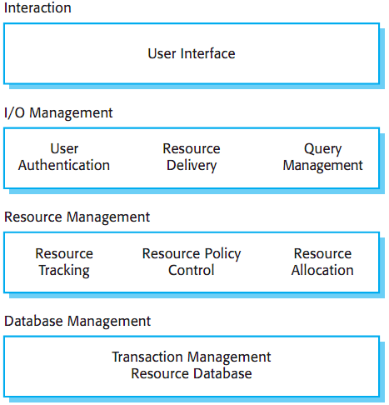
Example: Architecture of Resource Allocation System
Figure source: Software Engineering, I. Sommerville, 9th ed., p. 437

Slide 17
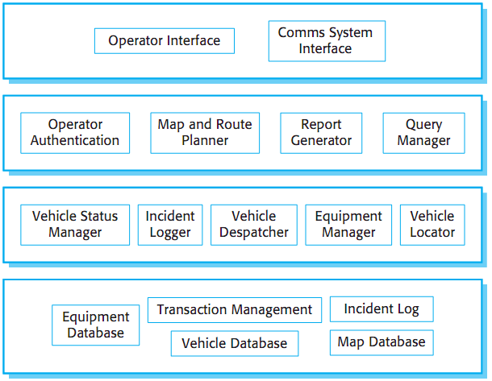
Example: Product Line Architecture of Vehicle Dispatcher System
Figure source: Software Engineering, I. Sommerville, 9th ed., p. 437

Slide 18
Steps to extend SPL to Create a New Application
Elicit stakeholders requirements
Select the existing system that is closest fit to the requirements
Renegotiate requirements
Adapt existing system
Deliver new family member
Reconfiguration
  Design-time reconfiguration
  Deployment-time reconfiguration

Slide 19
Steps to extend SPL to Create a New Application
Deployment-time reconfiguration
  Component selection
  Workflow and rule definition
  Parameter definition

Slide 20
Summary
Problems with reuse
  Increased maintenance costs; lack of tool support; not-invented-here syndrome; creating, maintaining, and using a component library
The reuse landscape
  Application frameworks, legacy system wrapping, service-oriented systems, software product lines, COTS product reuse
Key factors for reuse
  Development schedule, expected software lifetime, background, skills, and experience of development team, criticality of software and its non-functional requirements, application domain, system platform
Application frameworks
Software Product lines

