Slide 1
Software Reengineering
SEII-Lecture 26
Dr. Muzafar Khan
Assistant Professor
Department of Computer Science
CIIT, Islamabad.

Slide 2
Recap
CMMI
  Continuous as well as staged model
CMMI capability levels
  Incomplete, performed, managed, defined, quantitatively managed, optimized
Example – process area
  Specific goals and practices, general goals and practices
Other SPI frameworks
  SPICE, Bootstrap, TickIT, PSP, TSP
SPI return on investment
SPI trends

Slide 3
Unified Theory of Software Evolution [1/2]
The law of continuing change
  Real world computing context
The law of increasing complexity
  Complexity increases if software evolves
The law of self regulation
  Distribution of process and product measures close to normal
The law of conservation of organizational stability
  Average effective global activity rate is invariant

Slide 4
Unified Theory of Software Evolution [2/2]
The law of conservation of familiarity
  Maintain mastery of its content and behavior
The law of continuing growth
  Functional content must be continually increased
The law of declining quality
  Quality will be declined unless rigorously maintained
The feedback system law
  Good feedback system

Slide 5
Reengineering
Radical redesign of business processes and computing
Positive and negative changes
Efforts to improve competitiveness, downsizing, and outsourcing
System view – business reengineering and software engineering

Slide 6
Business Process Reengineering
“The search for, and the implementation of, radical change in business process to achieve breakthrough results.”
How is the search conducted?
How is the implementation achieved?
How to ensure that the “radical change” lead to breakthrough results (rather than organizational chaos)?

Slide 7
Business Processes
Set of logically related tasks
People, equipment, material resources, and business procedures
Examples: designing a new product, purchasing services and supplies, hiring a new employee
Every business process has a defined customer
Across the organizational boundaries
The business → business subsystems → business processes → business sub-processes

Slide 8
BPR Model [1/3]
BPR is iterative and evolutionary process
Changing business environment
Business definition
  Business goals are defined
  Cost reduction, time reduction, quality improvement, personal development and empowerment
  Business level or specific business component
Process identification
  Critical processes are defined
  Processes ranking

Slide 9
BPR Model [2/3]
Process evaluation
  Existing processes analysis
  Costs are noted
  Quality/performance problems are isolated
Process specification and design
  Use cases are prepared
  New set of tasks are designed
Prototyping
  Prototyping of the redesigned business process
Refinement and instantiation
  Feedback from the prototype

Slide 10
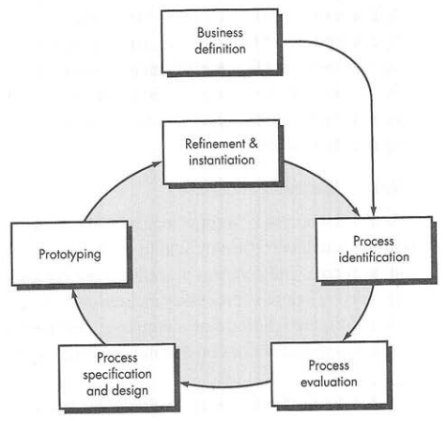
BPR Model [3/3]
Figure source: Software Engineering: A Practitioner’s Approach, R. S. Pressman, 7th ed., p. 766

Slide 11
Software Reengineering Process Model [1/4]
Reengineering absorbs a lot of resources
It is a rebuilding activity
Inventory analysis
  Inventory of all applications
  Business criticality, longevity, current maintainability
  Candidates for reengineering
  Resource allocation to candidate applications
  Inventory analysis on a regular basis

Slide 12
Software Reengineering Process Model [2/4]
Document restructuring
  Weak documentation for legacy system
  Creating documentation is too time consuming
  Documentation must be updated, but your organization has limited resources
  The system is business critical and must be fully re-documented
Reverse engineering
  Origin is hardware world
  One or more design and manufacturing specifications
  In SE, it is design recovery

Slide 13
Software Reengineering Process Model [3/4]
Code restructuring
  The most common type of reengineering
  Code is restructure/rewritten
  Reviews and testing
Data restructuring
  Full-scale reengineering activity
  Existing data architecture is analyzed
  Causes program architecture and code-level changes
Forward engineering
  Automated generation of new application
  Recover the design information from existing software and use it to alter the existing system

Slide 14
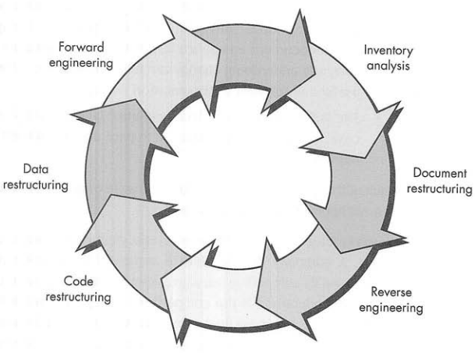
Software Reengineering Process Model [4/4]
Figure source: Software Engineering: A Practitioner’s Approach, R. S. Pressman, 7th ed., p. 769

Slide 15
Reverse Engineering [1/2]
There is no “magic slot”
Abstraction level, documentation completeness, tools, human analysts, process direction are highly variable
Abstraction level should be high
Completeness is the level of detail provided at an abstraction level
Completeness is directly proportional to the amount of analysis performed
Interactivity refers to integration of automated tools and analysts
One-way directionality

Slide 16
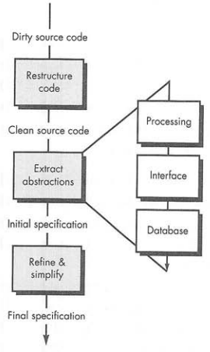
Reverse Engineering [2/2]
Figure source: Software Engineering: A Practitioner’s Approach, R. S. Pressman, 7th ed., p. 773

Slide 17
Reverse Engineering to Understand Data [1/2]
First reengineering task
Different levels of abstraction
At the program level, internal program data structures
At system level, global data structures
Internal data structures
  Definition of classes
  Grouping related program variables

Slide 18
Reverse Engineering to Understand Data [2/2]
Database structure
  Definition of data objects and their relationships
  Build an initial object model
  Determine candidate keys
  Refine the tentative classes
  Define generalizations
  Discover associations

Slide 19
Reverse Engineering to Understand Processing
Understand and extract procedural abstractions
Different level of abstractions
  System, program, component, pattern, and statement
Overall functionality must be understood
Block diagram of system interaction
Component specifications (if available) are reviewed for conformance to existing code
For large systems, automated tools may be used
Output of this process is passed to restructuring and forward engineering tools

Slide 20
Reverse Engineering User Interfaces
Most common reengineering activity
What are the basic actions (e.g., keystrokes and mouse clicks) that the interface must process?
What is a compact description of the behavioral response of the system to these actions?
What is meant by a "replacement," or more precisely, what concept of equivalence of interfaces is relevant here?
New interface may not mirror the old one
It is good to develop new metaphor

Slide 21
Summary
Unified theory of software evolution
Reengineering
  Business process reengineering and software reengineering
BPR model
  Business definition, process identification, Process evaluation, process specification and design, prototyping, refinement and instantiation
Software reengineering process model
  Inventory analysis, document restructuring, reverse engineering, code restructuring, data restructuring, forward engineering
Reverse engineering

