Slide 1
Software Process Improvement
SEII-Lecture 25
Dr. Muzafar Khan
Assistant Professor
Department of Computer Science
CIIT, Islamabad.

Slide 2
Recap
Software process improvement
Framework for SPI
SPI support groups, maturity and immaturity models
Assessment and gap analysis
Education and training
Selection and justification
Installation / migration
Evaluation
Risk management
Critical success factors

Slide 3
CMMI
Upgraded CMM as a complete framework
Comprehensive process meta-model
  “continuous” model
  “staged” model
Different process areas
  Project planning, requirements management etc.
Each process area is defined in terms of specific goals and practices

Slide 4
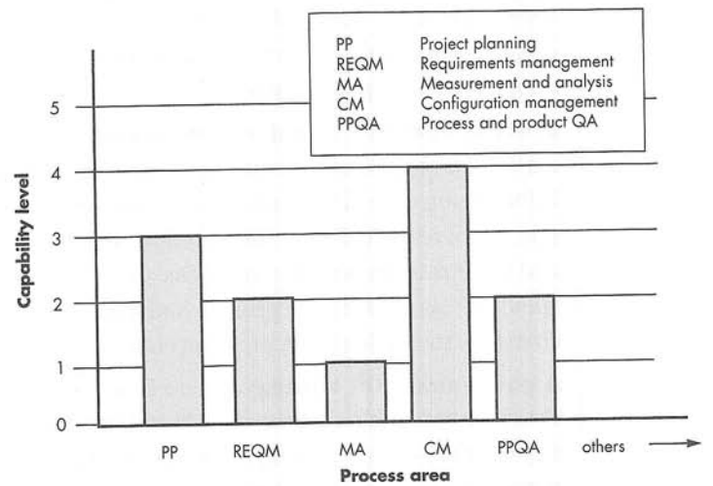
CMMI Process Area Capability Profile
Figure source: Software Engineering: A Practitioner’s Approach, R. S. Pressman, 7th ed., p. 798

Slide 5
CMMI Capability Levels [1/2]
Level-0, Incomplete
  The process area is either not performed or does not achieve all goals and objectives defined by level-1
Level-1, Performed
  Specified goals of the process area are satisfied
  Work tasks required are conducted
Level-2, Managed
  Level-1 criteria are satisfied
  Work conforms to organizationally defined policy
  People have adequate resources
  Stakeholders are actively involved
  Work tasks and products are monitored, controlled, and reviewed

Slide 6
CMMI Capability Levels [2/2]
Level-3, Defined
  Level-2 criteria are achieved
  Tailored process based on organization’s standard
  Contribution to process assets
Level-4, Quantitatively managed
  Level-3 criteria are satisfied
  Quantitative assessment to control and improve the process area
Level-5, Optimized
  Level-4 criteria are achieved
  Optimization using statistical means
  Continuous process improvement

Slide 7
Example – Process Area [1/4]
Project planning
SG 1 Establish estimates
  SP 1.1 Estimate the scope of the project
  SP 1.2 Establish estimate of work product and task attributes
  SP 1.3 Define project life cycle
  SP 1.4 Determine estimates for effort and cost
SG 2 Develop a project plan
  SP 2. 1 Establish the budget and schedule
  SP 2.2 Identify project risks
  SP 2.3 Plan for data management
  SP 2.4 Plan for project resources

Slide 8
Example – Process Area [2/4]
  SP 2.5 Plan for needed knowledge and skills
  SP 2.6 Plan stakeholder Involvement
  SP 2.7 Establish the project plan
SG 3 Obtain commitment to the plan
  SP 3.1 Review plans that affect the project
  SP 3.2 Reconcile work and resource levels
  SP 3.3 Obtain plan Commitment
GG I Achieve specific goals
  GP 1.1 perform base practices

Slide 9
Example – Process Area [3/4]
GG 2 Institutionalize a managed process
  GP 2.1 Establish an organizational policy
  GP 2.2 Plan the process
  GP 2.3 Provide resources
  GP 2.4 Assign responsibility
  GP 2.5 Train people
  GP 2.6 Manage configurations
  GP 2.7 Identify and involve relevant stakeholders
  GP 2.8 Monitor and control the process
  GP 2.9 Objectively evaluate adherence
  GP 2.10 Review status with higher-level management

Slide 10
Example – Process Area [4/4]
GG 3 Institutionalize a defined process
  GP 3.1 Establish a defined process
  GP 3.2 Collect improvement information
GG 4 Institutionalize a quantitatively managed process
  GP 4.1 Establish Quantitative Objectives
  GP 4.2 Stabilize sub process performance
GG 5 Institutionalize an optimizing process
  GP 5.1 Ensure continuous process improvement
  GP 5.2 Collect root causes of problems

Slide 11
The People CMM [1/2]
Process without people
Roadmap for implementing workforce practices
Continuous improvement
  generic workforce knowledge (core competencies)
  Specific SE and project management skills (workforce competencies)
  Process-related abilities
Five organizational maturity levels
It complements any SPI framework
Workforce atmosphere to attract, develop, and retain outstanding talent

Slide 12
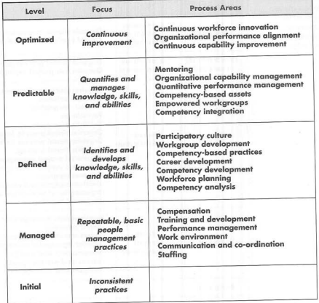
The People CMM [2/2]
Figure source: Software Engineering: A Practitioner’s Approach, R. S. Pressman, 7th ed., p. 802

Slide 13
SPICE and Bootstrap
Software Process Improvement and Capability dEtermination
  Support ISO’s process assessment
  Model for process management
  Guidelines for conducting an assessment and rating the process under consideration
  Construction, selection, and use of assessment instruments and tools
  Training for assessors
Bootstrap
  Conformance with SPICE
  Evaluation of software process using SE best practices
  Process maturity level

Slide 14
TickIT
Auditing method for ISO 9000:2001
“Plan-do-check-act” cycle
Plan
  Process objectives, activities, and tasks
Do
  Implementation of software process
Check
  Monitor and measure the process
Act
  Software process improvement activities
TickIT is used throughout the cycle

Slide 15
Personal Software Process [1/2]
Every developer uses some process
Planning
  Estimates for resources, size, and defects
  Metrics are recorded
  Development tasks are identified
  Project schedule is created
High-level design
  Component design
  Prototype development in case of uncertainty
  Issues are recorded and tracked
High-level design review
  Formal verification methods are applied
  Metrics are maintained for all important tasks

Slide 16
Personal Software Process [2/2]
Development
  Component-level deign is refined and reviewed
  Code generation and testing
  Metrics are maintained
Postmortem
  Analysis of metrics collected
  Process effectiveness is determined
  Measure and metrics guide for process modification

Slide 17
Team Software Process
Objectives are
  Self-directed project team
  Manager should coach and motivate their teams
  Process improvement by making CMM level-5 behavior normal and expected
  Improvement guidance for organizations
  Facilitate university teaching
Main activities
  Project launch
  High-level design
  Implementation
  Integration and testing
  Postmortem

Slide 18
SPI Return on Investment
Substantial investment in SPI
Qualitative level
  Better quality filters
  Better change management
  Less technical rework
Classic ROI equation
  ROI = [Σ(benefits) – Σ(costs)]/ Σ(costs) * 100%

Slide 19
SPI Trends
More failure than success
$25,000 - $70,000 cost per person
Focus should be on agile approach
Focus on the project level rather than organizational level
Few key practices rather than hundreds
Web-based training rather than traditional classroom
Cultural change at small level rather than organizational level
Current SPI frameworks are basis for better, simpler, and more agile methods

Slide 20
Summary
CMMI
  Continuous as well as staged model
CMMI capability levels
  Incomplete, performed, managed, defined, quantitatively managed, optimized
Example – process area
  Specific goals and practices, general goals and practices
Other SPI frameworks
  SPICE, Bootstrap, TickIT, PSP, TSP
SPI return on investment
SPI trends

