Slide 1
Software Process Improvement
SEII-Lecture 24
Dr. Muzafar Khan
Assistant Professor
Department of Computer Science
CIIT, Islamabad.

Slide 2
Recap
Class-oriented metrics
  Weighted methods per class, depth of the inheritance tree, number of children, coupling, response for class, lack of cohesion
Component-level design metrics
  Cohesion, coupling, and complexity
Operation-oriented metrics
  Average operation size, operation complexity average number of parameters per operation
Design metrics for WebApps
Metrics for source code
Metrics for object-oriented testing
Metrics for maintenance

Slide 3
Software Process Improvement
Triple constraint
Effective software process can be defined in effective manner
Assessment of existing process based on the defined effective process
Meaningful strategy to transform the process
It is not free
Reduced costs after the process improvement

Slide 4
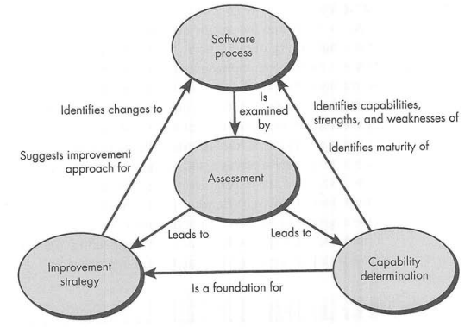
SPI Framework
Figure source: Software Engineering: A Practitioner’s Approach, R. S. Pressman, 7th ed., p. 788

Slide 5
SPI Support Groups
Quality certifiers
  Process quality leads to product quality
Formalists
  Process workflow, modeling languages
Tool advocates
  Tool-oriented
Practitioners
  Project-level planning and metrics
Reformers
  Organizational change, human issues
Ideologists
  Suitability for particular domain or organization structure

Slide 6
Maturity Model [1/2]
Overall indication of process maturity
Capability maturity model
Level-5, Optimized
  Quantitative feedback to identify process weaknesses
  Pro-active approach to strengthen it
  Software processes are evaluated and updated to prevent known types of defects from recurring
Level-4, Managed
  Detailed process and product metrics
  Meaningful variations in process performance can be distinguished from noise
  Trends can be predicted in process and product quality

Slide 7
Maturity Model [2/2]
Level-3, Defined
  Processes are documented, standardized, and integrated into a standard software process
  All projects follow an approved, customized version of process
Level-2, Repeatable
  Basic processes are established to track cost, schedule, and functionality
  Planning and managing new products is based on experience
Level-1, Initial
  Few processes are defined
  Success depends on individual efforts

Slide 8
Four Levels of Immaturity [1/2]
Level-0, Negligent
  Failure to allow successful development process
  All problems are perceived to be technical
  Managerial and quality assurance activities are considered as overhead
Level-1, Obstructive
  Counterproductive processes are imposed
  Processes are rigidly defined
  Adherence to the form is stressed
  Status quo, no power delegation

Slide 9
Four Levels of Immaturity [2/2]
Level-2, Contemptuous
  Disregard for good software engineering
  Complete schism between software development activities and process improvement activities
  No training program
Level-3, Undermining
  Total neglect of own charter
  Conscious discrediting of peer organization’s process improvement efforts
  Rewarding failure and poor performance

Slide 10
SPI Process
Who need SPI
  Large organizations?
How to initiate the process
SEI proposed IDEAL
  Initiating, Diagnosing, Establishing, Acting, and Learning
Another approach
  Look in the mirror, then get smarter, select the process model, instantiate the model, evaluate what has been done

Slide 11
Assessment and Gap Analysis
Before starting the journey, know precisely where you are
First road-map activity – assessment
  Uncover strengths and weaknesses
  Examine existing generic mechanisms / process activities
  Is the objective of the action clearly defined?
  Are work products required as input and produced as output identified and described?
  Are the work tasks to be performed clearly described?
  Are the people who must perform the action identified by role?
  Have metrics for the action been established?
  Are tools available to support the action?

Slide 12
Assessment and Gap Analysis
Focus on the following attributes
Consistency
  Important activities, actions, and tasks applied
Sophistication
  Level of sophistication for management and technical actions performed
Acceptance
  Software process and SE practice acceptance by management and technical staff
Commitment
  Management commitment to provide resources to achieve above attributes

Slide 13
Education and Training
Generic concepts and methods
  Focus on managers and practitioners
  Process and practice
  Intellectual tools to apply process effectively and to make rational decisions about improvements
Specific technology and tools
  Focus on practitioners
  Training for tools used in process
Business communication and quality-related topics
  Focus on all stakeholders
  “soft” topics
  Better communication and quality

Slide 14
Selection and Justification
Suitable process model
Set of framework activities to be applied
Major work products to be produced
Quality assurance checkpoints to assess progress
Focus on weaknesses
Consensus is difficult
Bad choice can do more harm than good
Once a choice is made, efforts should be done

Slide 15
Installation / Migration
Software process redesign
Feel of change
Sometimes entirely new process is recommended
Substantial organizational and technological transition is involved
If changes are minor, process migration
Incremental migration is more effective strategy

Slide 16
Evaluation
Evaluation occurs throughout SPI
Qualitative factors
  Management and practitioners’ attitudes
Quantitative metrics
  Product related metrics

Slide 17
Risk Management for SPI [1/2]
SPI is a risky undertaking
Lack of management support
Cultural resistance by technical staff
Poorly planned SPI strategy
Overly formal approach to SPI
Selection of inappropriate process
Risk management at three points
  Prior to the initiation of SPI road map
  During the execution of SPI activities
  During the evaluation activity that follows the initiation

Slide 18
Risk Management for SPI [2/2]
Risk categories
  Budget and cost
  Content and deliverables
  Culture
  Maintenance of SPI deliverables
  Mission and goals
  Organizational management
  Organizational stability
  Process stakeholders
  Schedule for SPI developments
  SPI development environment and process
  SPI project management and staff

Slide 19
Critical Success Factors [1/2]
Management commitment and support
  Organizational and culture changes
  Senior business managers should recognize the importance of software
  Technical managers should be involved in the development of local SPI strategy
Staff involvement
  SPI cannot imposed top down or from outside
Process integration and understanding
  Process should be integrated with other business processes and requirements

Slide 20
Critical Success Factors [2/2]
A customized SPI strategy
  Consider the local environment
Solid management of the SPI project
  SPI is a project like any other
  Project management

Slide 21
Summary
Software process improvement
Framework for SPI
SPI support groups, maturity and immaturity models
Assessment and gap analysis
Education and training
Selection and justification
Installation / migration
Evaluation
Risk management
Critical success factors

