Slide 1
Product Metrics
SEII-Lecture 22
Dr. Muzafar Khan
Assistant Professor
Department of Computer Science
CIIT, Islamabad.

Slide 2
Recap
Version control
  Project repository, version management capability, make facility, issue/bug tracking
Change control
Configuration audit
  compliments technical reviews
Status reporting
Configuration management for WebApp
  Content, people, scalability, politics

Slide 3
Importance
Measurement is a key element of any engineering process
Assessment of quality
SE is different than other disciplines
Often indirect metrics
Debate on “unmeasurable” software
Systematic way to assess quality
Discover and correct potential problems before they become serious defects

Slide 4
Framework for Product Metrics [1/4]
Measure, measurement, and metrics are often used interchangeably
Measure
  Quantitative indication of the extent, amount, dimension, size, or capacity of some attribute
  Example: number of errors uncovered within a single component
Measurement
  The act of determining a measure
  Example: number of components reviews
Metric
  An indicator
  “a quantitative measure of the degree to which a system, component, or process possesses a given attribute”
  Example: average number of errors found per review

Slide 5
Framework for Product Metrics [2/4]
The Challenge of Product Metrics
  Attempts to develop single metric
  If we want to evaluate an attractive car
Measurement process involves five activities
  Formulation
  Collection
  Analysis
  Interpretation
  Feedback

Slide 6
Framework for Product Metrics [3/4]
Principles for metrics characterization and validation
  A metric should have desirable mathematical properties
  When a metric represents a software characteristic that increases when positive traits occur or decreases when undesirable traits are encountered, the value of the metric should increase or decrease in the same manner
  Each metric should be validated empirically in a wide variety of contexts before being published or used to make decisions
Principles to conduct the activities
  Data collection and analysis should be automated
  Valid statistical techniques should be applied
  Interpretative guidelines should be established

Slide 7
Framework for Product Metrics [4/4]
Goal-oriented software measurement
  Goal, question, metric paradigm
  Establish explicit measurement goal
  Define a set of questions that must be answered
  Identify well-formulated metrics
Attributes of effective software metrics
  Simple and computable
  Empirically and intuitively persuasive
  Consistent and objective
  Consistent in its use of units and dimensions
  Programming language independent
  An effective mechanism for high-quality feedback

Slide 8
Metrics for Requirements Model
Few analysis and specification metrics
Project estimation metrics may be used
Prediction of the “size” of the resultant system
Function-based metrics
  Estimate the cost and effort
  Predict the number of errors
  Forecast the number of components and/or the number of project source lines

Slide 9
Function-Based Metrics [1/4]
Number of external inputs (EIs)
  Originates from user or other application
  Often used to update internal logical files
  Inquiries are different
Number of external outputs (EOs)
  Derived data within the application
  Reports, screens, error messages
  Individual data items within a report are not considered

Slide 10
Function-Based Metrics [2/4]
Number of external enquiries (EQs)
  An online input that generates online output
Number of internal logical files (ILFs)
  Logical grouping of data within the application’s boundary
Number of external interface files (EIFs)
  Logical grouping of data external to the application
FP = count total * [0.65 + 0.01 * ∑ (F_{i})]

Slide 11
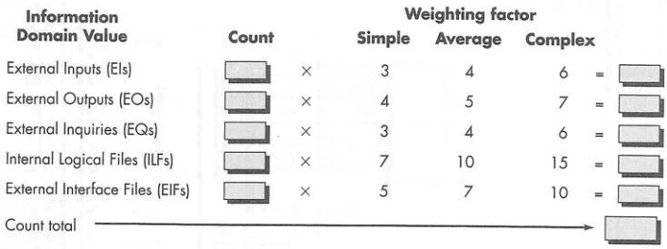
Function-Based Metrics [3/4]
Figure source: Software Engineering: A Practitioner’s Approach, R. S. Pressman, 7th ed., p. 621

Slide 12
Function-Based Metrics [4/4]
FP = count total * [0.65 + 0.01 * ∑ (F_{i})]
F_{i} (i = 1 to 14) are value adjustment factors
  Does the system require reliable backup and recovery?
  Are specialized data communications required to transfer information to or from the application?
  Are there distributed processing functions?
  Is performance critical?
  Will the system run in an existing, heavily utilized operational environment?

Slide 13
Metrics for Specification Quality [1/3]
Characteristics to assess requirements quality
  Specificity
  Completeness
  Correctness
  Understandability
  Verifiability
  Consistency
  Achievability
  Concision
  Traceability
  Modifiability
  Precision
  Reusability

Slide 14
Metrics for Specification Quality [2/3]
High quality requirements are
  Stored electronically
  Interpretable
  Annotated by relative importance
  Stable
  Versioned
  Organized
  Cross-referenced
  Right level of detail

Slide 15
Metrics for Specification Quality [3/3]
Total number of requirements
  n_{r} = n_{f} + n_{nf}
Specificity of requirements
  Q₁ = n_{ui} / n_{r}
  If value is closer to 1, lower ambiguity
Completeness of functional requirements
  Q₂ = n_{u} / (n_{i} * n_{s})
  n_{u} (number of unique functional requirements), n_{i} (number of inputs defined), n_{s} (number of states specified)
Completeness of functional and nonfunctional requirements
  Q₃ = n_{c} / (n_{c} * n_{nv})
  n_{c} (number of validated requirements)

Slide 16
Metric for Design Model
Design of new aircraft, computer chip etc.
Design measures are always there
Sometimes opposite the case in software design
Architectural design metrics
Structural complexity
  S(i) = f_{out} (i)
Data complexity
  D(i) = v(i) / (f_{out} (i) + 1)
System complexity
  C(i) = S(i) + D(i)

Slide 17
Architectural Design Metrics [1/2]
Simple morphology metrics
  Size = n + a
  n: number of nodes
  a: number of arcs
  Depth: longest path from root to leaf node
  Width: maximum number of nodes at any one level
  Connectivity density: arc-to-node ratio

Slide 18
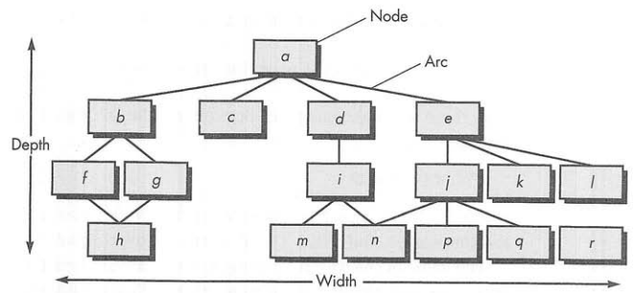
Architectural Design Metrics [2/2]
n = 17, a = 18
r = a/n = 1.06
Figure source: Software Engineering: A Practitioner’s Approach, R. S. Pressman, 7th ed., p. 625

Slide 19
Metrics for Object-Oriented Design [1/4]
Nine distinct and measurable characteristics
Size
  Population
    Static count of entities e.g. classes
  Volume
    Population measure at a given time instant
  Length
    a chain of interconnected design elements
  Functionality
    Indication of the value delivered to customer

Slide 20
Metrics for Object-Oriented Design [2/4]
Complexity
  In terms of structural characteristics
  How classes are interrelated with each other
Coupling
  Physical connections between elements
Sufficiency
  Degree of abstraction
  Design component is sufficient if it fully reflects all properties of the application domain object

Slide 21
Metrics for Object-Oriented Design [3/4]
Completeness
  Multiple points of view
  "What properties are required to fully represent the
  problem domain object?”
Cohesion
  All operations working together to achieve a single, well-defined purpose
Primitiveness
  Similar to simplicity
  The degree to which operation is atomic

Slide 22
Metrics for Object-Oriented Design [4/4]
Similarity
  The degree to which two or more classes are similar
Volatility
  Likelihood of possible change

Slide 23
Summary
Measurement and quality assessment
Framework for product metrics
  Measure, measurement, and metrics
  Formulation, collection, analysis, interpretation, feedback
  Principles for metrics characterization and validation
Metrics for requirements model
  Function-based metrics
  Metrics for specification quality
Metric for design model
  Architectural design metrics
  Metric for object-oriented design

