Slide 1
Software Configuration Management
SEII-Lecture 21
Dr. Muzafar Khan
Assistant Professor
Department of Computer Science
CIIT, Islamabad.

Slide 2
Recap
Change management
Software configuration management
SCM scenario
Elements of SCM
  Component, process, construction, and human elements
SCM repository
SCM process
  Identification of objects

Slide 3
Version Control
Procedures and tools to manage different versions of objects
Four major capabilities
  Project repository
  Version management capability
  Make facility
  Issue/bug tracking
Establish a change set- a collection of all changes

Slide 4
Change Control [1/3]
Balanced approach
Uncontrolled change leads to chaos in large projects
Combines human procedures and tools
Change request is submitted and evaluated to
  Assess technical merit
  Potential side effects
  Overall impact on other objects and system functions
  The projected cost of the change

Slide 5
Change Control [2/3]
Change report
  Change control authority
  Final decision on the status and priority of change
Engineering change order
  Describes the change to be made
  The constraints that must be respected
  The criteria for review and audit
Version control system updates the original file after the change

Slide 6
Change Control [3/3]
Change control and version control
Access control
  Authority to access and modify the object
Synchronization control
  Parallel changes are not overwrite
Informal change control prior to SCI becomes baseline
Formal change control after the product delivery

Slide 7
Configuration Audit [1/2]
Identification, version control, and change control
How to ensure changes are implemented
  Technical reviews
  Software configuration audit
SC audit compliments technical reviews
Questions to answer

Slide 8
Configuration Audit [2/2]
Has the change specified in the ECO been made? Have any additional modifications been incorporated?
Has a technical review been conducted to assess technical correctness?
Has the software process been followed and have software engineering Standards been properly applied?
Has the change been "highlighted" in the SCI? Have the change date and change author been specified? Do the attributes of the configuration object reflect the change?
Have SCM procedures for noting the change, recording it, and reporting it been followed?
Have all related SCIs been properly updated?

Slide 9
Status Reporting
Configuration status reporting / status accounting
What happened?
How did it?
When did it happen?
What else will be affected?
CSR entry is made in case of updated SCI
When configuration audit is conducted, results are reported as a part of CSR task
Output from CSR is placed online for use
CSR report is generated for regular intervals

Slide 10
Configuration Management for WebApp [1/2]
More frequent changes
Content
  Variety of content
  Challenge is to organize it rationally
  Conventional data modeling techniques
People
  Ad hoc manner
  No SE background
  No change management

Slide 11
Configuration Management for WebApp [2/2]
Scalability
  Size and complexity grow
  Changes may have larger impact
Politics
  Who “owns” a WebApp?
  Who assumes responsibility for the accuracy of the information on the website?
  Who ensures that quality control processes have been followed before information is published to the site?
  Who is responsible for making changes?
  Who assumes the cost of change?

Slide 12
Content Management [1/2]
Related to configuration management
Dynamic WebApp
Collection subsystem
  Create / acquire content
  Convert content to presentable form
  Organize content into packets
Management subsystem
  Content database
  Database capabilities
  Configuration management functions

Slide 13
Content Management [2/2]
Publishing subsystem
  Static elements
  Publication service
  External services

Slide 14
Change Management [1/2]
Classification of changes
Class 1
  Corrects an error or enhance local content or functionality
Class 2
  An impact on other content objects or functional objects
Class 3
  Broad impact on WebApp
Class 4
  Major design change

Slide 15
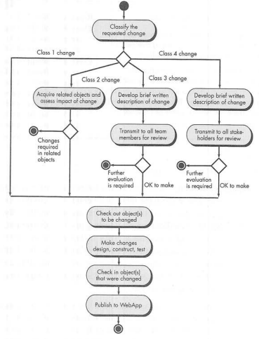
Change Management [2/2]
Figure source: Software Engineering: A Practitioner’s Approach, R. S. Pressman, 7th ed., p. 607

Slide 16
Version Control
A central repository for the webApp project should be established
Each Web engineer creates his or her own working folder
The clocks on all developer workstations should be synchronized
As new configuration objects are developed or existing objects are changed, they are imported into the central repository
As objects are imported or exported from the repository, an automatic, time-stamped log message is made

Slide 17
Auditing and Reporting
Log should be maintained for check-in and check-out
Complete log report for all team members
An automated email notification to stakeholders for every check-in and check-out

Slide 18
Summary
Version control
  Project repository, version management capability, make facility, issue/bug tracking
Change control
Configuration audit
  compliments technical reviews
Status reporting
Configuration management for WebApp
  Content, people, scalability, politics

