Slide 1
Software Configuration Management
SEII-Lecture 20
Dr. Muzafar Khan
Assistant Professor
Department of Computer Science
CIIT, Islamabad.

Slide 2
Recap
Component-level testing
  Equivalence partitioning, boundary value analysis, path testing
Navigation testing
  Testing navigation syntax and semantics
Configuration testing
  Server-side and client-side issues
Security testing
  Firewall, authentication, encryption, authorization
Performance testing
  Load and stress testing

Slide 3
Importance
Continuous changes
Confusion arises if poor change management
SCM is a set of tracking and controlling activities
SCM activities are developed to
  Identify change
  Control change
  Ensure that change is being properly implemented
  Report changes to stakeholders
Difference between software support and SCM

Slide 4
Origin of Changes
New business / market change
New stakeholder needs
Reorganization or business growth/downsizing
Budgetary or scheduling constraints

Slide 5
Software Configuration Management
Information
  Computer programs (source and exe)
  Work products for different stakeholders
  Data (within the program or external to it)
Software Configuration Items (SCI)
  Information items e.g. UML diagram or complete design document
First law of system engineering
  "No matter where you are in the system life cycle, the system will change, and the desire to change it will persist throughout the life cycle."

Slide 6
SCM Scenario
Project manager
  Timely completion
Configuration manager
  Procedures and policies are followed
Software engineers
  Work effectively, communicate and coordinate efficiently
Customer
  Follow formal procedures to request change
  Indicate bugs in product

Slide 7
Elements of a Configuration Management System
Component elements
  Set of tools to access and manage configuration items
Process elements
  Collection of actions and tasks for change management
Construction elements
  Set of tools that automate the construction of software
Human elements
  Set of tools and process features to implement effective SCM

Slide 8
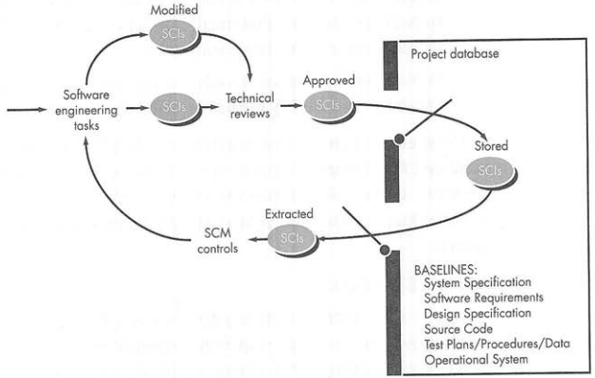
Baselines
Figure source: Software Engineering: A Practitioner’s Approach, R. S. Pressman, 7th ed., p. 588

Slide 9
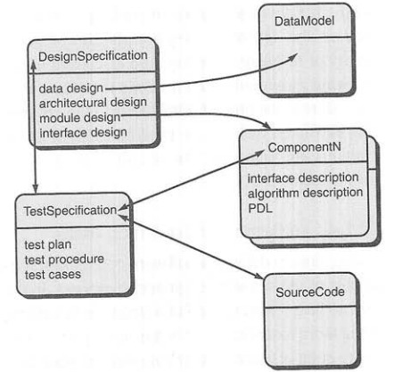
Configuration Objects
Figure source: Software Engineering: A Practitioner’s Approach, R. S. Pressman, 7th ed., p. 590

Slide 10
SCM Repository [1/3]
In early days of software engineering
  Paper documents
  Finding a configuration item was difficult
  When items are changed?
  Constructing a new version was time consuming and error prone
  Describing detailed relationships between components was virtually impossible
  Programmer had to remember a lot of things

Slide 11
SCM Repository [2/3]
Set of mechanisms and data structures
Data integrity, sharing, and integration
Meta-model
  How information is stored?
  How data can be accessed by tools?
  How data can be viewed by software engineers?
  How well data security and integrity can be maintained?
  How well the existing model can be extended?

Slide 12
SCM Repository [3/3]
Provides two classes of services
  Conventional services of modern DBMS
  Services specific to software engineering environment
Services for software team
  Integrate or directly support process management functions
  Support specific rules that govern the SCM function and the data maintained within the repository
  Provide an interface to other tools
  Accommodate storage of sophisticated data objects e.g. graphics and video

Slide 13
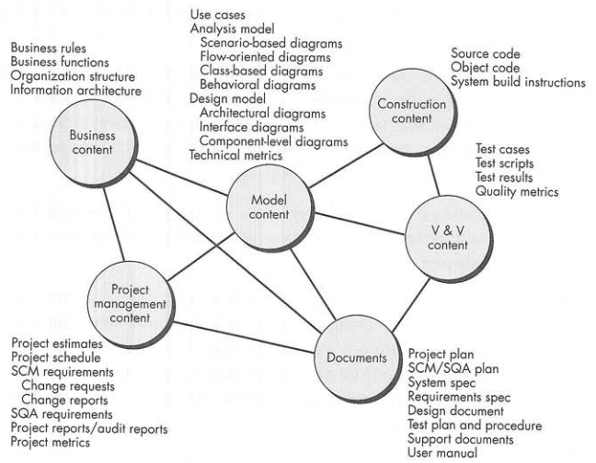
Contents of the Repository
Figure source: Software Engineering: A Practitioner’s Approach, R. S. Pressman, 7th ed., p. 591

Slide 14
SCM Features [1/2]
Versioning
  Many versions are created
  Must save all versions
  Must be able to control wide variety of object types
Dependency tracking and change management
  Variety of relationships
  Tracking all relationships is crucial
Requirements tracing
  Tracking of design and construction components to requirements
  Forward and backward tracing

Slide 15
SCM Features [2/2]
Configuration management
  Tracking of series of configurations representing specific project milestones or production releases
Audit trails
  Additional information about when, why, and by whom changes are made
  Source of changes can be entered as attributes of specific objects
  Repository trigger mechanism to enter audit information for change

Slide 16
SCM Process [1/3]
Main objectives
  To identify all items that collectively define the software configuration
  To manage changes to one or more of these items
  To facilitate the construction of different versions of an application
  To ensure software quality is maintained as the configuration evolves over time

Slide 17
SCM Process [2/3]
Questions to answer
How does a software team identify the discrete elements of a software configuration?
How does an organization manage the many existing versions of a program (and its documentation) in a manner that will enable change to be accommodated efficiently?
How does an organization control changes before and after software is released to a customer?
Who has responsibility for approving and ranking requested changes?
How can we ensure that changes have been made properly?
What mechanism is used to apprise others of changes that are made?

Slide 18
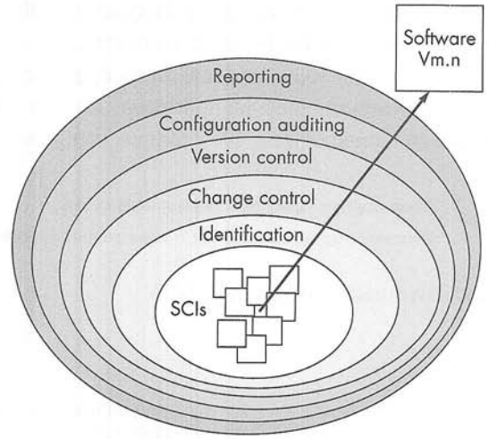
SCM Process [3/3]
Figure source: Software Engineering: A Practitioner’s Approach, R. S. Pressman, 7th ed., p. 593

Slide 19
Identification of Objects [1/3]
To manage and control items, we need to separately name and organize them using object-oriented approach
Basic objects
  Unit of information
  Example: section of requirements specification
Aggregate objects
  Collection of basic and other aggregate objects
  A list of pointers (at conceptual level)
  Example: DesignSpecification contains ComponentN and UMLClassDiagramN

Slide 20
Identification of Objects [2/3]
Distinct object features
Name
  Character string
  Unambiguous identification
Description
  List of data items that identify SCI type e.g. model element, program, data
  Project identifier, change/version information
List of resources
  Resources provided, processed, referenced, or otherwise required by the object
  Example: data types, specific functions, variable names
Realization
  A pointer to the unit of text in case of basic object and null for an aggregate object

Slide 21
Identification of Objects [3/3]
Relationships
  Class diagram <part-of> requirements model
  Requirements model <part-of> requirements specification
Hierarchy (cross-structure relationships)
  DataModel <interrelated> DataFlowModel
  DataModel <interrelated> TestCaseClassM

Slide 22
Summary
Change management
Software configuration management
SCM scenario
Elements of SCM
  Component, process, construction, and human elements
SCM repository
SCM process
  Identification of objects

