Slide 1
Project Management and Information Technology Context
SEII-Lecture 2
Dr. Muzafar Khan
Assistant Professor
Department of Computer Science
CIIT, Islamabad.

Slide 2
Outline
Recap
Systems Philosophy
Organization frames
Project life cycle
IT projects and recent trends
Project management process groups

Slide 3
Recap
Software/ software engineering
IT project failure / investment
Project / program
Project and portfolio management
Project management framework
Project success factors
Successful organizations and managers
Suggested skills for project managers

Slide 4
Systems Philosophy
No project done in isolation
Broad organizational context
Holistic view / systems thinking
Systems analysis
Systems management

Slide 5
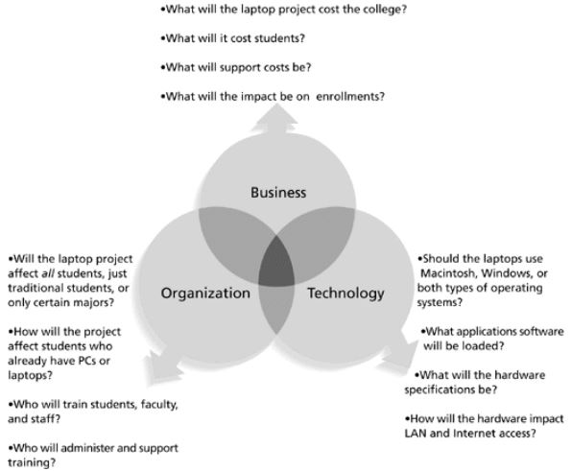
Three-Sphere Model
Figure source: IT Project Management, K. Schwalbe, 6th ed., p. 46

Slide 6
Organization Frames [1/2]
Structural frame
  Organization structure
  Roles and responsibilities
  Coordination and control
Human resource frame
  Harmony between organization’s needs and people’s needs

Slide 7
Organization Frames [2/2]
Political frame
  Organizational and personal politics
  Competition between groups/individuals
  Power, leadership, limited resources
  Project supporters and opponents
Symbolic frame
  Symbols and meanings
  Organization culture

Slide 8
Organizational Structures [1/2]
Functional
  Conventional structure
  Managers report to CEO
  Specialized staff
Project
  Program managers report to CEO
  Staff with various skills
Matrix
  Mix of functional and project structures
  Strong, balanced, and weak matrix

Slide 9
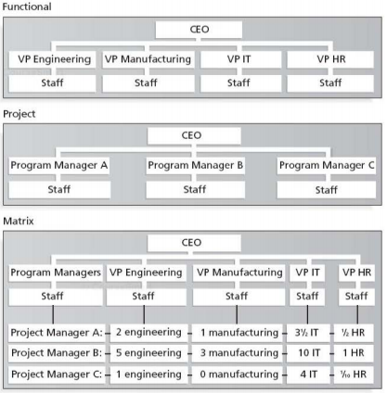
Organizational Structures [2/2]
Figure source: IT Project Management, K. Schwalbe, 6th ed., p. 49

Slide 10
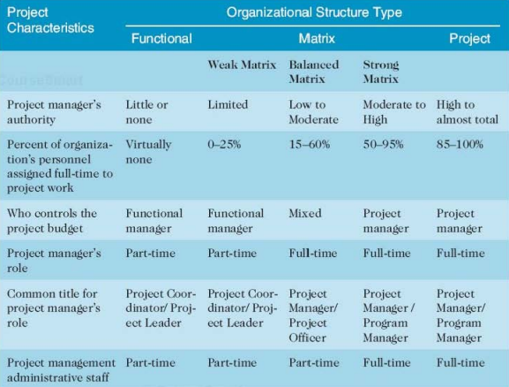
Organizational Structure and Project
Figure source: IT Project Management, K. Schwalbe, 6th ed., p. 50

Slide 11
Organizational Culture [1/2]
Set of shared assumptions, values, and behaviors
Cause of many problems
Subcultures
Main characteristics
  Member identity
  Group emphasis
  Risk tolerance
  Conflict tolerance

Slide 12
Organizational Culture [2/2]
Main characteristics
  Reward criteria
  Unit integration
  Open-systems focus
  People focus
  Control
  Means-ends orientation

Slide 13
Stakeholder Management
Stakeholders
  Directly involved in the project
  Internal to the organization
  External to the organization
  Top management
Competition for limited resources
Project manager has to manage relationships

Slide 14
Role of Top Management in Project Success
Adequate resources
Approval for unique project needs
Cooperation from other departments
Coaching for leadership issues
Use of standards and tools
Project management office

Slide 15
Project Life Cycle [1/3]
Various project phases
Work, deliverables, time, team, approval in each phase
In early phases
  Limited resources required
  High level of uncertainty
  More stakeholders’ influence
In middle phases

Slide 16
Project Life Cycle [2/3]
In middle phases
  Low level of uncertainty
  More resources required
In final phase
  Objectives achieved
  Formal customer’s approval
Phases vary in different domains

Slide 17
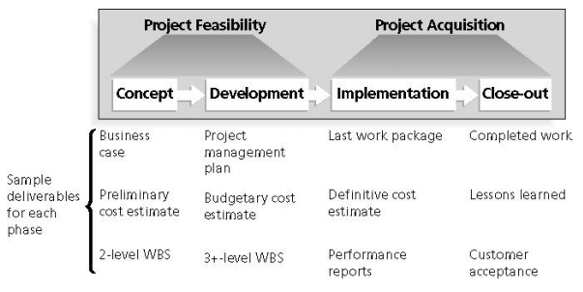
Project Life Cycle [3/3]
Figure source: IT Project Management, K. Schwalbe, 6th ed., p. 58

Slide 18
Product Life Cycles
Software development projects are subsets of IT projects
Software/system development life cycle
  Waterfall, spiral, incremental (predictive life cycle)
  Agile models (adaptive software development)

Slide 19
Management Reviews
Complex nature of IT projects/products
Status review at each phase
  Phase exits / kill points
  Evaluate progress
  Potential success
  Compatibility with organizational goals
  Systems’ view
  Frequent reviews

Slide 20
IT Projects
Complex in nature
  Scale
  Domains
  Products
  Resources
  Technology
  Team members

Slide 21
Summary
Systems Philosophy
  Business, organization, technology
Organization frames
  Structure, HR, political, symbolic
Project life cycle
  Concept, development, implementation, close-out
Notes:
Here is the outline for today’s lecture.

