Slide 1
Testing Web Applications
SEII-Lecture 18
Dr. Muzafar Khan
Assistant Professor
Department of Computer Science
CIIT, Islamabad.

Slide 2
Recap
Elements of software quality assurance
  Standards, reviews and audits, testing, error collection and analysis, change management, education, vendor management, security management, safety, risk management
SQA tasks
Goals, attributes, metrics
  Requirements quality, design quality, code quality, quality control effectiveness
Statistical quality assurance
Software reliability

Slide 3
Dimensions of Quality [1/2]
Content
  Syntactic and semantic
Function
  Conformance to requirements
Structure
  Extensible
Usability
  User interface
Navigability
  Links to other pages

Slide 4
Dimensions of Quality [2/2]
Performance
  Number of users
Compatibility
  Different configurations
Interoperability
  Other applications
Security
  Potential vulnerabilities

Slide 5
Errors within a WebApp Environment
Problems at client side
Different environments
Webapp configuration
Three layers architecture
Static operating environment

Slide 6
Testing Strategy [1/2]
The content model for the WebApp is reviewed to uncover errors
The interface model is reviewed to ensure that all use cases can be accommodated.
The design model for the webApp is reviewed to uncover navigation errors
The user interface is tested to uncover errors in presentation and/or navigation mechanics
Functional components are unit tested
Navigation throughout the architecture is tested

Slide 7
Testing Strategy [2/2]
The WebApp is implemented in a variety of different environmental configurations and is tested for compatibility with each configuration.
Security tests are conducted in an attempt to exploit vulnerabilities in the WebAPP or within its environment
Performance tests are conducted
The webApp is tested by a controlled and monitored population of end users; the results of their interaction with the system are evaluated for content and navigation errors, usability concerns, compatibility concerns, and WebApp security, reliability, and performance

Slide 8
Content Testing [1/2]
Objectives
  Syntactic errors
  Semantic errors
  Structure of content
Is the information factually accurate?
Is the information concise and to the point?
Is the layout of the content object easy for the user to understand?
Can information embedded within a content object be found easily?
Have proper references been provided for all information derived from other sources?

Slide 9
Content Testing [2/2]
Is the information presented consistent internally and consistent with information presented in other content objects?
Is the content offensive, misleading, or does it open the door to litigation?
Does the content infringe on existing copyrights or trademarks?
Does the content contain internal links that supplement existing content? Are the links correct?
Does the aesthetic style of the content conflict with the aesthetic style of the interface?

Slide 10
Database Testing
Original client-side request for information is different
Database may be remote
Transmission of raw data to server
Proper formatting of raw data acquired
Testing should ensure that
  Valid information is passed
  WebApp processes scripts accurately
  User data are passed correctly
  Queries are passed to data management layer

Slide 11
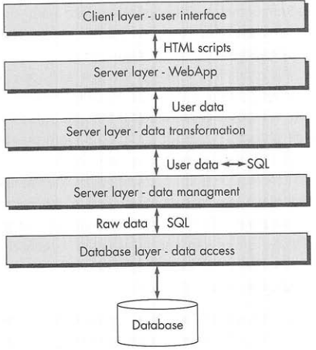
Layers of Interaction
Figure source: Software Engineering: A Practitioner’s Approach, R. S. Pressman, 7th ed., p. 536

Slide 12
User Interface Testing
Interface features are tested to ensure that design rules, aesthetics, and related visual content are available for the user without error
Individual interface mechanisms are tested in a manner that is analogous to unit testing
Each interface mechanism is tested within the context of a use case
The complete interface is tested against selected use cases
The interface is tested within a variety of environments to ensure that it will be compatible

Slide 13
Testing Interface Mechanisms [1/5]
Links
  Proper content is reached
  Build a list of all links
  Uncover bad URLs or links
  Links to external WebApp
Forms
  Labels correctly identify fields
  Mandatory fields are visually identified
  Server receives complete information
  Appropriate defaults are used
  Brower functions (e.g. back arrow) do not corrupt data
  Scripts for error checking work properly

Slide 14
Testing Interface Mechanisms [2/5]
Forms
  Proper width and data types
  Appropriate safeguard e.g. length of text
  Appropriate options for full-down menus
  Order of controls is meaningful
  Browser “auto-fill” do not lead to data errors
  Tab key initiates proper movement

Slide 15
Testing Interface Mechanisms [3/5]
Client-side scripting
  Black-box testing
  Coupled with forms testing
  Compatibility test for scripting language
  Organization standards
Dynamic HTML
  Dynamic webpages are executed
  Compatibility test

Slide 16
Testing Interface Mechanisms [4/5]
CGI scripts
  Black-box testing for data integrity
  Performance testing for server-side configuration
Streaming content
  Updated contents are properly displayed
  Suspended without error
  Restarted without difficulty
Cookies
  Client-side and server-side testing
  Proper persistence

Slide 17
Testing Interface Mechanisms [5/5]
Application specific interface mechanisms
  Checklist to check functionality
  Example: shopping cart functionality
  Boundary-test: maximum and minimum number of items
  Test a “check out” request for an empty cart
  Test proper deletion of an item
  Test to determine whether a purchase empties the cart
  Test to determine the persistence of cart contents
  Test to determine whether cart contents be called for at some future date

Slide 18
Usability Tests [1/3]
Define a set of usability testing categories and identify goals for each
Design tests that will enable each goal to be evaluated
Select participants who will conduct the tests
Instrument participants' interaction with the WebApp while testing is conducted
Develop a mechanism for assessing the usability of the WebApp

Slide 19
Usability Tests [2/3]
Different levels
Specific interface mechanism e.g. form
Complete web page
Complete WebApp

Slide 20
Usability Tests [3/3]
Test categories
  Interactivity
  Layout
  Readability
  Aesthetics
  Display characteristics
  Time sensitivity
  Personalization
  Accessibility

Slide 21
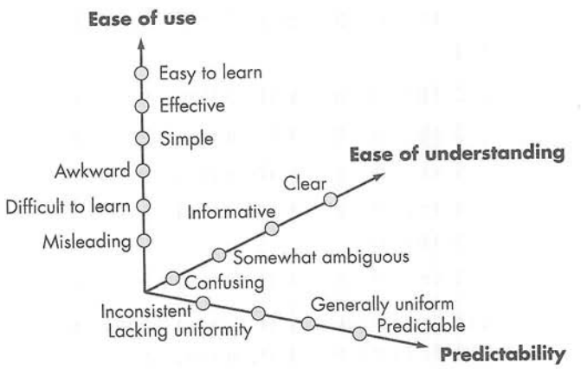
Qualitative Assessment of Usability
Figure source: Software Engineering: A Practitioner’s Approach, R. S. Pressman, 7th ed., p. 542

Slide 22
Compatibility Tests
Computers, display devices, operating systems, browsers, network connection speeds
Differences in client-side processing speed
Sometimes minor issues
Serious issues e.g. download speed, missing plug-in, page layout
Define a set of “commonly encountered” client-side configurations
Tree structures for possible configurations

Slide 23
Summary
Quality dimensions
  Content, function, structure, usability, navigability, performance, compatibility, interoperability, security
Testing strategy
Content testing
Database testing
User interface testing
  Testing interface mechanisms, usability tests, compatibility tests

