Slide 1
Software Quality Assurance
SEII-Lecture 17
Dr. Muzafar Khan
Assistant Professor
Department of Computer Science
CIIT, Islamabad.

Slide 2
Recap
Software reviews
Cost impact of software defects
Defect amplification model
Review metrics and their use
  Preparation effort (E_{p}), assessment effort (E_{p}), Rework effort (E_{r}), work product size (WPS), minor errors found (Err_{minor}), major errors found (Err_{major})
Formal and informal reviews
  Review meeting, review reporting and record keeping, review guidelines

Slide 3
Elements of Software Quality Assurance [1/3]
Standards
  IEEE, ISO, and other organizations
  Volunteer / imposed
  SQA job is to confirm it
Reviews and audits
  Quality control activity
  Intended to uncover errors and follow guidelines
Testing
  Key activity
  To find errors
  Proper planning and execution

Slide 4
Elements of Software Quality Assurance [2/3]
Error/defect collection and analysis
  Better understanding of errors
Change management
  Continuous changes
  Changes may lead to confusion
Education
  Educate project teams
  Software process improvement

Slide 5
Elements of Software Quality Assurance [3/3]
Vendor management
  Shrink-wrapped packages, tailored shell, and contracted software
  Quality guidelines for vendor
Security management
  Cyber crimes
  Privacy regulations
Safety
  Different domains
Risk management

Slide 6
SQA Tasks
Prepare SQA plan for a project
Participates in the development of the project’s software process description
Review software engineering activities to verify compliance with the defined software process
Audits designated software work products to verify compliance with those defined as part of the software process
Ensures that deviations in software work and work products are documented and handled according to a documented procedure
Records any noncompliance and reports to senior management

Slide 7
Goals, Attributes, and Metrics
Requirements quality
Design quality
Code quality
Quality control effectiveness

Slide 8
Requirements Quality
Ambiguity
  Number of ambiguous modifiers e.g. many, large etc.
Completeness
  Number of TBA, TBD
Understandability
  Number of sections/subsections
Volatility
  Number of changes per requirement
  Time (by activity) when change is requested
Traceability
  Number of requirements not traceable to design/code
Model clarity
  Number of UML models, descriptive pages per model

Slide 9
Design Quality
Architectural integrity
  Existence of architectural model
Component completeness
  Number of components that trace to architectural model
  Complexity of procedural design
Interface complexity
  Average number of pick to get to a typical function or content
  Layout appropriateness
Patterns
  Number of patterns used

Slide 10
Code Quality
Complexity
  Cyclomatic complexity
Maintainability
  Design factors e.g. cohesion, coupling etc.
Understandability
  Percent internal components
  Variable naming conventions
Reusability
  Percent reused components
Documentation
  Readability index

Slide 11
Quality Control Effectiveness
Resource allocation
  Staff hour percentage per activity
Completion rate
  Actual VS budgeted completion time
Review effectiveness
  Review metrics
Testing effectiveness
  Number of errors found and criticality
  Effort required to correct an error
  Origin of error

Slide 12
Statistical Quality Assurance
Software errors are collected and categorized
Tracing underlying cause of each error
Using the Pareto principle, isolate the 20 percent causes
Once causes are identified, correct the problems
“Spend your time focusing on things that really matter, but first be sure that you understand what really matters.”

Slide 13
Possible Causes of Errors [1/2]
Incomplete or erroneous specifications (IES)
Misinterpretation of customer communication (MCC)
Intentional deviation from specifications (IDS)
Violation of programming standards (VPS)
Error in data representation (EDR)
Inconsistent component interface (ICI)

Slide 14
Possible Causes of Errors [2/2]
Error in design logic (EDL)
Incomplete or erroneous testing (IET)
Inaccurate or incomplete documentation (IID)
Error in programming language translation of design (PLT)
Ambiguous or inconsistent human computer interaction (HCI)
Miscellaneous (MIS)

Slide 15
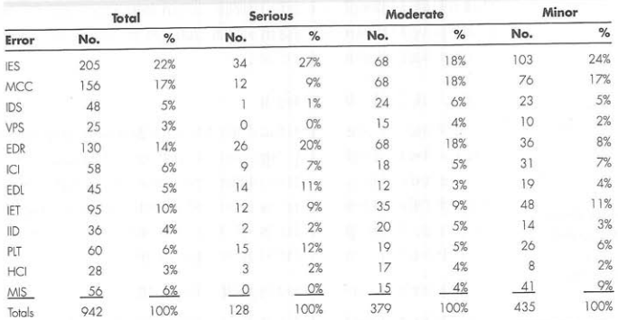
Example
Figure source: Software Engineering: A Practitioner’s Approach, R. S. Pressman, 7th ed., p. 440

Slide 16
Six Sigma
Motorola in 1980s
Statistical analysis of data to measure and improve operational performance by identifying and eliminating defects
Six standard deviations – 3.4 instances (defects) per million occurrences
Three core steps
  Define customer requirements, deliverables, and project goals
  Measure the existing process and its output
  Analyze defect metrics and determine the major causes
Two additional steps
  Improve and control process
Sometimes it is called DMAIC

Slide 17
Software Reliability
"the probability of failure-free operation of a computer program in a specified environment for a specified time"
Example: reliability of 0.999 over eight elapsed processing hours
Failure / nonconformance / annoying / re-work of weeks

Slide 18
Measures of Reliability and Availability
Prediction of software reliability
Hardware: failure due to (physical) wear rather than design defects
Software: design defects
Mean time between failure (MTBF)
  MTBF = MTTF + MTTR
Availability
  MTTF/(MTTF + MTTR) * 100%

Slide 19
Software Safety
Identification and assessment of potential hazards
Safety-related requirements can be specified
  List of undesirable events
  The desired system responses
Difference between software reliability and software safety

Slide 20
Summary
Elements of software quality assurance
  Standards, reviews and audits, testing, error collection and analysis, change management, education, vendor management, security management, safety, risk management
SQA tasks
Goals, attributes, metrics
  Requirements quality, design quality, code quality, quality control effectiveness
Statistical quality assurance
Software reliability

