Slide 1
Review Techniques
SEII-Lecture 16
Dr. Muzafar Khan
Assistant Professor
Department of Computer Science
CIIT, Islamabad.

Slide 2
Recap
Multi-aspects concept
  Transcendental view, user view, manufacturer’s view, product view, value-based view
Software quality
  Effective software process, useful product, add value for producer and user of a software product
Software quality models
  Garvin’s quality dimensions, McCall’s quality factors, ISO 9126 quality model
Software quality dilemma
Achieving software quality

Slide 3
Software Reviews
Filter for software process
To err is human
People are good at catching others’ errors
Three steps
  Point out needed improvements
  Conform those parts that are OK
  Achieve technical work of uniform quality without reviews
Different types of reviews

Slide 4
Cost Impact of Software Defects
Defect and fault are synonymous
Primary objective is to find errors
Primary benefit is early discovery of errors
  No propagation in next step
Design activities introduce 50-65% of all errors
Review techniques are 75% effective to uncover design flaws
It leads to reduced cost at later stages

Slide 5
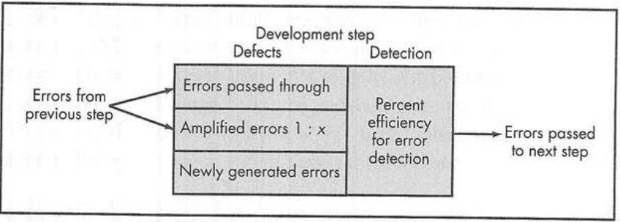
Defect Amplification Model
Figure source: Software Engineering: A Practitioner’s Approach, R. S. Pressman, 7th ed., p. 419

Slide 6
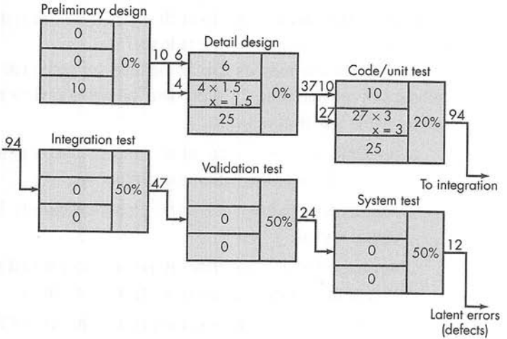
Example – No Reviews
Figure source: Software Engineering: A Practitioner’s Approach, R. S. Pressman, 7th ed., p. 419

Slide 7
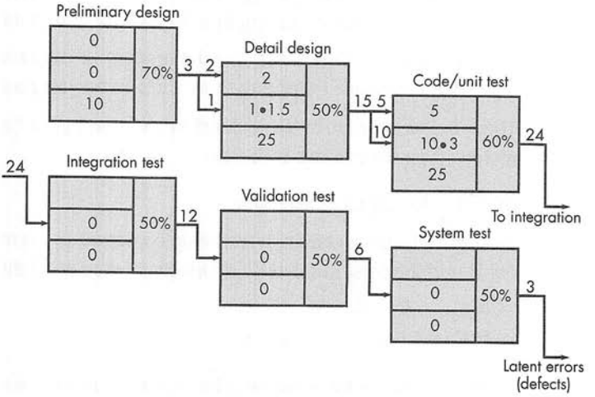
Example –Reviews Conducted
Figure source: Software Engineering: A Practitioner’s Approach, R. S. Pressman, 7th ed., p. 419

Slide 8
Review Metrics and Their Use [1/2]
Each action requires dedicated human effort
Project effort is finite
Need of metrics to assess effectiveness of each action
Review metrics
Preparation effort (E_{p})
  Number of person-hours prior to actual review
Assessment effort (E_{p})
  Number of person-hours required for actual review

Slide 9
Review Metrics and Their Use [2/2]
Rework effort (E_{r})
  Number of person-hours to correct errors uncovered during the review
Work product size (WPS)
  Size of work reviewed e.g. number of UML models
Minor errors found (Err_{minor})
  Number of minor errors found
Major errors found (Err_{major})
  Number of major errors found

Slide 10
Analyzing Metrics [1/2]
E_{review} = E_{p} + E_{a} + E_{r}
Err_{tot} = E_{minor} + E_{major}
Error density – number of errors found per unit of work reviewed
Error density = Err_{tot}/WPS
Example: 18 UML diagrams, 32 pages document, 18 minor and 04 major errors
Error density = 22/18 = 1.2 errors per UML diagrams OR
22/32 = 0.68 errors per page

Slide 11
Analyzing Metrics [2/2]
Different work products are reviewed
Percentage of errors uncovered for each review is computed against the total number of errors for all reviews
Error density for each work product is computed
When all reviews are conducted, average values indicate the errors in new documents

Slide 12
Cost Effectiveness of Reviews
Difficult to measure
Example: 0.6 errors per page
4 person-hours to correct minor error
18 person-hours to correct major error
Minor errors occurs about six time more frequently as compared to major errors based on the review data
Requirements-related error needs 6 person-hours to correct
Same error requires 45 person-hours if uncovered during testing
Effort saved per error = E_{testing} – E_{reviews}
45 - 6 = 39 person-hours

Slide 13
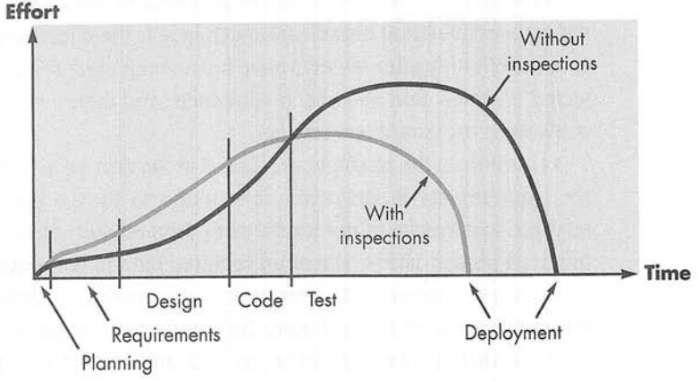
Effort Expanded With and Without Reviews
Figure source: Software Engineering: A Practitioner’s Approach, R. S. Pressman, 7th ed., p. 422

Slide 14
Reviews: A Formality Spectrum
Level of formality depends on different factors
  Product, time, people
Four characteristics of reference model
  Roles
  Planning and preparation for the review
  Review structure
  Follow-up

Slide 15
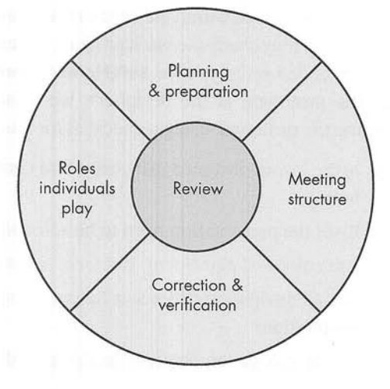
Reference Model
Figure source: Software Engineering: A Practitioner’s Approach, R. S. Pressman, 7th ed., p. 423

Slide 16
Informal Reviews
Simple desk check, casual meeting, or review-oriented aspects of pair programming
Effectiveness is considerably lower
  No advance planning/preparation, no agenda, no follow-up
Still good to uncover errors that may propagate
Simple review checklist to improve the efficiency

Slide 17
Example: Review Checklist
Work product: prototype
Reviewers: designer and colleague
Is the layout designed using standard conventions? Left to right? Top to bottom?
Does the presentation need to be scrolled?
Are color and placement, typeface, and size used effectively?
Are all navigation options or functions represented at the same level of abstraction?
Are all navigation choices clearly labeled?

Slide 18
Formal Technical Reviews
Objectives are
  To uncover errors in function, logic, or implementation
  To verify that the software under review meets its requirements
  To ensure that it is according to predefined standards
  To achieve that it is developed in a uniform manner
  To make project more manageable
Training ground for juniors
Promotes backup and continuity
Walkthroughs and inspections

Slide 19
The Review Meeting [1/2]
Constraints
  3-5 people
  No more than two hours (for each person) of advance preparation
  Meeting duration should be less than two hours
Focus should be on specific and small part of overall software
Producer informs project leader about the work product
Project leader contacts review leader
Review leader is responsible for the rest of arrangement

Slide 20
The Review Meeting [2/2]
Meeting is attended by the review leader, all reviewers, and the producer
One reviewer serves as recorder
Meeting starts with an introduction of the agenda and the producer
Producer “walk through” the work product
Decisions
  Accept the product without further modification
  Reject the product due to severe errors
  Accept the product provisionally
Sign-off at the end of meeting

Slide 21
Review Reporting and Record Keeping
Review issues list is produced
  Identify problem areas
  An action item checklist for corrections
Formal technical review summary report (a single page with possible attachments)
  What was reviewed?
  Who reviewed it?
  What were the findings and conclusions?
Follow-up procedure to ensure the rework

Slide 22
Review Guidelines [1/2]
Review the product, not the producer
Set an agenda and maintain it
Limit debate and rebuttal
Enunciate problem areas, but don’t attempt to solve every problem noted
Take written notes
Limit the number of participants and insist upon advance preparation

Slide 23
Review Guidelines [2/2]
Develop a checklist for each product that is likely to be reviewed
Allocate resources and schedule time for formal reviews
Conduct meaningful training for all reviewers
Review your early reviews

Slide 24
Summary
Software reviews
Cost impact of software defects
Defect amplification model
Review metrics and their use
  Preparation effort (E_{p}), assessment effort (E_{p}), Rework effort (E_{r}), work product size (WPS), minor errors found (Err_{minor}), major errors found (Err_{major})
Formal and informal reviews
  Review meeting, review reporting and record keeping, review guidelines

