Slide 1
Software Quality
SEII-Lecture 15
Dr. Muzafar Khan
Assistant Professor
Department of Computer Science
CIIT, Islamabad.

Slide 2
Recap
WebApp quality
  Usability, functionality, reliability, efficiency, maintainability, security, availability, scalability, time-to-market
Content quality
  Scope, depth, background, authority, currency, stability,
Design goals of WebApp
  Simplicity, consistency, identity, robustness, navigability, visual appeal, compatibility
WebApp design
  Interface, aesthetic, navigation, and architecture design

Slide 3
Quality
Multi-aspects concept
Transcendental view
  Difficult to explicitly define but easy to recognize
User view
  End user’s specific goals
Manufacturer’s view
  Product specification
Product view
  Inherent characteristics
Value-based view
  cost

Slide 4
Software Quality
“An effective software process applied in a manner that creates a useful product that provides measurable value for those who produce it and those who use it.”
Effective software process
  Infrastructure
  Check and balance
  Change control and technical reviews
Useful product
  Explicit and implicit requirements
  Reliable, error-free
Add value for producer and user of a software product
  Less maintenance effort
  Efficient business process

Slide 5
Garvin’s Quality Dimensions
Performance quality
Feature quality
Reliability
Conformance
Durability
Serviceability
Aesthetics
Perception
“soft” look of quality

Slide 6
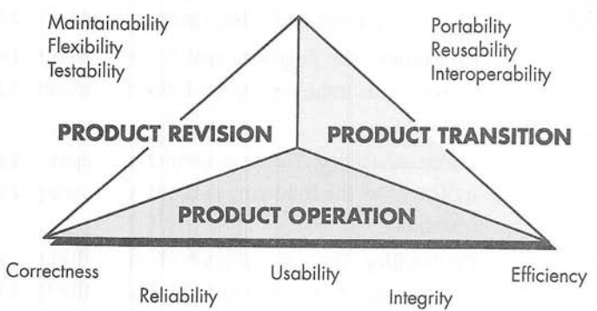
McCall’s Quality Factors
Figure source: Software Engineering: A Practitioner’s Approach, R. S. Pressman, 7th ed., p. 403

Slide 7
ISO 9126 Quality Factors [1/2]
Functionality
  Suitability
  Accuracy
  Interoperability
  Compliance
  security
Reliability
  Maturity
  Fault tolerance
  recoverability
Usability
  Understandability
  Learnability
  operability

Slide 8
ISO 9126 Quality Factors [2/2]
Efficiency
  Time behavior
  Resource behavior
Maintainability
  Analyzability
  Changeability
  Stability
  Testability
Portability
  Adaptability
  Installability
  Conformance
  Replaceability

Slide 9
Targeted Quality Factors [1/4]
Intuitiveness
  Is the interface layout conducive to easy understanding?
  Are interface operations easy to locate and initiate?
  Does the interface use a recognizable metaphor?
  Is input specified to economize keystrokes or mouse clicks?
  Does the interface follow the three golden rules?
  Do aesthetics aid in understanding and usage?

Slide 10
Targeted Quality Factors [2/4]
Efficiency
  Information and operations can be located and initiated
  Does the interface layout and style allow a user to locate operations and information efficiently?
  Can a sequence of operations (or data input) be performed with an economy of motion?
  Are output data or content presented so that it is understood immediately?
  Have hierarchical operations been organized in a way that minimizes the depth to which a user must navigate to get something done?

Slide 11
Targeted Quality Factors [3/4]
Robustness
  Will the software recognize the error if data at or just outside prescribed boundaries is input? More importantly, will the software continue to operate without failure or degradation?
  Will the interface recognize common cognitive or manipulative mistakes and explicitly guide the user back on the right track?
  Does the interface provide useful diagnosis and guidance when an error condition (associated with software functionality) is uncovered?

Slide 12
Targeted Quality Factors [4/4]
Richness
  Can the interface be customized to the specific needs of a user?
  Does the interface provide a macro capability that enables a user to identify a sequence of common operations with a single action or command?

Slide 13
Software Quality Dilemma [1/3]
“Good enough” software
  Known bugs
  Time to market
  Short cut
  Different domains
  Legal penalties
Cost of quality
  Cost of conformance and nonconformance
  Prevention cost
    Plan and coordinate activities
    Technical activities
    Test planning costs
    Training activities

Slide 14
Software Quality Dilemma [2/3]
Cost of quality
  Appraisal cost
    Technical reviews
    Data collection and metrics evaluation
    Testing and debugging
  Failure cost
    Internal failure cost
    External failure cost

Slide 15
Software Quality Dilemma [3/3]
Risks
  Low quality software increases risks for user and developer
  Sometimes very serious risks
Negligence and liability
  Customer/user VS developer
Quality and security
  Secure data
Impact of management actions
  Cost and schedule estimates

Slide 16
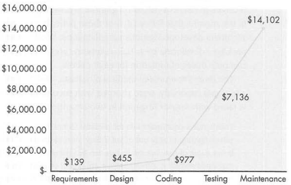
Relative Cost of Correcting Errors
Boehm and Basili (2001)
Figure source: Software Engineering: A Practitioner’s Approach, R. S. Pressman, 7th ed., p. 409

Slide 17
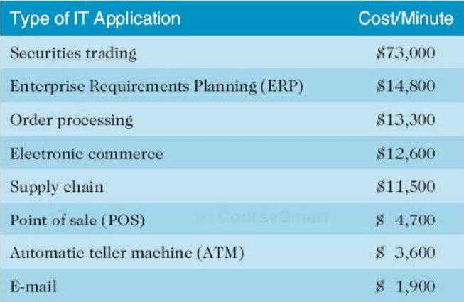
Cost of downtime
Standish group study in 2008
Figure source: IT Project Management, K. Schwalbe, 6th ed., p. 258

Slide 18
Achieving Software Quality
Software engineering methods
Project management techniques
Quality control
Quality assurance

Slide 19
Summary
Multi-aspects concept
  Transcendental view, user view, manufacturer’s view, product view, value-based view
Software quality
  Effective software process, useful product, add value for producer and user of a software product
Software quality models
  Garvin’s quality dimensions, McCall’s quality factors, ISO 9126 quality model
Software quality dilemma
Achieving software quality

